Slide 1
Fs-Logix
Imp Urls
What is FSLogix - FSLogix | Microsoft Learn
Types of Containers - FSLogix | Microsoft Learn
FSLogix Terminology - FSLogix | Microsoft Learn
Configuration Settings - FSLogix | Microsoft Learn
Configure SMB Storage Permissions - FSLogix | Microsoft Learn
Prerequisites for FSLogix - FSLogix | Microsoft Learn
Set up FSLogix Profile Container with Azure Files and AD DS or Microsoft Entra Domain Services - Azure Virtual Desktop | Microsoft Learn

Slide 2
Basic about user profiles….
Types of User Profiles
Local User Profiles. A local user profile is created the first time that a user logs on to a computer. The profile is stored on the computer's local hard disk. Changes made to the local user profile are specific to the user and to the computer on which the changes are made.
Roaming User Profiles. A roaming user profile is a copy of the local profile that is copied to, and stored on, a server share. This profile is downloaded to any computer that a user logs onto on a network. Changes made to a roaming user profile are synchronized with the server copy of the profile when the user logs off. The advantage of roaming user profiles is that users do not need to create a profile on each computer they use on a network.
Mandatory User Profiles. A mandatory user profile is a type of profile that administrators can use to specify settings for users. Only system administrators can make changes to mandatory user profiles. Changes made by users to desktop settings are lost when the user logs off.
Temporary User Profiles. A temporary profile is issued each time that an error condition prevents the user's profile from loading. Temporary profiles are deleted at the end of each session, and changes made by the user to desktop settings and files are lost when the user logs off. Temporary profiles are only available on computers running Windows 2000 and later.

Slide 3
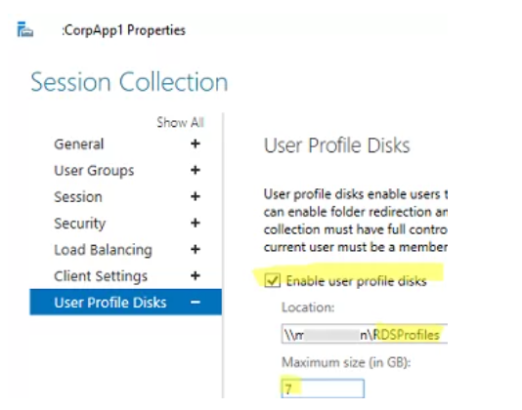
User profile disk that we user earlier with RDS…
User Profile Disks (UPDs) allow user data, customizations, and application settings to follow a user within a single collection. A UPD is a per-user, per-collection VHD file saved in a central share that is mounted to a user's session when they sign in - the UPD is treated as a local drive for the duration of that session.

Slide 4
What is fs-Logix
FS-Logix Profile Containers use the approach of offloading profiles onto virtual disks and attaching them to the session as soon as a user logs on.
FS-Logix enhances and enables a consistent experience for Windows user profiles in virtual desktop computing environments. FS-Logix isn't limited to virtual desktop environments, but could be used on physical desktops where a more portable user experience is desired.
Here are a few things that FS-Logix provides:
Roam user data between remote computing session hosts.
Minimize sign in times for virtual desktop environments.
Optimize file I/O between host/client and remote profile store.
Provide a local profile experience, eliminating the need for roaming profiles.
Simplify the management of applications and 'Gold Images'.

Slide 5
Key capabilities
Redirect user profiles to a storage provider. Mounting and using the profile from a storage provider eliminates delays often associated with solutions that copy profiles to and from a network location.
Redirect only the portion of the profile that contains Office¹ data by using an ODFC container. The ODFC container allows an organization already using an alternate profile solution² to enable Microsoft 365 applications in multi-session desktop environments.
Applications use the user's profile as if it were on the local disk. FSLogix uses a filter driver to virtualize and redirect the profile at the file system level. Applications are unaware the profile is on the network. Obscuring the redirection is important because many applications can't work properly with a profile stored remotely.
Profile containers used with Cloud Cache to provide high availability and disaster recovery profile solutions.
Application Rule Sets manage access to an application, font, printer, or other items. Access can be controlled using users, groups, IP Addresses, and other criteria. Application Rule Sets significantly decrease the complexity of managing large numbers of gold images.

Slide 6
At logon time, the FSLogix services and drivers, pause the logon process, attach the containers from their network locations and do other setup/configuration, and then allow the logon process to proceed.
Though the machine has never had the user logon to the machine before, when the populated FSLogix Profile container is attached, it appears to the OS and applications that the profile already existed on that machine.
This allows non-persistent environments to easily host users on any machine as their profile data and settings appear as soon as they logon to the machine.

Slide 7
Types of containers : Types of Containers - FSLogix | Microsoft Learn
Profile container
A profile container is the most common container used in an FSLogix solution. A profile container is all the data related to a user's profile, which is directly stored in the VHD(x). A Windows user profile is typically stored in C:\Users\%username%. Nearly all the files and folders found under this location would be included in an FSLogix profile container. Some data in a users profile shouldn't or can't be roamed which can be found in the exclusion list.
For users familiar with managing profiles, the function of the profile container may be compared to Microsoft User Profile Disk (UPD), Microsoft roaming profiles, or Citrix User Profile Management (UPM). Although the function is similar, the underlying method and technology is different, resulting in key FSLogix capabilities.
ODFC container
An ODFC container is a container type, which is focused on storing profile content that is unique to Microsoft Office applications. The ODFC container is most commonly implemented in conjunction other roaming profile solutions.

Slide 8
Normal profile behavior.
Machine should only be the RW profile instance.
Machine should only be the RO profile instance.
Machine should try to take the RW role and if it can't, it should fall back to a RO role.
Note : Microsoft Entra joined VMs can only access Azure Files shares or Azure NetApp Files shares for hybrid users using Microsoft Entra Kerberos for FSLogix user profiles.

Slide 9
Cloud Cache Overview : Cloud Cache Overview - FSLogix | Microsoft Learn
Cloud Cache is a feature that works with Profile and ODFC containers to provide resiliency and high availability. Cloud Cache uses the locally mounted container to provide periodic updates to the remote storage providers. Cloud Cache is designed to insulate users from short-term or intermittent local (inner-region, close proximity) storage issues. Based on the configuration, it can also be used as part of a Business Continuity or Disaster Recovery (BCDR) plan when using remote storage providers in different regions. Using Cloud Cache puts a performance and storage requirement on the virtual machine to accommodate the extra I/O operations and storage required by the local cache.
Will discuss this from public Article

Slide 10
How to setup (we will be using local share location in DC to store Fs-logix profiles)
> Other storage solution
Customer can use Any SMB shares, also Azure file, netapp files or blob storage as well.
Prerequisites
Successful deployment of a virtual desktop or Azure Virtual Desktop environment.
SMB file share with NTFS and share-level permissions correctly configured.
Download and install the latest version of FSLogix.
Review configuration options.

Slide 11
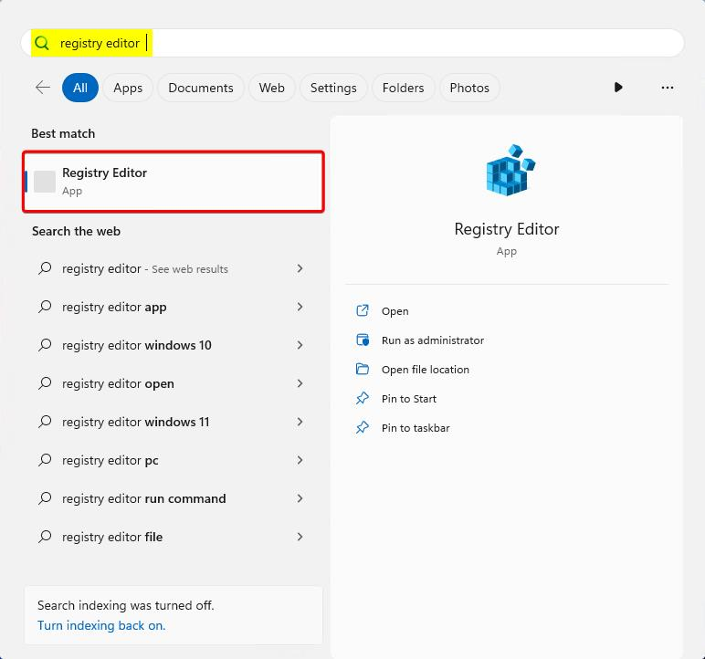
Verify FSLogix installation and version.
Sign in to the virtual machine as a local Administrator or an account with administrative privileges.
Select Start and Type Registry Editor directly into the Start Menu.
Select Registry Editor from the Start Menu.

Slide 12
Go to: HKEY_LOCAL_MACHINE\SOFTWARE\FSLogix\Profiles.
Add these settings:
Key Name | Data Type | Value | Description
Enabled | DWORD | 1 | REQUIRED
DeleteLocalProfileWhenVHDShouldApply¹ | DWORD | 1 | Recommended
FlipFlopProfileDirectoryName² | DWORD | 1 | Recommended
LockedRetryCount³ | DWORD | 3 | Recommended
LockedRetryInterval³ | DWORD | 15 | Recommended
ProfileType⁴ | DWORD | 0 | Default
ReAttachIntervalSeconds³ | DWORD | 15 | Recommended
ReAttachRetryCount³ | DWORD | 3 | Recommended
SizeInMBs | DWORD | 30000 | Default
VHDLocations | MULTI_SZ or REG_SZ | \\<storage-account-name>.file.core.windows.net\<share-name> | Example
VolumeType⁵ | REG_SZ | VHDX

Slide 13
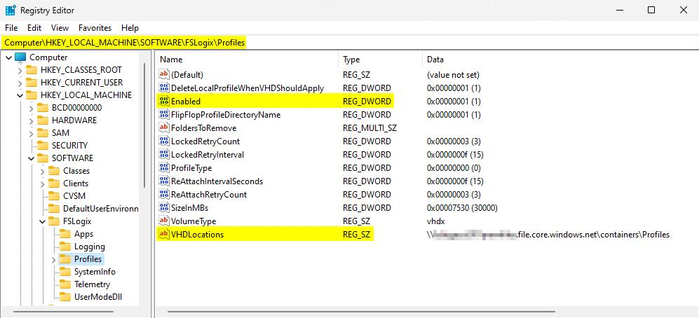
Check this article for CCD configuration : https://learn.microsoft.com/en-us/fslogix/tutorial-cloud-cache-containers

Slide 14
VHD Disk Compaction
VHD Disk Compaction is a process that runs every time a user signs out. The compaction process is designed to automatically decrease the amount of storage a user's container, depending on a predefined threshold. During the sign out phase, FSLogix evaluates the disk to determine if disk compaction should run.

Slide 15
Determining when VHD Disk Compaction runs
FSLogix determines whether to run the compaction process each time a user signs out. If the following criteria are met, VHD Disk Compaction runs:
Size of the container must be greater than 1 GB (size on disk).
Difference^{(C)} between the consumed size on disk^{(A)} and the queried minimum size^{(B)}. The difference must be greater than or equal to 20% of the consumed size within the container^{(A)}.
The difference is calculated as follows:
A - B = C
If C ≥ (A x 0.2), compaction runs.
If C < (A x 0.2), compaction doesn't run

Slide 16
Here are a couple of examples:
Example 1: The consumed size of a container is 6GB. When we call GetSupportedSize, the resulting minimum size is 2.5GB:
6 - 2.5 = 3.5 GB
20% of 6 GB = 1.2 GB
3.5 GB is greater than 1.2 GB, compaction runs.
Example 2: The consumed size of a container is 12GB. When we call GetSupportedSize, the resulting minimum size is 10GB:
12 - 10 = 2 GB
20% of 12 GB = 2.4 GB
2 GB is less than 2.4 GB, compaction doesn't run

