Slide 1
FINAL YEAR PROJECT · SYSTEM DEMONSTRATION
Suchana AI
An AI-Powered Cloud-Based Public Notice Management System for Nepal
Presented by: Ashok Bhattarai (NP069811)
Next.js 16 · NestJS 11 · Python ASGI · PostgreSQL · Qdrant · crawl4ai
Introduction · Architecture · Flows · User Interface · Pipelines

Slide 2
The Problem
Why public notices in Nepal are hard to find and easy to miss
▪ Fragmented sources. Every ministry, commission and public body publishes to its own website; there is no single national index.
▪ Unstructured formats. Most notices are scanned PDFs or images — invisible to ordinary text search engines.
▪ Deadline-driven loss. Vacancies, tenders and exam notices carry short windows; citizens miss them simply by not checking daily.
▪ Language barrier. Content is mixed Nepali and English, and existing search does not handle Devanagari well.
▪ No push channel. Nothing notifies a citizen when a notice relevant to them appears.
Consequence
A citizen must manually visit dozens of
government portals, read scanned documents
one by one, and repeat this every single day —
with no guarantee of completeness.
Suchana AI replaces that manual routine with
automated aggregation, machine-readable text,
semantic search and personalised alerts.
Suchana AI · Public Notice Management System · Ashok Bhattarai (NP069811)
2

Slide 3
Aim, Objectives and Scope
Aim: to design and build a cloud-based platform that automatically aggregates public notices from Nepali government sources, makes them searchable in natural language, and delivers relevant notices to citizens through personalised alerts.
Objectives
• Aggregate notices from any public source
without writing per-site code.
• Extract text from scanned documents
using bilingual OCR (Nepali + English).
• Answer natural-language questions with
citations from the notice corpus.
• Deliver keyword and category alerts
over email and WhatsApp.
In Scope
• Public browsing, search and filtering.
• Authenticated user dashboard: saved
notices, alert rules, activity.
• Admin panel: sources, scrape runs,
notices, users, plans, settings.
• RAG document upload and chat.
• Subscription plans and usage quotas.
Out of Scope
• Native mobile applications.
• Legally authoritative republication
of government documents.
• Automatic translation between
Nepali and English notice text.
• Real-time (sub-minute) scraping of
every configured source.
Suchana AI · Public Notice Management System · Ashok Bhattarai (NP069811)
3

Slide 4
The System at a Glance
Five capabilities delivered by three cooperating services
01. Automated Aggregation
Admin adds a source URL; the crawler detects
the page structure itself and keeps scraping
on a schedule — no per-site code.
02. Bilingual OCR Ingestion
Scanned PDFs and images are converted to text
with Tesseract (nep + eng), making image-only
notices fully searchable.
03. RAG Question Answering
Ask a question in plain Nepali or English;
answers are generated only from retrieved
notice text, with source citations.
04. Personalised Alerts
Keyword, category and organisation rules are
matched against every new notice and pushed
by email and WhatsApp.
05. Role-Based Administration
Separate guest, user and admin surfaces;
admins manage sources, notices, users,
plans and system settings.
06. Multilingual Interface
The entire interface switches between
English and नेपाली instantly, with
locale-aware dates.
Suchana AI · Public Notice Management System · Ashok Bhattarai (NP069811)
4

Slide 5
Technology Stack
Chosen for a single-developer build with production-grade behaviour
Layer
Technology
Why this choice
Web
Next.js 16 · React 19 · Tailwind v4 · shadcn/ui
App Router streaming, one language across the stack
API
NestJS 11 · Prisma 6 · PostgreSQL
Modular DI structure, typed schema and migrations
AI service
Python raw ASGI on Uvicorn
Only seven routes — no framework overhead needed
Vector store
Qdrant (dense + BM25 sparse)
Payload filtering and native hybrid fusion
Embeddings
intfloat/multilingual-e5-base (768-dim)
Nepali and English share one vector space, free and CPU-friendly
Generation
Groq — llama-3.3-70b-versatile
Very fast inference, OpenAI-compatible, generous free tier
Crawling
crawl4ai (Playwright-backed, async)
Renders JavaScript pages; declarative CSS-to-JSON extraction
OCR
Tesseract via pytesseract (nep + eng)
Scanned government notices need a Nepali language pack
Notifications
SMTP email · Evolution API (WhatsApp)
Reaches citizens on the channel they actually use
Tooling
Turborepo · pnpm workspaces · TypeScript 5
One repository, cached builds, shared domain types
Suchana AI · Public Notice Management System · Ashok Bhattarai (NP069811)
5

Slide 6
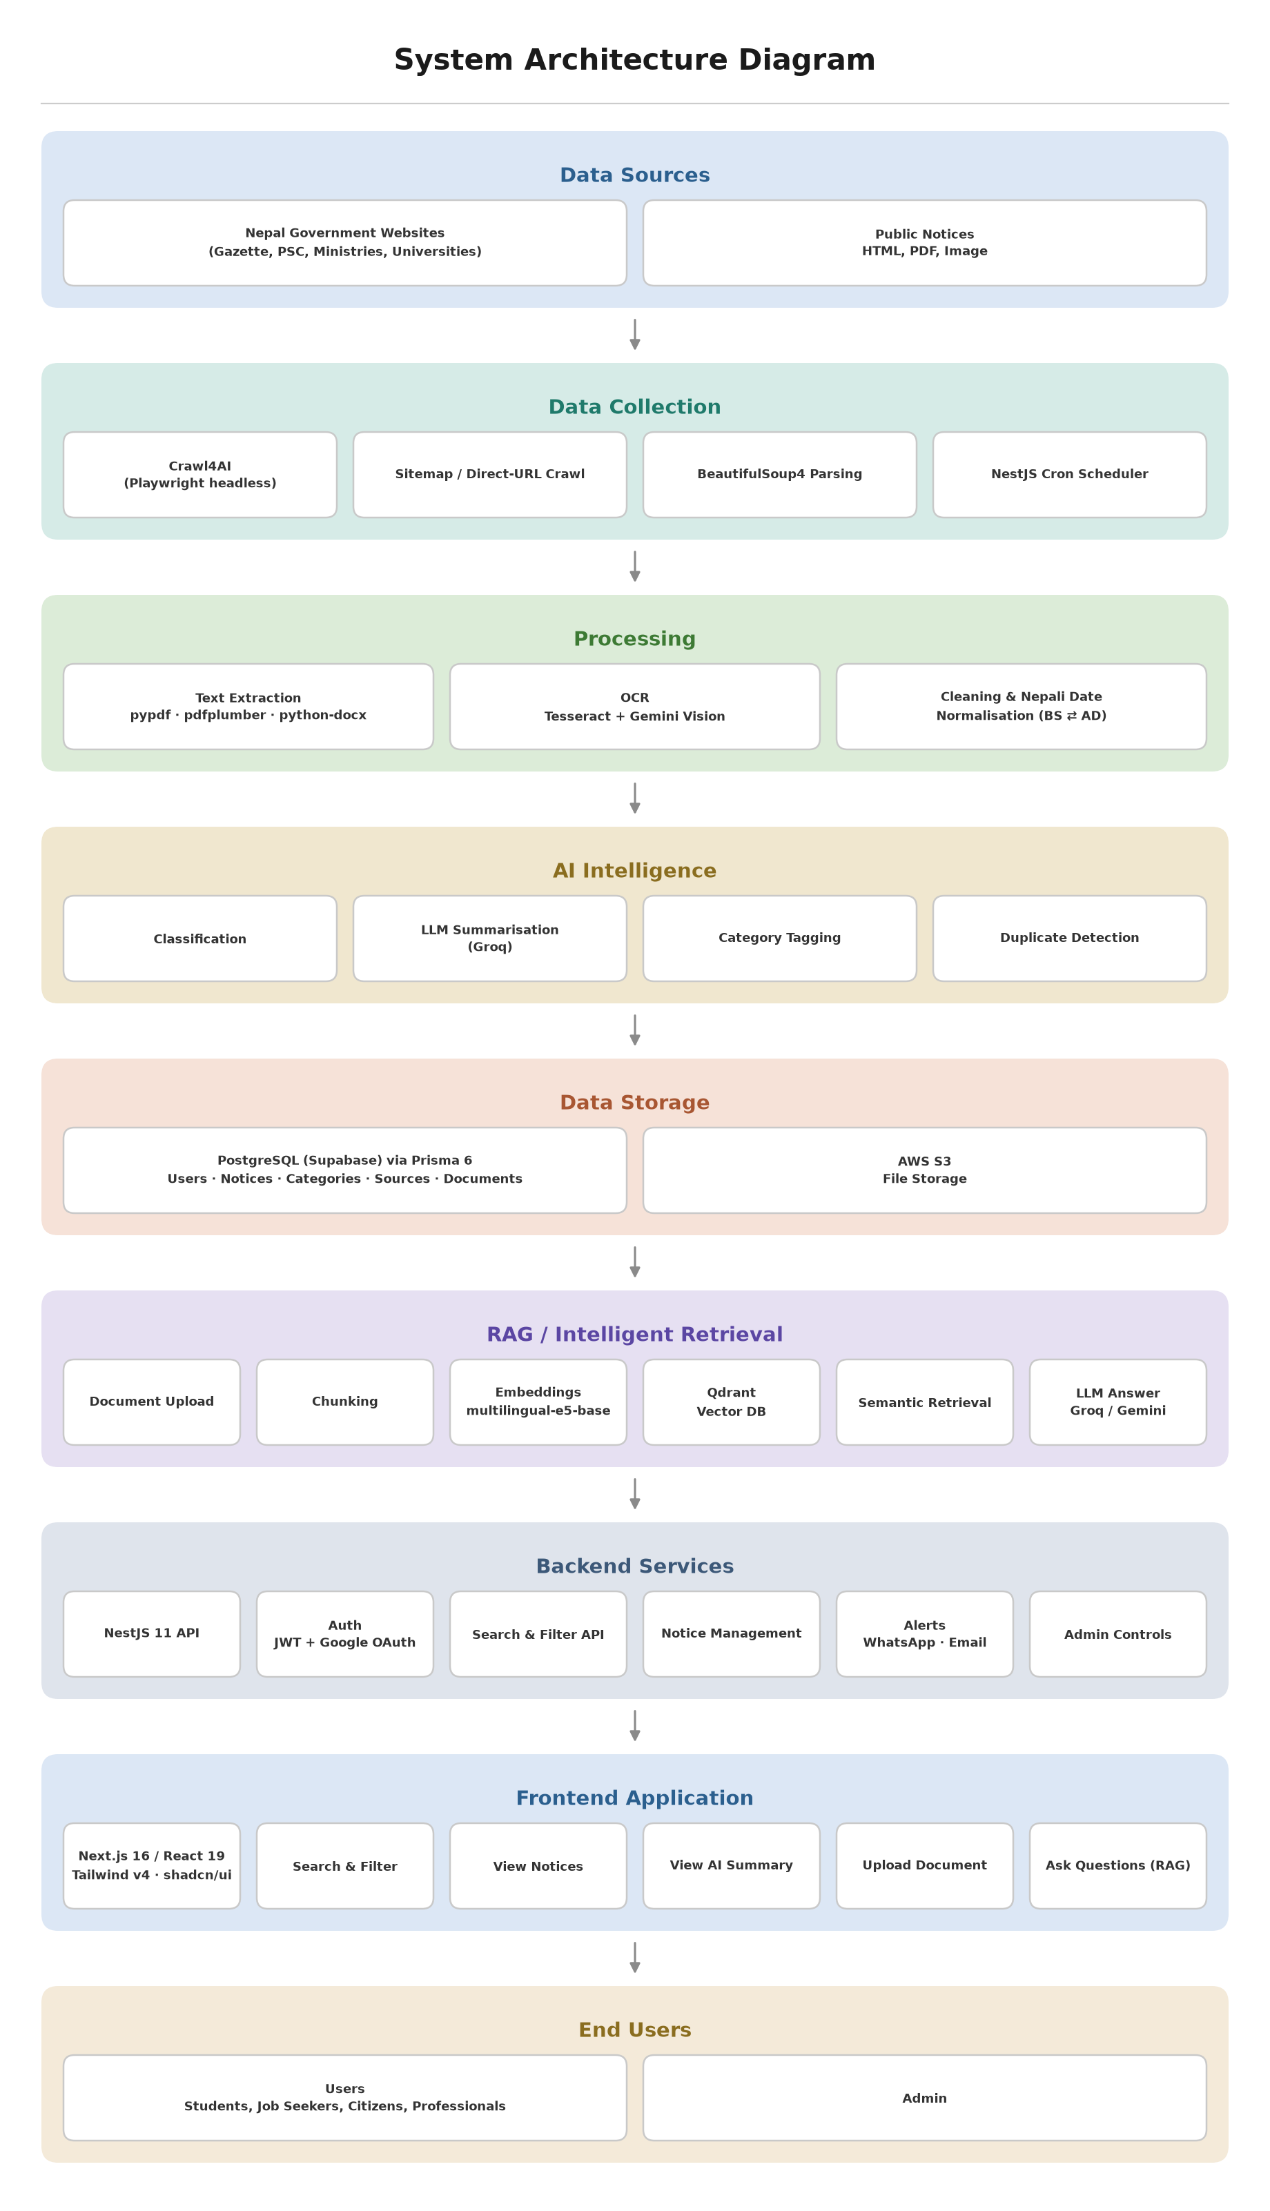
System Architecture
Three services, one system of record, clear ownership boundaries
Suchana AI · Public Notice Management System · Ashok Bhattarai (NP069811)
6

Slide 7
End-to-End Request Flow
How a single user action travels through the stack
Browser (Next.js)
NestJS API Gateway
Guards & Quota
Prisma / PostgreSQL
Python AI Service
Response + Citations
User action on a client component
Validated DTO, request ID attached
JWT verified, role and plan checked
System of record for all entities
Only for AI work: crawl, embed, query
Typed JSON returned to the browser
Cross-cutting behaviour
▪ Correlation IDs — an x-request-id is generated by NestJS middleware, forwarded through the axios interceptor, and set on the AI service, so one identifier links the logs of all three services.
▪ Structured logging — all services emit JSON logs by default, with configurable level, format and slow-query thresholds.
▪ Read-path caching — the public notices list and category counts are served from an in-process TTL cache (10s and 60s), cutting repeated database work under load.
▪ Connection tuning — pool size, pool timeout and a forced UTC session are applied to the database URL at startup so timezone-aware queries never drift.
Suchana AI · Public Notice Management System · Ashok Bhattarai (NP069811)
7

Slide 8
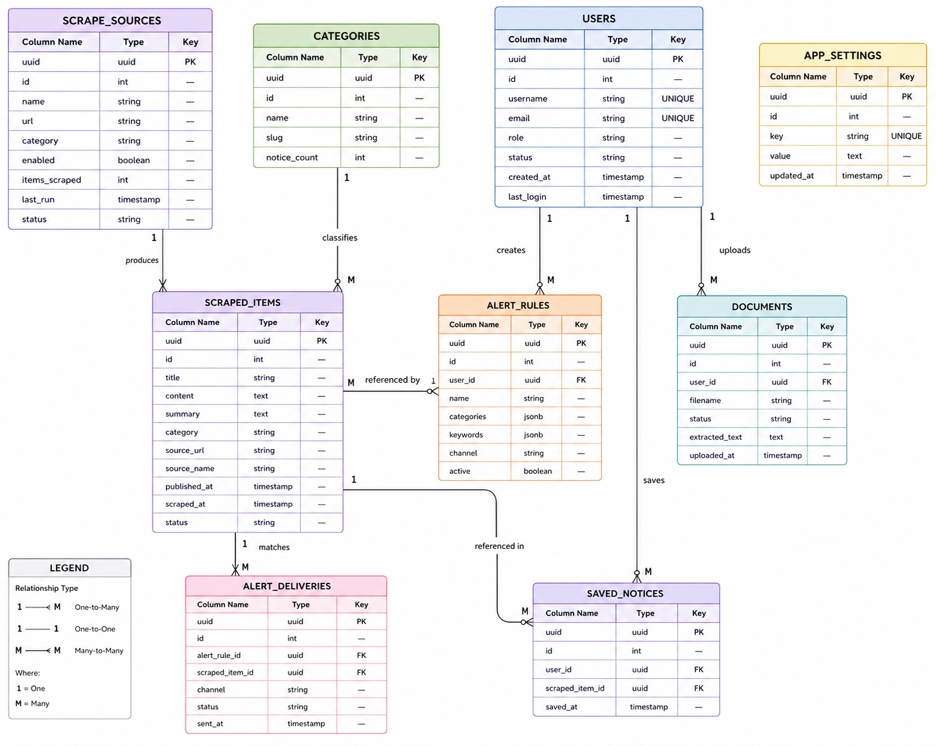
Domain Model
PostgreSQL is the single system of record; Qdrant stores only vectors
Core entities
▪ User — identity, role, plan and usage.
▪ Notice — title, organisation, category, priority, publish and expiry dates, source URL.
▪ Document — an uploaded or scraped file, its extraction status and OCR flag.
▪ Alert — a user rule of type keyword, category or organisation, with match history.
▪ ScrapeSource — a configured site, its cached CSS schema and pagination scheme.
▪ ScrapeRun / ScrapedItem — run history, live status and deduplicated results.
Figure 2 — Entity relationship diagram
Suchana AI · Public Notice Management System · Ashok Bhattarai (NP069811)
8

Slide 9
Pipeline I — Notice Scraping
Dynamic, multi-source crawling with no per-site code
Admin adds source
crawl4ai renders page
Schema detection
Extract rows + details
Dedupe & upsert
Notice published
Name, base URL, listing URLs
Playwright renders JavaScript pages
Cached → LLM → heuristics
Title, link, date, then detail body
Prisma writes to PostgreSQL
Indexed, alerted, searchable
Three-tier schema detection
1. Cached schema (free) — reuse the CSS schema stored on the source from the last successful run. This is the path almost every run takes.
2. LLM-assisted (paid once) — only when no schema is cached or the cached one returns zero rows; Groq reads the page once and proposes a schema.
3. Structural heuristics (free) — group sibling DOM elements by tag and class, score by repetition and list-like naming, penalise navigation and footers.
Why this design
Detection cost is paid at most once per source
per site redesign — never on a scheduled run.
Detail pages are handled generically: chrome
(nav, header, footer, script) is stripped and the
densest text block is kept, so no body selector
has to be written for any site.
Suchana AI · Public Notice Management System · Ashok Bhattarai (NP069811)
12

Slide 10
Pipeline II — Document Ingestion
From an uploaded file to searchable vectors
Upload (NestJS)
Extract text / OCR
Structure-aware chunking
Batched embedding
Index into Qdrant
Ready to query
Validated, stored, status tracked
pypdf, then Tesseract nep+eng fallback
800 chars, 120 overlap
e5-base, 768-dim, passage: prefix
Dense + BM25 sparse vectors
Live progress shown in the UI
Chunking that respects structure
Text is split on blank lines into paragraphs; paragraphs longer than the chunk size are split on sentence ends — including the Devanagari danda (।) — and only then on word boundaries. Segments are greedily packed, and each chunk begins with the tail of the previous one so a fact spanning a boundary still appears whole in at least one chunk.
The overlap is snapped to a word boundary, so no chunk starts mid-word — this measurably improved both retrieval quality and displayed text.
Lifecycle and operations
• Ingestion runs asynchronously; the UI polls a
progress endpoint for per-stage percentages.
• Documents can be embedded and un-embedded
without deleting the underlying file.
• Metadata (status, owner, timestamps) lives in
PostgreSQL; only vectors live in Qdrant.
Suchana AI · Public Notice Management System · Ashok Bhattarai (NP069811)
13

Slide 11
Pipeline III — Retrieval and Alerting
Grounded answers, and notices that find the citizen
RAG query pipeline
Alert pipeline
Intent router
Hybrid search
RRF + rescore
Groq answer
New notice
Match engine
Fan-out
Deliver
Small talk never touches Qdrant
Dense + BM25 run together
Cosine re-score, threshold, dedupe
Cited markdown, context only
Scraped or created
Keyword, category, org
Per-user rules, quota checked
Email and WhatsApp
▪ Hybrid retrieval. Dense embeddings capture meaning; BM25 catches exact identifiers such as notice numbers and dates. Qdrant fuses both rankings with Reciprocal Rank Fusion.
▪ Cosine re-scoring. Fused ranks are not similarities, so each hit is re-scored against the query vector — restoring a meaningful threshold and the relevance percentage shown to the user.
▪ Grounding. The model answers only from retrieved context; when the corpus does not contain the answer it says so, and degrades to an extractive answer if no API key is configured.
▪ Matching. Every newly published notice is evaluated against all enabled alert rules; matches update the rule's counter and last-matched timestamp.
▪ Channels. Email is delivered over SMTP; WhatsApp through a self-hosted Evolution API instance, with delivery status recorded per notification.
▪ Digests. A scheduled digest service batches matches for users who prefer a summary over immediate messages.
Suchana AI · Public Notice Management System · Ashok Bhattarai (NP069811)
14

Slide 12
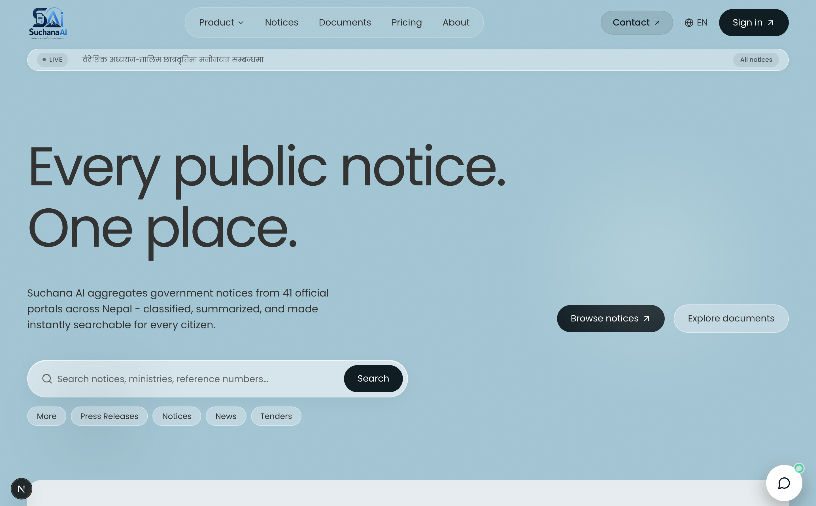
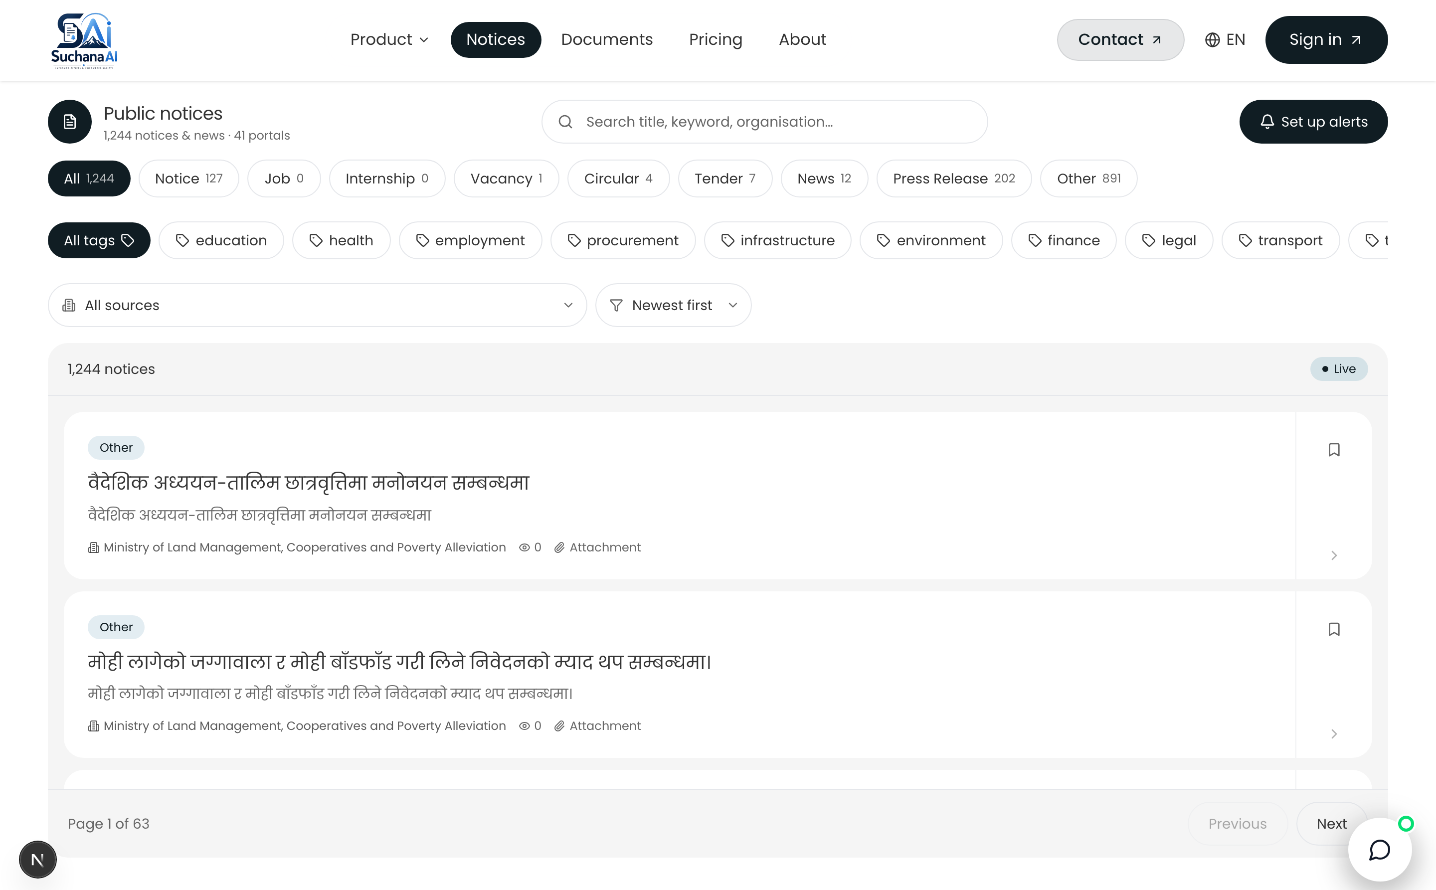
User Interface — Public Surface
Landing page and the notice browser, open to every visitor
Landing page
Value proposition, live notice counts and a direct entry point to search. Language toggle and theme switch are available before sign-in.
Notice browser
Full-text search with category, organisation, source and date filters; priority badges and deadline indicators on every card.
Suchana AI · Public Notice Management System · Ashok Bhattarai (NP069811)
9

Slide 13
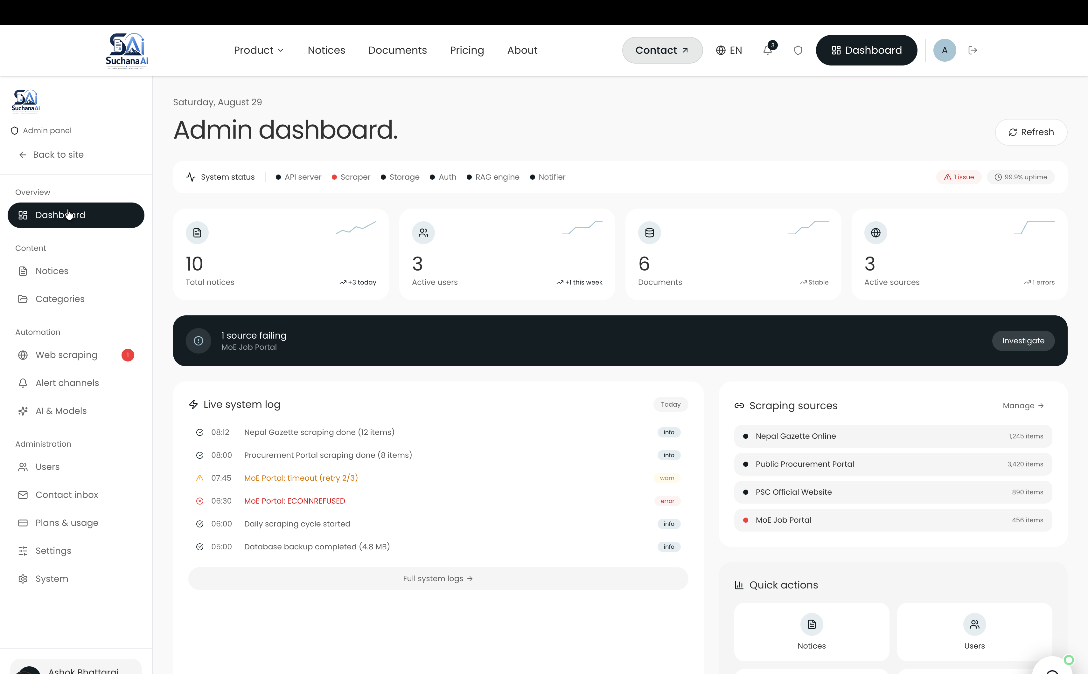
User Interface
Everything a signed-in citizen keeps track of
Overview
Saved notices, active alert rules, recent matches and remaining plan quota at a glance.
Saved notices
One-click bookmarking from any notice card, with the original source link preserved.
My alerts
Create keyword, category or organisation rules, enable or disable them, and see match counts.
Activity
A chronological log of searches, saves, alert matches and AI queries.
Settings
Profile, notification channels (email and WhatsApp), language and theme.
Figure 3 — Dashboard overview
Suchana AI · Public Notice Management System · Ashok Bhattarai (NP069811)
10

Slide 14
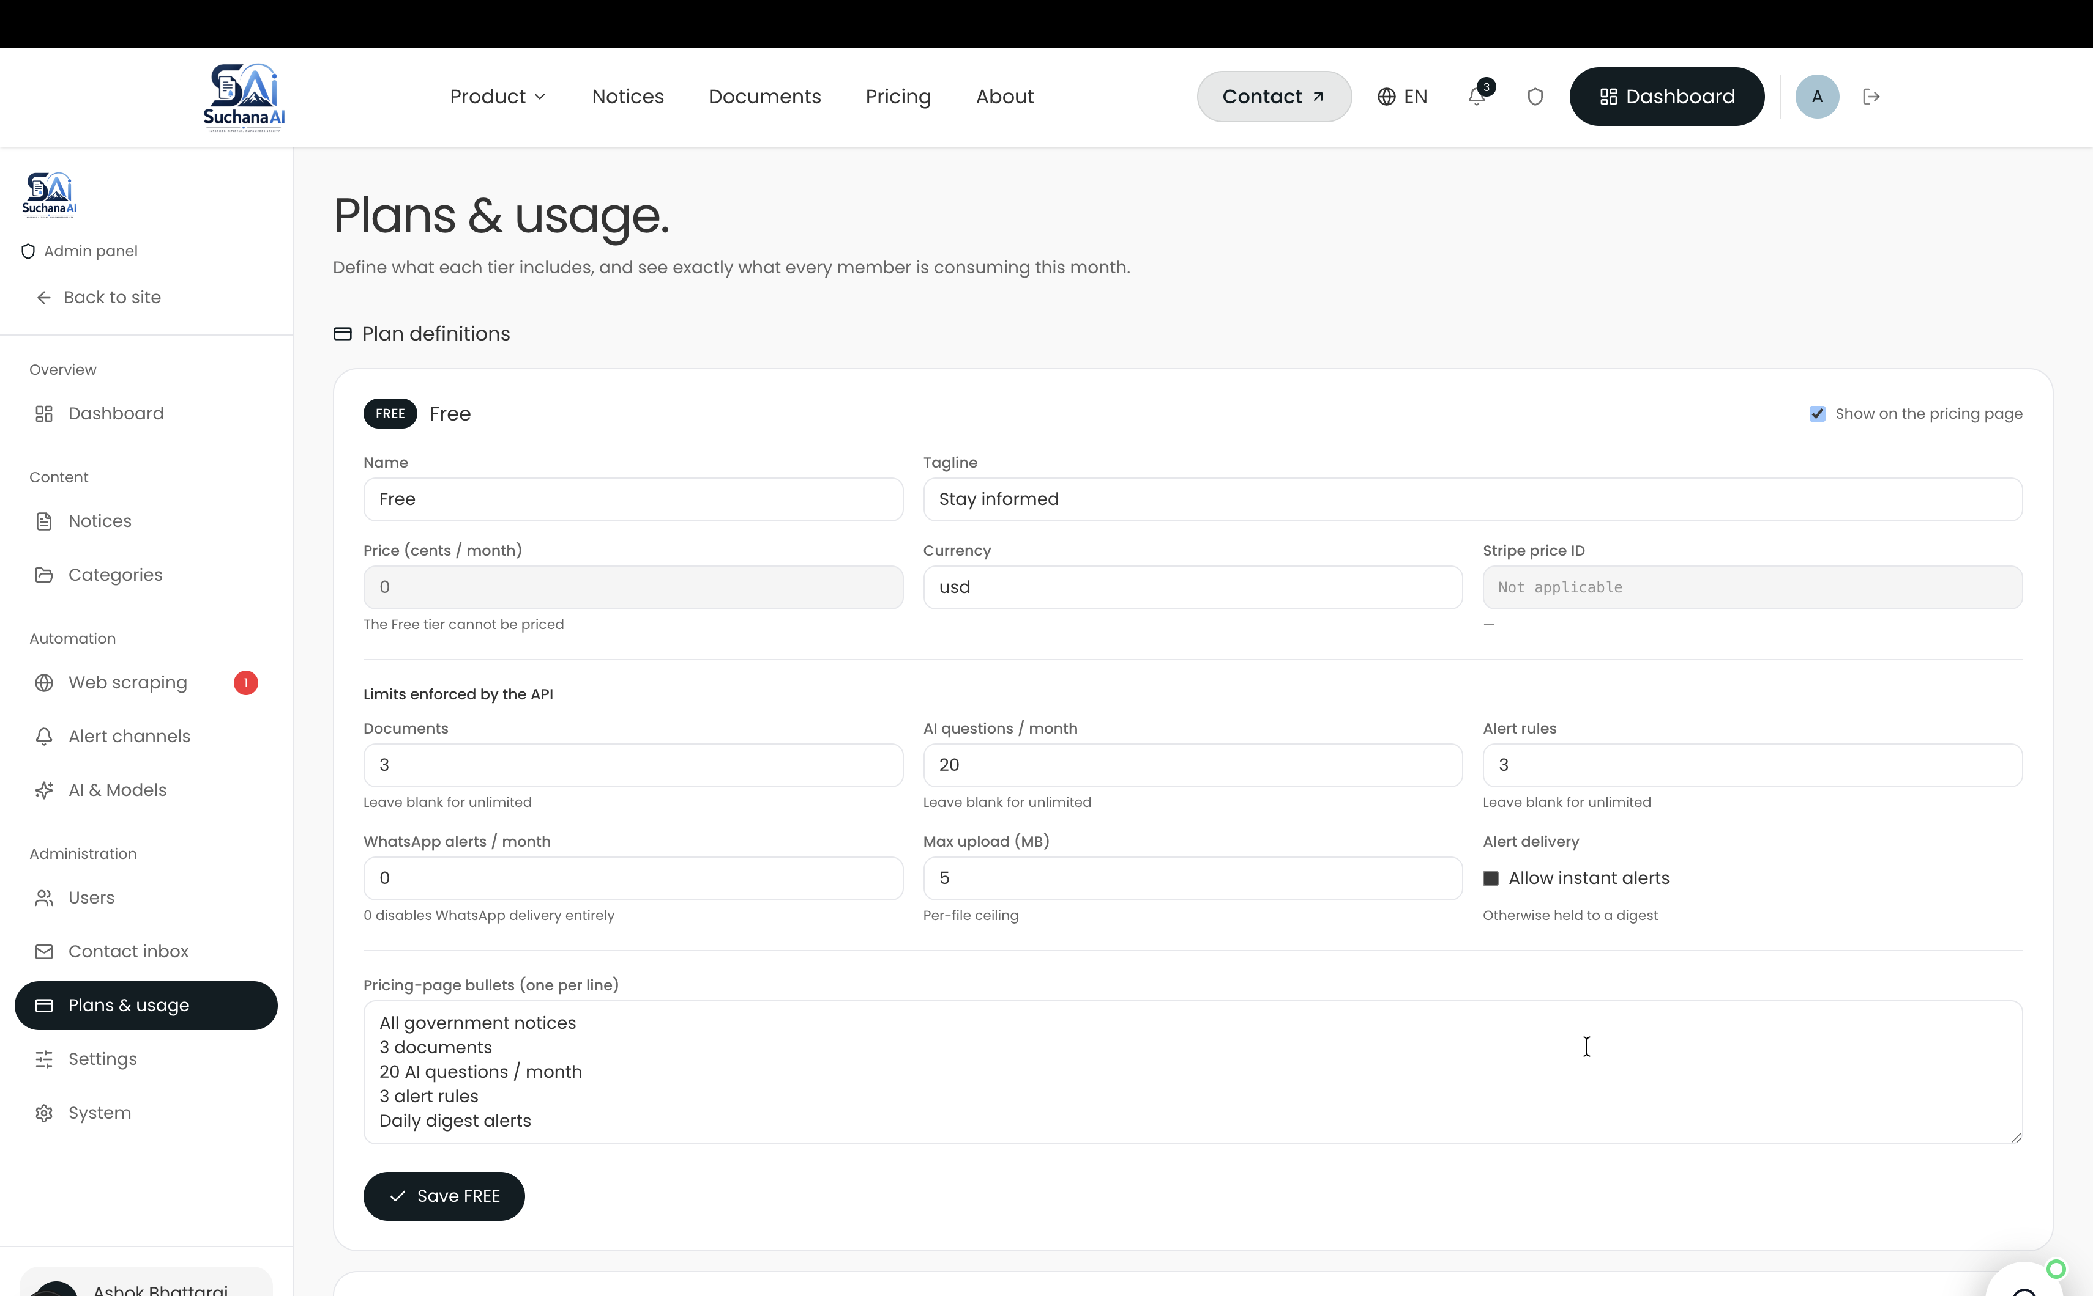
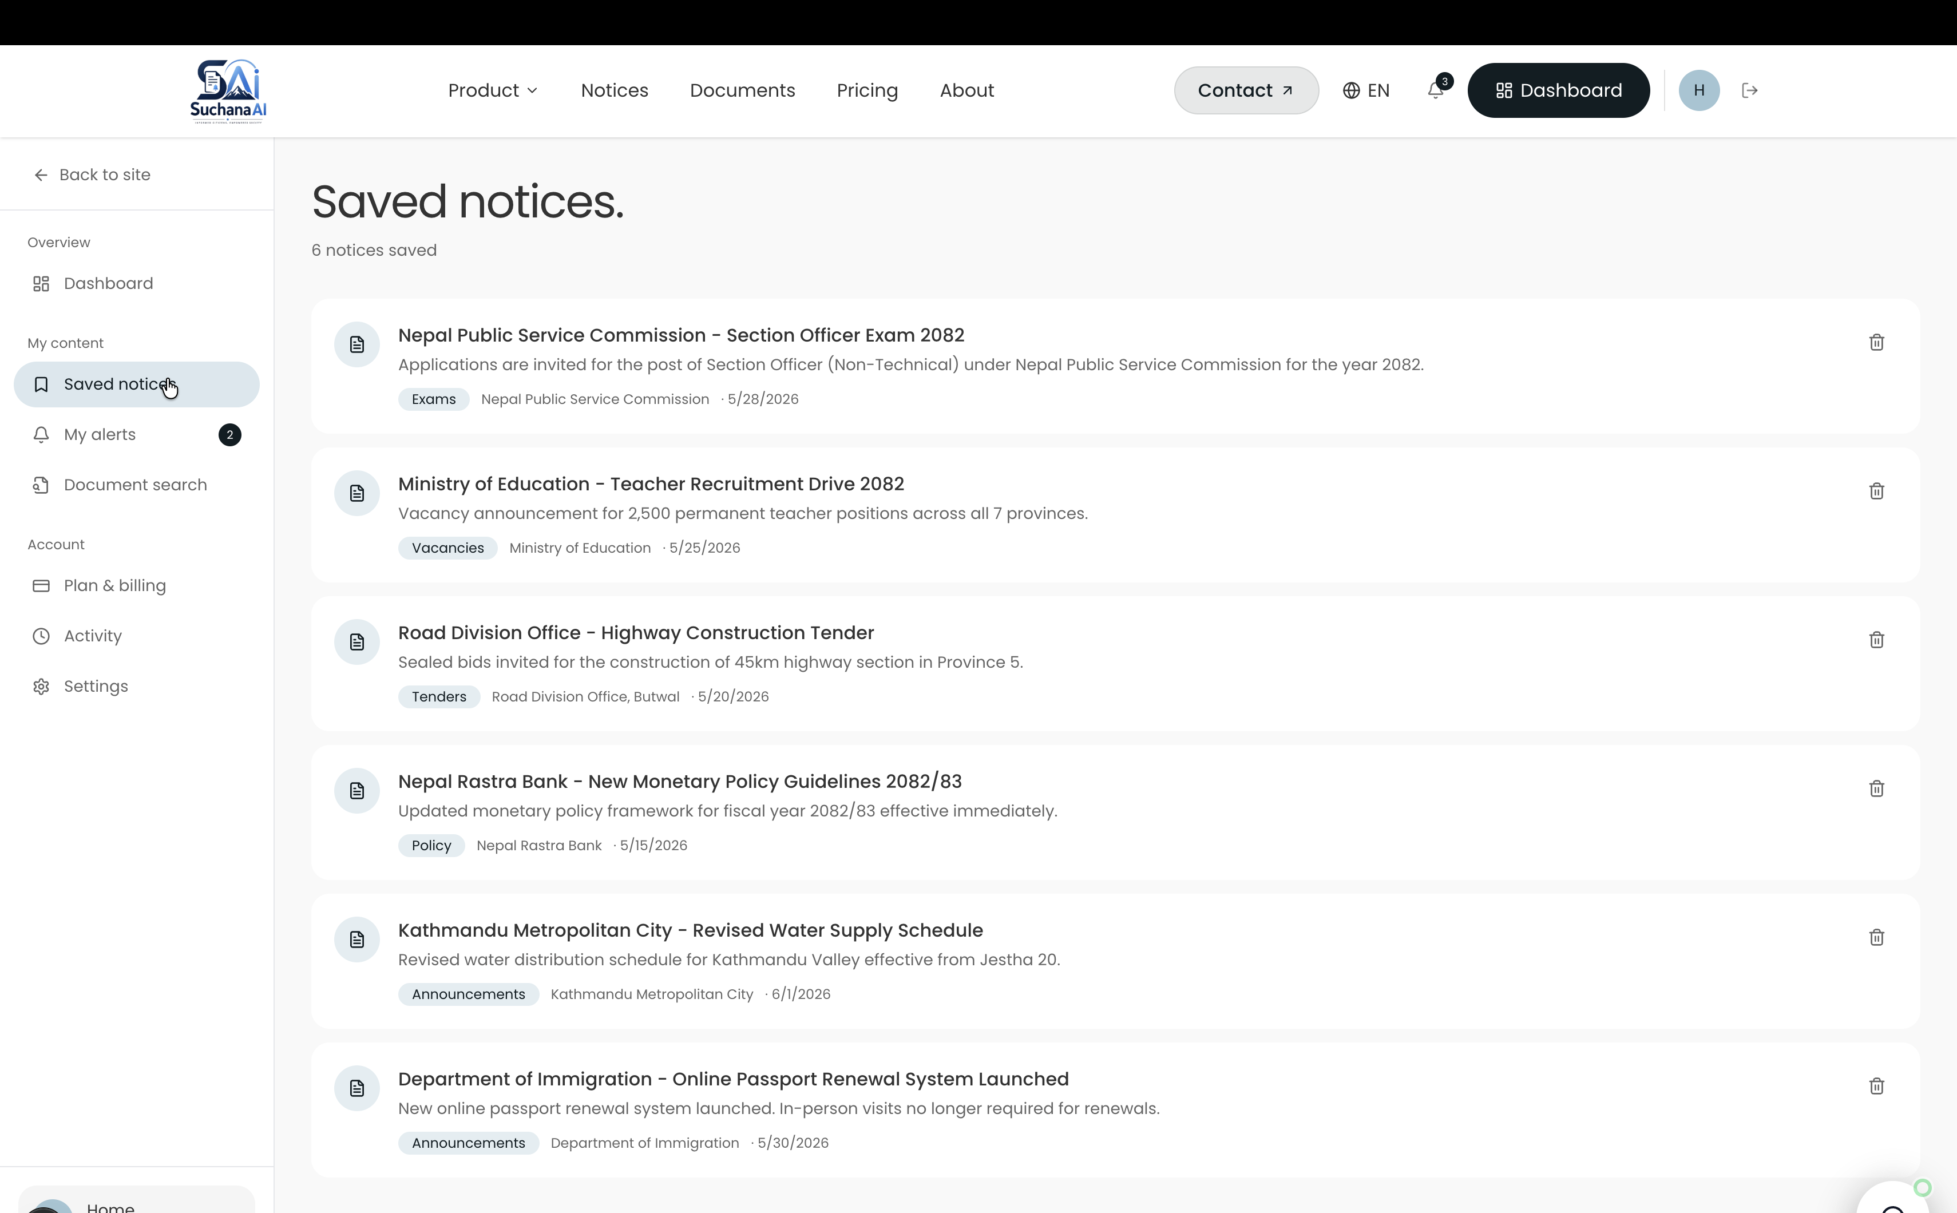
User Interface — Administration
Source configuration, live scrape monitoring and platform management
Scraping console
Add or edit a source, trigger a run on demand, and follow live status messages such as “Crawling Notice listing, page 2…” instead of an opaque spinner.
User and plan management
Role assignment, account status, subscription plans and per-user quota usage; further screens cover notices, categories, alert channels and system settings.
Suchana AI · Public Notice Management System · Ashok Bhattarai (NP069811)
11

Slide 15
Deployment, Status and Next Steps
Module
Status
Public site and notice browser
Complete
Authentication and RBAC (JWT)
Complete
Citizen dashboard and alerts
Complete
Admin panel and scraping console
Complete
Scraping pipeline (crawl4ai)
Complete
RAG ingestion and query
Complete
Plans, quotas and billing
Complete
Cloud deployment and hardening
Complete
Thank you — questions welcome.
Suchana AI · Public Notice Management System · Ashok Bhattarai (NP069811)
15

