Slide 1
Bankruptcy Prediction

Slide 2
Problem Statement
The goal of the project is to predict whether the firm is Bankrupt or not using the historical dataset.
Bankruptcy refers to increasing interest to firms that stands to lose money because of unpaid debts.
Create a Classification predication model to predict the outcome.
Dataset features include firm's assets, liabilities, shares, debts , etc.
Dataset contains 6819 records and 95 features.

Slide 3
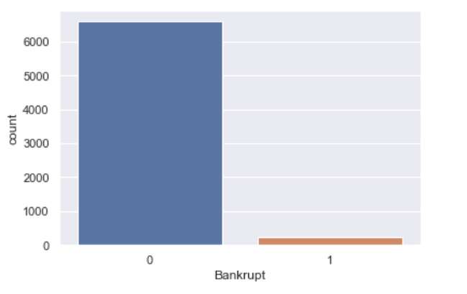
Imbalanced dataset
Dataset is highly imbalanced. Hence requires, resampling techniques to balance the dataset before modeling.
We use SMOTE, Borderline SMOTE techniques to balance the dataset, so that the model is able to learn the patterns with equal proportion of both the classes.
Otherwise, model will be inefficient to predict the minority class in case of unseen data is introduced.
We could see that the minority class is 220 and the majority class is 6599, which is highly imbalanced

Slide 4
Feature Importance
Independent variables which are highly correlated with target variables are important variables which has high impact in making the target variable as 1.
Below are the high positively correlated variables with target variable.
Debt ratio, current liability to assets, current liability to current assets, Liability-Assets flag, Total Expense/Assets, Cash/current liability, Fixed assets turnover Frequency, contingent liabilities/net worth, Fixed Assets to Assets, Net value growth rate, Revenue per person, Total assets to GNP price, Quick ratio.
The firm is mostly becoming Bankrupt whenever the values of these variables are high, which indicates the importance of these features in making the target variable as 1

Slide 5
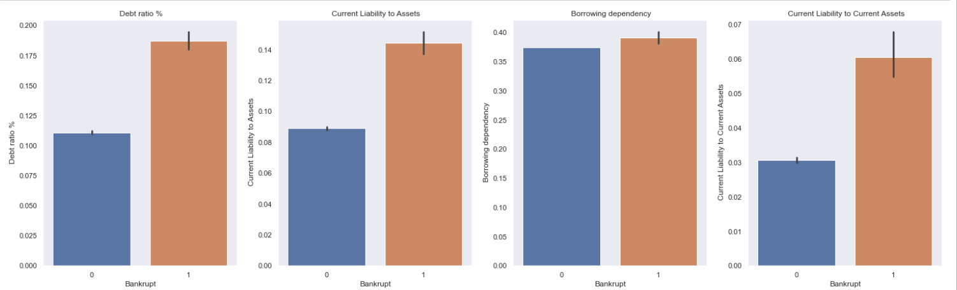
Important Features vs Bankrupt

Slide 6
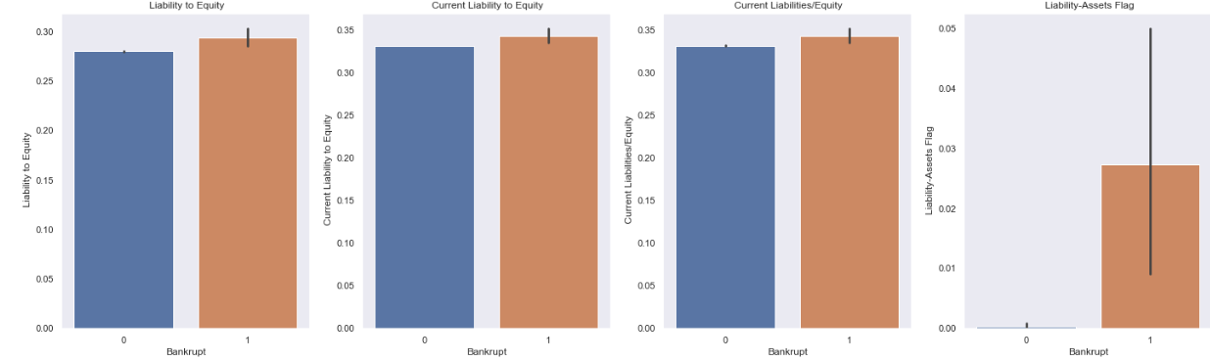
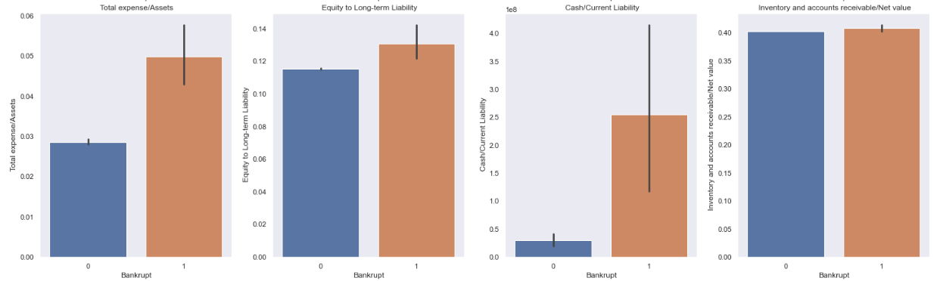

Slide 7
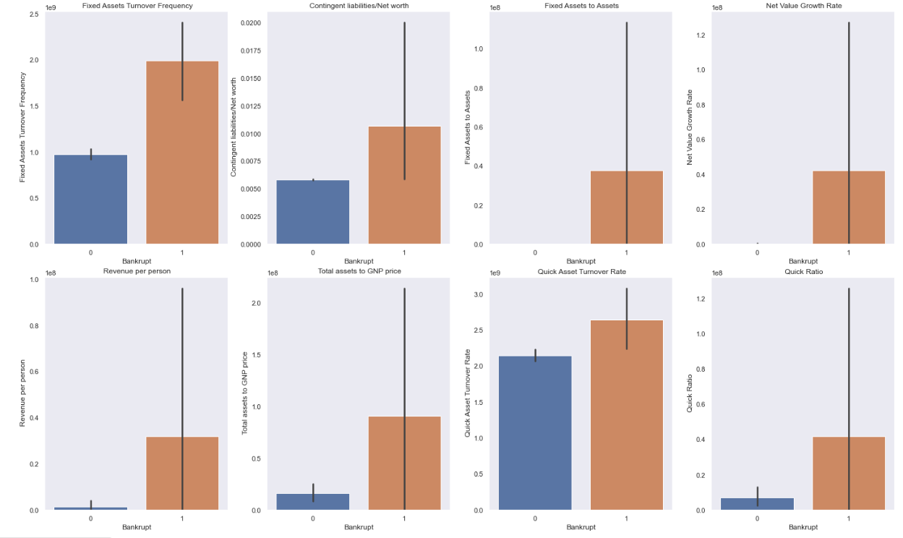

Slide 8
Debt-Ratio: The debt ratio refers to the proportion of total debt to total assets of a bankrupt entity. Bankrupt firms are having high Debt ratio. Firms should reduce the debt and increase the assets to escape from Bankruptcy
Current liability to assets: The current liability to assets ratio is used to assess a company's short-term liquidity and ability to meet its current obligations with its existing assets. Firms with high Current liability to assets ratio also has the chance of getting bankrupt
Current liability to current assets: The current liability to current assets ratio is used to assess a company's short-term liquidity and ability to meet its current obligations with its current assets such as cash, accounts receivable, inventory, and other assets. Higher this ratio, also increases the chances of Bankruptcy.
Liability assets flag : If total liabilities exceeds total assets, it is a concern for the firm to act, else it would increase the bankruptcy chance.

Slide 9
Cash/current liability : It measures a company's ability to meet its short-term obligations with its available cash. Firms with less cash equivalents have high probability for Bankrupt.
Net value growth rate: It measures the rate of change in the net value of an asset, investment, or portfolio over a specific period of time. Less growth leads to higher chances of bankrupt
Quick-ratio : It measures a company's ability to pay off its current liabilities without relying on the sale of inventory. Quick ratio checks the ability of the firm on repayment.
Fixed assets turnover frequency : It measures a company's efficiency in generating sales revenue from its investment in fixed asset.

Slide 10
Scaling and resampling
The dataset has outliers, which might be the important datapoints since it can not be removed. Hence, we can use robust scaling to scale the dataset which also handles the outliers.
Robust scaling uses the median and scales the data according to the quantile range which is between 25th and 75th quantile.
To balance the dataset, SMOTE and Borderline SMOTE techniques are used, where the former cerates synthetic datapoints to the minority class to level up to the majority class, while the latter ignores the noise points while creating the synthetic points.
These techniques is handy in order to improve the model learning efficiency.

Slide 11
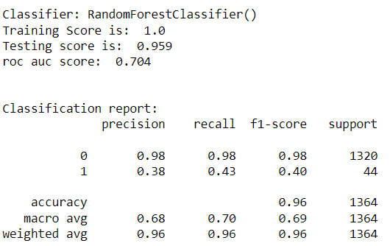
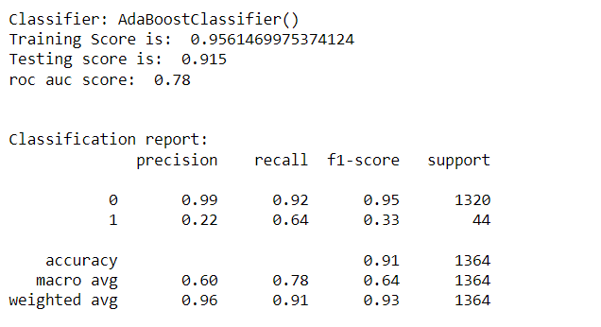
Model Evaluation
After creating and evaluating multiple classification models, it is evident that Random forest, Adaboost, Xgboost models gives best results in predicting the minority class effectively.

Slide 12
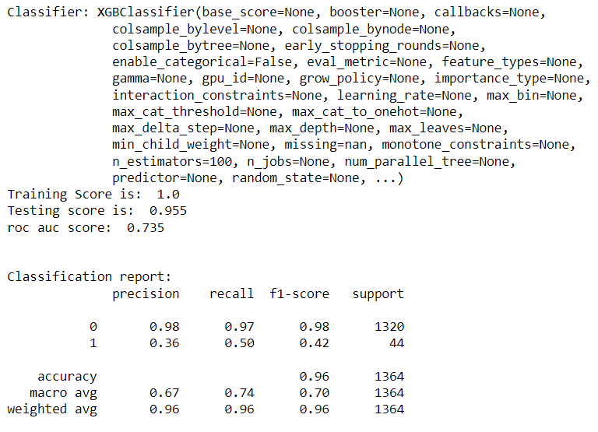

Slide 13
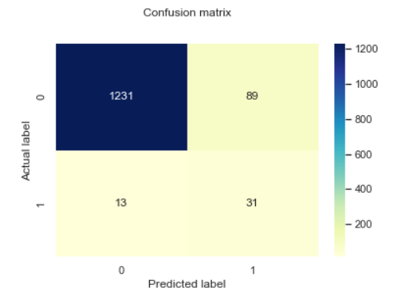
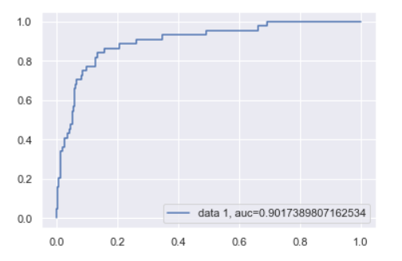
Final MODEL
After tuning the hyper parameters for Random forest, Adaboost and XGBoost, it is found that Adaboost with borderline SMOTE technique gives better results in terms of recall, f1-score, aoc score, accuracy. Hence, we can use Adaboost Model for Bankruptcy Prediction.

Slide 14
Thank YOu

