Slide 1

Central University of Karnataka
DROWSY FACE DETECTION USING
COMPUTER VISION
Dept. of Computer Science
Presented by : ARCHANA (2018MCA01)
Under the guidance of : Dr.R.S.Hegadi (HOD and Asst. Professor)
Aparna. Singh
(Organizer@Develearn Institute)

Slide 2
CONTENTS
Introduction
Problem statement
Existing System
Proposed System
Objective
Requirements
Methodology
Results
Conclusion
References

Slide 3
Introduction
In this 21st century, every human being is trying to lead their life as easy as possible and want to do the things quickly. As human is continuously adjusting to this instantly growing autonomous world especially autonomous industry, he or she needs to take care of their safety also.
Safety of human being is the main objective of the automobile industry especially vehicle automation.as we know that in the current world almost 99.99% people uses the vehicles for transportation purpose. And heavy transportations occur mostly for long period of time and at night period. So there will be a chances of drivers fall asleep or go drowsy. And during day time also, sometimes the drivers may go drowsy or feel sleepy. Some of the main reasons of the road accidents include distracted driving, drunk driving and reckless driving.
To avoid the accidents due to drowsy face, the current project is developed. In this project the camera is fixed inside the vehicle infront of driver, the system will monitor the face of the driver, whenever the driver eyes are closed or feel sleepy then the system will beep an alarm to alert the driver.

Slide 4
Problem Statement
The problem statement of the current project is to “to develop an end to end software which will detect the face is drowsy or not which is captured by camera or webcam. If found drowsy than alert through an alarm”.

Slide 5
Existing System
To solve the current problem, earlier many researches were tried to build the systems. Some of them were succeded also. The main three approaches they applied for the drivers are:
Steering pattern monitoring method
Vehicle position in lane monitoring
Eye and Face monitoring
Physiological Method
Among the above methods the affordable and portable method is eye and face monitoring.

Slide 6
Proposed System
By seeing the drawbacks of the previous methods the easier and cost effective method is Eye and Face monitoring. For this Computer vision technology is used which will help in image processing. We have developed the system which will alert the driver whenever the driver the drowsy face detected. For this a webcam is used for the monitoring the driver.
Here we focused on eye closure movement. To make this to happen we built a deep learning classifier model which will identify the opened and closed eyes. Whenever the closed eyes were found for certain amount of time the we made the adjustment to beep the alarm to alert the driver.

Slide 7
Objective
The main objective is to “ to develop an end to end software which will detect the face is drowsy or not which is captured by camera or webcam. If found drowsy than alert through an alarm”. It involves the steps like
Face detection
Eye detection
Identification of closed eye
Alert the driver

Slide 8
Requirements
Software requirements :
Python IDE
Open CV
Tensorflow
Keras
Hardware requirements :
Modern operating system: Windows OS.
X-86 64-bit CPU.
2 GB Graphics Card.
8 GB RAM.
10 GB free disk space.
Working webcam

Slide 9
Methodology
To build the system for the eye closure movement the following steps are followed.
Take image as input from a camera.
Detect the face in the image and create a Region of Interest (ROI).
Detect the eyes from ROI and feed it to the classifier.
Classifier will categorize whether eyes are open or closed.
Calculate score to check whether the person is drowsy.

Slide 10
Classifier model
The classifier model developed here will classify whether the eyes are closed or open. It involves the following stepsafter the eyes region of interests were marked.
Resizing the image
Normalizing the image
Dimensioning the image
Classifying the image as closed or open

Slide 11
Dataset
Here the dataset used is eye dataset which is taken from the internet. The dataset involves approximately 4000 images. The images include with glasses and without glasses. And are also captured with different light conditions like morning, afternoon, cloudy and at night.

Slide 12
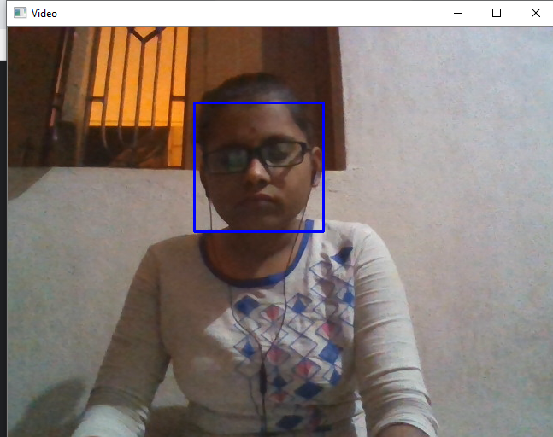
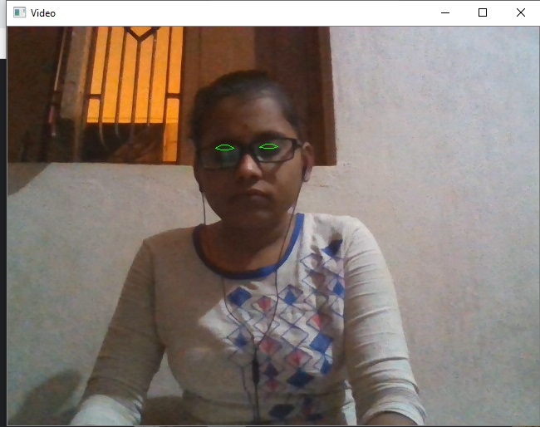
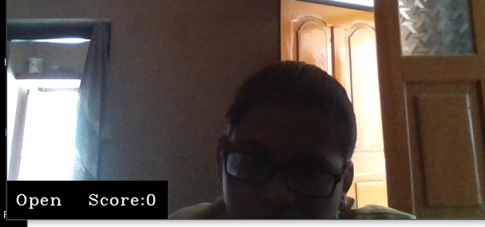
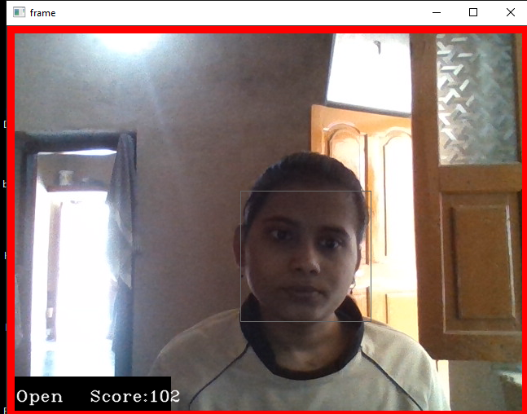
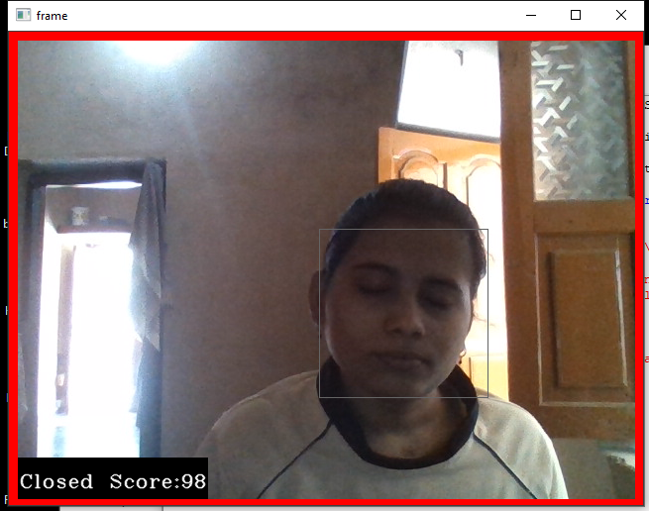
Output

Slide 13
Result
The result of the system is good. It can able to identify the opened and closed eyes and will beep alarm whenever the eyes were closed for certain amount of time. The current project is giving accuracy of 82%. It can be further improvised by adding more datasets.

Slide 14
Conclusion
In the current project the experimental results show the output. The drivers can use this system for their safety to save their lives. They can use the system in any light conditions. Here we used few test cases. It can be tested with more experiments for accurate results. It can also further improvised by adding voice messages to the driver instead of alarm and more number of datasets. For future it can be made into a application. In case of side movements of driver it has to be checked in future. Currently the system is giving an accuracy of result of 82%. It can be extended with more experiments.

Slide 15
References
Bergasa, L.M., Nuevo, J.: Real-time system for monitoring driver vigilance. In: Proceedingsof the IEEE International Symposium on Industrial Electronics, vol. III, pp. 1303–1308(2005).
Tadesse E., Sheng, W., Liu, M.: Driver drowsiness detection through HMM based dynamicmodeling. In: IEEE International Conference on Robotics and Automation, pp. 4003–4008(2014)
Ling, Z., Lu, X., Wang, Y., Zhou, Y., Wang, G., Li, J.: Local sparse representation for driverdrowsiness expression recognition. In: Chinese Automation Congress (CAC), pp. 733–737(2013)
Anumas S., Kim, S-.C.: Driver fatigue monitoring system using video face images physiological information. In: International Conference on Biomedical Engineering,pp. 125–130 (2011)
. Xiong, X., De la Torre, F.: Supervised descent method and its applications to face alignment.In: Proceedings of IEEE Conference on Computer Vision and Pattern Recognition, pp. 532–539, Portland, OR (2013)
https://www.pyimagesearch.com/2017/05/08/drowsiness-detection-opencv//.
https://www.pantechsolutions.net/driver-drowsiness-detection-using-opencv-and-python

Slide 16
THANK YOU

