Slide 1
Unit 2: Introduction to GUI
• GUI (Graphical User Interface) allows visual interaction.
• Users interact with windows, buttons, menus, dialogs.
• Java supports GUI via AWT and Swing.
• GUI programs follow an event-driven model.
Notes:
The Abstract Window Toolkit (AWT) is Java's original API for creating Graphical User Interfaces (GUIs) and window-based applications. It was introduced with Java 1.0 in 1995 and forms the foundation for more modern frameworks like Swing and JavaFX

Slide 2
CLI vs GUI
CLI: Command Line Interface
- Text commands
- Used in terminals
GUI: Graphical User Interface
- Windows, buttons, icons
- User-friendly interaction

Slide 3
AWT vs Swing
AWT:
- Platform dependent
- Heavyweight components
Swing:
- Platform independent
- Lightweight components
- Rich UI components
Notes:
Swing is platform-independent because its components are written entirely in Java, not native code. Unlike AWT (Abstract Window Toolkit), which relies on host operating system peers, Swing components are lightweight, rendered by Java code, and display consistently across different platforms, such as Windows, Linux, or macOS, ensuring the same look and fee

Slide 4
Basic Swing Window Example (Code)
import javax.swing.*;
public class FirstGUI {
public static void main(String[] args) {
JFrame frame = new JFrame("First GUI");
frame.setSize(400,300);
frame.setDefaultCloseOperation(JFrame.EXIT_ON_CLOSE);
frame.setVisible(true);
}
}

Slide 5
Swing Containers
Top Level Containers:
- JFrame
- JDialog
- JApplet
Containers hold GUI components like buttons and text fields.

Slide 6
Swing Component Hierarchy
JFrame
└── JPanel
├── JButton
├── JTextField
└── JLabel

Slide 7
Layout Managers
Layout managers control component arrangement.
Types:
- FlowLayout
- BorderLayout
- GridLayout
- GridBagLayout

Slide 8
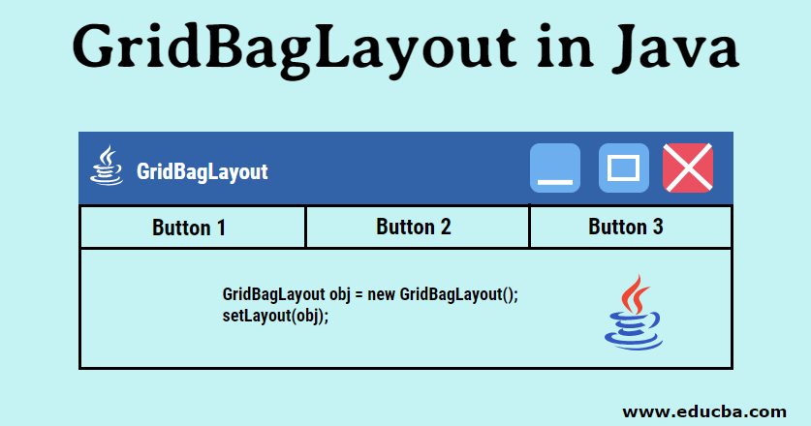

Slide 9
FlowLayout Example (Code)
import javax.swing.*;
import java.awt.*;
public class FlowExample {
public static void main(String[] args) {
JFrame frame = new JFrame("Flow Layout");
frame.setLayout(new FlowLayout());
frame.add(new JButton("A"));
frame.add(new JButton("B"));
frame.add(new JButton("C"));
frame.setSize(300,200);
frame.setVisible(true);
}
}

Slide 10
BorderLayout Example (Code)
frame.setLayout(new BorderLayout());
frame.add(new JButton("North"), BorderLayout.NORTH);
frame.add(new JButton("South"), BorderLayout.SOUTH);
frame.add(new JButton("East"), BorderLayout.EAST);
frame.add(new JButton("West"), BorderLayout.WEST);
frame.add(new JButton("Center"), BorderLayout.CENTER);

Slide 11
Swing Input Components
Common components:
- JTextField
- JTextArea
- JCheckBox
- JRadioButton
- JComboBox
- JButton

Slide 12
Event Handling Concept
Event Driven Model:
User Action → Event → Listener → Method Execution
Listeners detect user interaction.

Slide 13
Button Event Example
button.addActionListener(new ActionListener() {
public void actionPerformed(ActionEvent e) {
System.out.println("Button Clicked");
}
});

Slide 14
Dialog Boxes
Swing provides dialog boxes using JOptionPane.
Types:
- Message Dialog
- Confirm Dialog
- Input Dialog

Slide 15
Dialog Example Code
JOptionPane.showMessageDialog(null, "Welcome");
String name = JOptionPane.showInputDialog("Enter name");
int result = JOptionPane.showConfirmDialog(null, "Continue?");

Slide 16
Menus in Swing
Menu Components:
- JMenuBar
- JMenu
- JMenuItem
Used in desktop applications.

Slide 17
Menu Code Example
JMenuBar bar = new JMenuBar();
JMenu file = new JMenu("File");
JMenuItem open = new JMenuItem("Open");
file.add(open);
bar.add(file);
frame.setJMenuBar(bar);

Slide 18
File Chooser Example
JFileChooser chooser = new JFileChooser();
int result = chooser.showOpenDialog(null);
if(result == JFileChooser.APPROVE_OPTION){
System.out.println(chooser.getSelectedFile());
}

Slide 19
Mini Project: Student Registration System
Features:
- Name, Email, Phone
- Gender selection
- Course dropdown
- Address input
- Submit and Reset buttons

Slide 20
Student Registration Code Structure
Main Components:
- JFrame
- JTextField
- JComboBox
- JRadioButton
- JTextArea
- JButton
Uses ActionListener for event handling.

Slide 21
Learning Outcomes
After completing this module students can:
• Build Java GUI applications
• Use Swing components
• Apply layout managers
• Implement event handling
• Build small desktop applications

