Slide 1
Unit 3: Cloud Platforms and Tools

Slide 2
Agenda
Intro to Cloud Platforms
AWS, Azure, GCP Overview
Compute Services
Storage Services
Database Services
Real-world Use Cases

Slide 3
What Are Cloud Platforms?
On-demand compute, storage, and services
Pay-as-you-go pricing
Managed infrastructure
Global availability

Slide 4
Why Learn Cloud Platforms?
Most companies shifting to cloud
High demand for cloud engineers
Supports DevOps, AI, ML, Big Data
Essential skill for IT/CS graduates

Slide 5
Amazon Web Services (AWS)
Launched 2006, largest cloud provider
Over 200+ services
Strong in compute, storage, global reach

Slide 6
AWS Key Features
EC2: Virtual machines
S3: Object storage
Lambda: Serverless functions
RDS: Managed database

Slide 7
Microsoft Azure
Released 2010, enterprise-focused
Strong integration with Windows ecosystem
Widely used in corporate environments

Slide 8
Azure Key Features
Virtual Machines
Blob Storage
SQL Database
Azure Functions

Slide 9
Google Cloud Platform (GCP)
Leader in AI/ML and Big Data
Runs services like YouTube, Google Search
Popular for analytics-heavy workloads

Slide 10
GCP Key Features
Compute Engine
Cloud Storage
BigQuery
Cloud Functions

Slide 11
3.2.1 Compute Services Overview
Allows running apps on cloud servers
Virtual machines, serverless, containers
Scalable and reliable

Slide 12
Compute Services Comparison
AWS: EC2, Lambda
Azure: Virtual Machines, Azure Functions
GCP: Compute Engine, Cloud Functions

Slide 13
When to Use Compute Services?
Web hosting
Mobile backend
Batch processing
AI model execution

Slide 14
3.2.2 Storage Services Overview
Stores data reliably in cloud
Types: Object, File, Block storage
High durability and availability

Slide 15
Storage Services Comparison
AWS: S3, Elastic Block Store, Elastic File System
Azure: Blob, Disk, File Storage
GCP: Cloud Storage, Persistent Disk
Notes:
S3, EBS, and EFS are Amazon Web Services' core storage options, differing in data type (object, block, file), access (internet, single instance, shared), and use case (backups/web, databases/OS, shared files/apps). S3 (Simple Storage Service) is massive object storage for static content, backups, data lakes. EBS (Elastic Block Store) provides high-performance block storage, like a virtual hard drive, for single EC2 instances (databases, boot volumes). EFS (Elastic File System) offers scalable, shared file storage (NFS) for multiple Linux instances, ideal for content management or shared folders.

Slide 16
Storage Use Cases
Media storage
Backups and disaster recovery
Application data
Big data lakes

Slide 17
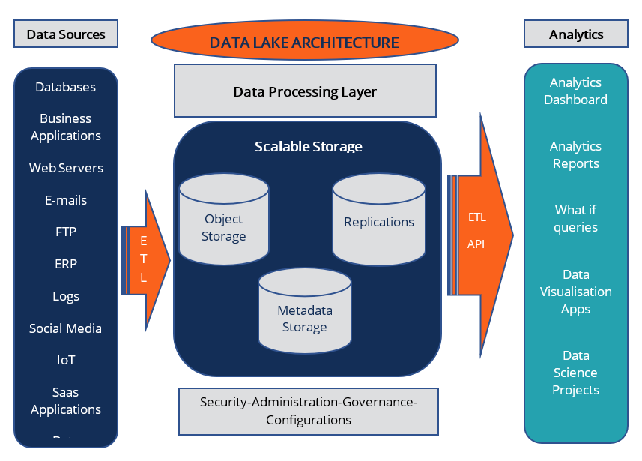
Data Lake
Notes:
Metadata in a data lake is stored in a centralized repository called a metastore (like AWS Glue Catalog or Hive Metastore) as structured data, acting as a "map" to find, understand, and govern the raw, often unstructured, data files in the lake, providing context (source, format, schema, lineage, quality) and enabling data discovery, security, and governance, preventing the lake from becoming a "data swamp"

Slide 18
3.2.3 Database Services Overview
Relational and NoSQL options
Fully managed services
Automatic backups and scaling

Slide 19
Database Services Comparison
AWS: RDS, DynamoDB
Azure: SQL Database, Cosmos DB
GCP: Cloud SQL, Firestore, Bigtable

Slide 20
Database Use Cases
E-commerce systems
Financial applications
User authentication/metadata
Real-time apps

Slide 21
Real-World Cloud Use Cases
E-commerce websites hosted on AWS
Universities using Azure for LMS
BigQuery used for large-scale analytics

Slide 22
Industry Examples
Netflix uses AWS for streaming
LinkedIn uses Azure for enterprise services
Spotify uses GCP for data analytics

Slide 23
Summary
AWS, Azure, GCP dominate cloud market
Compute, Storage, Database = core services
Cloud skills essential for IT careers

