Slide 1


Exploring
GraphQL APIs

Slide 2
Exploring GraphQL APIs
This lesson covers
Using GraphQL’s in-browser IDE to test GraphQL requests
Exploring the fundamentals of sending GraphQL data requests
Exploring read and write example operations from the GitHub GraphQL API
Exploring GraphQL’s introspective features
Notes:
The easiest way to start learning about the powerful features of the GraphQL language is to use its feature-rich interactive in-browser IDE. This IDE uses GraphQL’s type system to provide features you can use to explore what you can do with GraphQL and to write and test your GraphQL requests without leaving your browser. Using this IDE, we will continue to explore examples of GraphQL queries and mutations. We’ll look at the fundamental parts of a GraphQL request and test examples from the official GitHub GraphQL API.

Slide 3
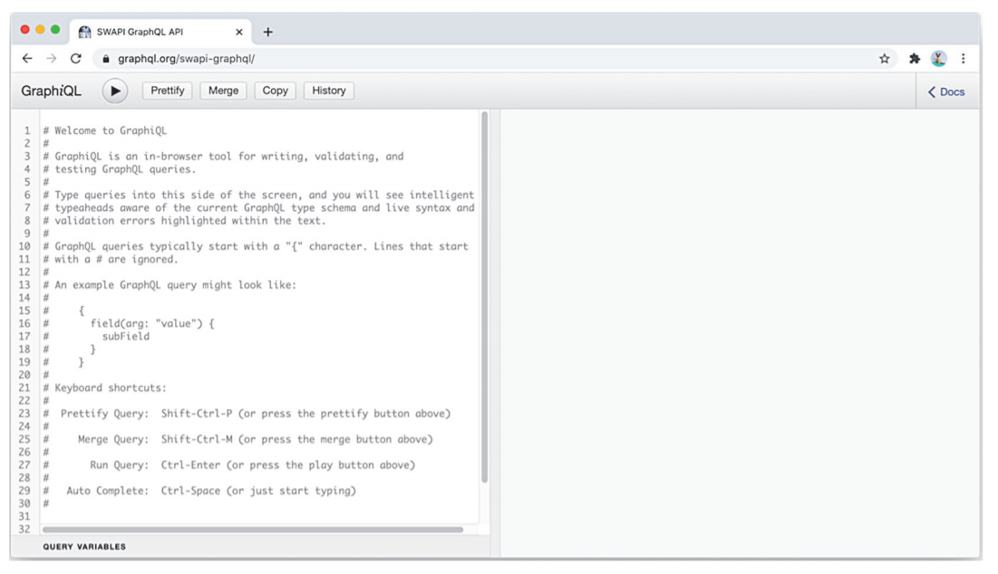
The GraphiQL editor
Notes:
When thinking about the requests your client applications need to make to servers, you can benefit from a graphical tool to first help you come up with these requests and then test them before committing to them in application code. Such a tool can also help you improve these requests, validate your improvements, and debug any requests that are running into problems. In the GraphQL world, this tool is called GraphiQL (with an i before the QL and pronounced “graphical”). GraphiQL is an open source web application (written with React.js and GraphQL) that can be run in a browser. GraphiQL is one of the reasons GraphQL is popular. It is easy to learn, and it will be a very helpful tool for you. I guarantee that you will love it. It is one of my favorite tools for frontend development, and I cannot imagine working on a GraphQL-based project without it. You can download GraphiQL and run it locally, but an easier way to get a feel for what this tool has to offer is to use it with an existing GraphQL API service like the Star Wars service that we previewed in lesson 1. Head over to az.dev/swapi-graphql in your browser to find the GraphiQL editor, which works with the Star Wars data and is publicly available for you to test.
Figure shows what it looks like. This editor is a simple two-pane application: the left pane is the editor, and the right pane is where the results of executing GraphQL requests appear.

Slide 4
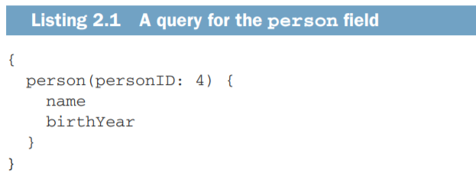
The GraphiQL editor
Go ahead and type the following simple GraphQL query in the editor
Notes:
This simple GraphQL query asks for the name and birth year of the person whose ID is 4. To execute the query, you can press Ctrl-Enter or press the run button (with the little black triangle).

Slide 5
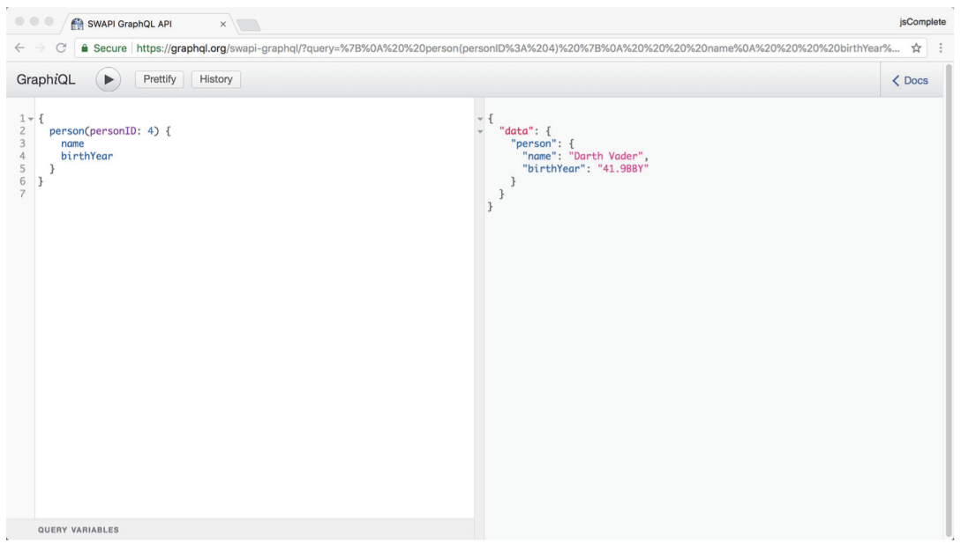
Notes:
When you do, the result pane shows the data that the query is asking for, as shown in figure
The best thing about the GraphiQL editor is that it provides intelligent type-ahead and autocompletion features that are aware of the GraphQL type schema you are currently exploring. For the previous example, the editor is completely aware that there is a person object with name and birthYear fields. In addition, the editor has live syntax and validation error highlighting for any text you type.
NOTE The awesome features in GraphiQL are all possible because of the GraphQL schema. With one big query to the server, this editor can know about everything the server offers

Slide 6
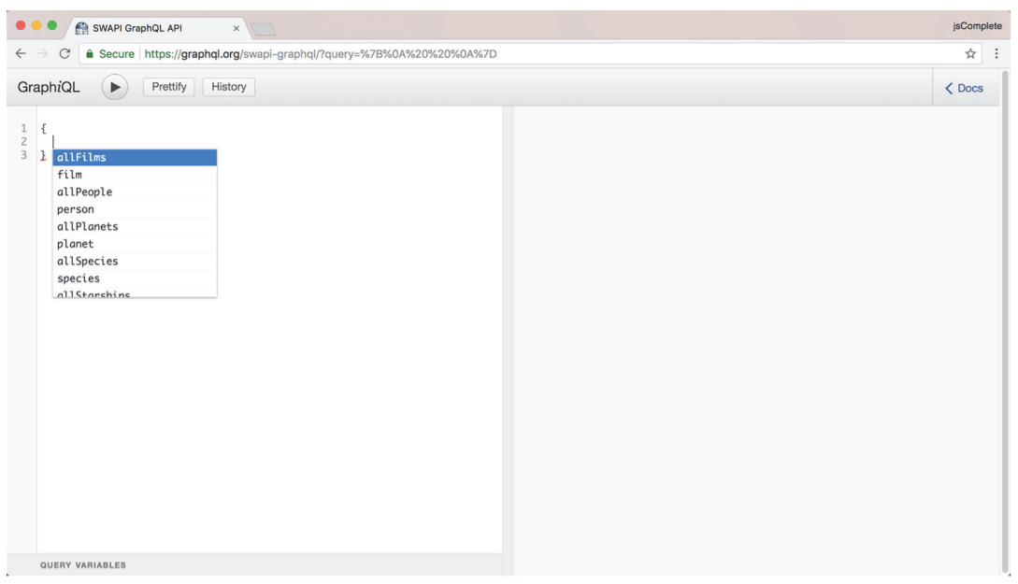
Notes:
To explore these features, clear the editor pane (you can select all the text in the editor with Ctrl-A). Then, just type an empty set of curly brackets: {}. Place your cursor within this empty set, and press Ctrl-Space. You get an autocompletion list like that shown in figure
Nice! You can very quickly start exploring what fields this GraphQL API offers right there in the editor while you are thinking about your requests. The person field we used before is one of the items in the list. This list will also be used to autocomplete fields as you type them. Type p, and notice how the list changes to highlight what starts with p. Then, type an e and see how the list only highlights the person field. Press Enter to “pick” the currently highlighted item in the list
The great thing about this type-ahead list is its context awareness. It shows you the fields available on the level where you are typing. For example, now that you picked the person field, type another empty set of curly brackets after the word person, put your cursor within this new set, and bring up the type-ahead list by pressing CtrlSpace. You should see a new list, this time with all the fields you can ask for in the context of a person object (NEXT SLIDE)

Slide 7
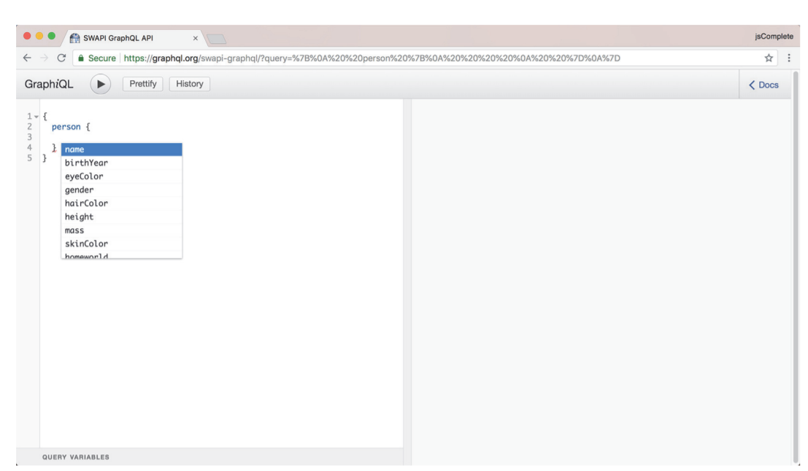
Notes:
Context awareness is extremely helpful, and I am talking not about the “less typing” aspect but rather about the discoverability and validation aspects that enable you to work more quickly and make fewer mistakes. This is an example of the power and control I was talking about in the previous lesson. And that is how GraphQL is different.
Before we pick the name and birthYear fields again, note that one of the closing curly brackets has a red underline. This is part of the live error highlighting you also get in this tool. Discard the type-ahead list by pressing Esc, and hover your mouse cursor over the underlined curly bracket. You should see an error complaining about unexpected syntax. This is because the text in the editor is not yet valid GraphQL syntax. Every time you start a new level of curly brackets, known as a selection set, it needs its own fields.
Go ahead and pick the name and birthYear fields within the person field. The query syntax is now valid (the red underline is gone), but the query is still missing one important piece—and this time, it is not a syntax problem.

Slide 8
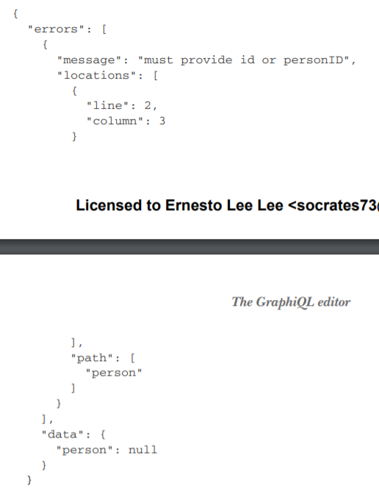
Notes:
You can always execute the query to see what the server has to say about it. If the server rejects the query, it will most likely give you a good reason why it did. For example, executing the query we have right now returns the following.
Note that the response in listing is a normal JSON response (200-OK) and that it gives two top-level properties: an errors property that is an array of error objects and a data property that represents an empty response. A GraphQL server response can represent partial data when that server has errors about other parts of the response. This makes the response more predictable and makes the task of handling errors a bit easier. The error message here is helpful: the path “person” must provide id or personID. Since we are asking the server about one person, it needs a way to identify which person’s data to return. Note again that this was not a syntax problem but rather a missingrequired-value problem.

Slide 9
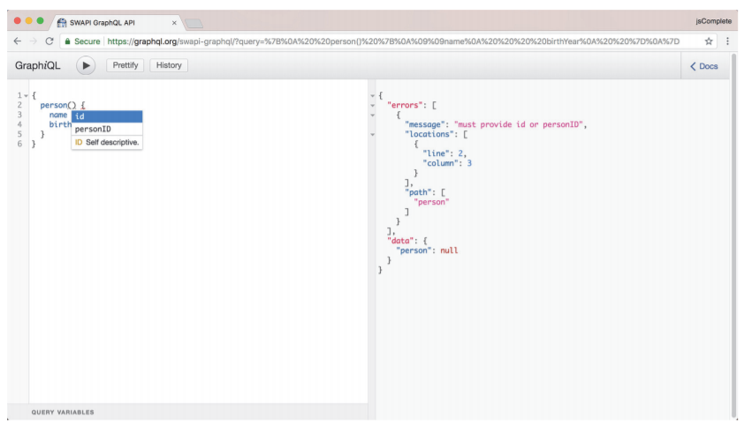
The GraphiQL editor
Notes:
To make a path provide a value, we use syntax similar to calling functions. Place the cursor immediately after the word person, and type the ( character. GraphiQL autocompletes it and shows you a new type-ahead list that, this time, knows what values can be provided as arguments for the person field
Now you can pick the personID argument, give it a value of 4, and get back to the same query you started with. But this time, you discovered the elements you needed through the powerful features of the GraphiQL editor.

Slide 10
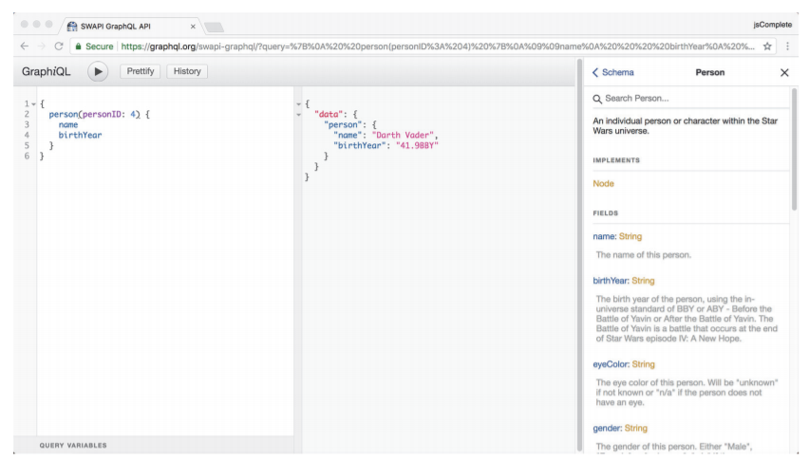
Notes:
In addition to discovering the structure and types of elements inline while you type them, you can browse the Docs section to see full lists and more details. Click the Docs link in the top-right corner of the editor. You should see a search box that you can use to find any type in the current GraphQL schema. I typed the word person and picked the first result; figure shows the schema type Person with its description and fields
Take a moment to explore more of what the GraphiQL editor has to offer. Try more queries, and get a feeling for how easy it is to come up with them.

Slide 11
The basics of the GraphQL language
Requests
At the core of a GraphQL communication is a request object, The source text of a GraphQL request is often referred to as a document.
A document contains text that represents a request through operations like queries, mutations, and subscriptions.
In addition to the main operations, a GraphQL document text can contain fragments that can be used to compose other operations,
Notes:
To ask any GraphQL server for data, we send it a request written in the GraphQL query language.
A GraphQL request contains a tree of fields. Let’s explore these two fundamental concepts of the language in detail.

Slide 12
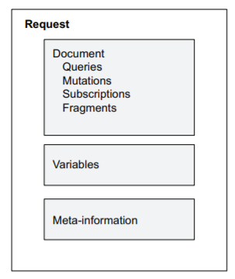
Requests
The structure of a GraphQL request
Notes:
A GraphQL request can also contain an object representing values of variables that may be used in the request document text. The request may also include meta-information about operations. For example, if the request document contains more than one operation, a GraphQL request must include information about which operation to execute. If the request document contains only one operation, the GraphQL server will just execute that. You do not even need to label the operation with a name in that case, but naming operations is a good practice to follow

Slide 13
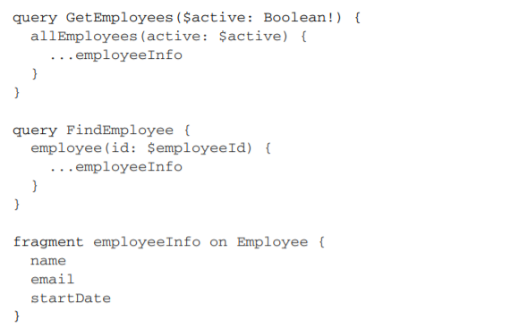
Requests
Notes:
Let’s look at a full GraphQL request. Here is a hypothetical example (don’t worry about the new syntax just yet).

Slide 14

Requests
Since this document uses generic variables (the ones starting with the $ sign), we need a JSON object to represent values specific to a request.

Slide 15
Requests
Also, since the document contains more than one operation (GetEmployees and FindEmployee), the request needs to provide the desired operation to be executed.
operationName="GetEmployees"
Notes:
If we send all three elements of this request to a GraphQL server, it will parse the whole document, pick the GetEmployees query, fill the variable values, and return the data response for that query. Three types of operations can be used in GraphQL: ○ Query operations that represent a read-only fetch ○ Mutation operations that represent a write followed by a fetch ○ Subscription operations that represent a request for real-time data updates

Slide 16
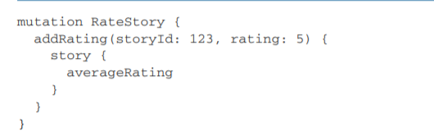
Requests
Here is a hypothetical example of a mutation operation.
Notes:
The mutation operation in listing adds a new five-star rating record for a story and then retrieves the new average rating of that same story. Note that this is a write followed by a read. All GraphQL mutation operations follow this concept.

Slide 17
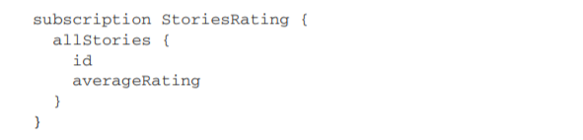
Requests
Here is a hypothetical example of a subscription operation.
Notes:
The subscription operation in listing instructs the GraphQL server to open a socket connection with the client, send story IDs along with their average ratings, and keep doing that when the information changes on the server. This feature is a much better alternative than continuously polling data to keep a UI view up to date.

Slide 18
Fields
One of the core elements in the text of a GraphQL operation is the field.
The simplest way to think about a GraphQL operation is as a way to select fields on objects.
A field always appears within a selection set (inside a pair of curly brackets), and it describes one discrete piece of information that you can retrieve about an object.
Notes:
It can describe a scalar value (like the name of a person or their birth year), an object (like the home planet of a Star Wars character), or a list of objects (like the list of films in which a Star Wars character appeared). For the last two cases, the fields contain another selection set to customize the information needed about the objects the fields describe.

Slide 19
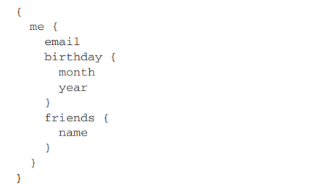
Fields
Here is an example GraphQL query with different types of fields
Notes:
The fields email, month, year, and name are all scalar fields. Scalar types represent primitive leaf values. GraphQL schemas often support four major scalar types: Int, String, Float, and Boolean. The built-in custom scalar value ID can also be used to represent identity values. We’ll see an example in lesson 4.
TIP The term leaf comes from Graph theory. It means a vertex with no children.
You can also customize a GraphQL schema to support more scalar values with certain formats. For example, a schema can be designed to have a Time scalar value representing a time value in a standard and parsable format (ISO/UTC). The me and birthday fields describe objects, so they require their own nested selection sets to represent their properties. The friends field describes a list of friend objects, so it also requires a nested selection set to represent the properties of the objects in that list
All GraphQL operations must specify their selections down to fields that return scalar values (leaf values). For example, they cannot have fields that describe objects without providing further nested selection sets to specify which scalar values to fetch for these objects. The last-nested level of fields should always consist of only fields that describe scalar values. For the example, if you did not specify the nested selection set for the friends field (the { name } part), the GraphQL query would not be valid because in that case, not all of the last-nested-level fields would describe scalar values. The root fields in an operation usually represent information that is globally accessible to your application and its current user.
NOTE I use the term root field to refer to the first-level fields in a GraphQL operation

Slide 20
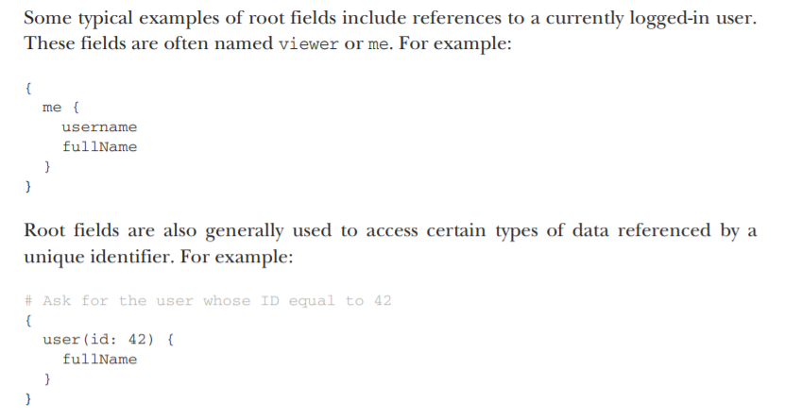
Notes:
In this query, the user field represents one of many users in a graph of data. To instruct the server to pick one user, we specify a unique ID value for the user field. Note that in the previous example, the # character is used to write a comment about the query. This is the official character to comment a single line (or the remainder of a line) in a GraphQL document. There is no supported way to have multiline comments in GraphQL documents, but you can have many lines, each of which starts with the # character. The server will just ignore all the comments. It will also ignore any extra spaces, all line terminators, and all insignificant commas between fields. These characters can be used to improve the legibility of source text and emphasize the separation of tokens. They have no significance to the semantic meaning of GraphQL documents.

Slide 21
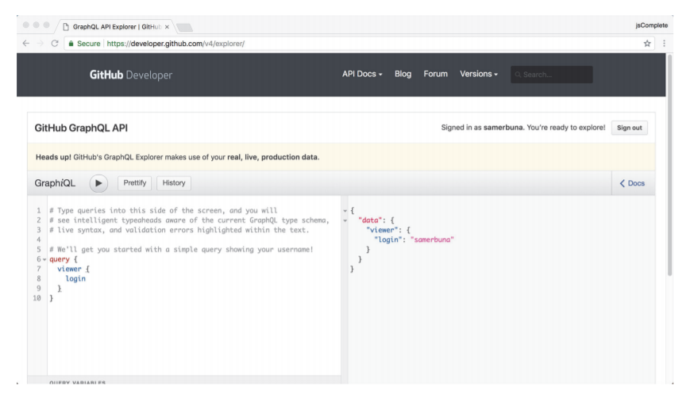
Examples from the GitHub API
Notes:
Now that you know about requests, documents, operations, and fields, let’s put this knowledge to use and explore some real-world examples of GraphQL requests from the GitHub API. GitHub moved from REST APIs to GraphQL APIs in 2017. We can use their GraphQL API explorer at az.dev/github-api; this embedded GraphiQL editor (figure) includes the proper authentication headers for the API (you need to be logged in with a GitHub.com account).
TIP You can also use a standalone GraphiQL editor to explore the GitHub API (see az.dev/graphiql-app). You have to manually include an access token in that app. You can use this standalone app with any GraphQL API service.
Let’s first look at some common queries from this API.
WARNING The GitHub API uses your real, live production data at GitHub.com

Slide 22
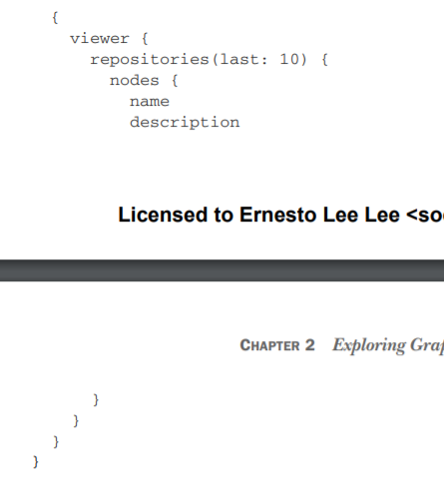
Reading data from GitHub
For example, here is a query to see information about the most recent 10 repositories that you own or contribute to.
Notes:
When you first launch the GitHub GraphQL API explorer, it has a default simple query that displays your login. The currently logged-in user is represented by the viewer field. Under this field, you can read all the information that is available about you at GitHub.

Slide 23
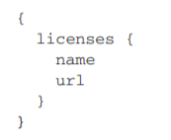
Reading data from GitHub
Here is another query to see all the supported licenses in GitHub along with their URLs.
Notes:
Next is a more complex query to find the first 10 issues of the facebook/graphql repository

Slide 24
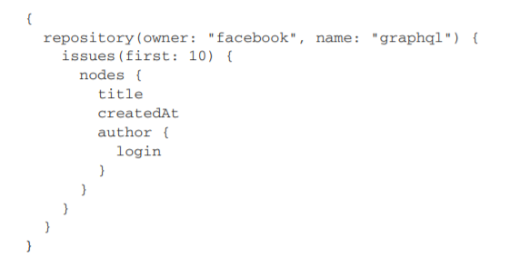
Reading data from GitHub
Notes:
. It asks for the name of the author and the title used for the issue page, along with the date when the issue was created.

Slide 25
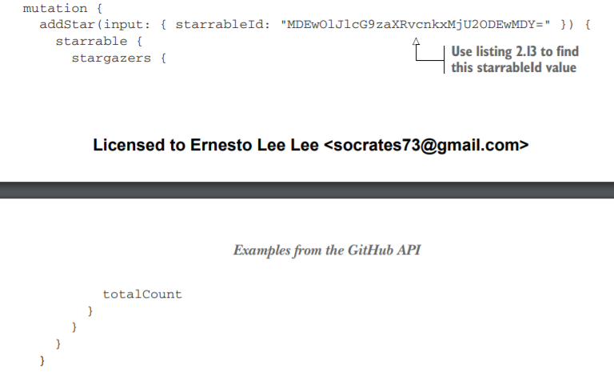
Updating data at GitHub
Notes:
Let’s now explore some mutations we can do with the GitHub GraphQL API. The simplest mutation is to “star” a repository. If you execute the following mutation under your logged-in user, its action and clicking the star button.

Slide 26
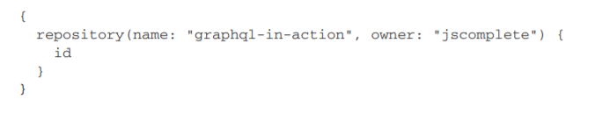
Updating data at GitHub
The input for this mutation is a simple object that has a starrableId value, which is the node identifier for the graphql-in-action repository.
I was able to find that value using this query
Notes:
The mutation stars the repository and then reads the new total number of stargazers after the mutation.

Slide 27
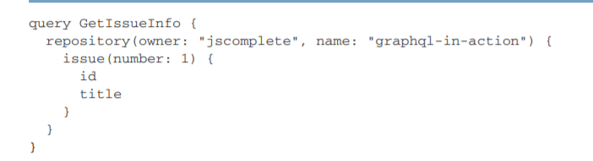
Updating data at GitHub
Notes:
Let’s execute another mutation. This time, let’s add a comment to an issue in a repository. I created an issue for you to test this mutation under the repository. You can see the details of this issue using the following query.
This gives you the value of the id field needed to add a comment to the issue using a mutation

Slide 28
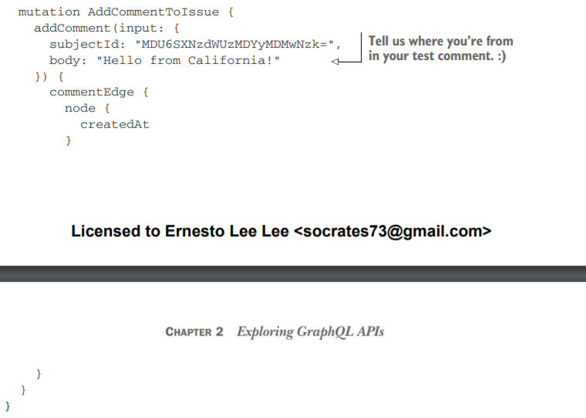
Updating data at GitHub
Now execute the following mutation, which uses that id value.
Notes:
After the mutation in listing saves your comment to the special issue, it reports the createdAt date for that comment. Feel free to send as many comments as you wish to this special issue, but only do so through the GitHub API explorer. You can see the comments you added

Slide 29
Introspective queries
GraphQL APIs support introspective queries that can be used to answer questions about the API schema.
This introspection support gives GraphQL tools powerful functionality, and it drives the features we have been using in the GraphiQL editor.
For example, the awesome type-ahead list in GraphiQL is sourced with an introspective query.
Notes:
Introspective queries start with a root field that’s either __type or __schema, known as meta-fields. There is also another meta-field, __typename, which can be used to retrieve the name of any object type.
Fields with names that begin with double underscore characters are reserved for introspection support.
NOTE Meta-fields are implicit. They do not appear in the fields list of their types. The __schema field can be used to read information about the API schema, such as what types and directives it supports. We will explore directives in the next lesson

Slide 30
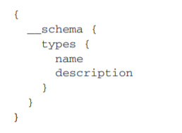
Introspective queries
Let’s ask the GitHub API schema what types it supports. Here is an introspective query to do that
Notes:
This query returns all the types this schema supports, and it also includes the descriptions of these types. This is a helpful list to explore the custom types defined in the GitHub GraphQL schema. For example, you should see that the GitHub API schema defines types like Repository, Commit, Project, Issue, PullRequest, and many more

Slide 31
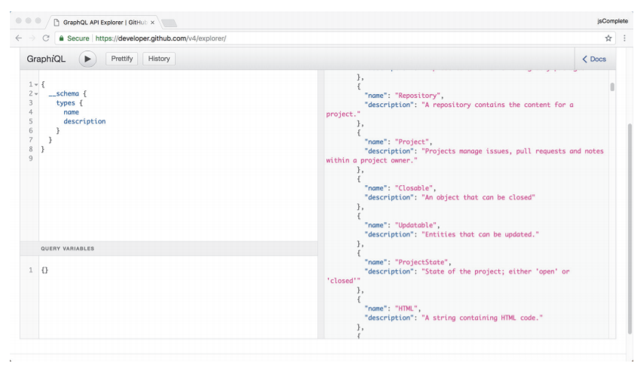
Notes:
If you need to retrieve information about a single type, you can use the __type metafield.

Slide 32
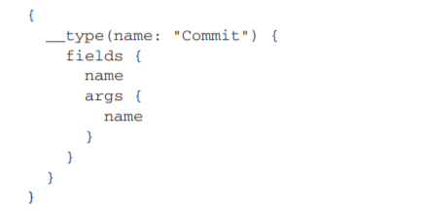
Introspective queries
For example, here is a query to find all the supported fields under the type Commit along with any arguments they accept.
Notes:
Use the GraphiQL type-ahead feature to discover what other information you can retrieve under these introspective meta-fields.

Slide 33
Summary
GraphiQL is an in-browser IDE for writing and testing GraphQL requests.
It offers many great features to write, validate, and inspect GraphQL queries and mutations.
These features are made possible thanks to GraphQL’s introspective nature, which comes with its mandatory schemas.
A GraphQL request consists of a set of operations, an object for variables, and other meta-information elements as needed.
Notes:
○ GraphQL operations use a tree of fields. A field represents a unit of information. The GraphQL language is largely about selecting fields on objects. ○ GitHub has a powerful GraphQL API that you can use to read data about repositories and users and do mutations like adding a star to a repository or commenting on an issue in a repository. ○ GraphQL introspective queries offer a way for clients to get meta-information about the GraphQL API.

Slide 34
"Complete Lab"

