Slide 2
Kubernetes
DESCRIPTION: Course overview As a result of attending this class, students should be able to containerize simple software applications and services, deploy them with Docker, Kubernetes, test the containerized version, and troubleshoot issues with deployment.
Course summary
Container, Docker
Create containerized services
Manage containers and container Images
Create custom container images
Deploy containerized applications
Deploy multi-container applications

Slide 3
Kubernetes cluster.
API Server - The REST API endpoint for managing most aspects of the Kubernetes cluster.
Replication Controller - Ensures the number of specified pod replicas are always running by starting or shutting down pods.
Scheduler - Finds a suitable host where new pods will be reside.
etcd - A distributed key value store where Kubernetes stores information about itself, pods, services, etc.
Flannel - A network overlay that will allow containers to communicate across multiple hosts.
The minion hosts will run the following services to manage containers and their network.
Kubelet - Host level pod management; determines the state of pod containers based on the pod manifest received from the Kubernetes master.
Proxy - Manages the container network (IP addresses and ports) based on the network service manifests received from the Kubernetes master.
Docker - An API and framework built around Linux Containers (LXC) that allows for the easy management of containers and their images.
Flannel - A network overlay that will allow containers to communicate across multiple hosts.

Slide 4
AUDIENCE AND PREREQUISITES:
Audience for this course
Developers who wish to containerize software applications
Administrators who are new to container technology and container
orchestration
Architects who are considering using container technologies in software
architectures
Prerequisites for this course
Red Hat recommends these prerequisites:
Be able to use a Linux terminal session and issue operating system
commands
Have Red Hat Certified System Administrator (RHCSA) certification or
equivalent experience
Have experience with web application architectures and their
corresponding technologies
Learn the benefits of containers, Docker, Kubernetes, and Red Hat OpenShift with our
free, technical overview Deploying Containerized Applications Technical Overview
(DO080).

Slide 5
Introduction
The largest cloud providers such as AWS, Microsoft Azure and Oracle Cloud announced Kubernetes integrations into their respective cloud platforms, not mentioning Google where Kubernetes came from originally. So, every developer would benefit from at least learning the basics of Kubernetes. That's exactly what we are going to do in this post.
“Kubernetes is a system for managing containerized applications across a cluster of nodes”
In simple terms, you have a group of machines (e.g. VMs) and containerized applications (e.g. Dockerized applications), and Kubernetes will help you to easily manage those apps across those machines. We will see a practical example later.

Slide 6
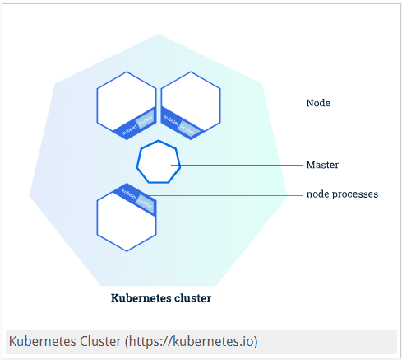
Kubernetes components
Kubernetes cluster consists of Master and Nodes:
Master is the controlling machine and has components which operate as the main management contact point for users. Nodes are where your containerized apps run.
Simply put, you run your containerized apps in nodes and you control them through the master.
Both master and nodes have very important components which we discuss below.

Slide 7
Master Components
Etcd is a consistent and highly-available key-value store used as Kubernetes’ backing store for all cluster data. Basically, it is a database for Kubernetes data and represents the state of the cluster.
API Server is what exposes Kubernetes API, as its name suggests. It is the main management point of the entire cluster. It acts as the bridge between various components disseminating information and commands. In simple terms, it is the frontend of the Kubernetes control pane.
Controller Manager is responsible for regulating the state of the cluster and performing routine tasks. For example, the replication controller ensures that the number of replicas defined for a service matches the number currently deployed on the cluster. Another example is the endpoints controller adjusting, well, endpoints by watching for changes in Etcd.
Scheduler Service is what assigns workloads to nodes. This is how it does it:
Reads the workload's operating requirements
Analyze the current infrastructure environment
Place the workload on an acceptable node(s)

Slide 8
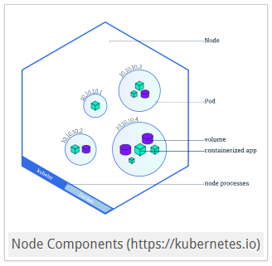
Node Components
Docker is used in order to run your containers, duh! rkt can be used as an alternative to docker.
Kubelet is the main contact point for each node with the cluster group, relaying to and from control pane services (master).
Proxy is used for maintaning network rules and performing connection forwarding. This is what enables the Kubernetes service abstraction (DNS).
You won't directly interact with these components directly but it is good to know what is happening behind the magic.
If the above components are something you don't have to know, the following you must know. Pay great attention.

Slide 9
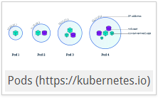
Kubernetes Work Units
Pod is the most basic unit in Kubernetes. It represents a unit of deployment, i.e. a single instance of an application which may consist of either a single container or a small number of containers that are tightly coupled and that share resources (for example, a cloud sql proxy container should run in the same pod as the main application). Other than an application container (or multiple containers), a pod encapsulates storage resources, a unique network IP and options that govern how the container(s) should run.
Excuse the image size. You rarely have to directly deploy pods (I never have). You mostly will attach into the process for debugging and testing purposes.

Slide 10
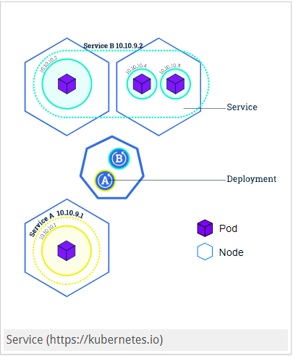
Kubernetes Work Units
Service groups together logical collections of pods that perform the same function and presents them as a single entity. Also, it acts as a basic load balancer between pods and enables consumers not to worry about anything beyond a single access location.

Slide 11
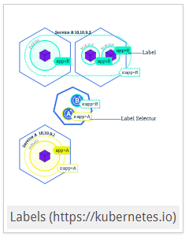
Kubernetes Work Units
Label is an arbitrary tag to mark work units. Basic key-value pairs. They are what enable services to group several pods together. Let's say you give your pods this label "microservice: auth" and the service with the same selector ("microservice: auth") will be able to forward traffic to those pods.

Slide 12
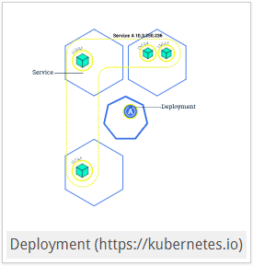
Kubernetes Work Units
Deployment provides a declarative syntax to create/update pods. You tell a deployment your desired state (how many, how fast, when) and it changes the actual state to the desired state at a specified rate.
Ingress manages external access to the services. Provides load balancing, SSL termination and path/hos based routing, which are considered its advantages over services of "Load Balancer" type. See below for more details.
Ingress Controller is what implements Ingress definitions. That is, you write what you need in Ingress objects and ingress controllers will turn them into reality. It means that Ingress itself is nothing without Ingress Controllers

Slide 13
Common pitfalls
Using services of type "LoadBalancer" to expose externally: In most tutorials, even in the official documentation, they use LoadBalancer services to expose the application. The reason is that it is really easy to do and great of testing. However, when you want to do SSL termination or route/host based routing, services are not your friends. Use Ingressfor real applications.
GKE Ingress Controller: In GKE, you don't have to manage your own ingress controller because GKE has its own managed for you. It is great and it works great. However, it cannot force https at the time of this writing. Maybe it will change in the future. But for now, you will have to manage your own Ingress Controller if https is a must for your app, which it should be in 2018. See the full example about on how to do that.
SSL certificates: Don't manage them yourself. Use kube-lego which automatically updates your certificates when they are about to expire.

Slide 14
Bonus
Zero Downtime: By using something called readiness-probe and a rolling update strategy it is very easy to achieve zero-downtime deployment. Let me know in the comments if you want a post showing how to do this.
Don't be afraid to switch to Kubernetes: Kubernetes is a new technology and is full of dark magic. That's why, it is very natural to be afraid to switch from old tools to Kubernetes, especially in production. I know I was terrified. So, what I did was to switch gradually. First step was to forward 10% of the production traffic to our Kubernetes cluster and the rest 90% to our old setup. Next step was to monitor how it was doing. If it was doing OK we changed those numbers to 30% and 70%. And on it goes until it reaches 100% to Kubernetes cluster and 0% to our old setup. This way, you can make sure that your new Kuberbetes cluster will do just fine even in production. We were using NGINX in our old setup and this is how we split traffic between upstreams:
upstream dashboard_app_server
{
server old-setup.com weight=9;
server new-kubernetes-cluster.com weight=1;
}
It means that 90% of the traffic goes to old old-setup.com and 10% goes to new-kubernetes-cluster.com. Pretty easy.

Slide 15
Zero Downtime Deployment with Kubernetes
It is 2018 and your users will not, I repeat, WILL NOT tolerate any downtime or outage with your application. Especially if your app is in the B2B sector and other people's money depends on your app. That's why, as a responsible developer you come to the office on Sundays and deploy the new version of your application hoping that people are not using your application on weekends and that everything will go smoothly and there will be only 10 minutes of downtime as usual. You go to Intercom ( or whatever you use for customer support) and see that there are already a few people complaining about the outage. You tell them everything is fine now and go home with a bad mood. You don't want to do anything now but drink/smoke/(insert your bad habit here).
Instead of all that BS, you could have used your Sunday for something more useful. Only if there was no downtime while deploying a new version. But that's just an unachievable dream.
Well, I am happy to tell you that with Kubernetes it is extremely easy, I repeat, EXTREMELY EASY to do a zero-downtime deployment . Are you feeling excited? Let's see a practical example then, shall we?

Slide 16
Deploy your app
apiVersion: extensions/v1beta1
kind: Deployment
metadata:
name: myapp-deployment
spec:
template:
metadata:
labels:
app: myapp
spec:
containers:
- name: myapp-container
image: jahongirr/myapp:1
imagePullPolicy: Always
ports:
- containerPort: 80
protocol: TCP
deployment.yml

Slide 17
Everything is simple here. We are running our app on the port 80. Time to create the deployment:
kubectl create -f deployment.yaml
Verify that the app is running by doing kubectl get pods. If you see something like the following, you should be good:
myapp-deployment-5c66bd8856-t6rrt 1/1 Running 0 6m

Slide 18
kubeadm init --pod-network-cidr=192.168.0.0/16 --apiserver-advertise-address=<private IP>

