Slide 1




Towards Serverless 2.0
By
Ashok Kumar NR
29-OCT-2020

Slide 2

Serverless 101
State of Serverless in CNCF
AWS Lambda Live Demo
When to use What (Deep Dive into Arch)
Serverless Framework Demo

Slide 3
What is Serverless?

Slide 4
Compute Without Server
Run code without managing infra
Pay only for resources used
Event driven invocation
Stateless

Slide 5
What is Serverless?
Serverless is lightweight event-based microservices.
-Google Functions
Serverless is the native architecture of the cloud that enables you to shift more of your operational responsibilities to AWS, increasing your agility and innovation. Serverless allows you to build and run applications and services without thinking about servers.
- AWS

Slide 6
What is Serverless
No Servers to provision or manage
Automatically scales with usage
Never pay for idle
HA

Slide 7
What is Container
Standard unit of software that packages up code and all its dependencies
Application runs quickly and reliably from one computing environment to another

Slide 8
Container Orchestration Engine
Container orchestration engine automates deploying, scaling, managing containerized application on a group of the servers.
It is known as COE.
COE Enables
Clustering
Scheduling
Scalability
LB
Fault tolerance
Deployment

Slide 9
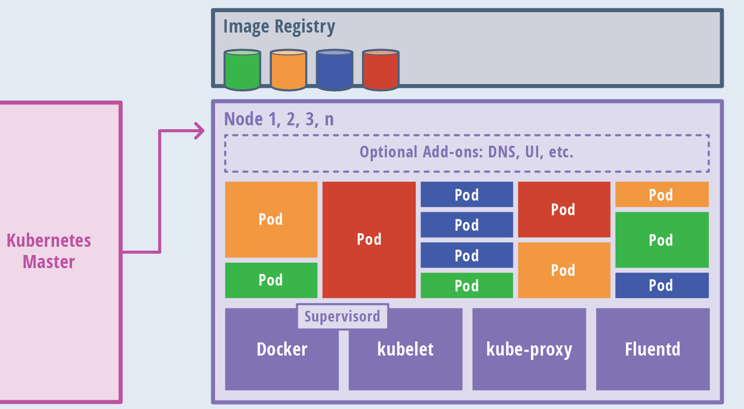
COE Not Always Required ?

Slide 10
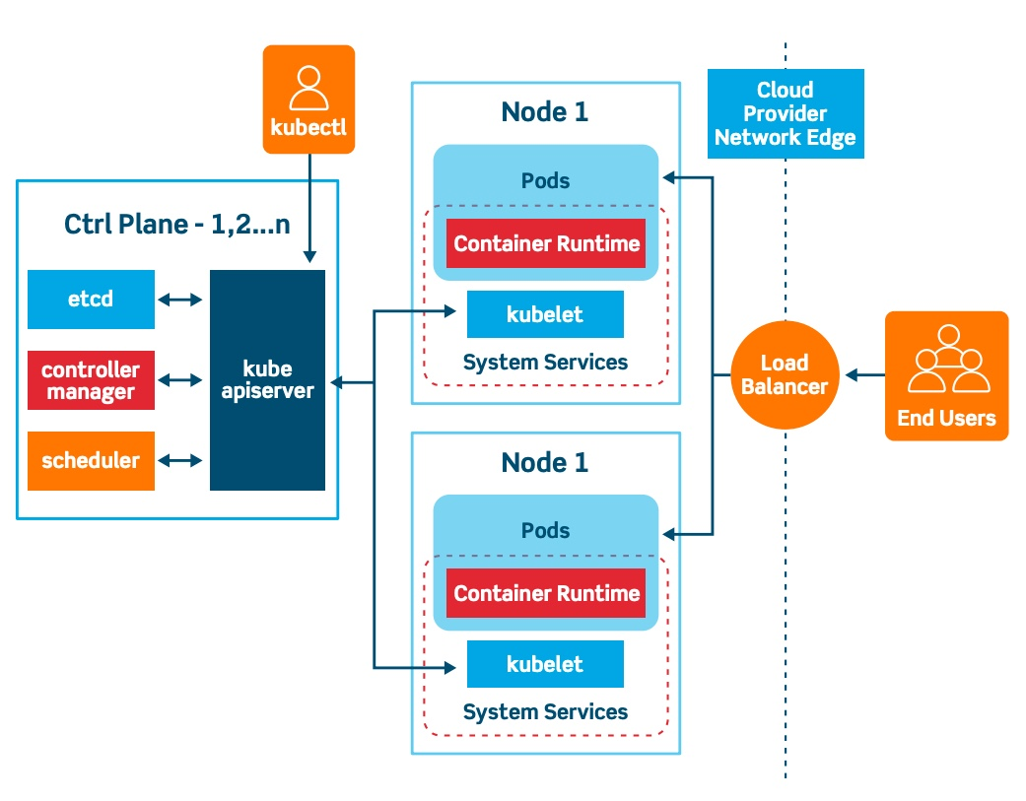
Kubernetes Arch

Slide 11
History of Serverless
2012 -used to describe BaaS and Continuous Integration services run by third parties
2014 -AWS launched Lambda
2015 -AWS launched API Gateway
2016 -Serverless Conference

Slide 12
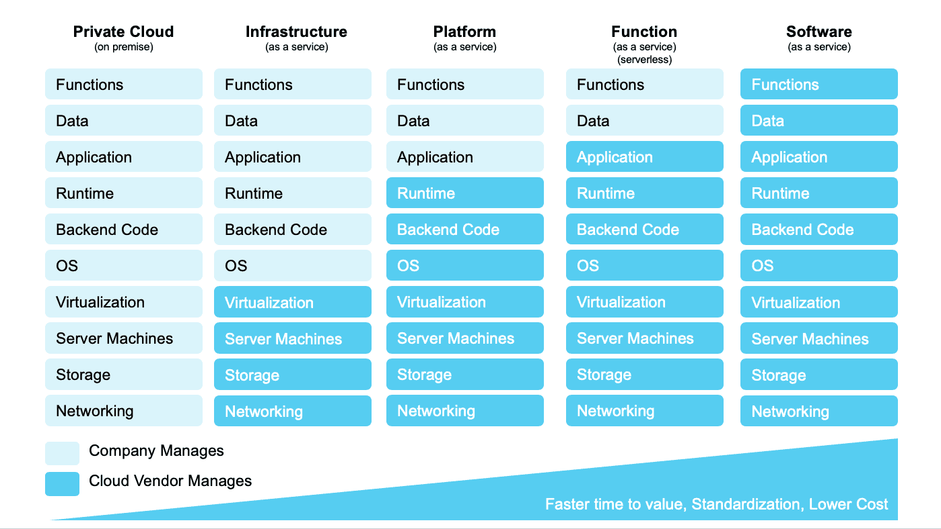
Serverless SRM
Source: unraveldata.com

Slide 13
FaaS vs PaaS ?

Slide 14
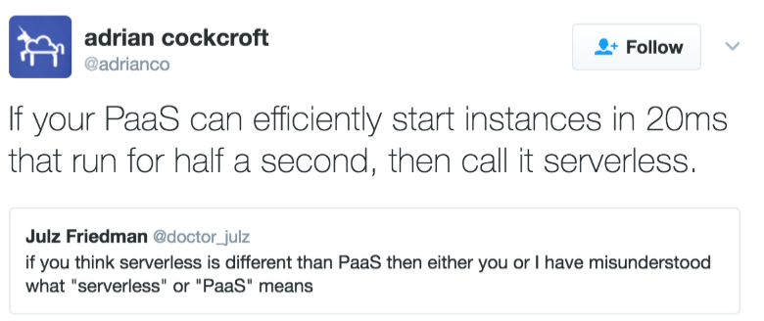
FaaS vs PaaS

Slide 15
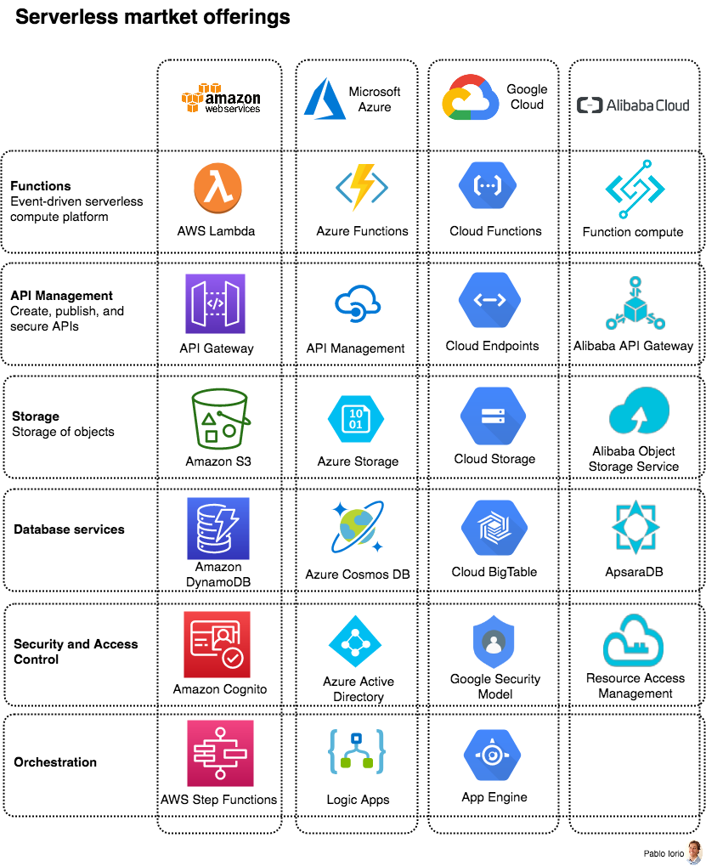
Market Serverless Offerings

Slide 16
State of Serverless in CNCF is Serverless

Slide 17
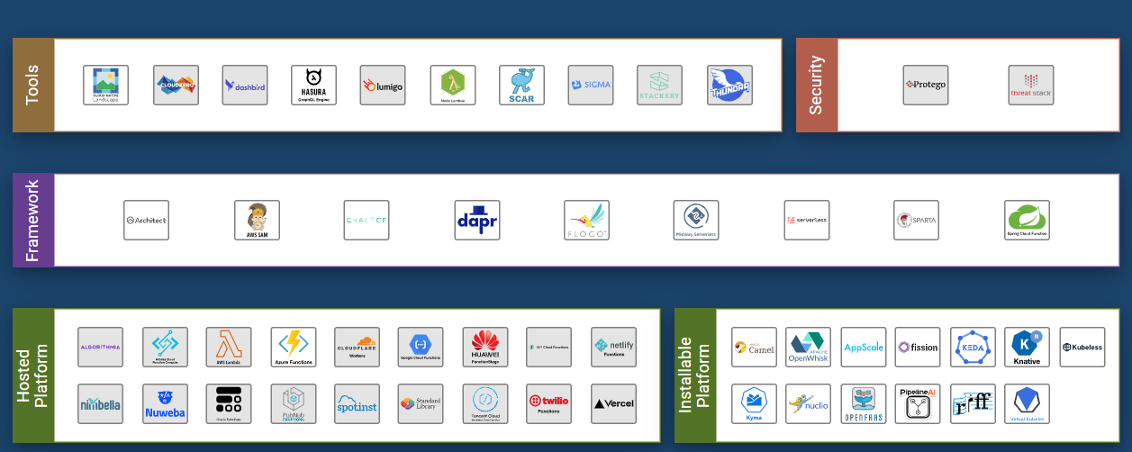
State of Serverless in CNCF is Serverless
https://landscape.cncf.io/format=serverless

Slide 18
Serverless Application Use Cases

Slide 19
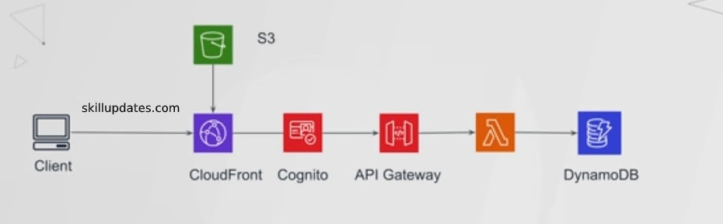
Web Applications and Backends
Reference Architecture: Sample code
Example: Weather application
https://github.com/aws-samples/lambda-refarch-webapp

Slide 20
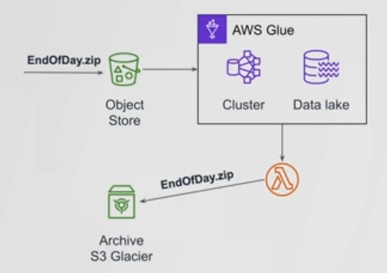
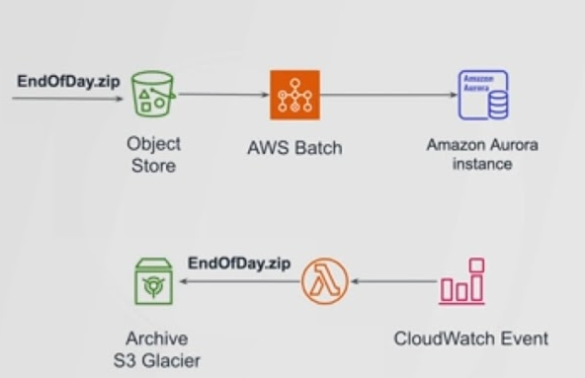
Batch Application

Slide 21
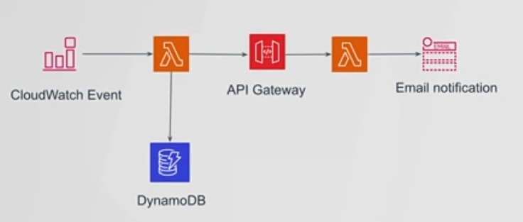
Event Driven Application
Event Triggers
Faster Start-up time
Event Based Triggers
Stateless
Cloud Vendor Based
Pricing

Slide 22
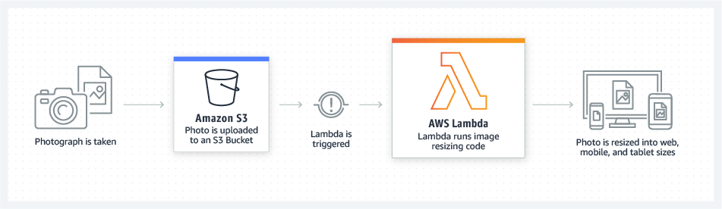
Data processing
Reference Architecture: Sample code
Example: Image Thumbnail Creation
https://github.com/awslabs/lambda-refarch-fileprocessing

Slide 23
When to use Serverless? When to use k8s?

Slide 24
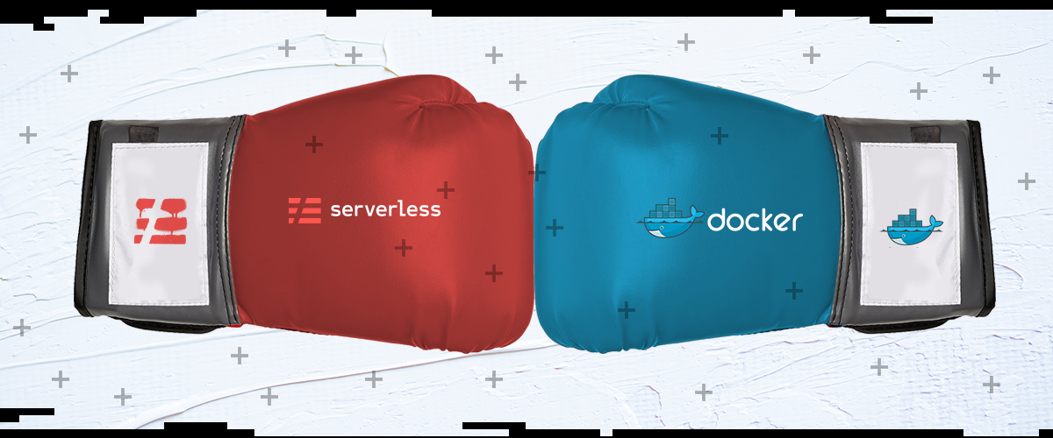
Source: medium

Slide 25
Source: medium

Slide 26
Serverless vs Container
Serverless
Container
Container technology enables you to scale
Containers are vendor-agnostic
Full flexibility and control
Minimum overhead
Requires minimal infrastructure provisioning
As you pay per function execution
There’s no worry about scalability
Super Power - Easier to onboard focus on solving business problem from get go
Super Power - Complete control of environment rich echosystem

Slide 27
Serverless vs Container
Serverless
Container
Data inside a container disappears forever
OpenShift only works with the Kubernetes orchestrator
Applications that don’t require a graphical interface
“black box” technology
Application grows, the complexity of troubleshooting explodes
always depends on a third party vendor
Sometimes can be Very tricky to get right and typically requires significant upfront human resource costs

Slide 28
Money Matters
Serverless
Container
3 million/month ,512 Memory, 300 ms execution time , Unpredictable traffic
$148.67/month (CP) + $15 (t3.small worker node) = $163.67/month
cost will increase during higher spike coz of scaling
90 million/month ,512 Memory, 250 ms execution time , predictable traffic
$148.67/month (CP) + $29 (t3.medium worker node) = $177.67/month
3 million/month ,512 Memory, 300 ms execution time , Unpredictable traffic
$7.67/month
90 million/month ,512 Memory, 250 ms execution time , predictable traffic
$230/month

Slide 29
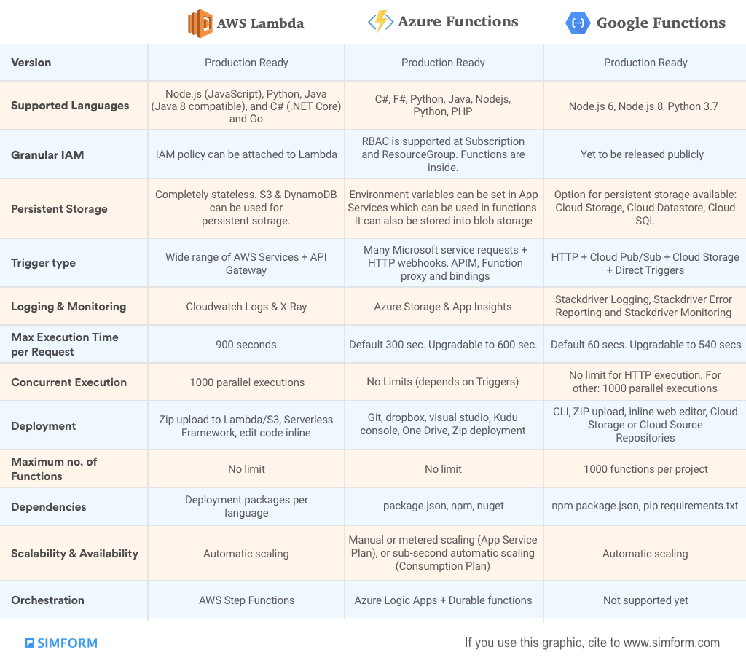
FaaS Offerings Comparison
Source: simform.com

Slide 30
Demo Time

Slide 31
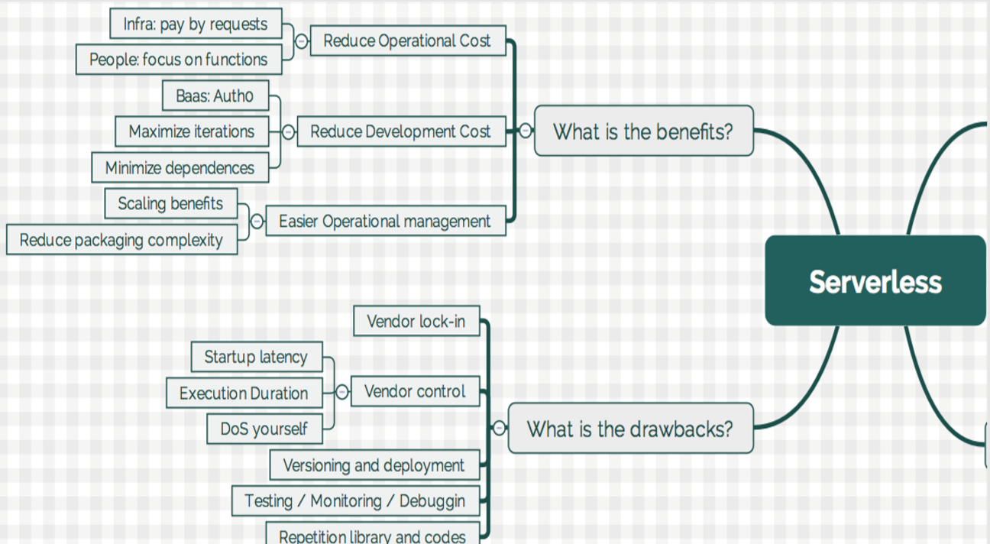
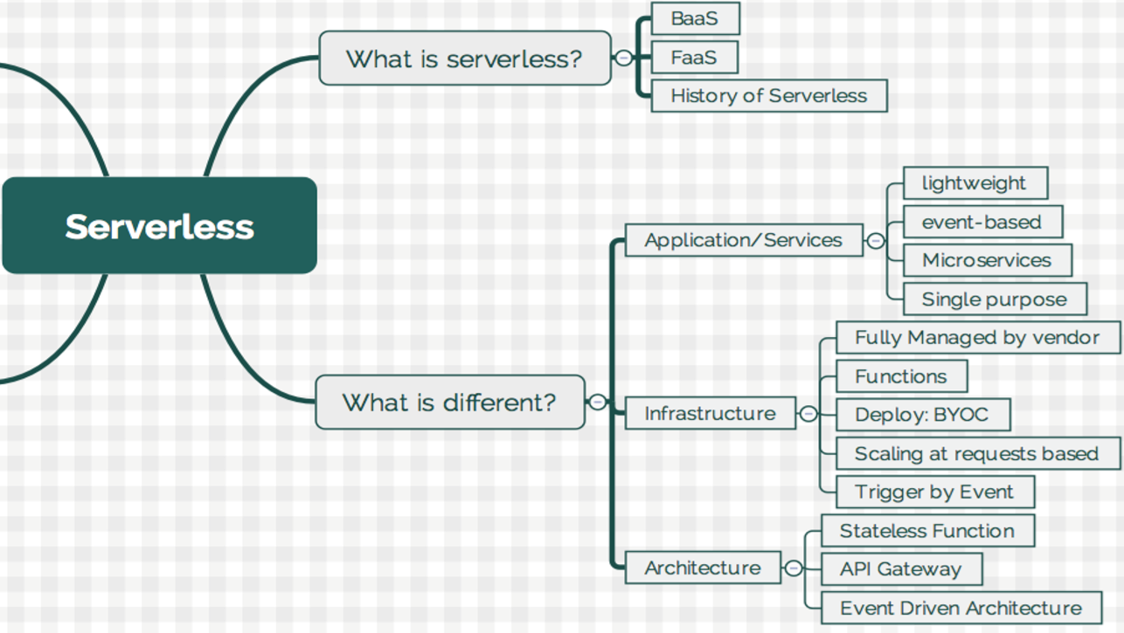
Serverless 101

Slide 32
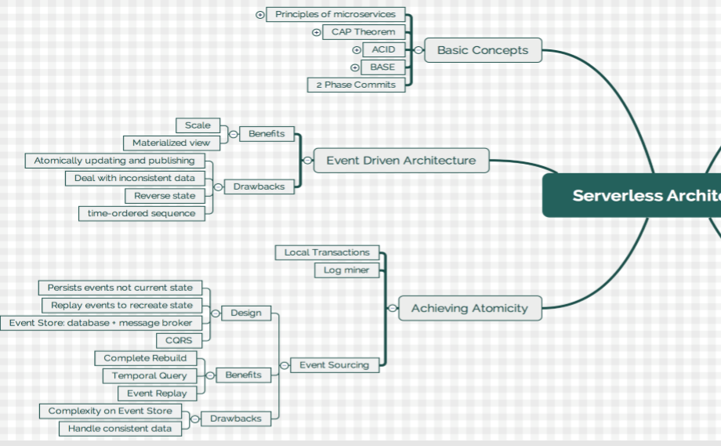
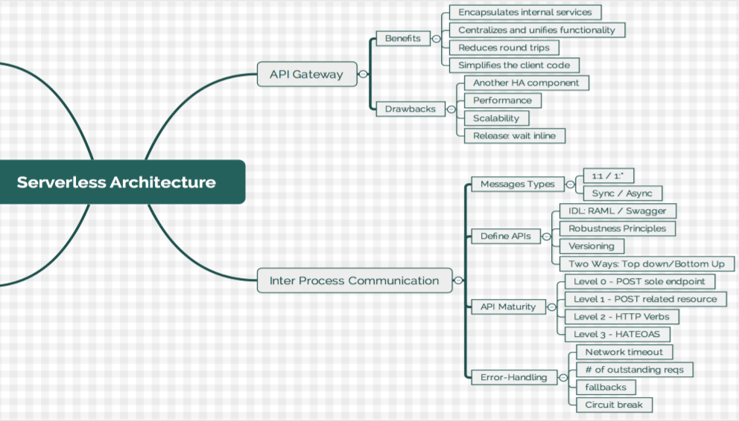
Serverless Arch

Slide 33
Functions into apps
I want to sequence functions
I want to select functions based on data
I want to retry functions
I want try/catch/finally
I have code that runs for hours

Slide 34
Upcoming session.. Agenda
Step functions
Understanding of “Lambda Layers”
Migration Strategies
Demo (Installable FaaS platform)

Slide 35
THANK YOU
www.comviva.com
CONFIDENTIAL AND PROPRIETARY
All trade marks, trade names, symbols, images, and contents etc. used in this document are the proprietary information of Comviva Technologies Limited. Unauthorized copying and distribution is prohibited.
© 2019 Comviva Technologies Limited. All rights reserved

