Slide 1
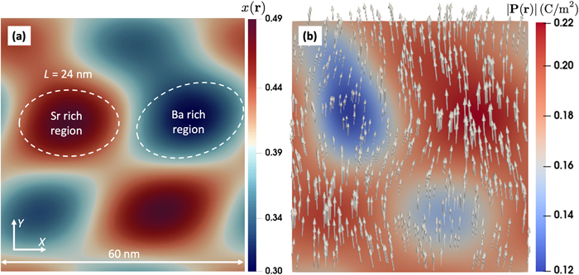
From: Modeling structure–properties relations in compositionally disordered relaxor dielectrics at the nanoscale
J. Appl. Phys. 134, 104102 (2023)
^{Date of Download: 5/21/2026}
Copyright © 2026 . All rights reserved.
Notes:
Figure Legend: (a) Periodic composition field x ( r ), generated for x = 0.4, δ x = 0.1, L = 24 nm. The dimensions of the simulation box are 60 × 60 nm. Dashed white lines highlight approximate boundaries of the Sr- (red) and Ba-rich (blue) regions. Orientation of the global Cartesian reference system axes ( X , Y ) is also shown. (b) An equilibrium state of the P ( r ) field, computed at E ≡ 0 and T = 265 K, corresponding to the composition field in panel (a). Variations in the magnitude of the local polarization indicate that the Ba-rich areas (red) are polarized more strongly than the Sr-rich areas (blue). Slight bending of the field vectors (shown by the white arrows) is present at the boundaries between the regions.

