Slide 1

CONCORDIA
Team Name: TRidents
Team Leader: Ashok Jangam
DIFFERENT TEAMS. SAME TRUTH.
Team Size: 4
Problem Statement 5: Supply Chain Ontology and Governed Analytics
Simulated manufacturer. Five metrics. One answer for every team.

Slide 2

One question. Six source systems. Too many answers.
Mid-size discrete manufacturer · supply chain leadership, procurement, logistics, planning and finance
“What was our on-time delivery in May?”
What it costs today
• Review meetings open by reconciling numbers, not deciding
• Month-end numbers move later with no record of why
• Chat over raw tables invents a sixth answer
• Cost and audit data leak to people who should not see them
Procurement
ERP
on time = received by the PO need date
Logistics
TMS
on time = left the dock by carrier pickup
Customer service
CRM
measured against the latest revised promise
Planning
WMS · MES
last night's snapshot, different part numbers
Concordia: each metric defined once, computed once in Snowflake, the same for every team, with its evidence attached.
Finance
ERP
missing freight booked as zero cost
Team definitions are illustrative of common practice, not measurements of a specific company.

Slide 3
Architecture: one governed path from source record to answer
Snowflake-native end to end · the language model routes and narrates, SQL computes every number
SOURCES
LAND
CORE
APP
EXPERIENCE
ERP orders · costs
RAW_RECORD
append-only, hashed
Stream + Task
Quarantine · 111
Identity resolution
Ontology: part · party ·
facility · geography
Ledger + knowledge graph
Metric SQL M1–M5
Published grid
19 as-of points
Persona-masked
secure functions
Semantic view
Streamlit in Snowflake
7 pages, owner role
MES production
WMS stock · holds
Ask Concordia
Analyst + SQL guard
TMS shipments
CRM promises
Cortex Analyst
ontology-first answers
IoT docks · lots
Synthetic world
seeded simulator, 2 batches
GOV metric contracts (versioned, hashed) · entitlements · rejected aliases · evidence · query audit · pipeline runs
Roles: ADMIN builds, TRANSFORM runs the task, APP_OWNER (never ACCOUNTADMIN) owns the app and uses governed interfaces.

Slide 4
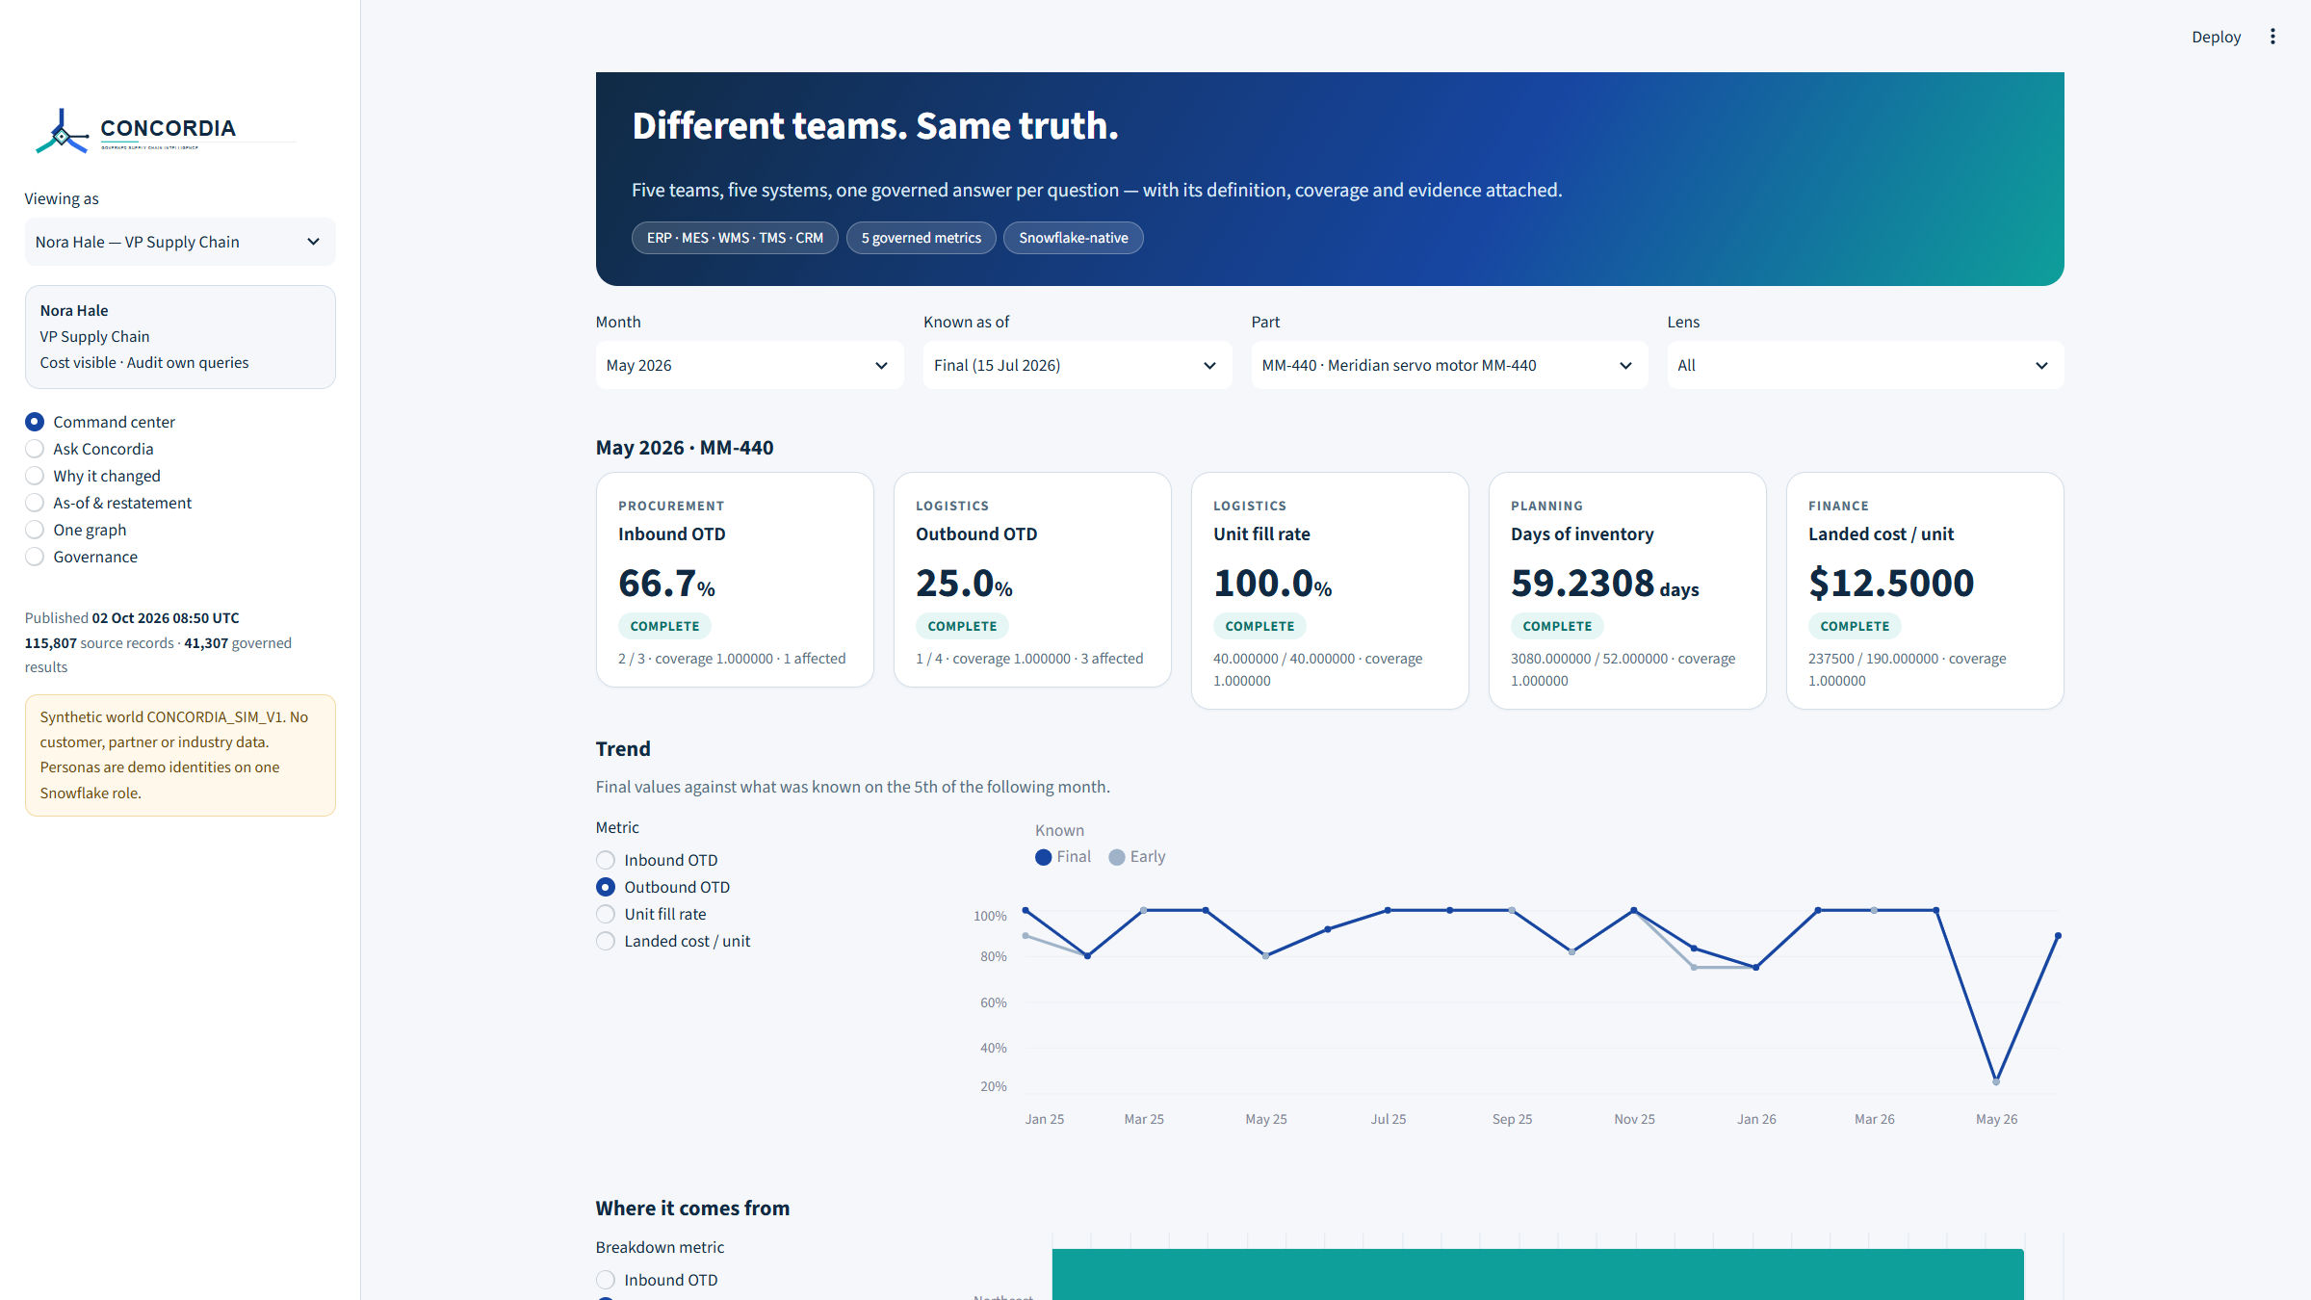
What every team gets: one number, its definition, its evidence
Live Streamlit in Snowflake app over the governed APP layer
1
Five governed metrics
Supplier OTD, customer OTD, fill rate, days of inventory, landed cost. Versioned, hashed contracts.
2
Ask over the ontology
Cortex Analyst generates semantic SQL; a guard proves metric rows against the exact published scope.
3
Ambiguity is refused
Bare “OTD” asks inbound or outbound. “OTIF” is rejected. Missing cost stays incomplete.
4
As-of replay
What was known on the 5th versus final, and what each late load restated.
5
Cross-domain evidence
Supplier-to-customer paths, substitutions, lots, production consumption and synthetic IoT dock events.
Screenshot: Command center as the VP Supply Chain persona, MM-440, May 2026, final as-of. Synthetic data.

Slide 5
End to end, verified on the deployed account
Synthetic world CONCORDIA_SIM_V1 · two extract batches · every check re-run against live Snowflake
Generate
126,073 records
Land
stream + quarantine
Resolve
one part, one party
Compute
SQL metric functions
Publish
43,948 results
Ask
evidenced answer
35/35
103/103
8/8
14/14
golden checks
grid samples
hero checks
security checks
SQL equals the independent Python reference
published rows equal a live function call
including the restated landed cost
masking, alias refusal, role isolation
Hero: MM-440 servo motor, May 2026, one answer for every team
Supplier OTD
Customer OTD
Fill rate
Landed cost, 5 Jun
Landed cost, 15 Jul
2/3 · 66.7%
1/4 · 25.0%
40/40 · 100%
INCOMPLETE
$12.50 per unit
All data is synthetic. Parity checks prove consistency, not business impact; time saved and accuracy on real ERP data are not measured.

Slide 6

CONCORDIA Different teams. Same truth. github.com/ashokjangam/snowcore-pdm

