Slide 1
GEO_Spatial
File created on: 24/09/26 7:34:28 pm IST

Slide 2
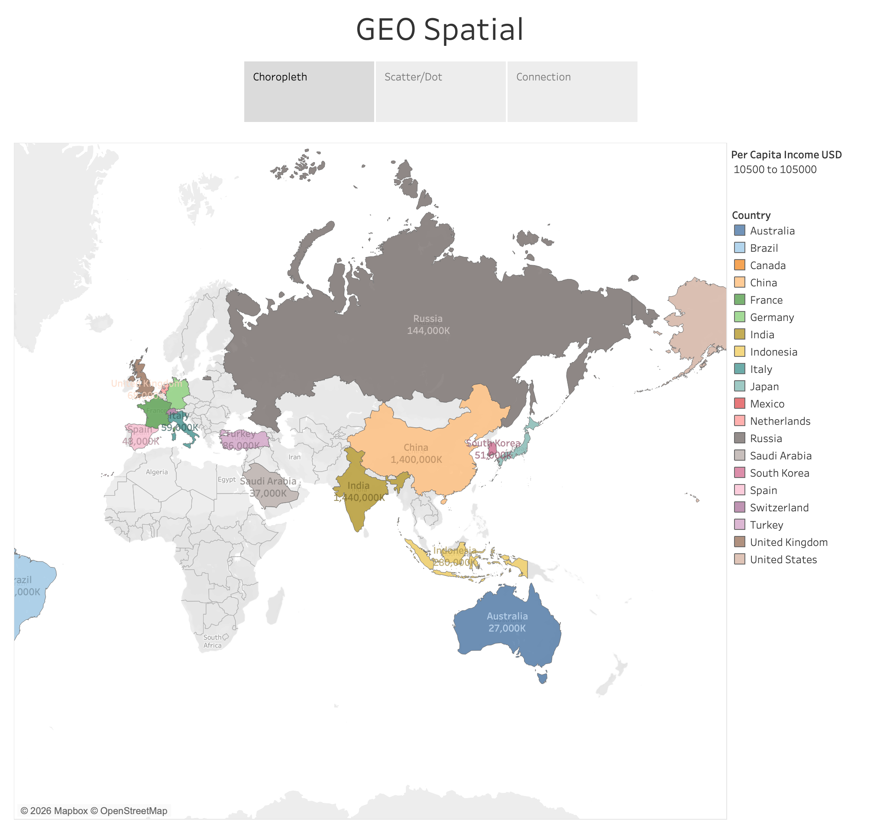

Slide 3
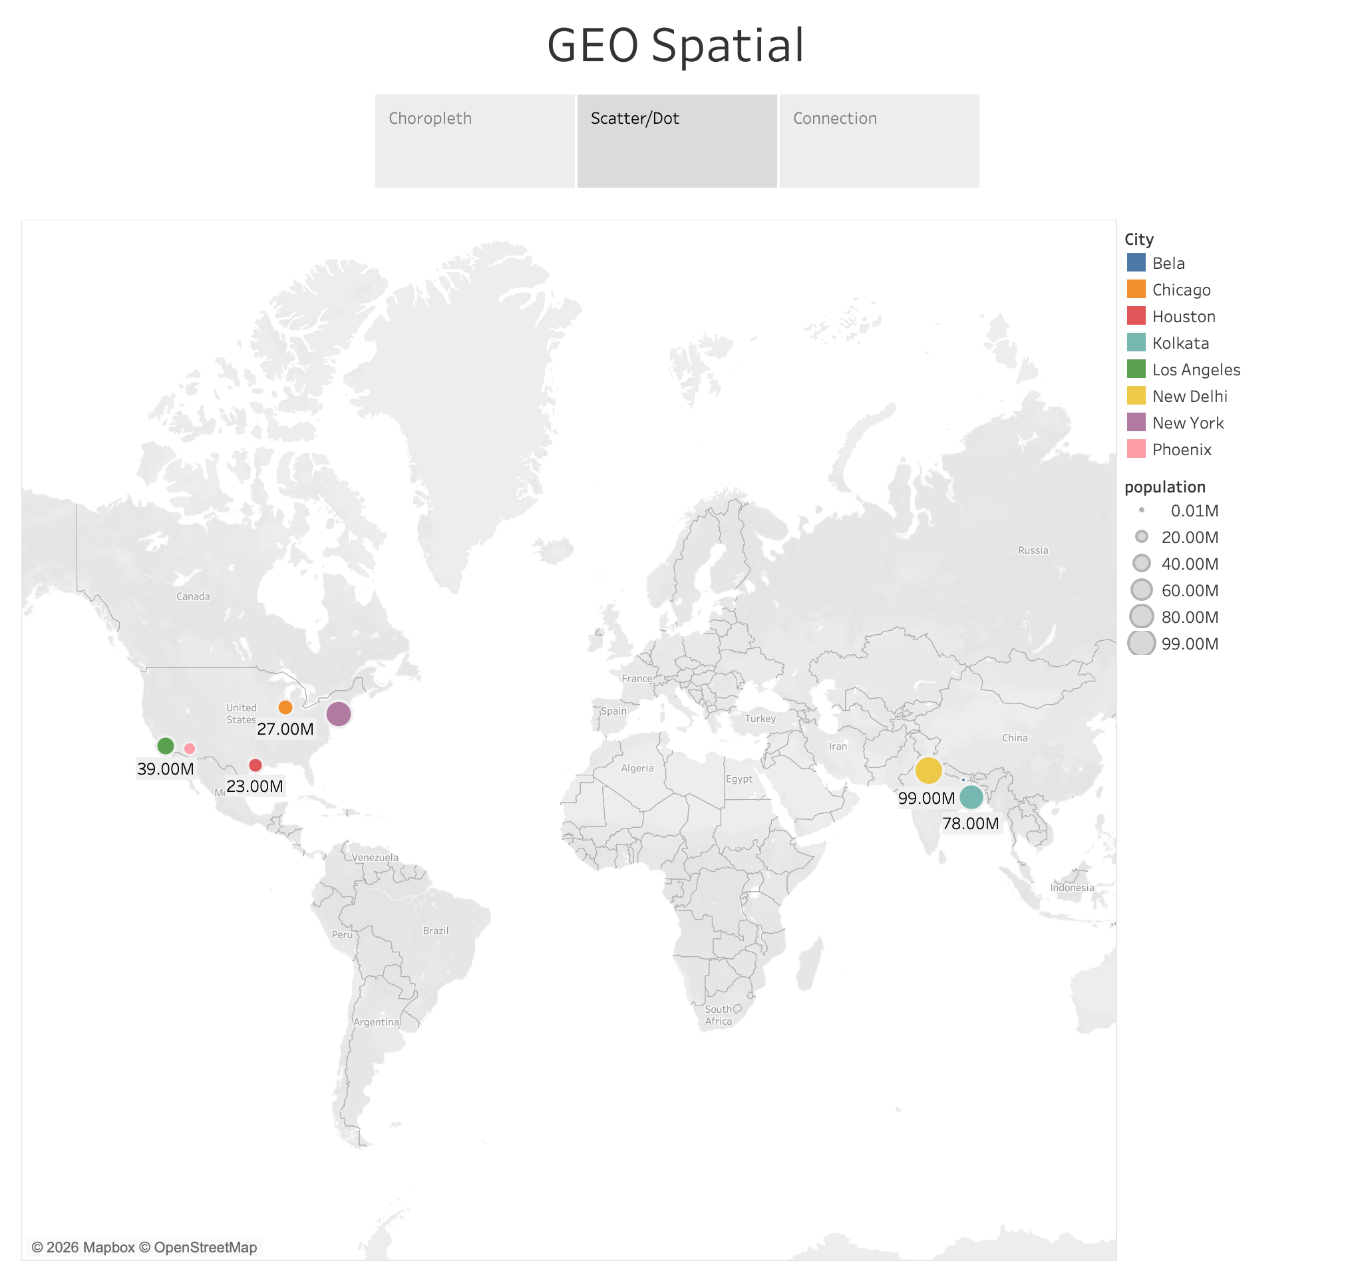

Slide 4
