Slide 1
ThreeD
File created on: 23/09/26 10:13:34 pm IST

Slide 2
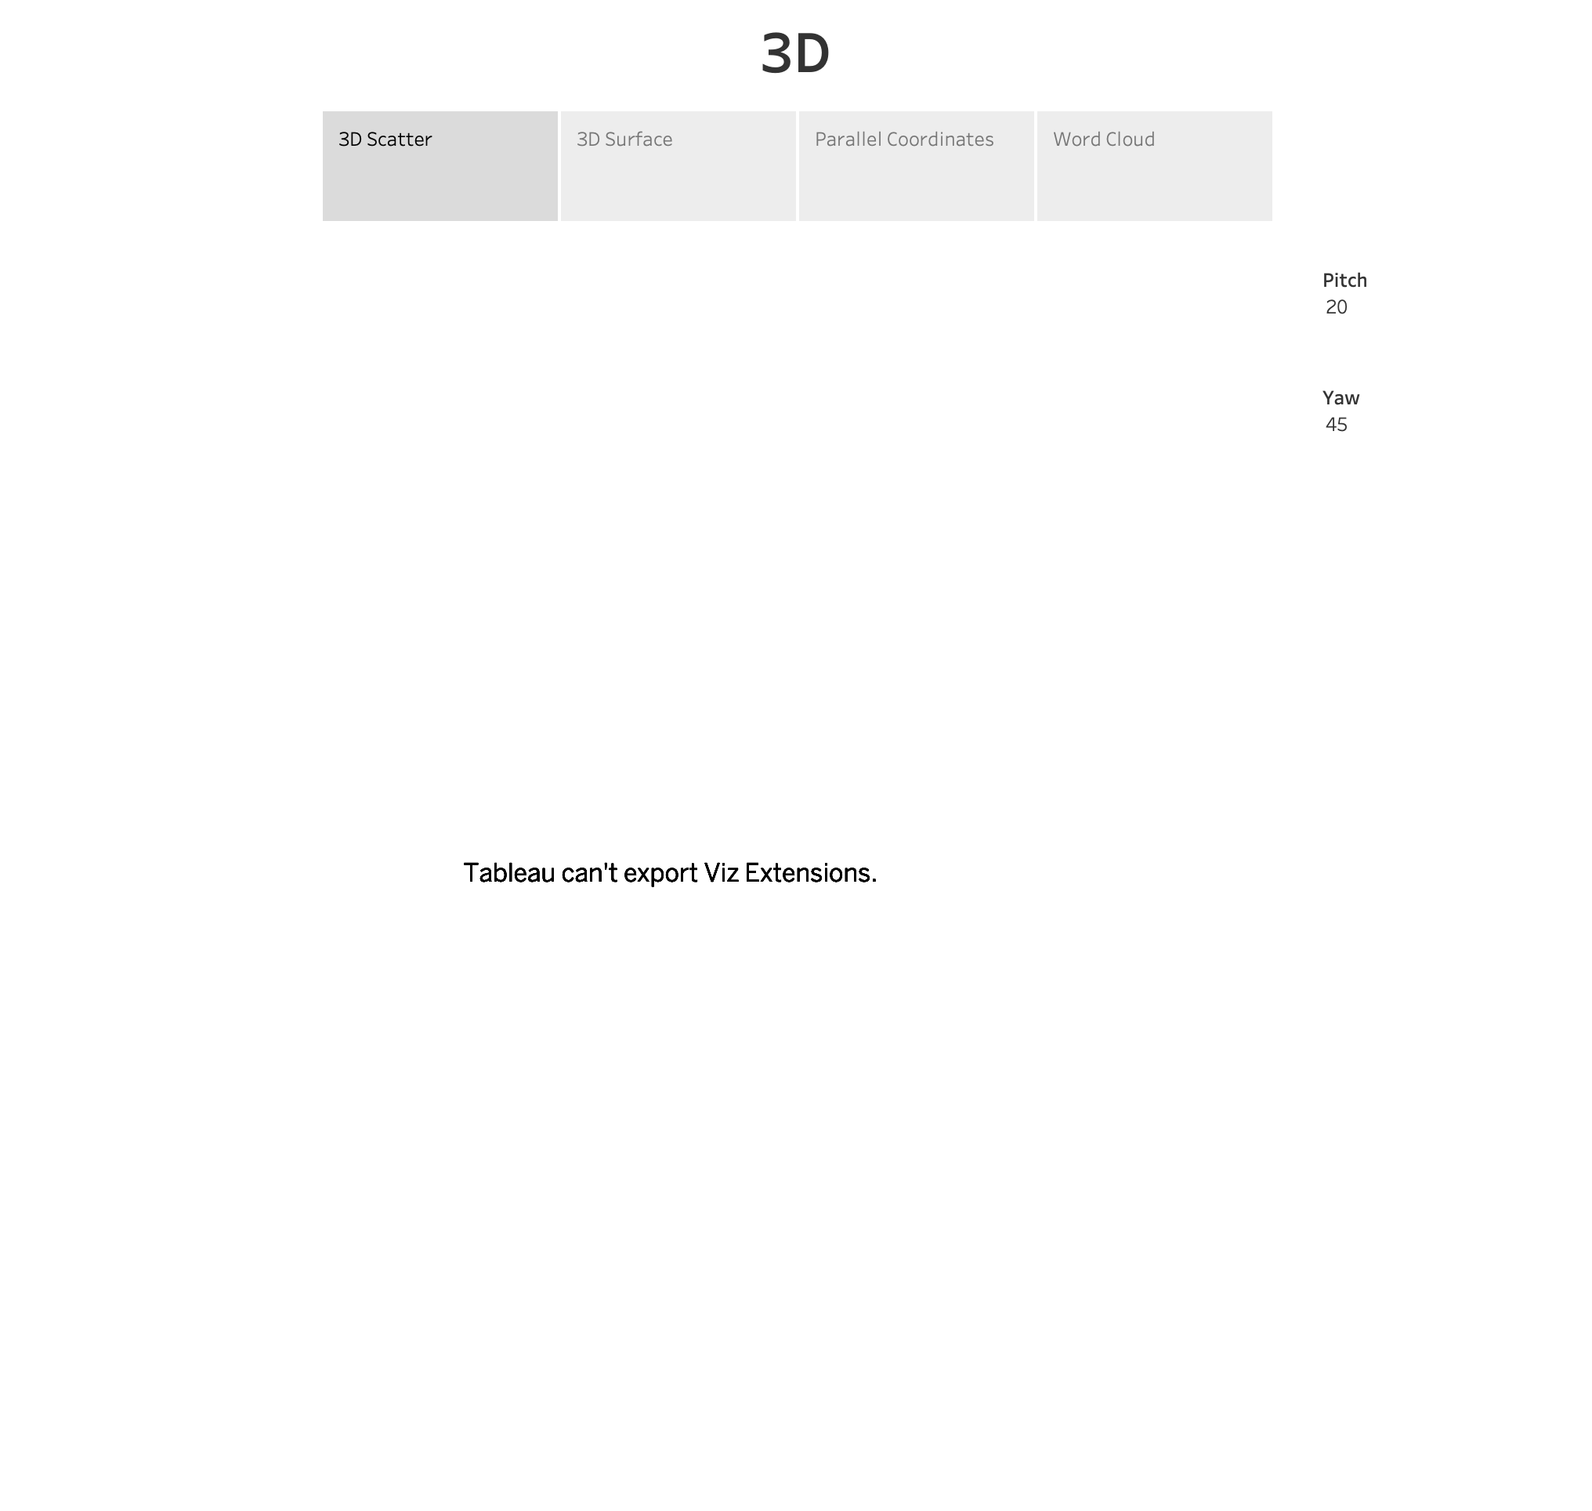

Slide 3
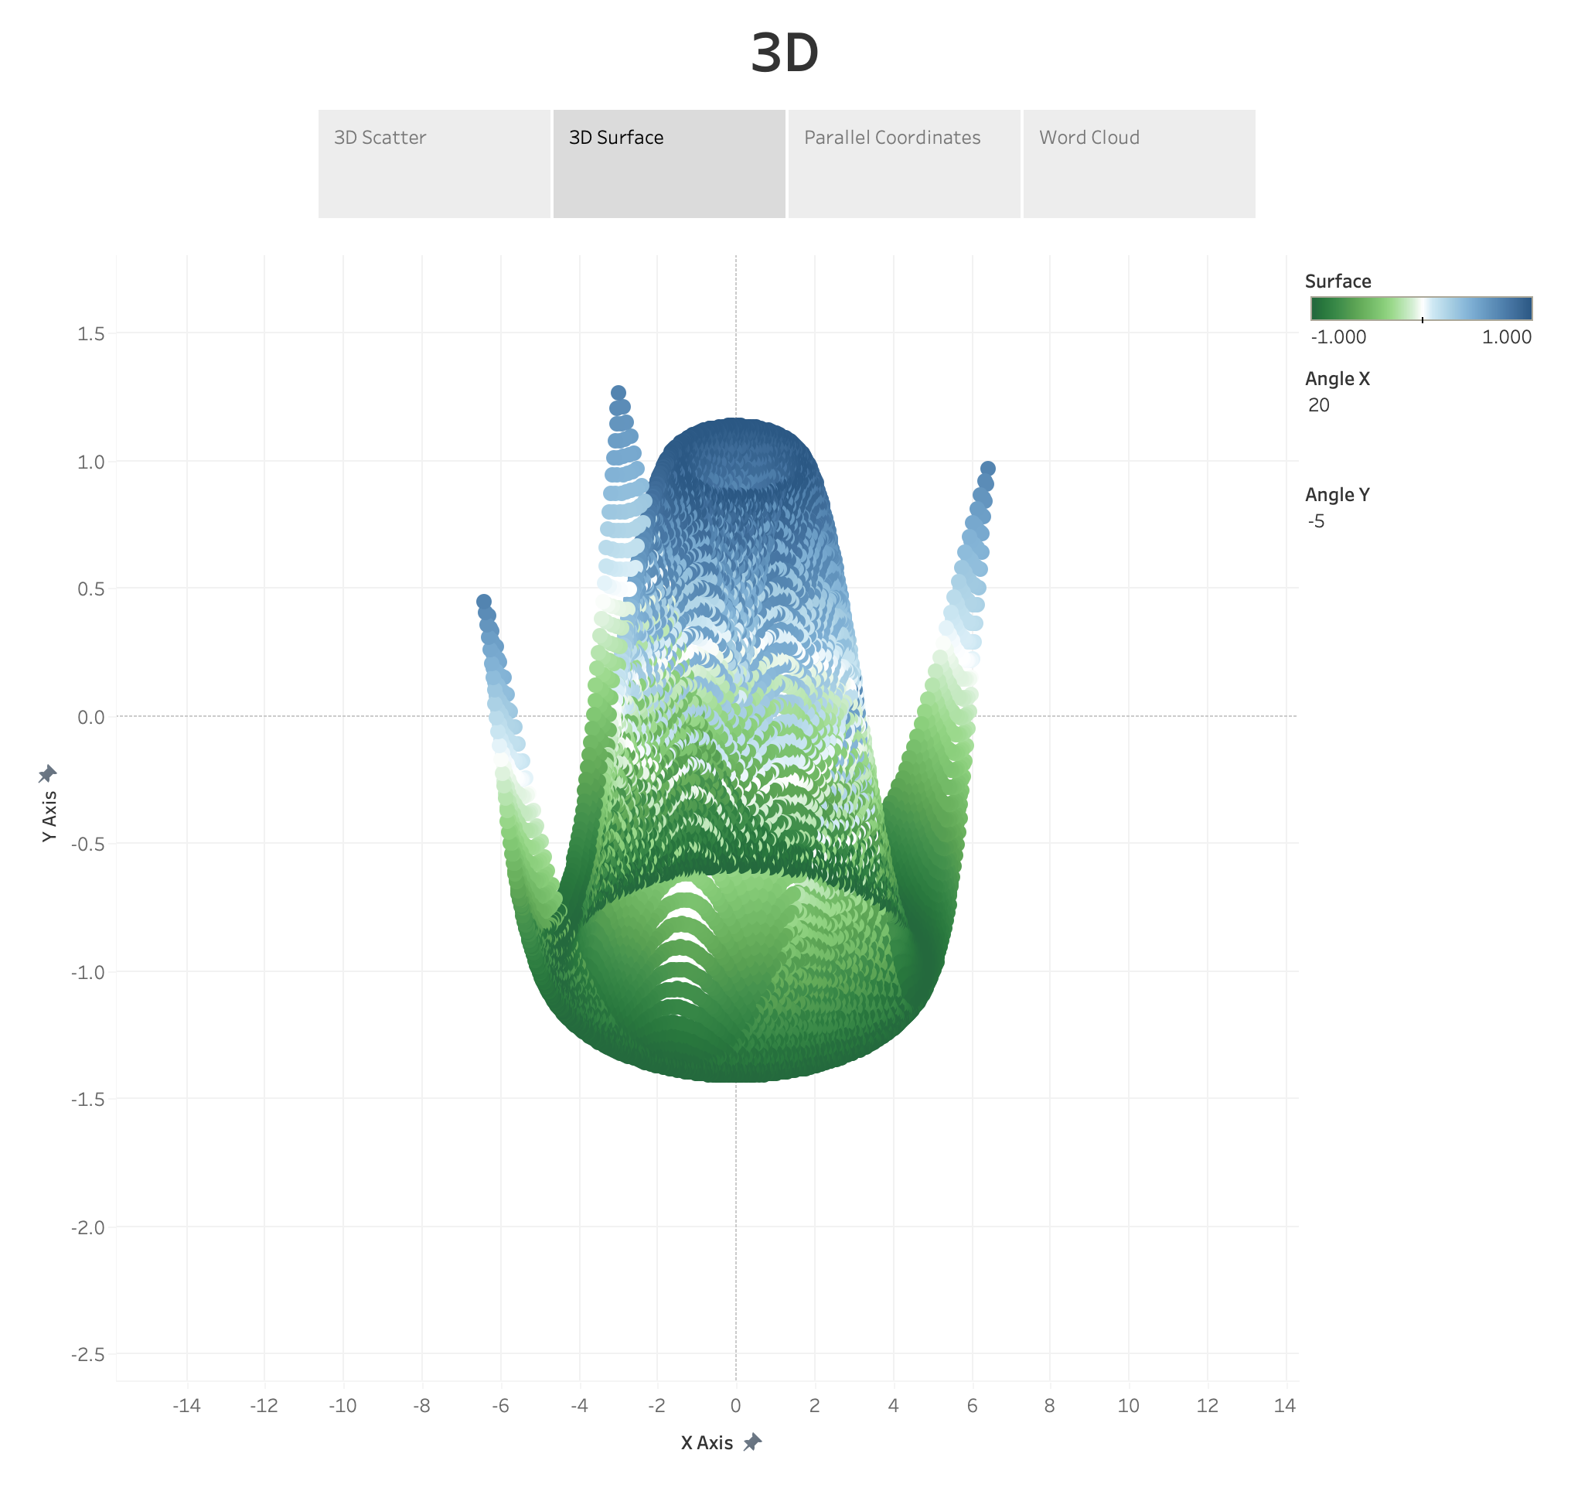

Slide 4
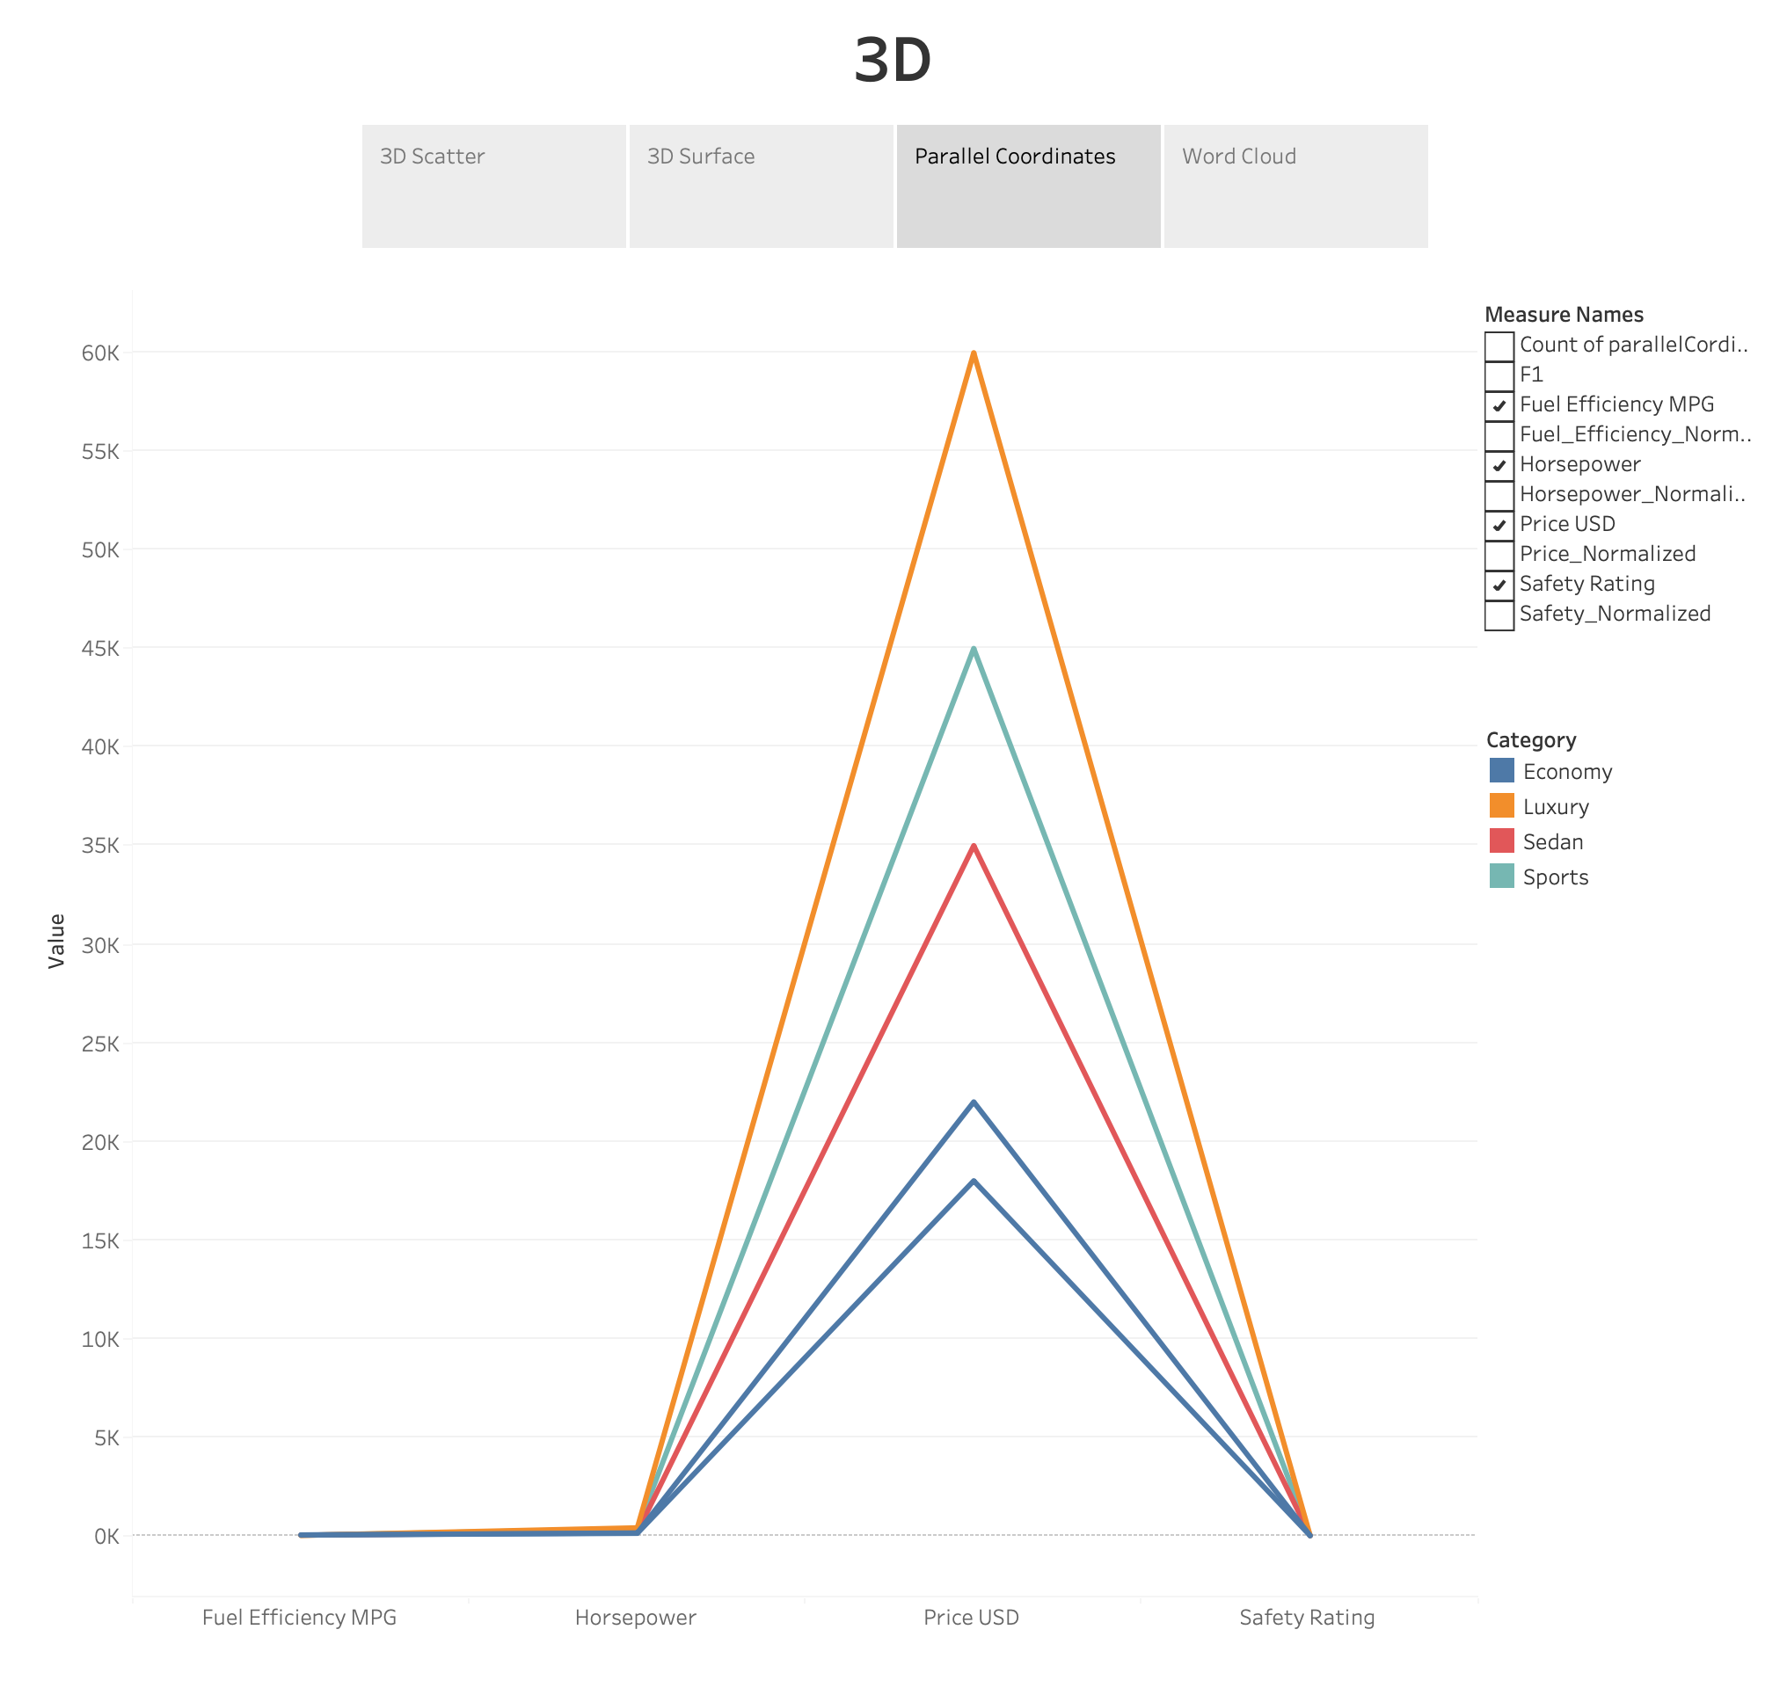

Slide 5
