Slide 1
P2W
File created on: 23/09/26 3:55:50 pm IST

Slide 2
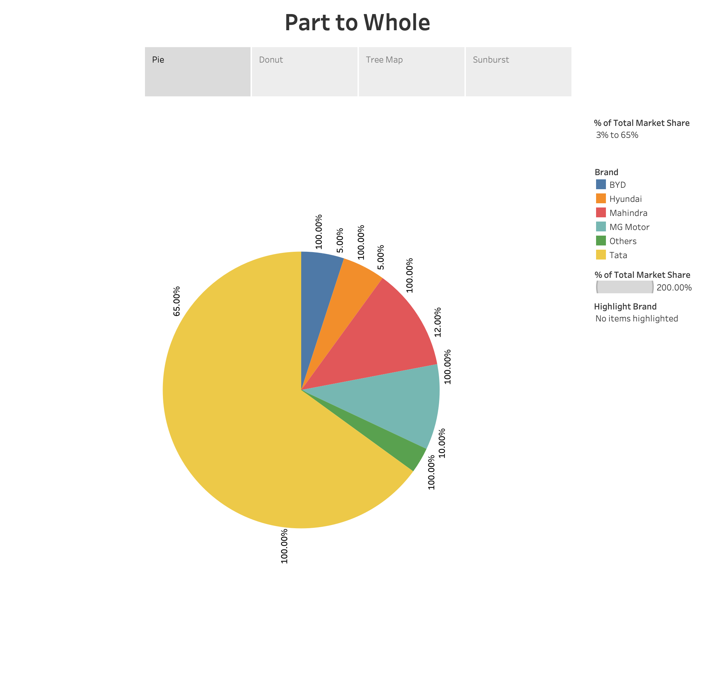

Slide 3
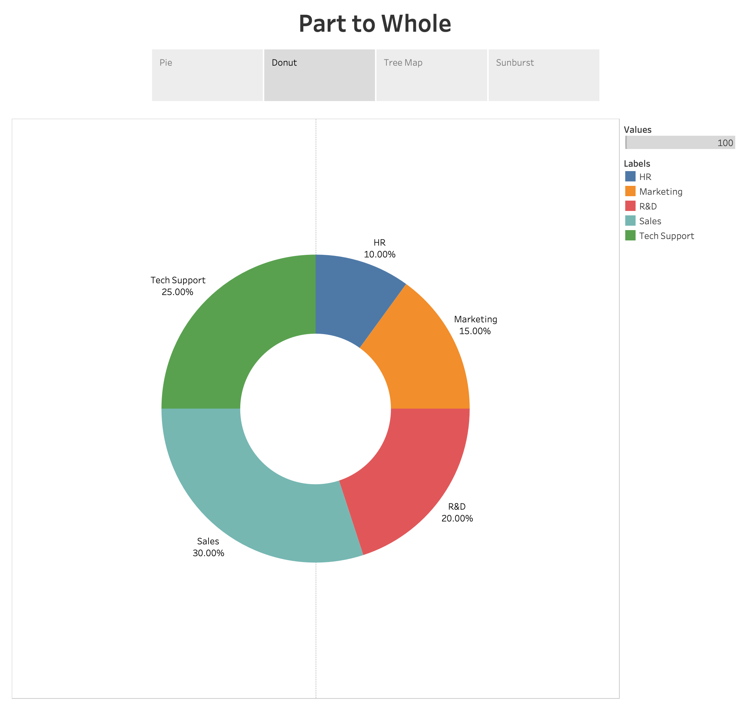

Slide 4
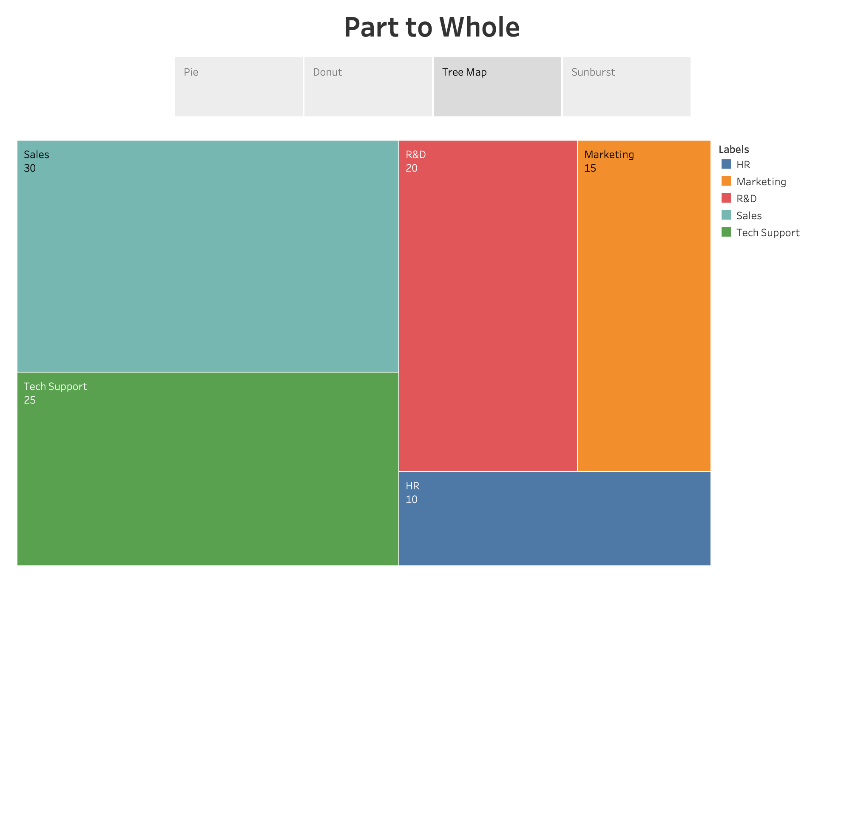

Slide 5
