Slide 1
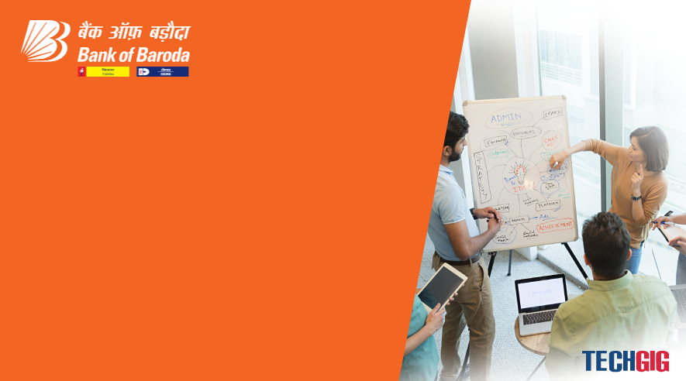

Bank of Baroda Hackathon - 2022
Technology Partner
Your Team Name : R2D2
Your team bio : We are RPA enthusiast believes in IT industrial revolution
Date : 09/11/2022

Slide 2
Problem Statement?
Why did you decide to solve this Problem statement?
Cheque processing is a highly error prone process which comes with heavy cost for a company.
With recent development in AI and ML it’s possible to handle this automate via RPA and other technologies.

Slide 3
User Segment & Pain Points
Which user /advertiser segment would be early adopter of your product & why?
Banking and other cheque processing companies.
Because cheque processing is commonly used process and widely done in banking and finance industry.

Slide 4
Pre-Requisite
What are the alternatives/competitive products for the problem you are solving?
There are no requirment centric solution for available for the same.

Slide 5
Azure tools or resources
Azure tools or resources which are likely to be used by you for the prototype, if your idea gets selected Microsoft OCR(Optical character recoginisation) technology Microsoft Azure

Slide 6
Any Supporting Functional Documents
Present your solution, talk about methodology, architecture & scalability
We are planning to use RPA UiPath tool for solving this problem. RPA UiPath comes with inbuilt Microsoft/Google and other OCR technology. Provides high secure and easy scalability.
Post deployment support and guaranteed up time for it’s server.

Slide 7
Key Differentiators & Adoption Plan
How is your solution better than alternatives and how do you plan to build adoption?
While most of the available AI and ML based solutions are open source and do not provide any guarantee against security.
We propose you enterprise solution which can be easily trusted by banking sector.

Slide 8
GitHub Repository Link & supporting diagrams, screenshots, if any
How far it can go?

Slide 9
Thank You
Ashok Kumar Kalbhor
Bhavana Pawar

