Slide 1
Talent Journey Automation Internship
Hi Talent
Presented by,
Ashok Khandhar

Slide 2
About the compuny
“HiTalent is a startup that is on a mission to help students & young professionals upgrade their skills and get a job in the IT sector.”
Programming languages using:
JavaScript, Java, python
Technologies using:
Git-GitHub, Rest-Api, Docker, docker-compose, AWS
Learning:
Backend (node.js)
frontend (Angular)
freecodecamp (responsive web designing)

Slide 3
Journey of internship
01
04
Git-GitHub
docker-compose
02
05
Rest-Api
Redis with node
03
06
Docker
MySQL with node
Learning of git commands and GitHub functionalities
Building images with together
Rest-Api using node.js
Attached cache with rest-Api
Docker, creating images and containers
Attached database with rest-Api

Slide 4
07
10
MySQL & Redis with node
freecodecamp
08
Cloud uisng AWS
09
frontend
Cache and database with rest-Api
Responsive web designing
Cloud and hosting application on AWS
Learning Angular for frontend
Working with Angular

Slide 5


Git-GitHub
Learned about Git and GitHub and worked on it.
Learned Git commands and Interaction with GitHub using Git.
Created personal branch from Company's official repository using Git.
Uploaded one simple hello world file on GitHub using Git.
repository contains roadmap for internship and personal branch saves all work during the internship.

Slide 6
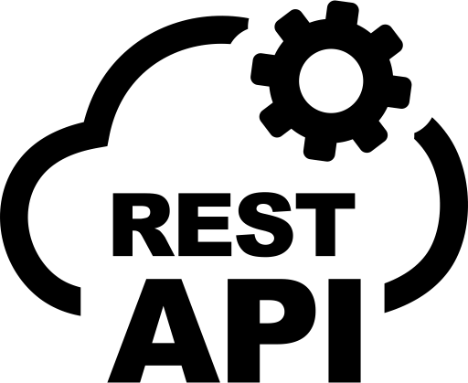
Rest-Api
Learned core JavaScript, Node.js for Rest-Api
Created Simple Rest-Api using node.js
Api simply print hello world.
Created Rest-Api support parameter name as argument.
Api take name as parameter and print it on screen.
exposed rest API using ngrok.

Slide 7

ngrok
To host application publicly
Expose local port to public DNS
Hosting from local devices

Slide 8
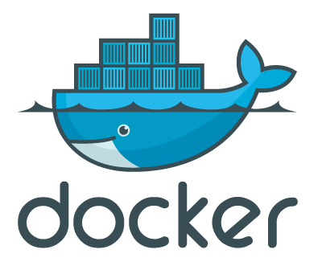
docker
Learned about docker commands and docker Hub
Created docker image of rest-Api and uploaded on docker Hub.
Learned about docker-compose.

Slide 9

docker-compose
Docker-compose for creating multiple container
For integrate cache and database with node on docker

Slide 10

Cache with node
Learned about Redis for caching.
Integrated with node.js
Exposed with docker-compose

Slide 11

database with node
Learned about MySQL for database.
Integrated with node.js
Exposed with docker-compose

Slide 12
Database & cache with node
Integrated database & cache with Rest-Api
Exposed with docker-compose

Slide 13

Cloud hosting using AWS
Exposed api application on cloud using AWS
Learned how it work.
Created EC2 instance
Upload code files using File Zilla
Authenticate using keypair
Run and exposed instance using docker-compose

Slide 14

frontend
learned about frontend using Angular for auth
Created simple authenticate Angular app
Use cookies for authentication

Slide 15

freecodecamp
Learning Responsive Web Design from freecodecamp Basic HTML and HTML5 Basic CSS Applied Visual Design
Projects:
Tribute page
survey form

Slide 16
Thank you

