Slide 1
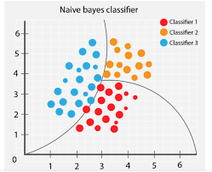
STUDENT GRADUATE PREDICTION BY USING
NAIVE BAYES CLASSIFER
Presented by
Guided by
P Jahnavi (20NG1A05B5)
K Pavani (20NG1A0588)
SK Gouse Babu (20NG1A05B7)
K Ashok Babu (21NG5A0508)
T Naga Mounika
Submitted for the partial fulfillment of
Bachelor of Technology in
Computer science & Engineering
Department of Computer Science & Engineering
Month - Year

Slide 2
Content
Abstract
Introduction
Literature survey
Data Set
Algorithm
Implementation
Output
Conclusion
Applications
References
Title of project
Month - Year
2

Slide 3
1. Abstract
Student graduation is important in the accreditation assessment process. Because student graduation there are standards that must be Achieved by the Study Program items, namely a four-year study period and a 3.0 GPA.
Therefore we need a prediction that can Anticipate from the beginning of the graduation standard level that has been set.
This study aims to predict student graduation using Naïve Bayes Classifier with a data mining approach. Naïve Bayes provides accurate prediction results with a minimum error rated compared to all other data mining components.
With the prediction of the student, graduation can be used as input, especially the Information System Study Program in making policies for improvement in the future.
Keywords: predicted, data mining, Naïve Bayes classifier
Title of project
Month - Year
3

Slide 4

2. Introduction
Graduation is one of the supporters of the items in the assessment
of study program accreditation.
Especially for the Information Systems Studies Program Faculty of Computer Science, with satisfactory results.
Currently majoring in Information Systems have not been able to predict students who graduate on time or not .
Based on the number of students who entered should be proportional to the number of students who graduated in the class as well as the anticipation of students who do not graduate on time
Graduation
Graduation Prediction
Data mining approach
Classification method
Naive Bayes classification method
Title of project
Month - Year
4

Slide 5
3.Literature survey
l
Literature References
1.Prediction Graduate Student using Naïve Bayes:
A Naïve Bayes Classifier is a term dealing with a simple probabilistic classification based on applying Bayes' theorem.
In simple terms, a Naïve Bayes Classifier assumes that the presence (or absence) of a particular feature of a class is unrelated to the presence (or absence) of any other feature.
Naïve Bayes is a statistical classification technique that can be used to design a possibility in the future of a class.
The Naïve Bayes theorem comes from the classification technique of the same decision tree and neural network. Naïve Bayes is proven to have high accuracy and speed when used in large databases with data.
Title of project
Month - Year
5

Slide 6
2.Prediction Graduate Student using WEKA :
WEKA has been developed at Waikato University in New Zealand; the name is Waikato Environment for Knowledge Analysis The program is written in Java and distributed under the terms of the GNU General Public License [11].
Many classification methods have been developed with the help learning algorithms such as Bayesian, DecisionTree, K-NN (K-Nearest Neighbour), Support Vector Machine(SVM) and boosting, many classification methods have been developed.
All these classifiers are are forms of training and set of rules are implemented. Bayesian classifier originates from the Theory of Bayesian Decision[12]. In this study, the software used in data processing that is using tools WEKA.
WEKA is a software that implements various machine learning algorithms to perform several processes related to information retrieval or data mining. Features found on WEKA like Classification, Regression, Clustering, Association Rules, Visualization, and Data Preprocessing.
Title of project
Month - Year
6

Slide 7
4. Data set
Data Understanding phase :
In this phase, the dataset which we have collected is prediction graduate student . In this
the dataset contains both student information.We are using this dataset from “KAGGLE” website.
The dataset contains 2000 instances
The features are :
Name
Id
Gender
Sem 1
Sem 2
Sem 3
Sem 4
Sem 5
Sem 6
Sem 7
Sem 8
Result
Title of project
Month - Year
7

Slide 8
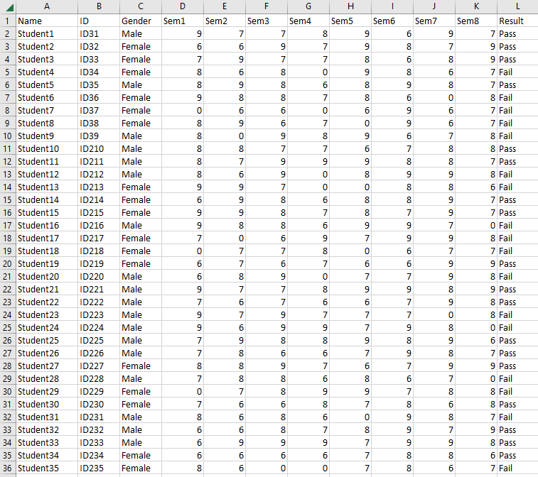
Data set
Title of project
Month - Year
8

Slide 9
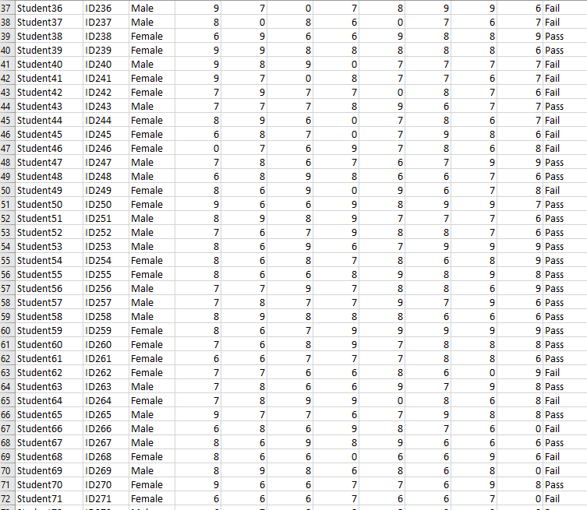
Title of project
Month - Year
9

Slide 10
Phase Modeling Algorithm :
After the data preparation phase then obtained attributes used to predict a student's graduation. The attribute is gender, origin high school, entrance, organizations, scholarship and GPA. Then the data is calculated using the Naïve Bayes method. To be counted, the attribute used will be transformed first.
Accuracy= the number of correct predictions total number of predictions x 100%
Accuracy= 27+97 27+3+0+97 x 100 %=97.6378 % (1)
Error Rate= the number of incorrect predictions total number of predictions x 100 %
Error Rate= 3+0 27+3+0+97 x 100%=2.3622% (2)
Title of project
Month - Year
10

Slide 11
5 . Algorithm
Collect data : Gather a dataset of labeled examples where each example contains features of a student (such as their grades, GRE scores, etc.) and a label indicating whether they are a graduate student or not.
Split data : Split the data into a training set and a test set. The training set will be used to train the Naive Bayes model, while the test set will be used to evaluate the model's performance.
Train Naive Bayes model : Use the training set to train a Naive Bayes model. This involves calculating the prior probability of each class (graduate student or not) and the conditional probability of each feature given each class.
Make predictions : Use the trained Naive Bayes model to make predictions on the test set. For each example in the test set, calculate the probability of the example belonging to each class using Bayes' theorem and choose the class with the highest probability as the predicted class.
Evaluate performance : Evaluate the performance of the Naive Bayes model by comparing its predictions to the true labels in the test set. Calculate metrics such as accuracy, precision, recall, and F1 score to assess the model's performance.
Tune hyperparameters : Experiment with different hyperparameters of the Naive Bayes model (such as the smoothing parameter) to improve its performance .
Title of project
Month - Year
11

Slide 12
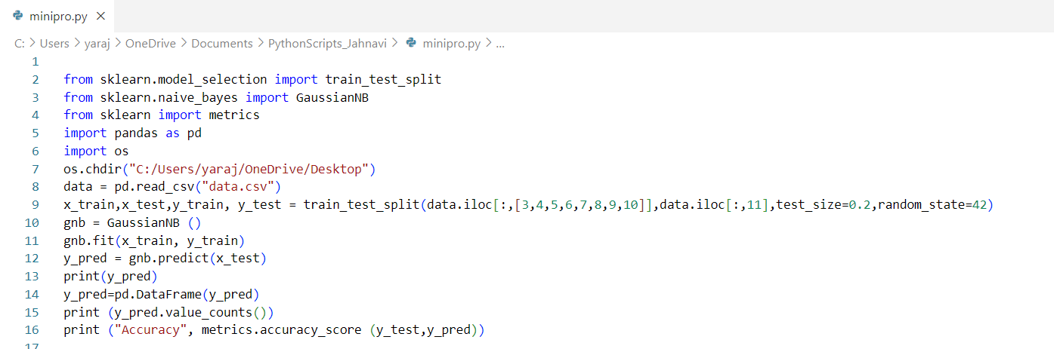
6. Implementation
Here this program is done in python IDLE 3.10.7 in this program i had taken a dataset in that 1000 instances and in that I 100 instances are train size and remaing data will go to testing and by gnb model we will predict the accuracy .
Title of project
Month - Year
12

Slide 13
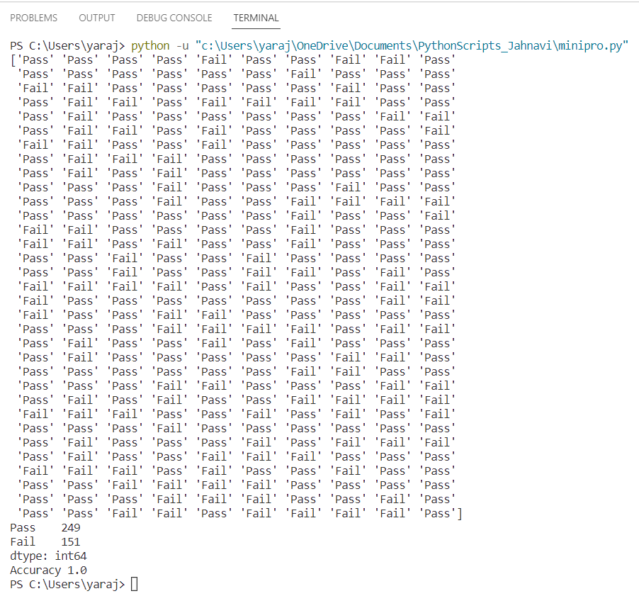
7. Output
Title of project
Month - Year
13

Slide 14
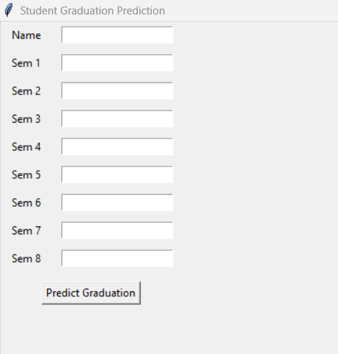
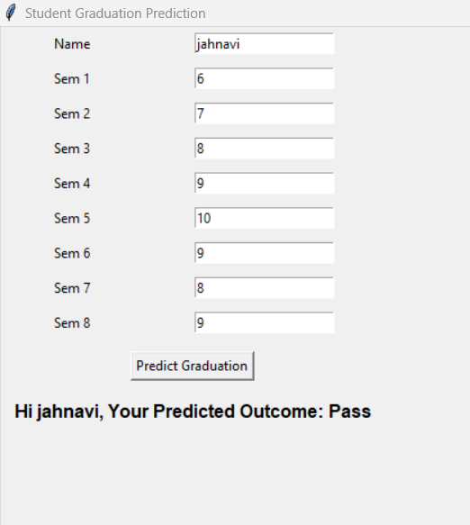
7. Output(Window)
Title of project

Slide 15
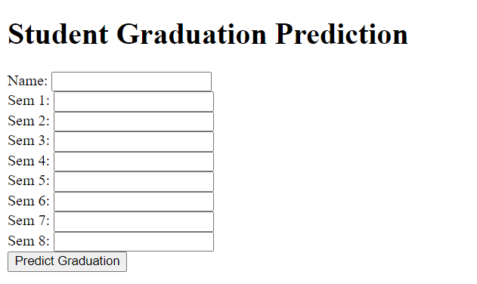
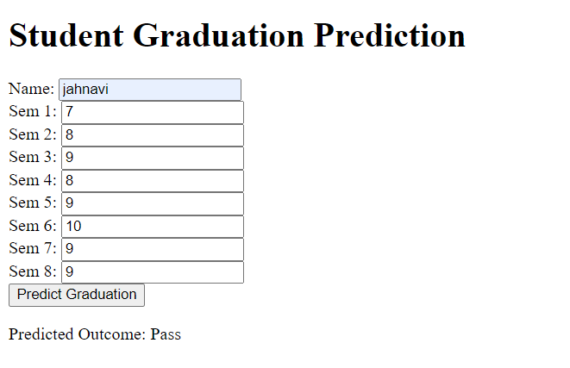
7. Output(Web Application)

Slide 16
8. Conclusion
This project , prediction graduate student is good for predicting and it give the content of the student graduation . This prediction is classification is incredibly significant in categorizing the gender by giving the training set and test set of the output.
In the NAÏVE BAYES classification we use Gaussian Naïve Bayes model for the student graduate prediction .
In the future the other optimization algorithm can be used with Naïve Bayes algorithm .
The evaluation of this experiment is done on the basis of gender,math score,writing score and reading sore .
In this we get accuracy by using the probability problem and get the accuracy we are able to say that the integral concept ends up in increased accuracy .

Slide 17
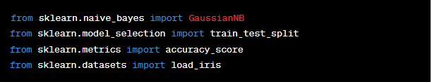

9. Applications
Import necessary libraries:
Load the dataset:
Split the data into training and testing sets:
Title of project
Month - Year
17

Slide 18


Applications
4.Train the GNB model:
5.Predict the test set labels:
6.Calculate the accuracy of the GNB model:
Title of project
Month - Year
18

Slide 19
10. References
Python Machine Learning by Sebastian Raschka and Vahid Mirjalili - Chapter 3: A Tour of Machine Learning Classifiers Using Scikit-Learn (covers Naive Bayes classification and GNB in Python)
Scikit-learn documentation on Gaussian Naive Bayes classifier: https://scikit-learn.org/stable/modules/generated/sklearn.naive_bayes.GaussianNB.html
Medium article on predicting graduate admissions using Naive Bayes in Python: https://towardsdatascience.com/predicting-graduate-admissions-using-naive-bayes-in-python-5e8d5c1b9922
GitHub repository containing code for predicting graduate admissions using Naive Bayes in Python: https://github.com/abhinavvv09/Graduate-Admission-Predictor-using-Naive-Bayes-Classification
Research paper on using Naive Bayes for student performance prediction: https://ieeexplore.ieee.org/document/8460966
Research paper on using machine learning for predicting graduate students in India: https://www.researchgate.net/publication/339923808_Predicting_Graduate_Students_in_India_Using_Machine_Learning_Techniques

Slide 20


