Slide 1
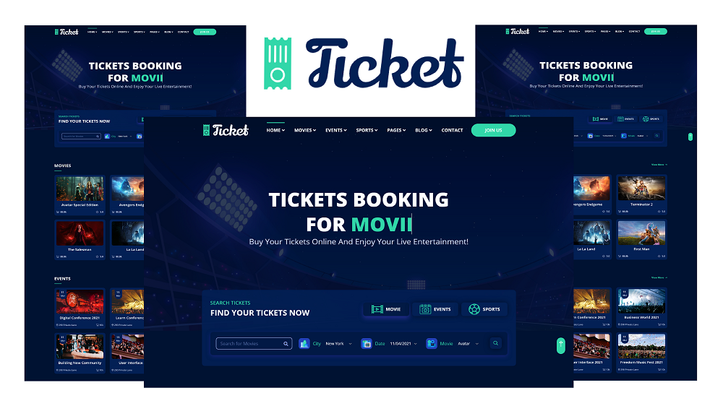
Online Movie Ticketing
Team: PythonFSDGroup2Capstone
Ashok Bathula
Sai Lakshmi
Sindhu Jahnavi
Vijoy Joseph

Slide 2
Outline
Problem Statement
Objective
Microservices
Project Overview
Onboarding-Architecture
Project Flow
Technology and Tools Used
Conclusion

Slide 3

Problem Statement
Students and workers often face challenges in purchasing movie tickets through conventional methods. Long queues at ticket counters are time-consuming and inconvenient, especially for those with busy schedules. Our Aim is to solve this problem by providing a more efficient and practical movie ticket booking application.
Users can book movie tickets and Anywhere and Anytime through their mobile phones.

Slide 4
Objective
Our objective is to provide best user experience to people so that people can book movie tickets online without stepping outside.

Slide 5
Microservices
Authentication API
Movie API & Ticket API
Feedback API

Slide 6

Project Overview

Slide 7
Project Overview
Authentication API
Movie API (API GET) & Ticket API (API POST)
Feedback API
Movie
Login
logout
Home
Search
My SQL Work Bench
My SQL Work Bench
Mongo
Db
My SQL Work Bench

Slide 8

Onboarding Architecture

Slide 9
Architecture
Authentication API
JWT validator
My SQL Server
Login/Register
POST request
Token generated
Movie API
& Ticket API
POST /GET/
DELETE
My SQL Server
GET/POST
Front End
Angular
GET
Feedback API
Get Feedbacks
Mongo Db
GET
Search Movie
My SQL Server
GET
GET

Slide 10
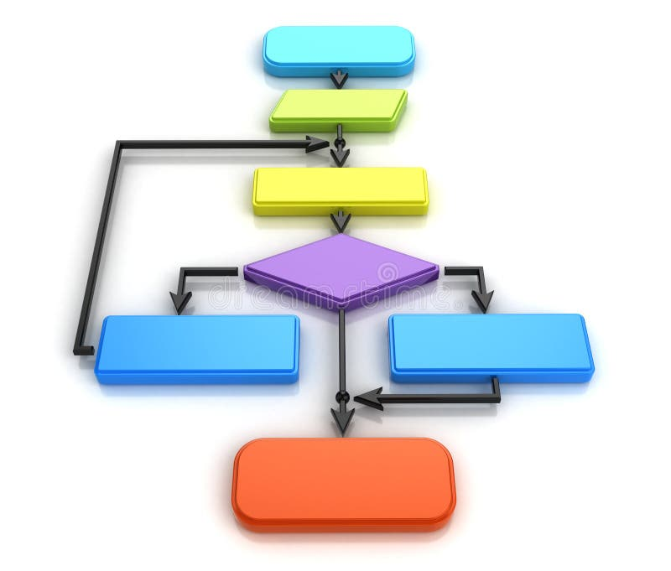
Project Flow

Slide 11
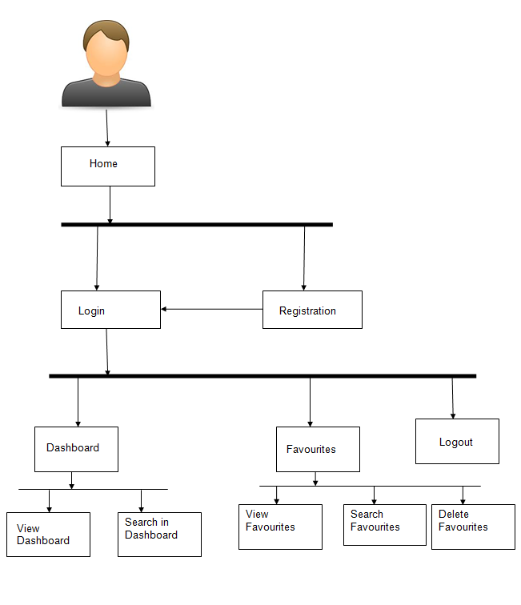
Project Flow
Home
Login
Search
Search by Movie name
Movie Details
Recommends
Movie Booking
View Movies
Add & Delete Movie
Book Movie
View Ticket
Download Ticket
Search Books

Slide 12







Technologies and Tools Used

Slide 13
Conclusion
The Online Movie Ticketing app helps the user to book tickets online. It also helps user to search movies and download their tickets.

Slide 14

Thank You

Slide 15


