Slide 1
What's new in SharePoint Online

Slide 2








Agenda
SharePoint Modern Experience
Branding and Theming, Modern Lists & Libraries
Sharing
Improvements
External Sharing
OneDrive Sharing & Files On Demand
What's new for Developers
SharePoint Framework
Admin
Site Scoped Conditional Access Policies, Restricted Domain Sharing
Idle Session Timeout
Road Map
Conclusion

Slide 3
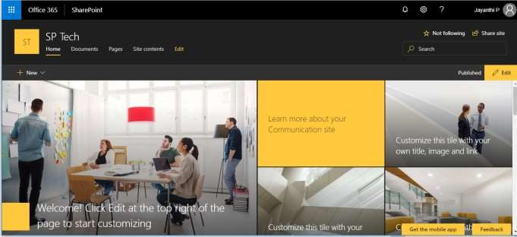


Modern Experience- What? Why?
New User Interface for
Sites
Site Pages
Lists & Libraries
Mobile Friendly & Responsive
Easier to Use
It’s like upgrading a car

Slide 4
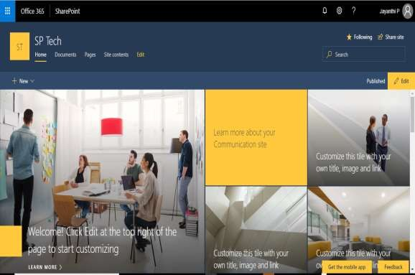
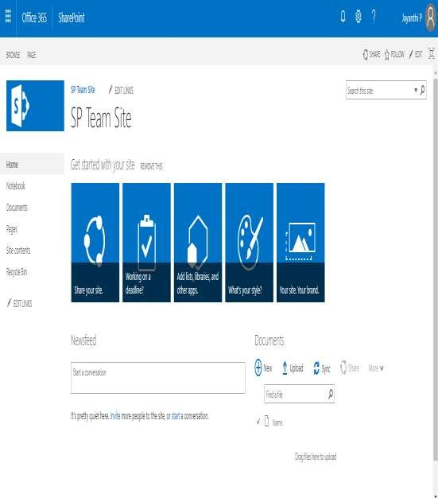
Difference between Classic and Modern UI

Slide 5
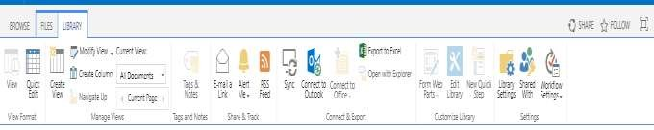
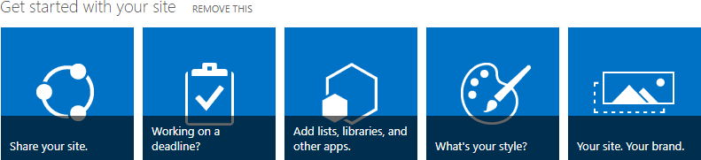
What’s gone in Modern UI?
Ribbon
“Get Started with your site”
RSS Feed
Most Popular Items
Tree View
Publishing*
Content Organizer
Classic Web Parts
News Feed

Slide 6

But its not about what's gone

Slide 7
SharePoint UI – Complicated to Simple
SharePoint
Designer
InfoPath
SharePoint Designer Workflows
PHA
Custom Actions
Office UI Fabric
PowerApps
Microsoft Flow
SharePoint
Framework
Classic
Modern

Slide 8
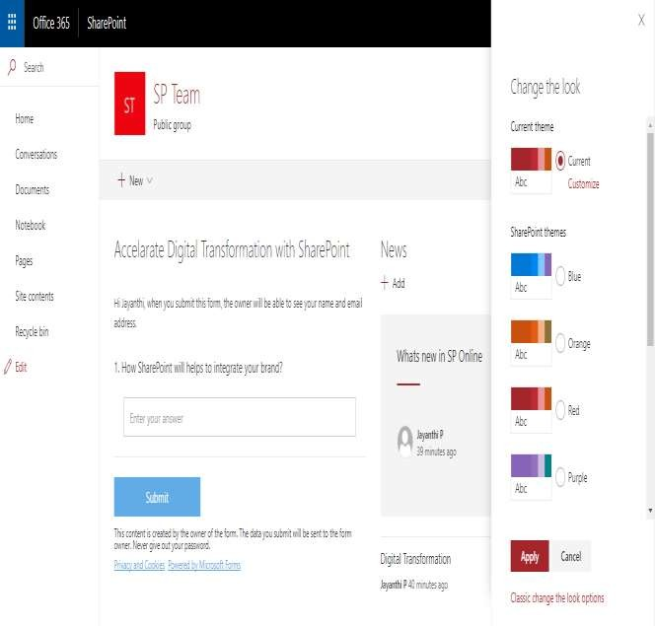
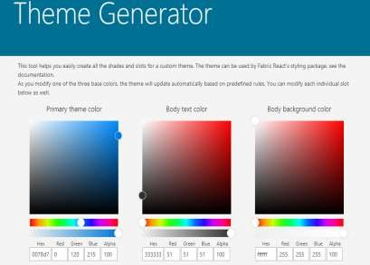
Page Designs
Office UI Fabric Custom Theme Generator
https://developer.microsoft.com/en- us/fabric#/styles/themegenerator

Slide 9
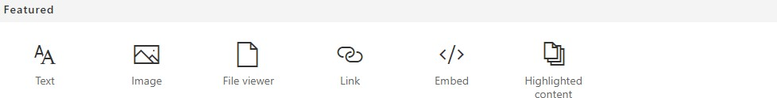
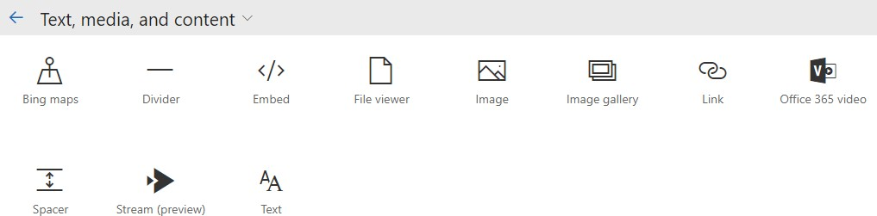
List of New Web parts

Slide 10
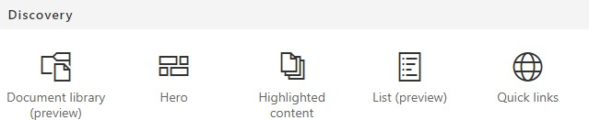
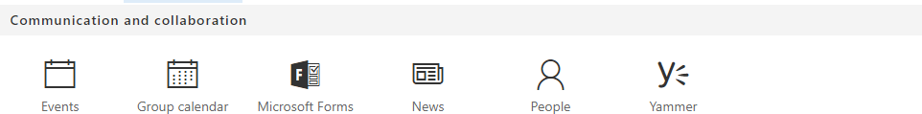
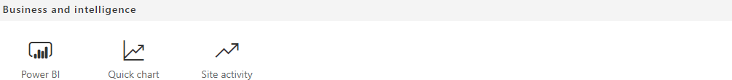
Continued…

Slide 11

Improved Experience in SharePoint Lists & Libraries
What's new in Document Library?
What's new in SharePoint List?

Slide 12
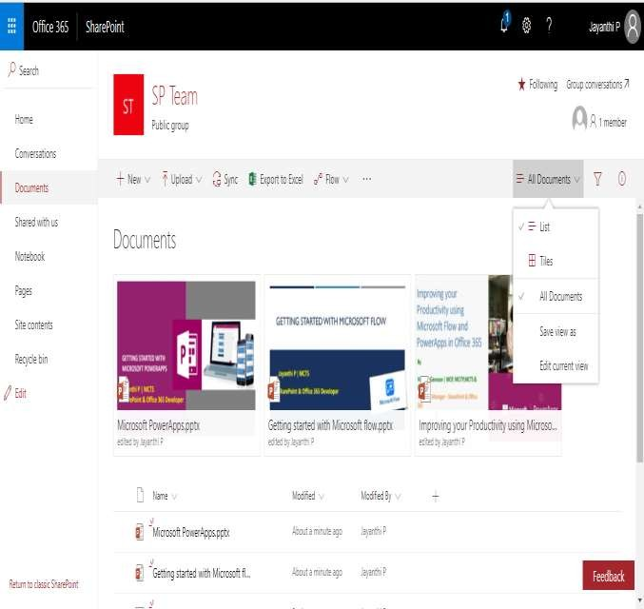
What's new in Document Library?
Pin important items to the top of the library for improved visibility
Copy and move files
Ability to view and directly edit document
metadata
Import files from other libraries
Microsoft Flow Integration Option to Upload Folders Library Views management

Slide 13
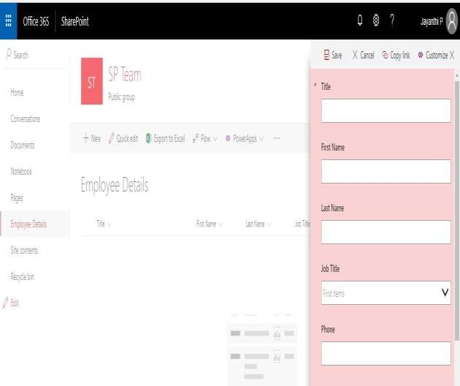

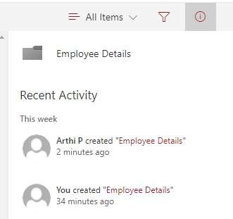
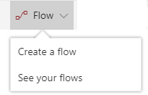
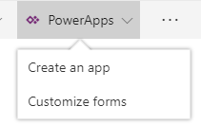

What's new in List
Quick actions for commonly used Lists tasks
PowerApps & Flow Integration
Predictive Indexing Attention Views
Column Formatting

Slide 14

Future of SharePoint Development
SharePoint Framework

Slide 15

What's SPFx?
Another method/way to build solutions for SharePoint
Client Side SharePoint Development
Responsive and mobile-ready
Works for SP Online and SP On-Premise(SP 2016 Feature Pack2)

Slide 16

Why SPFx?
Instant application debugging using Workbench without SharePoint site.
Instant SharePoint site debugging using workbench (which is uploaded in SharePoint site)
Automated process for deploying the updates
Opens a way to use different JavaScript frameworks

Slide 17
Build and Deploy engaging Web Parts using SPFx
Demo

Slide 18
Improving the ways which you share and work together
External Sharing
One Drive Files On Demand

Slide 19
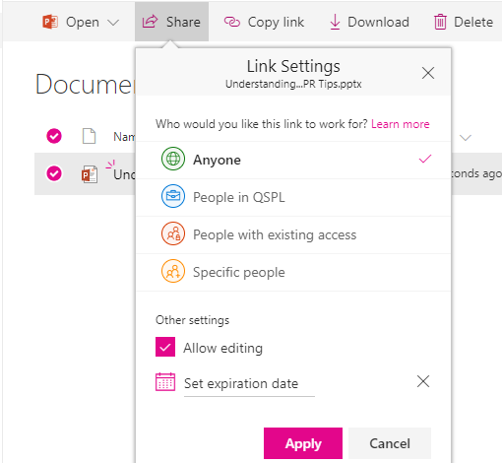
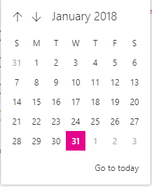
External Sharing
Collaborative your content with external vendors, clients or external customers
Sharing with authenticated external users
Sharing with anonymous users
Sharing only with external users in your directory
➢
➢

Slide 20
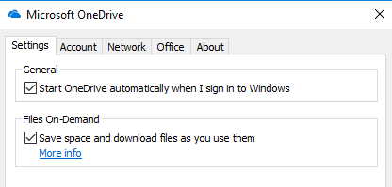


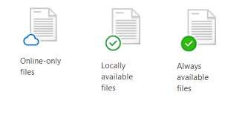
OneDrive Files On Demand
Access all your files in OneDrive without having to download all of them and use storage space on your device.
✓
✓
Save space on your device by making files online only
Set files and folders to be always available locally on your
device
✓
See important information about files, such as whether they are shared
See thumbnails of over 270 different file types even if you
don’t have the required application installed to open it
✓

Slide 21
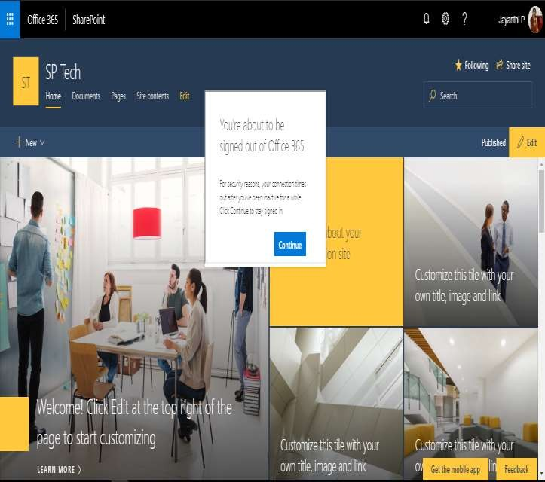
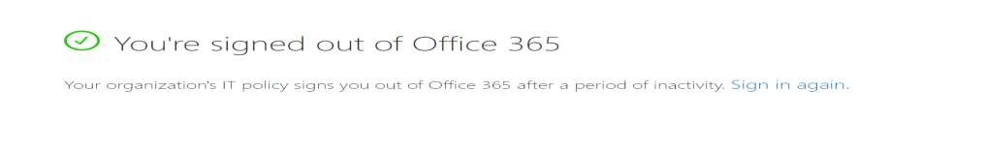
How to keep your data safe?
Idle Session Time Out
Configure a threshold at which a user is warned and subsequently signed out of SharePoint or OneDrive after a period of inactivity.
Set-SPOBrowserIdleSignOut -Enabled
$true -WarnAfter (New-TimeSpan - Seconds 60) -SignOutAfter (New- TimeSpan –Seconds 120)

Slide 22



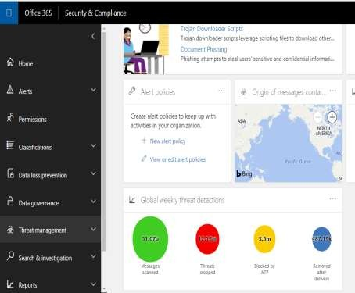


Collaborate in safer manner by preventing user from opening or downloading malicious files.
ATP for SharePoint
Safe Links, Safe Attachments, Spoof Intelligence and advanced anti-phishing capabilities.
Takes up to 30 minutes for this functionality to spread to all Office 365 datacenters.

Slide 23

Access Control
Site Scoped Conditional Access Policies
Device-based policies for SharePoint and OneDrive help administrators ensure corporate data is not leaked onto unmanaged devices such as non-domain joined or non-compliant devices by limiting access to the content to the browser, preventing files from being taken offline or synchronized with OneDrive.
Restricted Domain Sharing Control
Limit sharing invitations to a limited number of email domains by listing them in the allow list or opt to use the deny list, listing email domains to which users are prohibited from sending invitations

Slide 24
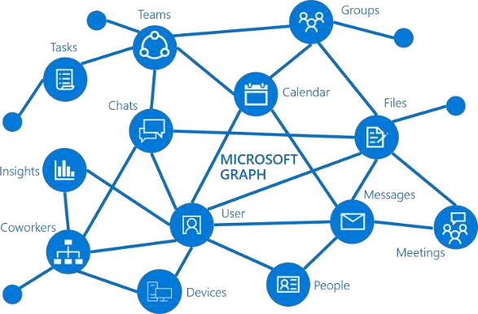
Accessing Usage Reports via Graph API
Activity - The amount of interaction with the service such as number of files viewed
Usage - The amount of content created or generated in the service, such as total storage used

Slide 25



Roadmap
1
Hub Site
2
New SharePoint Admin Center
3
Associate Team Site to New Office 365 group
4
Improved Search Experience

Slide 26
Product | User Voice Site
Microsoft SharePoint | https://sharepoint.uservoice.com/
Delve | https://delve.uservoice.com/
Microsoft OneDrive | https://onedrive.uservoice.com
Microsoft PowerApps | https://powerusers.microsoft.com/
Microsoft Flow | https://powerusers.microsoft.com/
Power BI | https://powerusers.microsoft.com/
Microsoft Forms | https://microsoftforms.uservoice.com
Microsoft Planner | https://planner.uservoice.com
Microsoft Teams | https://microsoftteams.uservoice.com
Dynamics 365 | https://dynamics.uservoice.com/

