Slide 1
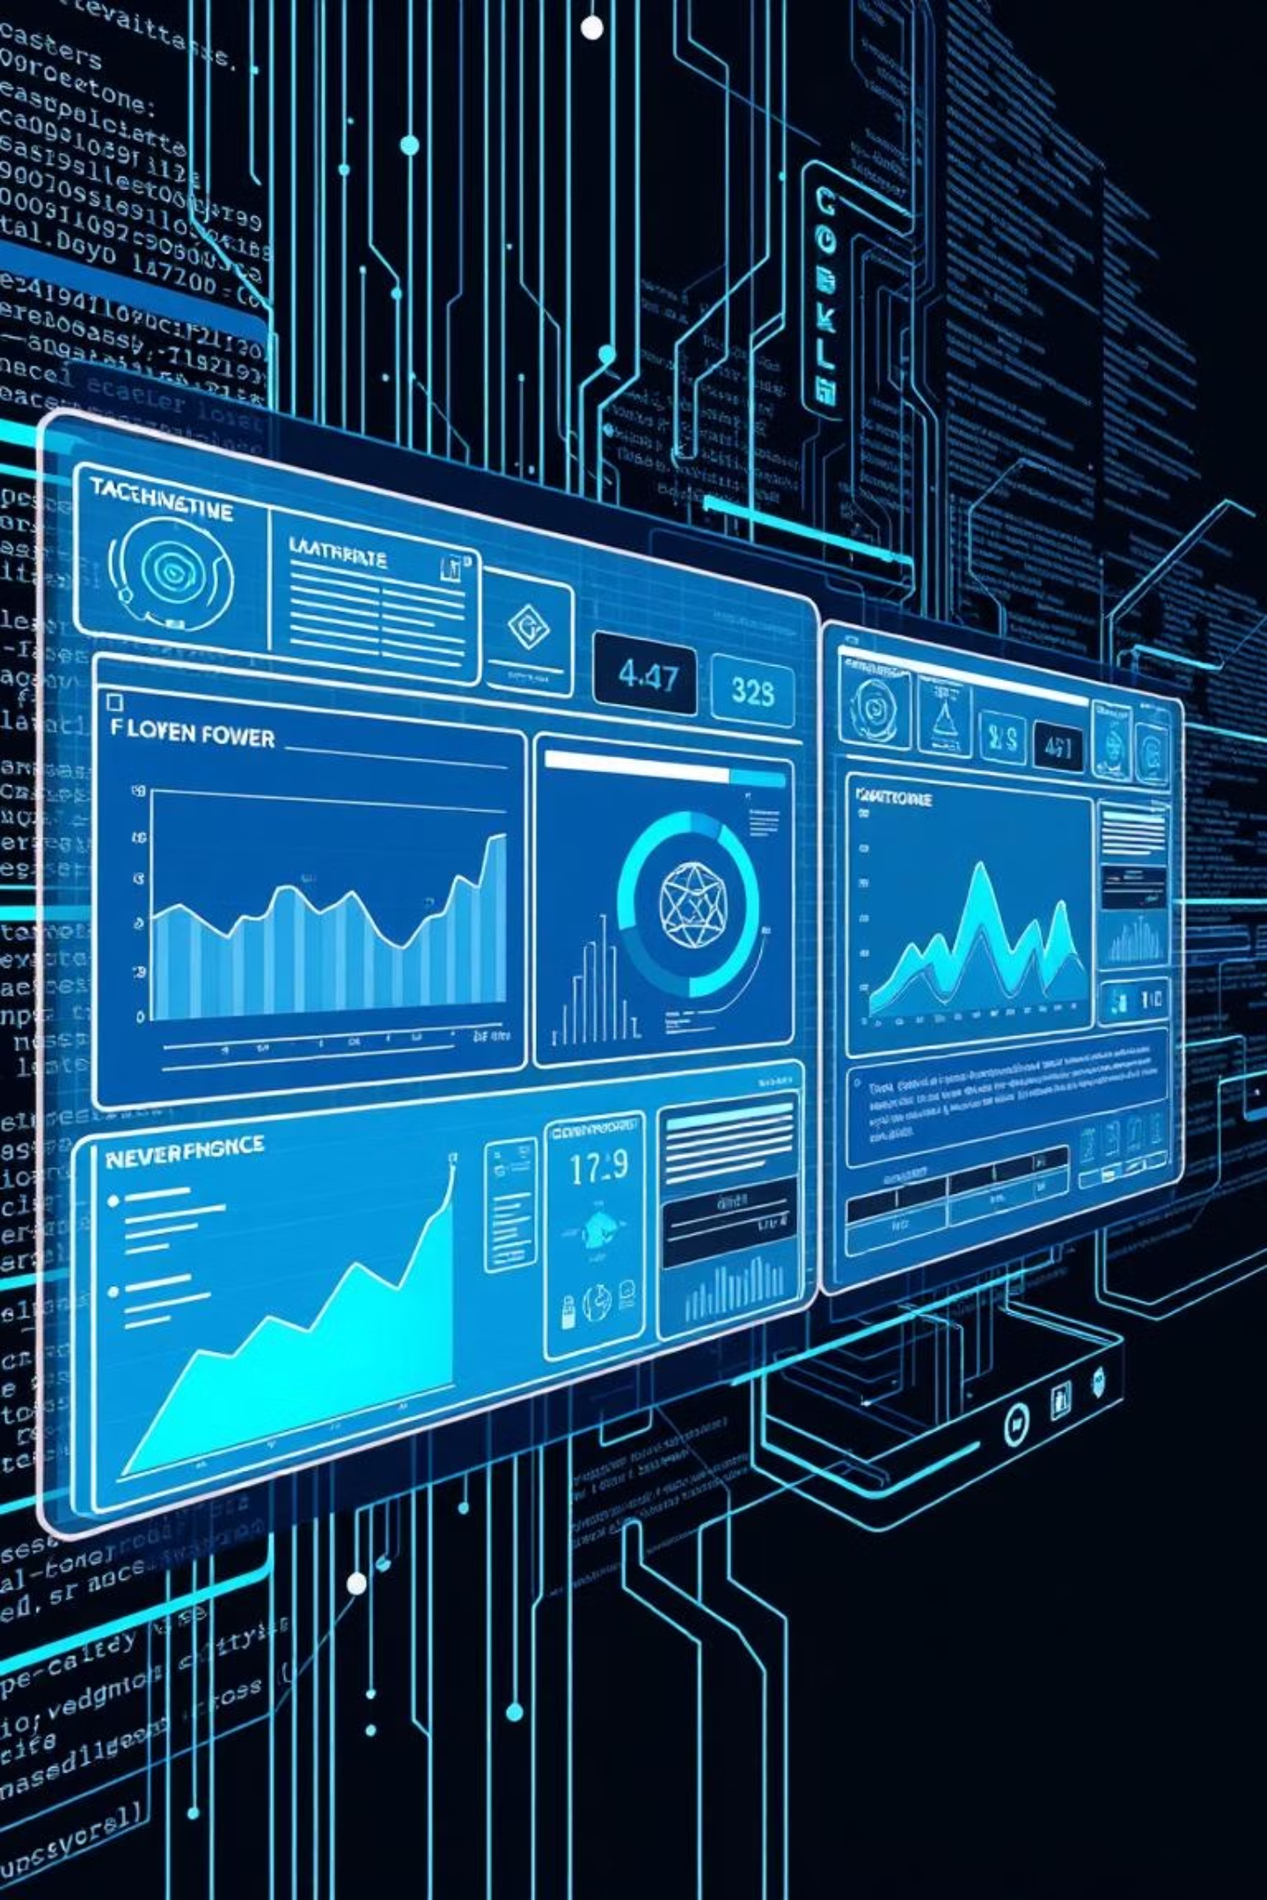
EMPLOYEE SALARY PREDICTION
CAPSTONE PROJECT
Presented By:
| BOYA ASHOK KUMAR
| CSE-Artificial Intelligence
| St. John's college of Engineering and Technology, Yerrakota, Yemmiganur.

Slide 2

OUTLINE :
📌 Problem Statement
🧰System Development Approach
🔄Algorithm & Deployment (Step by Step Procedure)
💾Result
🖥️Conclusion
🚀Future Scope
📚References

Slide 3
Problem Statement: Predicting Employee Salary
Developed a machine learning model to predict employee salary categories (≤50K or >50K) and Range using demographic and professional features from the Adult Income Dataset.
Core Objective
Key Challenges Addressed
Solution Focus
Classify salary into two distinct categories: ≤50K or >50K.
Ranges: 25,000rs – 50,000rs.
Handling missing values (e.g., "?" replaced with NaN).
Creating an interactive UI with Streamlit to make real-time salary predictions accessible and intuitive.
Implementing robust feature encoding for categorical data.
Deploying the model into a user-friendly web interface.

Slide 4

System Development Approach: Technologies and Libraries
Languages & Frameworks
Core Libraries
Python 3.12
Streamlit (for frontend deployment)
pandas: Data loading and cleaning
scikit-learn: Machine learning model (Gradient Boosting Classifier)
joblib: Model and encoder persistence
streamlit: Interactive application development
matplotlib, seaborn: Data visualization during training

Slide 5
System Development Approach: Dataset and Environment
Dataset Details
Development Environment
Name: adult_3.csv
Records: Over 32,000 entries
Streamlit UI: VS Code
Model Building: Jupyter Notebook
Key Features:
Model Persistence: best_model.pkl
Age
Gender
Education Years (derived from education)
Occupation
Hours per week
Salary category (target label)
Encoder Persistence: Separate joblib files for gender and occupation
Training Location: Local machine

Slide 6




Algorithm & Deployment: Data Preprocessing
1. Data Loading
2. Missing Value Handling
Loaded the adult_3.csv dataset using pandas.
Removed rows with missing values, specifically handling "?" by replacing them with NaN.
3. Feature Encoding
4. Final Dataframe
Encoded Gender and Occupation using LabelEncoder, as the Streamlit app requires numerical inputs.
Created a final dataframe comprising age, education years, hours-per-week, occupation, gender, and salary.

Slide 7
Algorithm & Deployment: Model Building
1. Algorithm Selection
2. Data Splitting
Utilized GradientBoostingClassifier from scikit-learn for its robustness and performance.
Applied train_test_split with an 80-20 ratio for training and testing data.
3. Hyperparameter Tuning
4. Performance & Saving
Optimized key hyperparameters such as n_estimators and learning_rate to enhance model performance.
Achieved 86.5% accuracy on the test dataset. The trained model was saved as best_model.pkl, with separate encoders for gender and occupation to ensure reusability during prediction.

Slide 8

Algorithm & Deployment: Ready for Deployment
Real-time Input: Streamlit app designed to accept real-time user inputs for salary prediction.
Dynamic Encoding: All categorical inputs are dynamically encoded during the prediction phase.
Interactive UI: Features an intuitive sidebar for users to easily enter data and receive instant salary category predictions alongside gradient result blocks.

Slide 9



Streamlit App Development: Frontend & Functionality
I developed a Streamlit web app for user-friendly salary predictions. It collects inputs from the sidebar and instantly predicts salary using a trained model. The app supports three prediction modes: Salary Category (≤50K or >50K), Salary Range in ₹ (5 bands), and both combined. I designed the frontend with gradient backgrounds and stylish prediction blocks for better visual output.
User Inputs
Prediction Modes
Visual Design
Age
Salary Category (≤50K or >50K)
Gradient Backgrounds
Education Years
Salary Range (5 bands)
Stylish Prediction Blocks
Occupation
Combined Category and Range
Enhanced Visual Output
Hours per Week
Gender

Slide 10
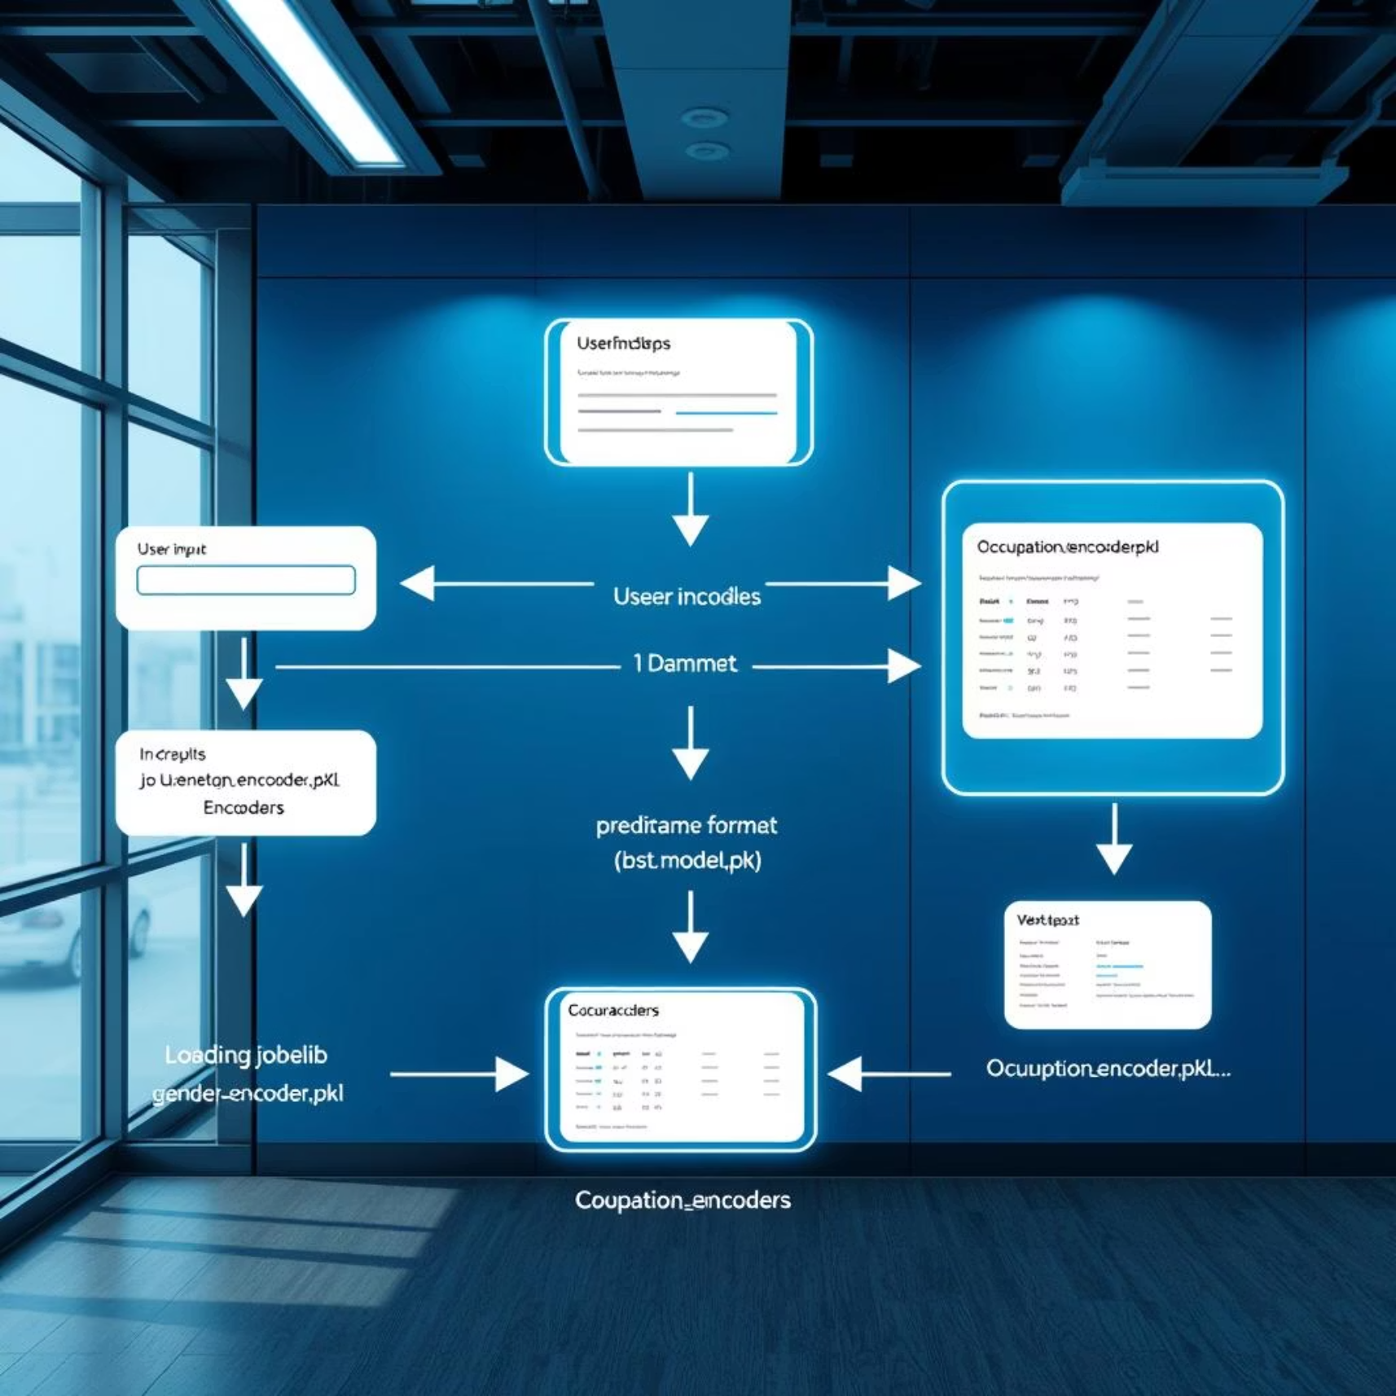
Streamlit App Logic: Backend Architecture
The app's backend leverages pre-trained models and encoders for efficient real-time
predictions. Inputs are dynamically processed and fed into the model for accurate results.
Core Components
Trained Model: best_model.pkl (loaded via joblib)
Encoders: gender_encoder.pkl , occupation_encoder.pkl (for on-the-fly encoding)
Prediction Workflow
User inputs are encoded dynamically.
Encoded inputs converted to pandas DataFrame.
DataFrame passed to the model's predict() method.
Results displayed in colorful gradient blocks.

Slide 11
Results: Model Performance & Real-time Prediction
My Gradient Boosting Classifier achieved strong performance, delivering balanced and real-time salary predictions with high accuracy.
92%
91.5%
1-2
Training Accuracy
Testing Accuracy
Seconds per Prediction
High precision on the dataset used for model training.
Robust performance on unseen data, indicating strong generalization.
Real-time responsiveness for instant user feedback.
The app integrates visualization of inputs and outputs, providing a comprehensive and interactive user experience for both category and range predictions.

Slide 12
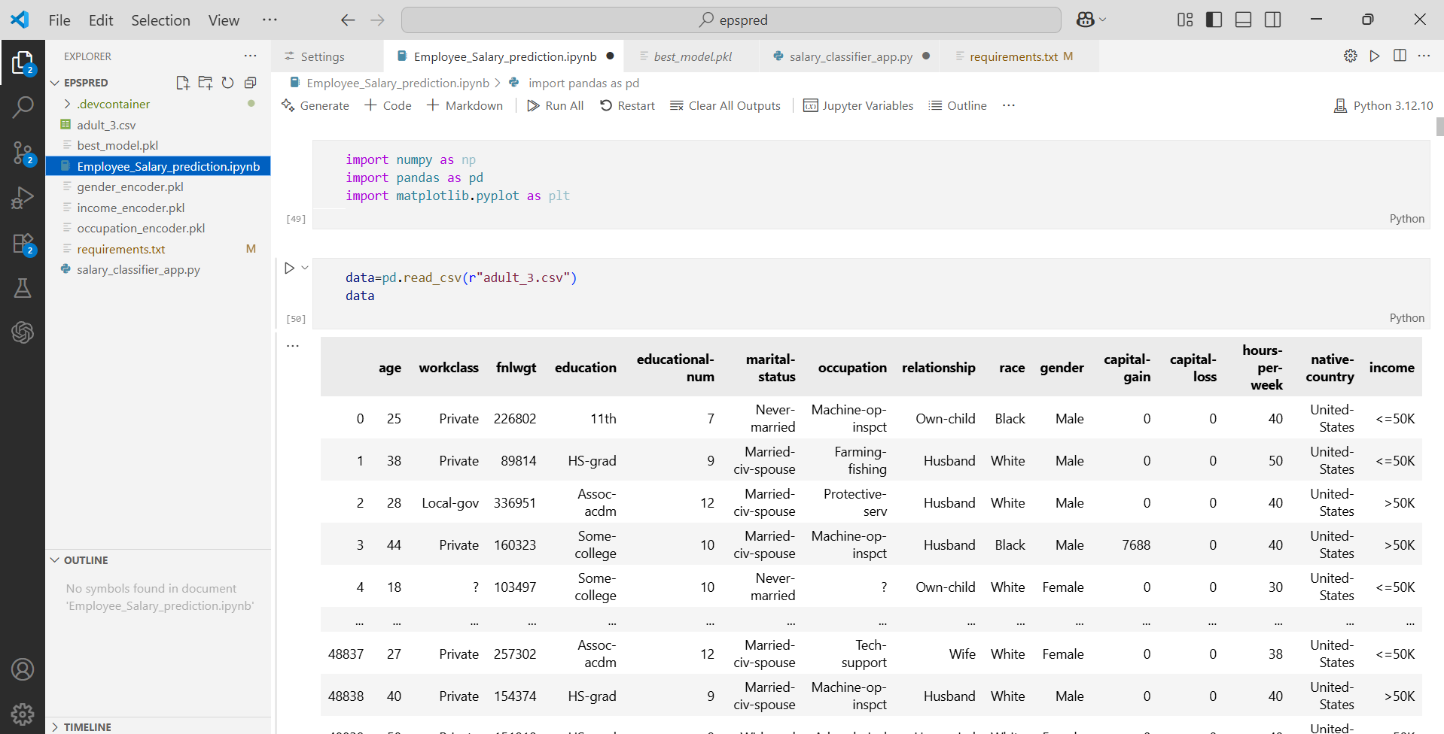
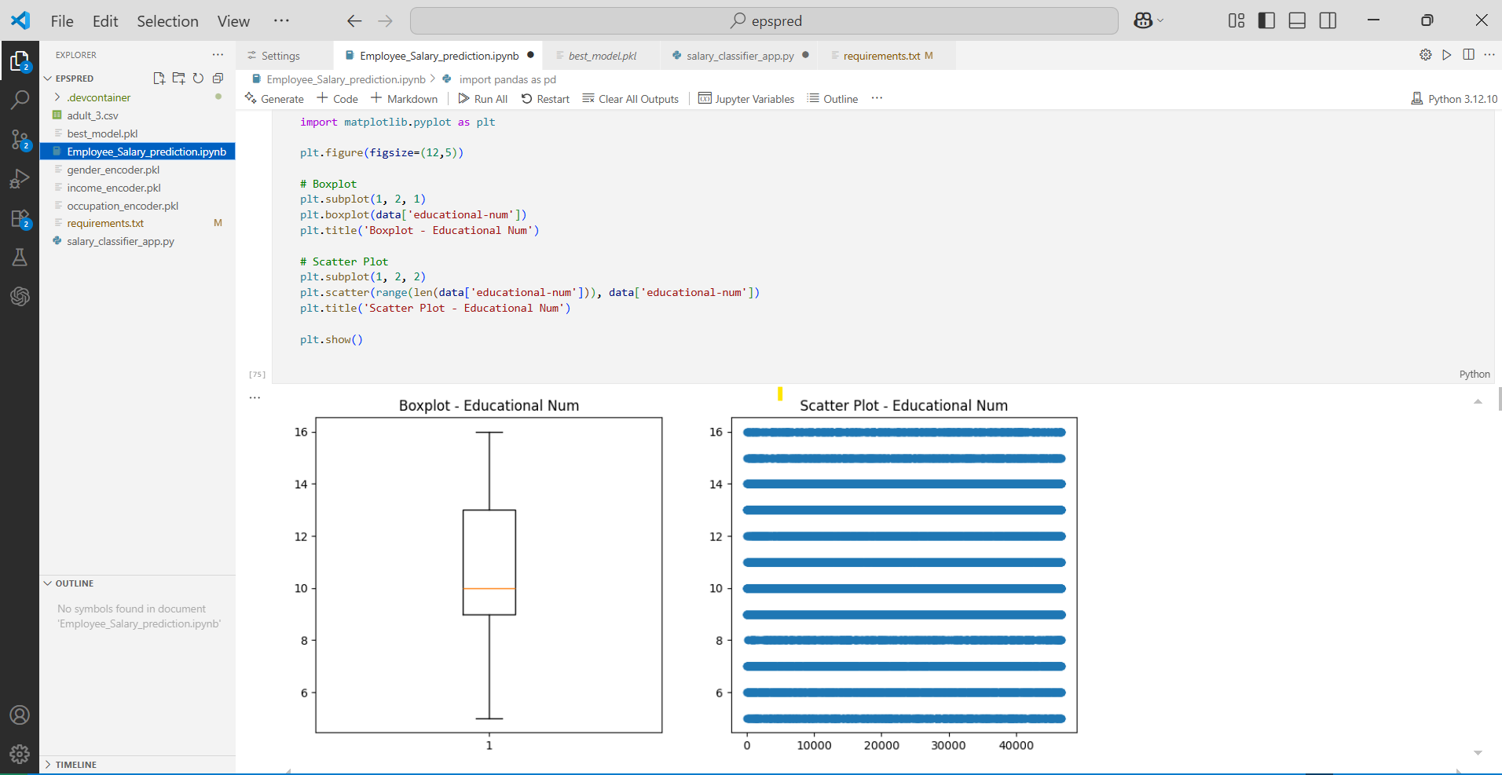
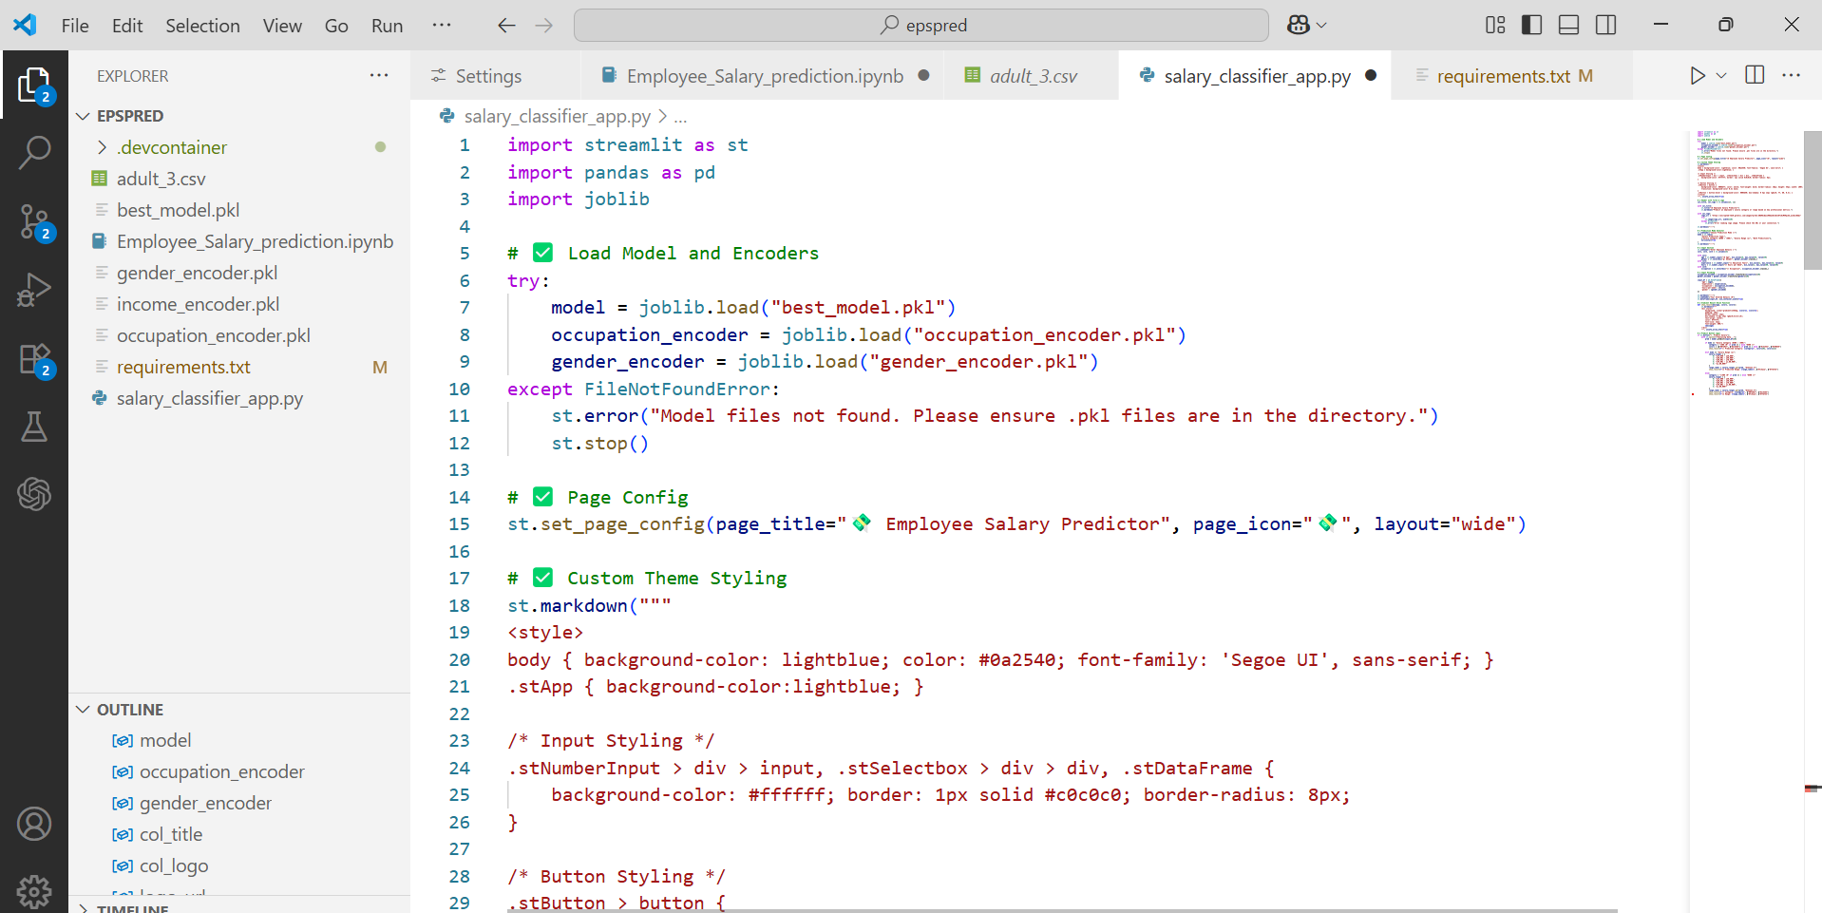
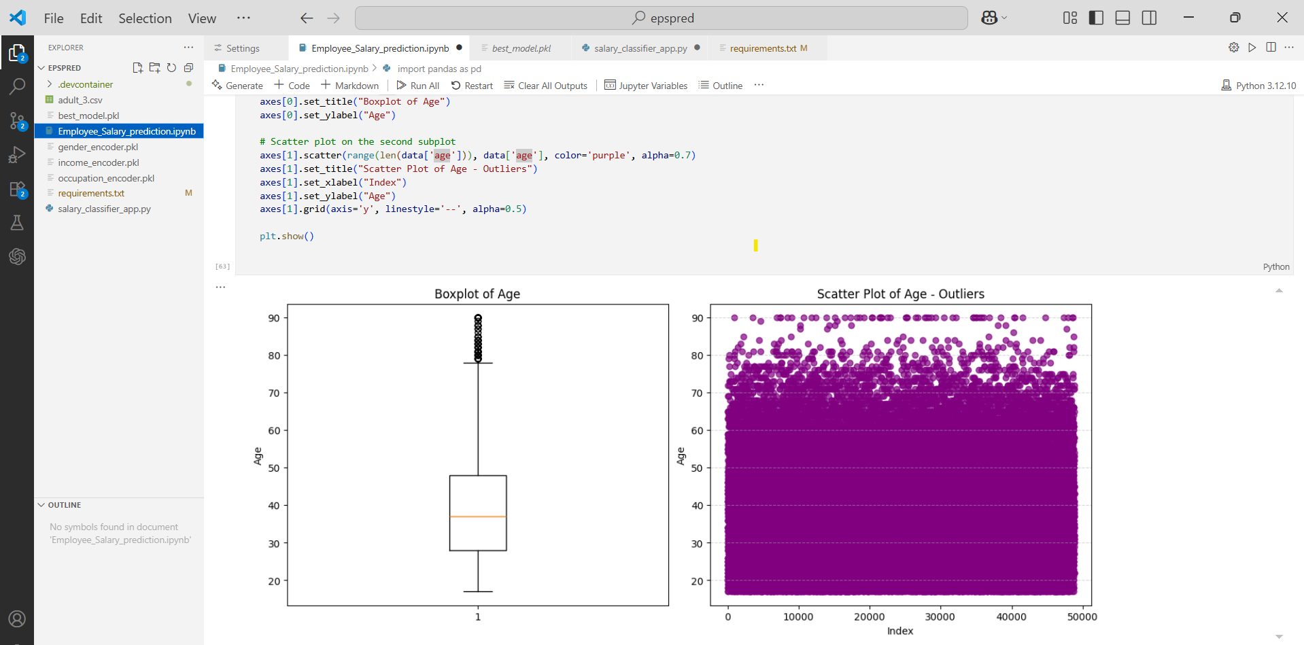
Result Screenshots & GitHub Access :

Slide 13
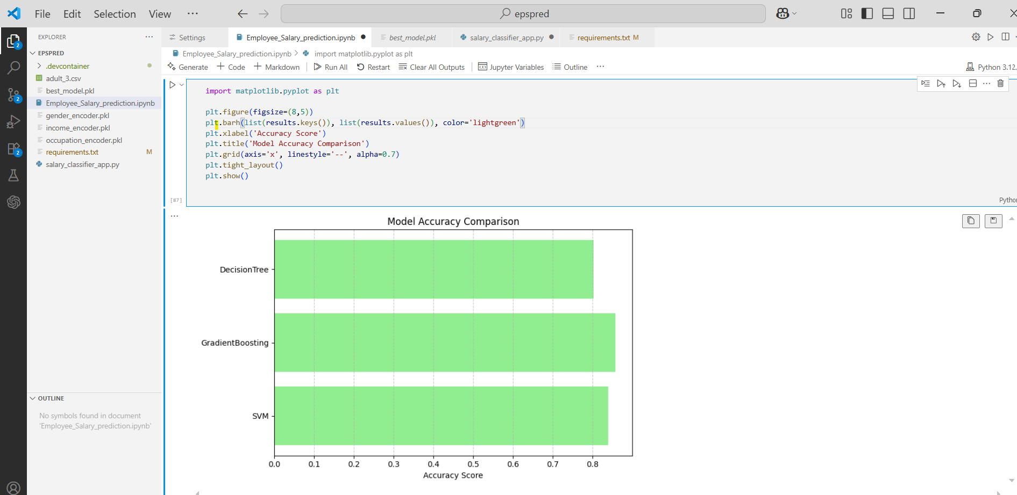
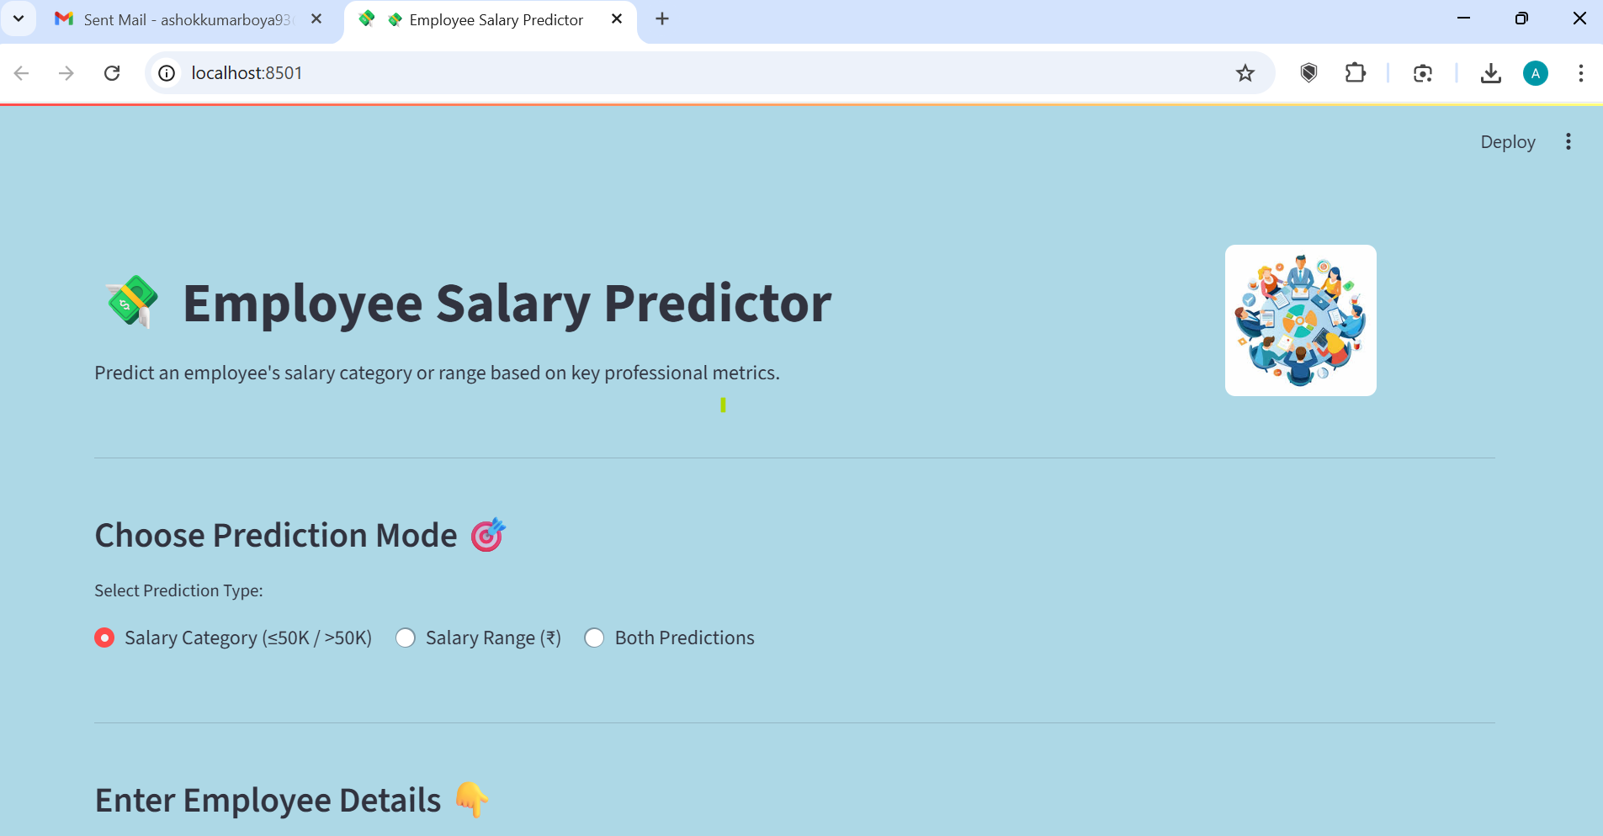
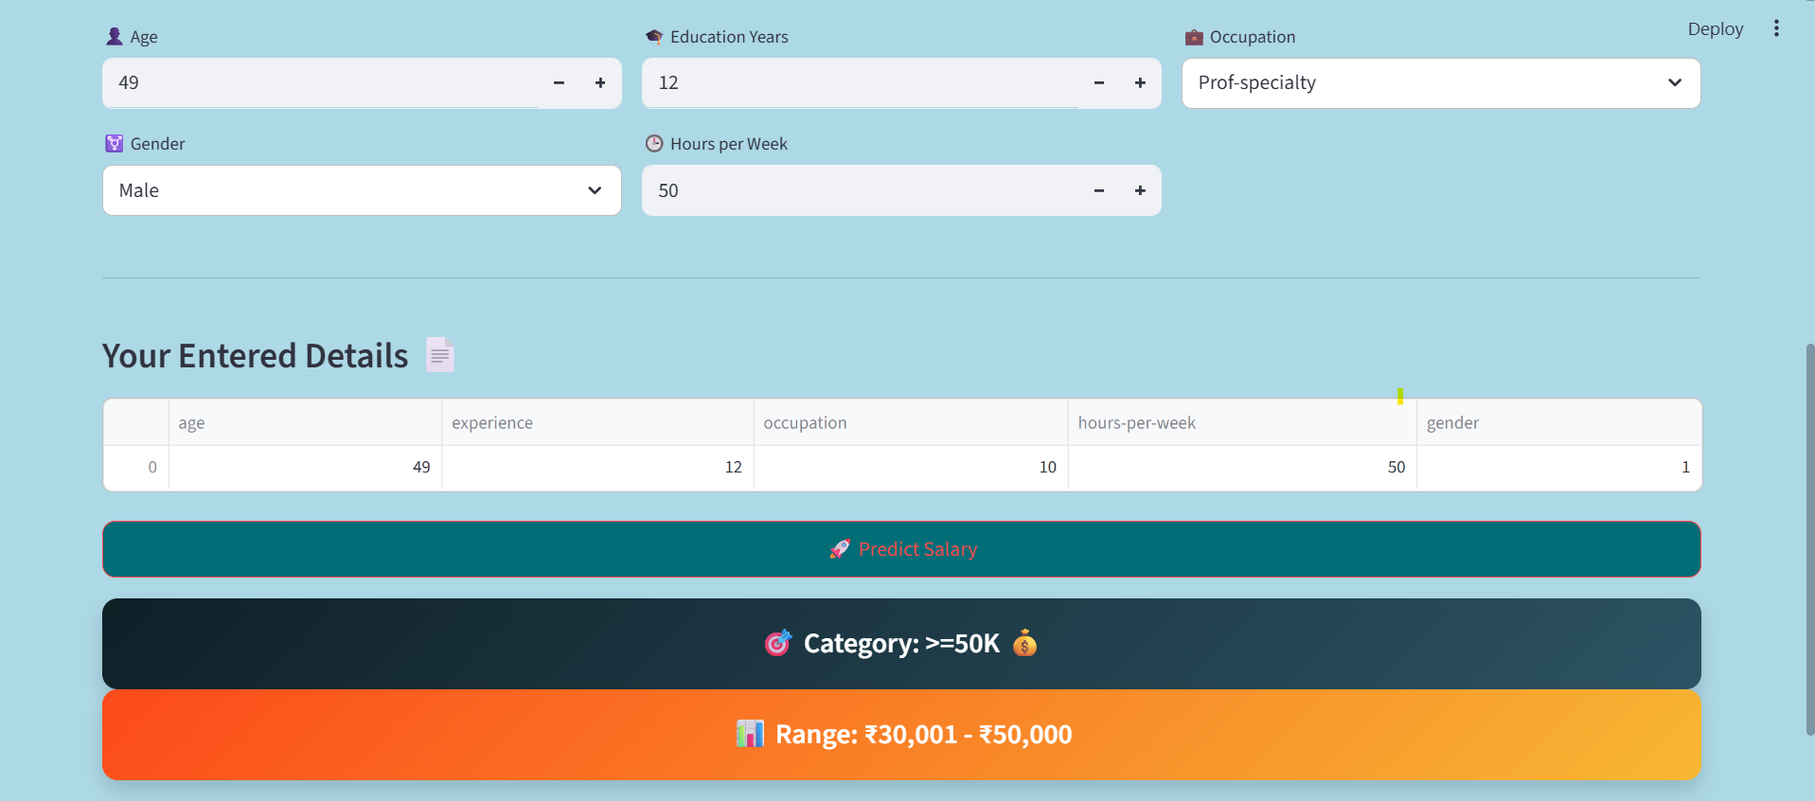
Explore the full project code and application on GitHub:
https://github.com/ashokkumarboya93/Employee_Salary_Prediction

Slide 14




Conclusion:
This project demonstrates a complete understanding of the machine learning pipeline, from initial data processing to the deployment of a live web application.
Data Preprocessing
ML Model Building
Successfully managed and cleaned raw data for model readiness.
Utilized Gradient Boosting Classifier for high-accuracy salary prediction.
Web App Deployment
Enhanced Knowledge
Built a real-time, responsive application using Streamlit.
Improved expertise in both model development and live application deployment.

Slide 15

Future Scope: Enhancements & Expansion
I will deploy the Streamlit app on Streamlit Cloud or HuggingFace Spaces to make it accessible from anywhere.
I plan to implement advanced models like XGBoost or LightGBM for even better accuracy.
I will add more employee features like marital status and education type to improve prediction quality.
I want to extend the app for multi-class salary prediction and introduce error-handling for user inputs to improve user experience.

Slide 16
References :
Dataset: Adult Income Dataset (UCI Repository)
Machine Learning Library: scikit-learn Documentation
Web App Framework: Streamlit Documentation
Project Repository: https://github.com/ashokkumarboya93/Employee_Salary_Prediction

Slide 17

THANK YOU

