Slide 1



AI Book Recommendation Chatbot
This presentation explores the development of an AI-powered book recommendation chatbot, revolutionizing how readers discover new titles and addressing the challenge of information overload in the vast book market.
by Boya Ashok Kumar

Slide 2
Introduction
Personalized Recommendations
Efficient Discovery
The chatbot uses machine learning to suggest books based on user input, creating a personalized reading experience.
Users quickly find relevant titles, saving time and expanding their reading horizons.

Slide 3
Technologies
1
Python
2
NLTK
3
ChatterBot
Versatile programming language, widely used in data science.
Natural Language Toolkit, enabling text analysis for natural language interactions.
Python library for creating conversational chatbots, incorporating TF-IDF and Cosine Similarity.
4
Scikit-learn
5
Books Dataset
Machine learning library for data analysis, using TF-IDF and Cosine Similarity.
Collection of book information including title, author, genre, description, and reviews.

Slide 4





Process
User enters a query, for example, "Recommend a mystery novel."
AI detects keywords related to genre, author, or theme, such as mystery, thriller, or romance.
TF-IDF converts text data into numerical representations, highlighting important words in documents.
Cosine Similarity measures similarity between user query vector and book vectors, selecting top N most similar books.
The chatbot suggests books to the user, ranked by relevance and popularity, displaying book title, author, and a brief synopsis.

Slide 5
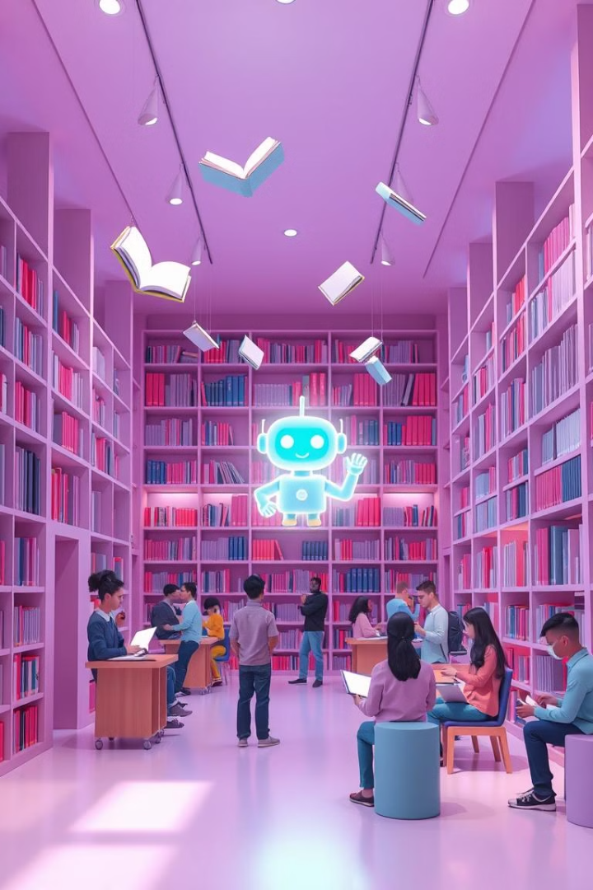
Conclusion
The AI Book Recommendation Chatbot improves book discovery with personalized suggestions. It's a scalable solution for online bookstores and libraries. Future enhancements include incorporating user ratings and reviews, expanding the dataset, and implementing advanced NLP techniques like BERT and GPT-3.

