Slide 1
Accelerated Learning Initiative Angular – Creating Directives and Advanced Components

Slide 2
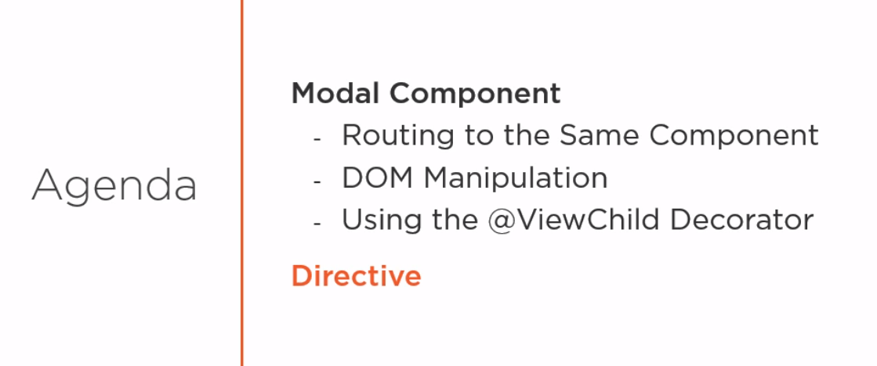
Agenda
Copyright © 2017 Accenture All rights reserved.

Slide 3
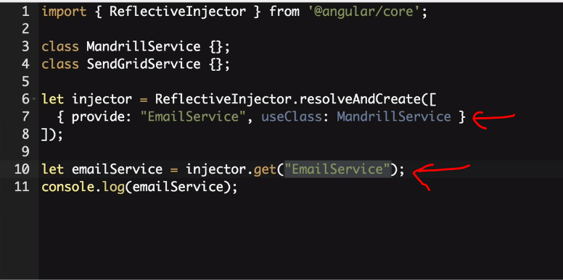
String TOKEN
Copyright © 2017 Accenture All rights reserved.
Notes:
The car class has only one type of engine as engine is instantiated within the car class

Slide 4
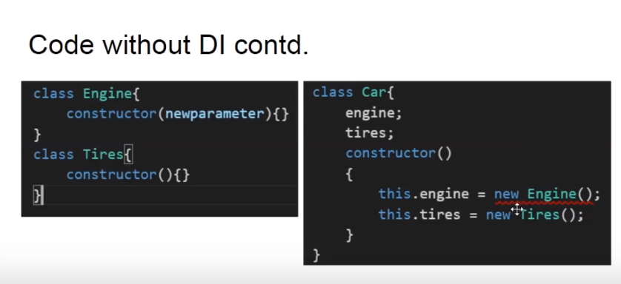
Code without DI contd.
Copyright © 2017 Accenture All rights reserved.

Slide 5
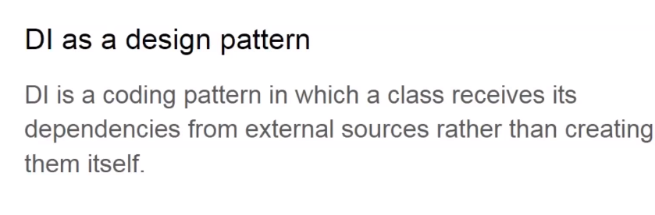
DI as a design pattern
Copyright © 2017 Accenture All rights reserved.

Slide 6
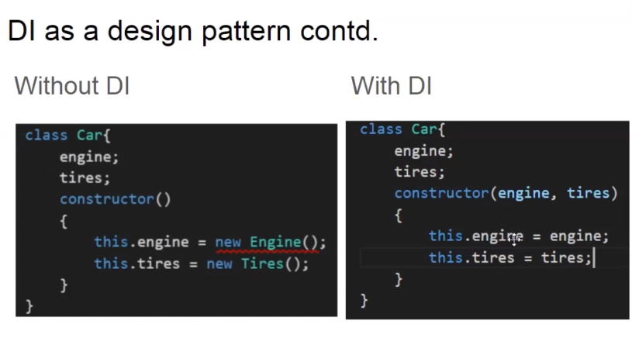
DI as a design pattern contd.
Copyright © 2017 Accenture All rights reserved.

Slide 7
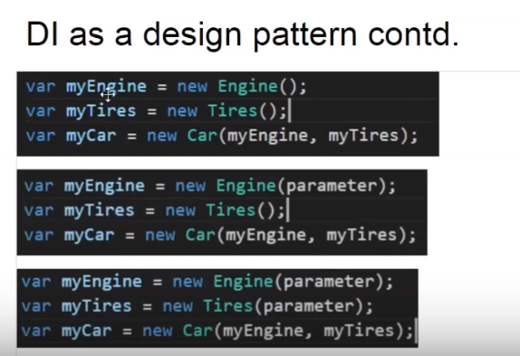
DI as a design pattern contd.
Copyright © 2017 Accenture All rights reserved.

Slide 8
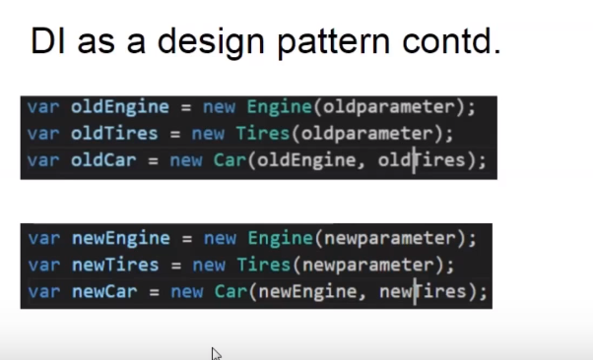
DI as a design pattern contd. With test cases
Copyright © 2017 Accenture All rights reserved.
Notes:
1) We can test the car class with different dependencies
2) Developers have to create the dependencies before passing them to the car class
3) What if the dependency has its own dependency and what if number of dependencies increase ?

Slide 9
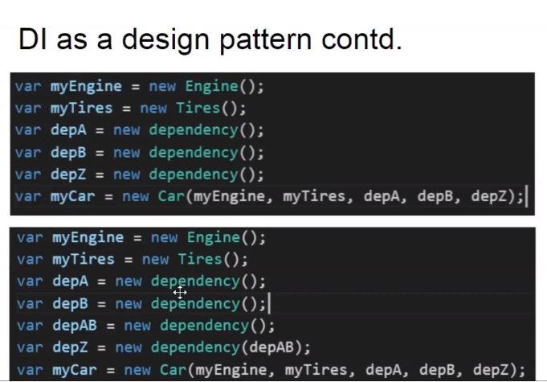
DI as a design pattern contd.. With more dependencies
Copyright © 2017 Accenture All rights reserved.
Notes:
With increase in number if dependencies , it becomes difficult for developer to manager them and there is where DI as angular framework comes into picture

Slide 10
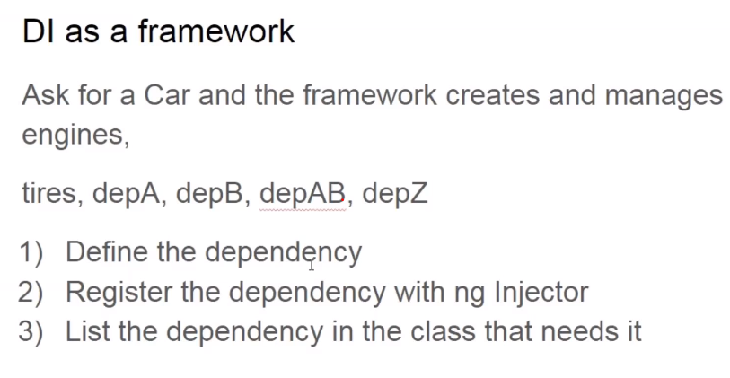
DI as framework
Copyright © 2017 Accenture All rights reserved.
Notes:
DI framework makes developer job easy and if I ask for a car the DI framework creates it with all its dependencies . For this to work all we have to do is Define, register and list it , the DI framework does the job of creating the dependency before creating the main object and manage them

Slide 11
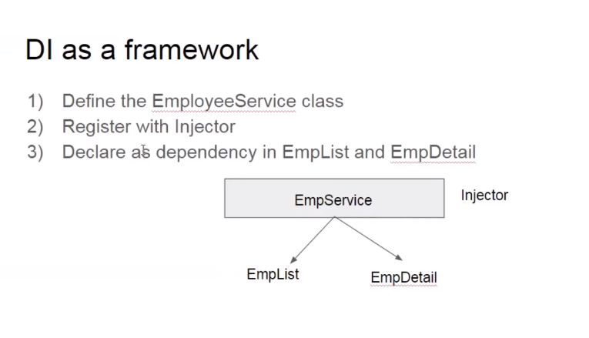
DI as framework
Copyright © 2017 Accenture All rights reserved.
Notes:
Important point to note here is angular creates a single instance of the service ( singleton service)

Slide 12
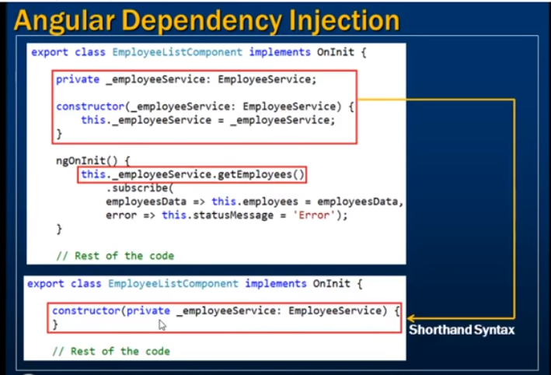
DI as framework another example with shorthand syntax
Copyright © 2017 Accenture All rights reserved.

Slide 13
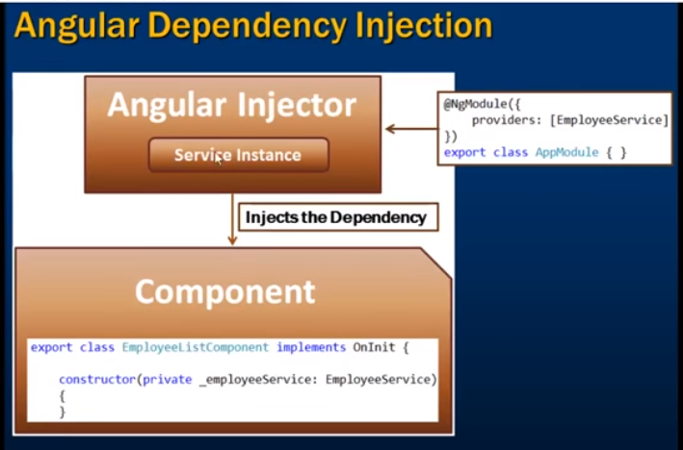
DI as framework another example with shorthand syntax
Copyright © 2017 Accenture All rights reserved.
Notes:
Angular injector creates the service instance and injects into the required component
How does injector know about the service is by registering the service into DI framework
2 ways to register
Provider property of ngModule decorator ( module level)
Component decorator (Component level)

