Slide 1
Dot Net Core
Guide to setup development environment for Dot Net Core on Windows
Created By: Ashok Kumar

Slide 2
Tools
Dot net core framework
Visual studio code
Some useful extensions for Visual Studio Core.

Slide 3
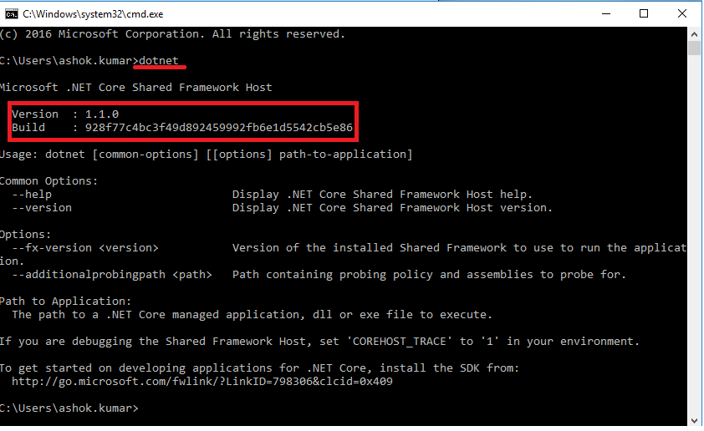
Installing Dot Net Core framework
Go to the below link to install the latest releases for framework
https://www.microsoft.com/net/core#windowscmd
After installation check framework version by running below command using Command line

Slide 4
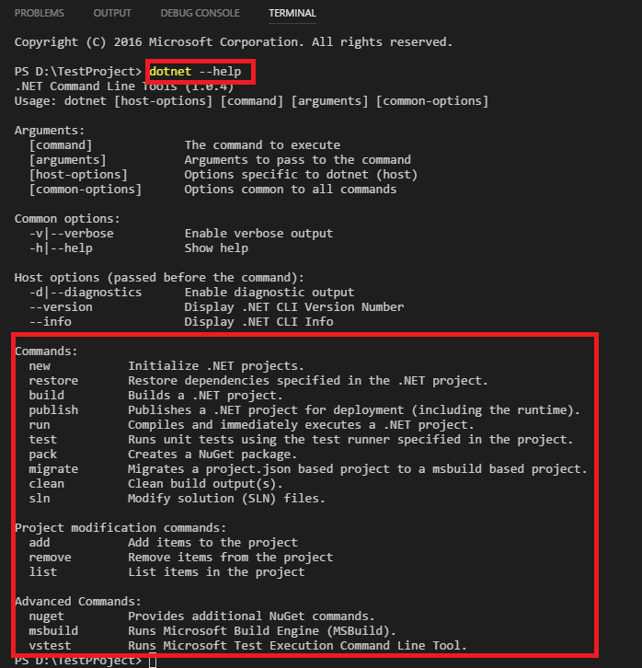
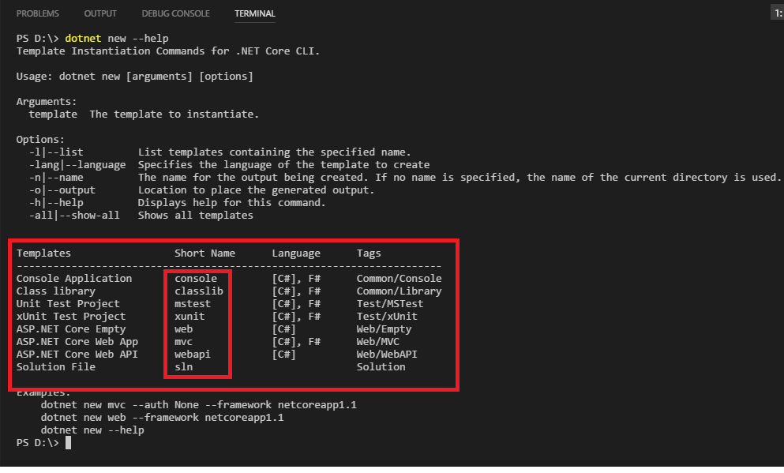
For creating different types of project dot net core framework provides different CLI commands as shown below.
For example : Creating mvc application type below on command line.
dotnet new mvc

Slide 5
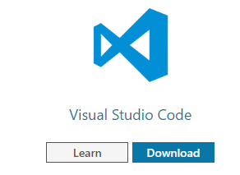
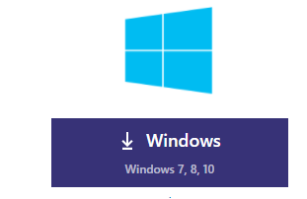
Installing IDE(Visual Studio Code)
Go to the bottom of page on below link to download the Visual Studio Code
and click download
https://www.microsoft.com/net/core#windowscmd

Slide 6
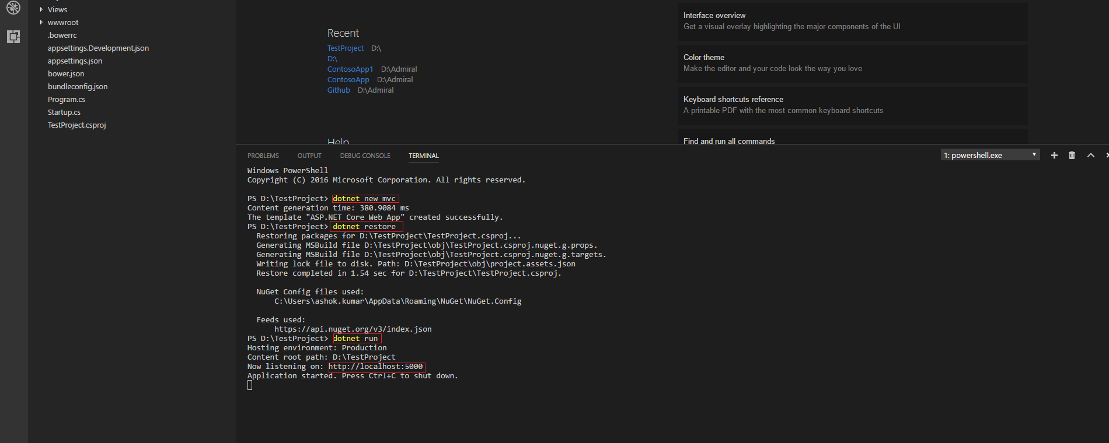
After installation open Visual Studio Code to create first application as below
Step1 : Create a folder and open the folder using Visual Studio Code
Step2: Go to the View->Integrated Terminal and type command as shown below.
Step3: Open the browser type http://localhost:5000 to see the running website.

Slide 7
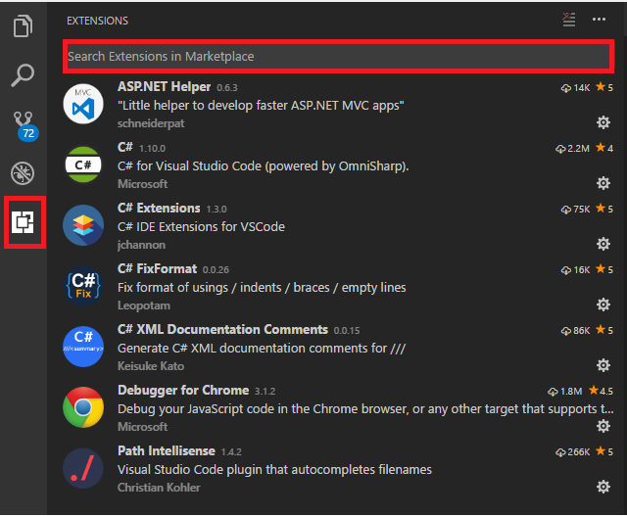
Useful extensions to support Core development
To install extensions we have to first set the proxy settings in Visual Studio Code using following steps.
Note: This step is to be followed only when your system is running behind the firewall.
Go to the File->Preferences->Settings ,click and Go to USERSETTINGS section and put the below settings
{
"http.proxy": "http://inspop-proxy.inspopcorp.com:8080",
"https.proxy": "https://inspop-proxy.inspopcorp.com:8080",
"http.proxyStrictSSL": false,
}
To install the extensions, click on the symbol and search for all extensions in the search bar as highlighted in below image.

Slide 8
Project to Project reference in Core
For adding project reference there are two ways
Adding the reference directly to .csproj file as shown below
<ItemGroup>
<ProjectReference Include="..\lib1\lib1.csproj" />
</ItemGroup>
Adding the reference using CLI as shown below
dotnet add app/app.csproj reference lib1/lib1.csproj
For more information please visit the below link
https://docs.microsoft.com/en-us/dotnet/core/tools/dotnet-add-reference

Slide 9
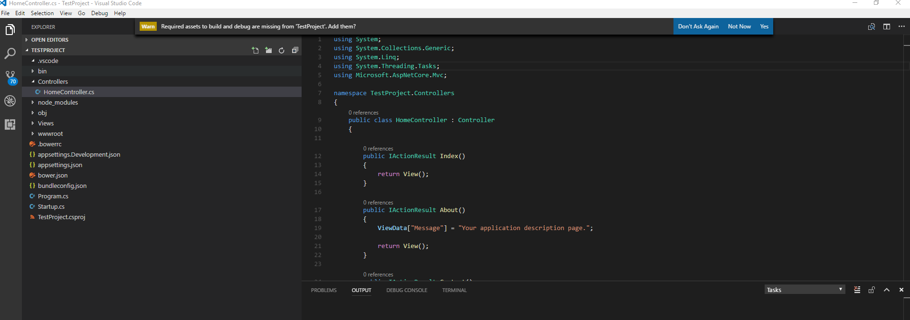
Debugging setup in Visual Studio Code
There are two ways to configure debugging.
1) Automatic: Once you open the visual studio having a project already created, open any c# file, a model popup appears as Warn shown below , click on Yes to setup debug. Two new files are created under .vscode folder in the visual studio code named launch.json and task.json, where launch.json file contains the debug info and task contains the build info.

Slide 10
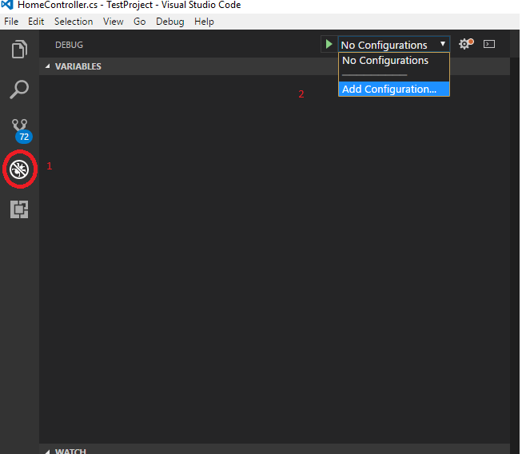
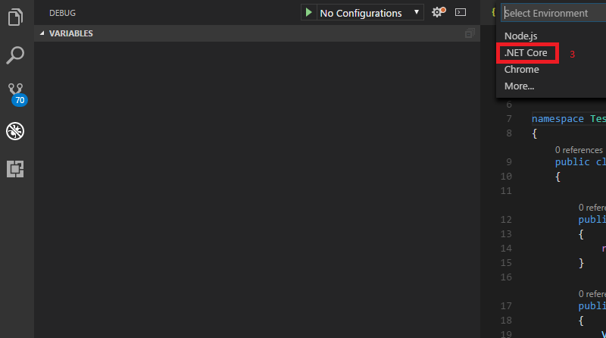
2) Manual configure the debug: Click on the second last option in left pane in Visual Studio Code and choose the blue highlighted option and click .Net Core environment option from dropdown , this will create a launch.json file.
Once the launch.json created , configure the path according to your directory structure as shown below.

Slide 11
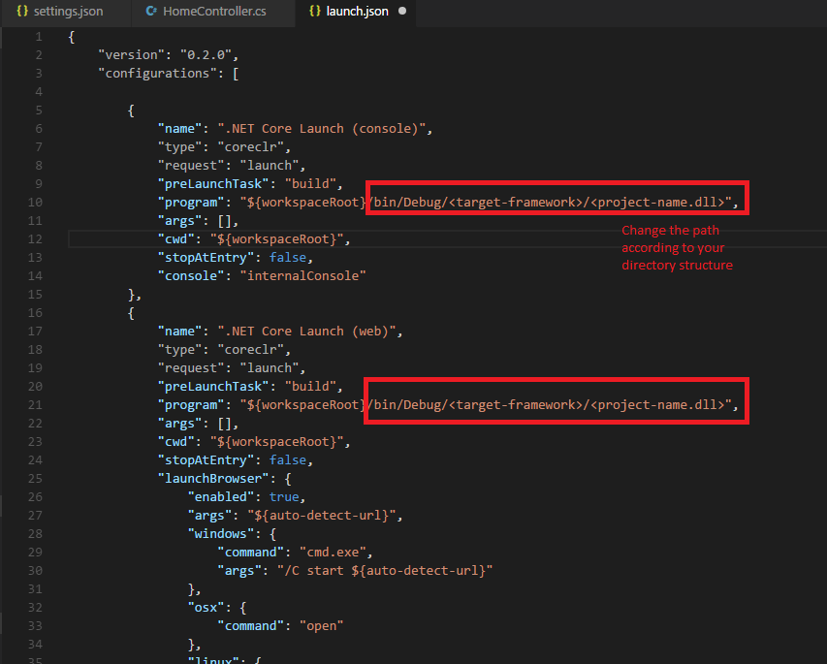
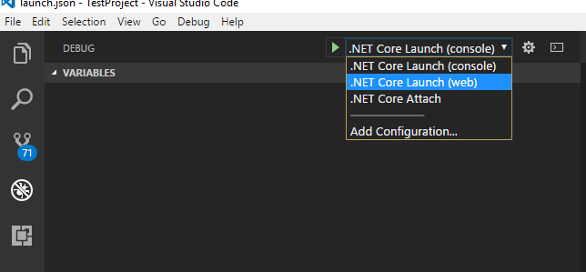
Running the debug session : Choose the options to debug.

