Slide 1
Classification & Prediction of Asthmatic Infants(0-4 years)using Neural Networks
M.Ashok,Assistant Professor(SS)/IT,
Rajalakshmi Institute of Technology
V.Nithya,Assistant System Engineer,
Tata Consultancy Services
Kumar Thanasekaran,Soultion Architect,
Tata Consultancy Services

Slide 2
Problem Statement
Identification of Asthma symptoms is tough for 0-4 years category of infants.
Stage(Inception/Mild/Severe) of asthma will be diagnosed by different number of variable parameters.

Slide 3
Solution Path
4 variables will be used to identify the inception level of asthma
7 variables will be used to identify the mild level of asthma
6 variables will be used to identify the severity level of asthma

Slide 4
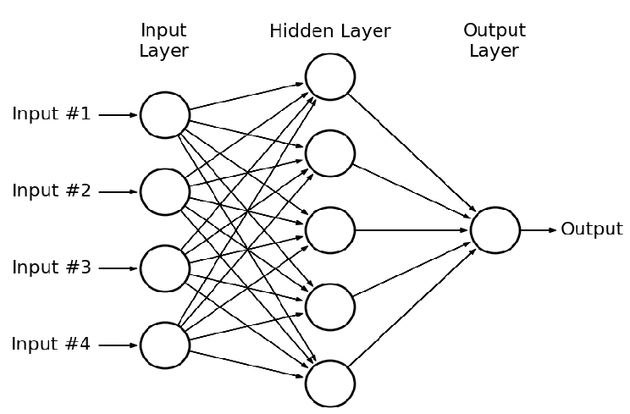
Basic Neural Architecture

Slide 5
Tools
Python 2.7.14/3.6
Keras
Pysqlite

