Slide 1

WIPRO – Java Training
M.Ashok
Rajalakshmi Institutions

Slide 2
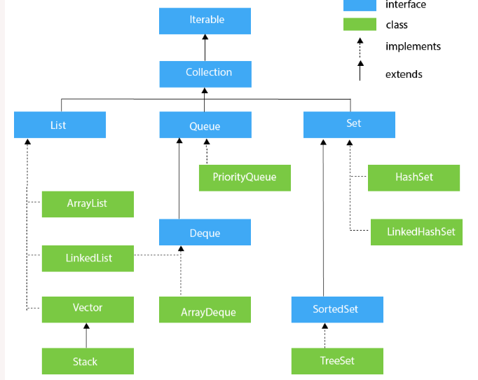

Slide 3
ArrayList
import java.util.*;
class TestJavaCollection1{
public static void main(String args[]){
ArrayList<String> list=new ArrayList<String>();//Creating arraylist
list.add("Ravi");//Adding object in arraylist
list.add("Vijay");
list.add("Ravi");
list.add("Ajay");
//Traversing list through Iterator
Iterator itr=list.iterator();
while(itr.hasNext()){
System.out.println(itr.next());
}
}
} //Ravi Vijay Ravi Ajay

Slide 4
LinkedList
import java.util.*;
public class TestJavaCollection2{
public static void main(String args[]){
LinkedList<String> al=new LinkedList<String>();
al.add("Ravi");
al.add("Vijay");
al.add("Ravi");
al.add("Ajay");
Iterator<String> itr=al.iterator();
while(itr.hasNext()){
System.out.println(itr.next());
}
}
}
//Ravi Vijay Ravi Ajay

Slide 5
Vector
import java.util.*;
public class TestJavaCollection3{
public static void main(String args[]){
Vector<String> v=new Vector<String>();
v.add("Ayush");
v.add("Amit");
v.add("Ashish");
v.add("Garima");
Iterator<String> itr=v.iterator();
while(itr.hasNext()){
System.out.println(itr.next());
}
}
} //Ayush Amit Ashish Garima

Slide 6
Stack
import java.util.*;
public class TestJavaCollection4{
public static void main(String args[]){
Stack<String> stack = new Stack<String>();
stack.push("Ayush");
stack.push("Garvit");
stack.push("Amit");
stack.push("Ashish");
stack.push("Garima");
stack.pop();
Iterator<String> itr=stack.iterator();
while(itr.hasNext()){
System.out.println(itr.next());
}
}
} //Ayush Garvit Amit Ashish

Slide 7
Queue Interface
import java.util.*;
public class TestJavaCollection5{
public static void main(String args[]){
PriorityQueue<String> queue=new PriorityQueue<String>();
queue.add("Amit Sharma");
queue.add("Vijay Raj");
queue.add("JaiShankar");
queue.add("Raj");
System.out.println("head:"+queue.element());
System.out.println("head:"+queue.peek());
System.out.println("iterating the queue elements:");
Iterator itr=queue.iterator();
while(itr.hasNext()){
System.out.println(itr.next());
}
queue.remove();
queue.poll();
System.out.println("after removing two elements:");
Iterator<String> itr2=queue.iterator();
while(itr2.hasNext()){
System.out.println(itr2.next());
}
}
}
head:Amit Sharma
head:Amit Sharma
iterating the queue elements: Amit Sharma Raj JaiShankar Vijay Raj
after removing two elements: Raj Vijay Raj

Slide 8
ArrayDeque
import java.util.*;
public class TestJavaCollection6{
public static void main(String[] args) {
//Creating Deque and adding elements
Deque<String> deque = new ArrayDeque<String>();
deque.add("Gautam");
deque.add("Karan");
deque.add("Ajay");
//Traversing elements
for (String str : deque) {
System.out.println(str);
}
}
}
Gautam Karan Ajay

Slide 9
HashSet
import java.util.*;
public class TestJavaCollection7{
public static void main(String args[]){
//Creating HashSet and adding elements
HashSet<String> set=new HashSet<String>(); //no duplicates
set.add("Ravi");
set.add("Vijay");
set.add("Ravi");
set.add("Ajay");
//Traversing elements
Iterator<String> itr=set.iterator();
while(itr.hasNext()){
System.out.println(itr.next());
}
}
}
Vijay Ravi Ajay

Slide 10
LinkedHashSet
import java.util.*;
public class TestJavaCollection8{
public static void main(String args[]){
LinkedHashSet<String> set=new LinkedHashSet<String>(); //null
set.add("Ravi");
set.add("Vijay");
set.add("Ravi");
set.add("Ajay");
Iterator<String> itr=set.iterator();
while(itr.hasNext()){
System.out.println(itr.next());
}
}
}
Ravi Vijay Ajay

Slide 11
TreeSet
import java.util.*;
public class TestJavaCollection9{
public static void main(String args[]){
//Creating and adding elements
TreeSet<String> set=new TreeSet<String>(); //Sorted order
set.add("Ravi");
set.add("Vijay");
set.add("Ravi");
set.add("Ajay");
//traversing elements
Iterator<String> itr=set.iterator();
while(itr.hasNext()){
System.out.println(itr.next());
}
}
}
Ajay Ravi Vijay

