Slide 1

WIPRO – Java Training
M.Ashok
Rajalakshmi Institutions

Slide 2
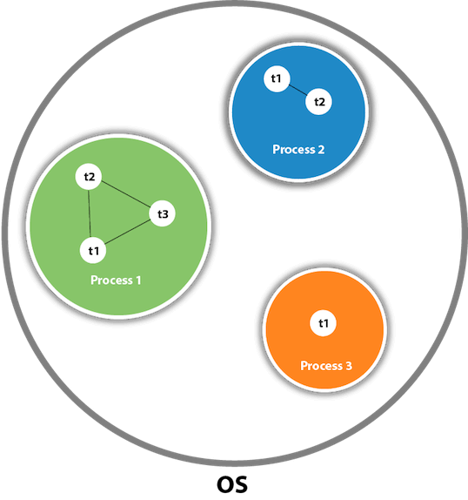

Slide 3
Advantages of Java Multithreading
It doesn't block the user because threads are independent and you can perform multiple operations at the same time.
You can perform many operations together, so it saves time.
Threads are independent, so it doesn't affect other threads if an exception occurs in a single thread.

Slide 4
By extending Thread class
class Multi extends Thread{
public void run(){
System.out.println("thread is running...");
}
public static void main(String args[]){
Multi t1=new Multi();
t1.start();
}
}

Slide 5
By implementing Runnable interface
class Multi3 implements Runnable{
public void run(){
System.out.println("thread is running...");
}
public static void main(String args[]){
Multi3 m1=new Multi3();
Thread t1 =new Thread(m1);
t1.start();
}
}

Slide 6
How to perform multiple tasks by multiple threads
class Simple1 extends Thread{
public void run(){
System.out.println("task one");
}
}
class Simple2 extends Thread{
public void run(){
System.out.println("task two");
}
}
class TestMultitasking3{
public static void main(String args[]){
Simple1 t1=new Simple1();
Simple2 t2=new Simple2();
t1.start();
t2.start();
}
}

Slide 7
Sleep method
class TestSleepMethod1 extends Thread{
public void run(){
for(int i=1;i<5;i++){
try{Thread.sleep(500);}catch(InterruptedException e){System.out.println(e);}
System.out.println(i);
}
}
public static void main(String args[]){
TestSleepMethod1 t1=new TestSleepMethod1();
TestSleepMethod1 t2=new TestSleepMethod1();
t1.start();
t2.start();
}
}

Slide 8
Writing Data
import java.io.FileOutputStream;
public class FileOutputStreamExample {
public static void main(String args[]){
try{
FileOutputStream fout=new FileOutputStream("D:\\testout.txt");
String s="Welcome to javaTpoint.";
byte b[]=s.getBytes();//converting string into byte array
fout.write(b);
fout.close();
System.out.println("success...");
}catch(Exception e){System.out.println(e);}
}
}

Slide 9
Reading Data
import java.io.FileInputStream;
public class DataStreamExample {
public static void main(String args[]){
try{
FileInputStream fin=new FileInputStream("D:\\testout.txt");
int i=0;
while((i=fin.read())!=-1){
System.out.print((char)i);
}
fin.close();
}catch(Exception e){System.out.println(e);}
}
}

Slide 10

ashok.m@ritchennai.edu.in
+91-7667472476

