Slide 1

WIPRO – Java Training
M.Ashok
Rajalakshmi Institutions

Slide 2
Java Annotations
Java Annotation is a tag that represents the metadata i.e. attached with class, interface, methods or fields to indicate some additional information which can be used by java compiler and JVM.
Annotations in Java are used to provide additional information, so it is an alternative option for XML and Java marker interfaces.

Slide 3
Built-In Java Annotations
@Override
@SuppressWarnings
@Deprecated

Slide 4
Built-In Java Annotations used in other annotations
@Target
@Retention
@Inherited
@Documented

Slide 5
@Override
class Animal{
void eatSomething(){System.out.println("eating something");}
}
class Dog extends Animal{
@Override
void eatsomething(){System.out.println("eating foods");}//should be eatSomething
}
class TestAnnotation1{
public static void main(String args[]){
Animal a=new Dog();
a.eatSomething();
}}

Slide 6
@SuppressWarnings
import java.util.*;
class TestAnnotation2{
@SuppressWarnings("unchecked")
public static void main(String args[]){
ArrayList list=new ArrayList();
list.add("sonoo");
list.add("vimal");
list.add("ratan");
for(Object obj:list)
System.out.println(obj);
}}

Slide 7
@Deprecated
class A{
void m(){System.out.println("hello m");}
@Deprecated
void n(){System.out.println("hello n");}
}
class TestAnnotation3{
public static void main(String args[]){
A a=new A();
a.n();
}}

Slide 8
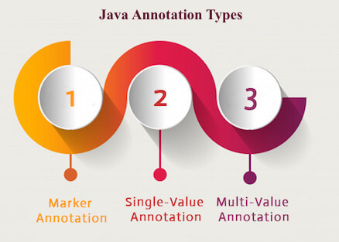
Java Custom Annotations

Slide 9
Marker Annotation
@interface MyAnnotation{}

Slide 10
Single-Value Annotation
@interface MyAnnotation{
int value();
}
@MyAnnotation(value=10)

Slide 11
Multi-Value Annotation
@interface MyAnnotation{
int value1();
String value2();
String value3();
}
}
@MyAnnotation(value1=10,value2="Arun Kumar",value3="Ghaziabad")

Slide 12
Junit
It is an open-source testing framework for java programmers.
The java programmer can create test cases and test his/her own code.
To perform unit testing, we need to create test cases.
The unit test case is a code which ensures that the program logic works as expected.

Slide 13
Types of unit testing
1) Manual Testing
If you execute the test cases manually without any tool support, it is known as manual testing. It is time consuming and less reliable.
2) Automated Testing
If you execute the test cases by tool support, it is known as automated testing. It is fast and more reliable.

Slide 14
Annotations for Junit testing
@Test annotation specifies that method is the test method.
@Test(timeout=1000) annotation specifies that method will be failed if it takes longer than 1000 milliseconds (1 second).
@BeforeClass annotation specifies that method will be invoked only once, before starting all the tests.
@Before annotation specifies that method will be invoked before each test.
@After annotation specifies that method will be invoked after each test.
@AfterClass annotation specifies that method will be invoked only once, after finishing all the tests.

Slide 15
Assert class
void assertEquals(boolean expected,boolean actual): checks that two primitives/objects are equal. It is overloaded.
void assertTrue(boolean condition): checks that a condition is true.
void assertFalse(boolean condition): checks that a condition is false.
void assertNull(Object obj): checks that object is null.
void assertNotNull(Object obj): checks that object is not null.

Slide 16
Logic to find the maximum number for an array.
public class Calculation {
public static int findMax(int arr[]){
int max=0;
for(int i=1;i<arr.length;i++){
if(max<arr[i])
max=arr[i];
}
return max;
}
}

Slide 17
test case
import org.junit.Test;
public class TestLogic {
@Test
public void testFindMax(){
assertEquals(4,Calculation.findMax(new int[]{1,3,4,2}));
assertEquals(-1,Calculation.findMax(new int[]{-12,-1,-3,-4,-2}));
}
}

Slide 18
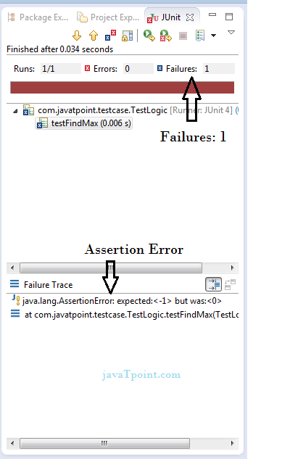
Output

Slide 19
Correct program logic
public class Calculation {
public static int findMax(int arr[]){
int max=arr[0];//arr[0] instead of 0
for(int i=1;i<arr.length;i++){
if(max<arr[i])
max=arr[i];
}
return max;
}
}

Slide 20
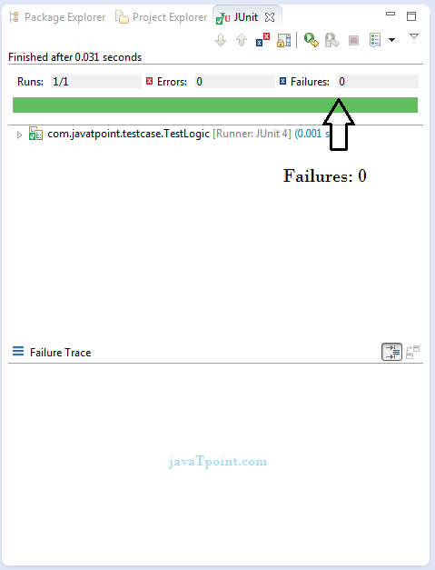
Output

Slide 21
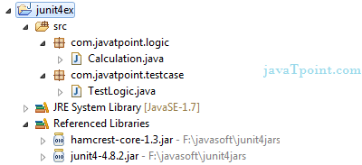
To Work
You need to load junit4.jar and hamcrest-core.jar files.
right click on TestLogic class -> Run As -> 1Junit Test

