Slide 1

WIPRO – Java Training
M.Ashok
Rajalakshmi Institutions

Slide 2
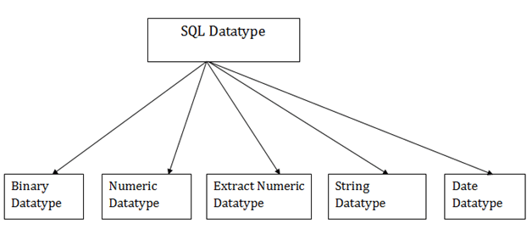
SQL Datatype

Slide 3
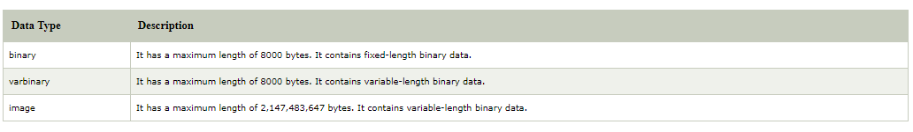
Binary

Slide 4
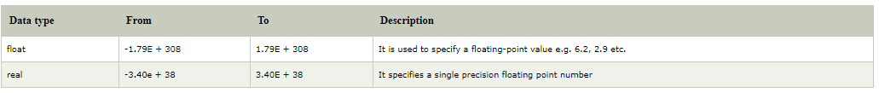
Approximate Numeric Datatype

Slide 5
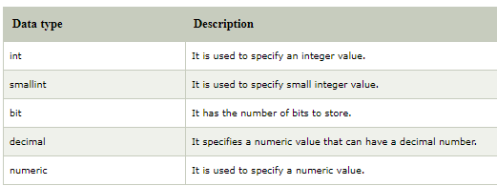
Exact Numeric Datatype

Slide 6
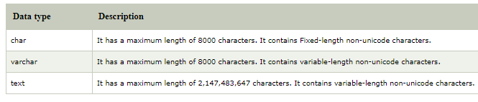
Character String Datatype

Slide 7
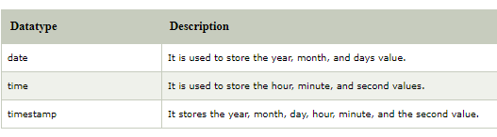
Date and time Datatypes

Slide 8
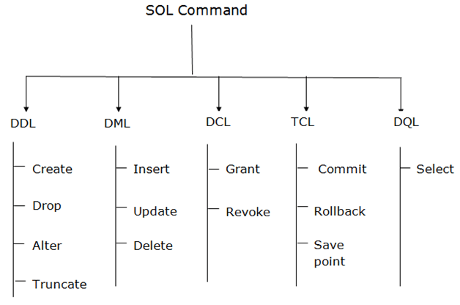
Types of SQL Commands

Slide 9
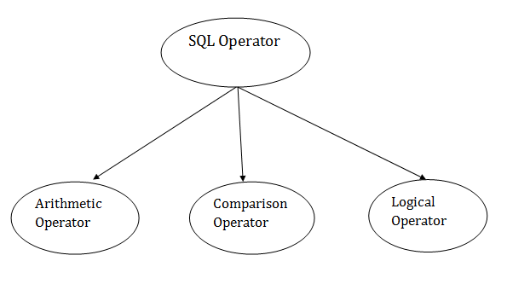
SQL Operators

Slide 10
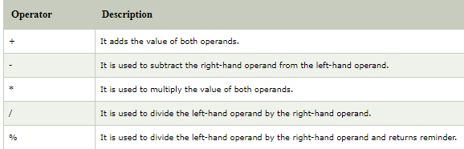
SQL Arithmetic Operators

Slide 11
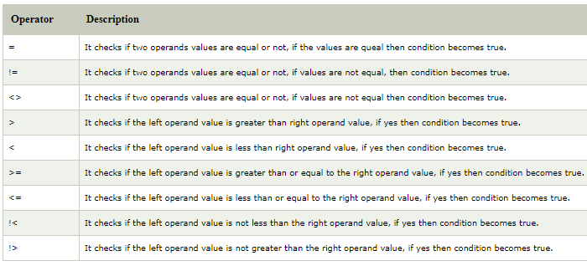
SQL Comparison Operators

Slide 12
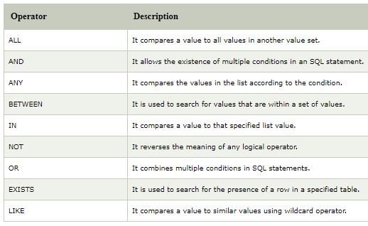
SQL Logical Operators

Slide 13
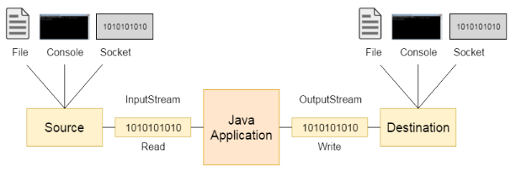
Java/IO

Slide 14
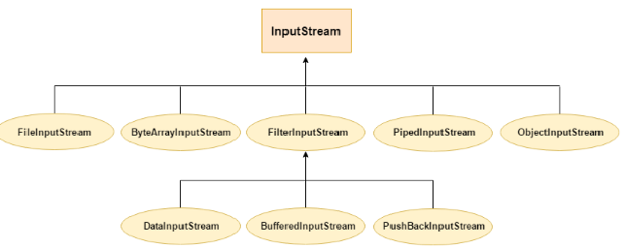
Input Stream

Slide 15
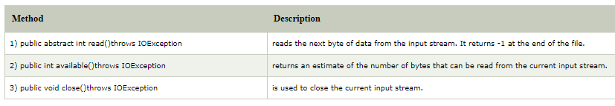
Methods

Slide 16
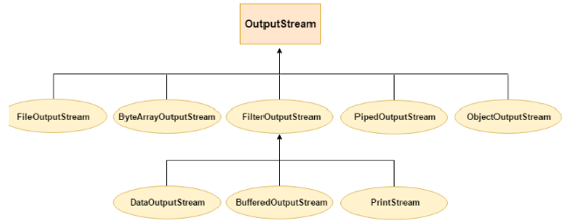
Output Stream

Slide 17
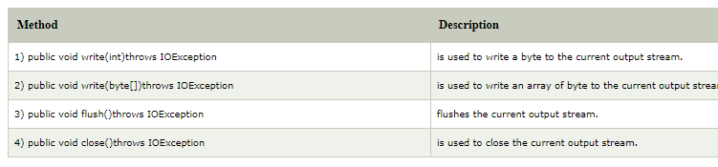
Methods

