Slide 1

WIPRO – Java Training
M.Ashok
Rajalakshmi Institutions

Slide 2
SQL CREATE Database
CREATE DATABASE database_name;

Slide 3
SQL DROP Database
DROP DATABASE database_name;

Slide 4
SQL RENAME Database
RENAME DATABASE old_db_name TO new_db_name;

Slide 5
SQL SELECT Database
USE DATABASE database_name;

Slide 6
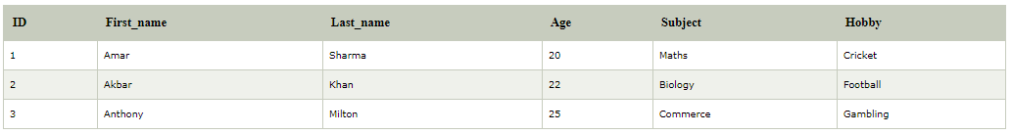
SQL SELECT

Slide 7
SQL SELECT
SELECT expressions
FROM tables
WHERE conditions;

Slide 8
Optional clauses in SELECT statement
[WHERE Clause] : It specifies which rows to retrieve.
[GROUP BY Clause] : Groups rows that share a property so that the aggregate function can be applied to each group.
[HAVING Clause] : It selects among the groups defined by the GROUP BY clause.
[ORDER BY Clause] : It specifies an order in which to return the rows.

Slide 9
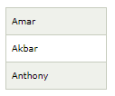
select first_name from student_details;

Slide 10
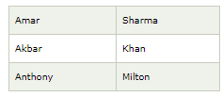
SELECT first_name, last_name FROM student_details;

Slide 11
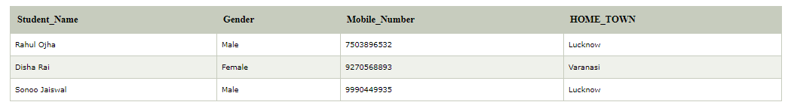
SQL SELECT DISTINCT

Slide 12
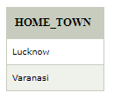
SELECT DISTINCT home_town FROM students

Slide 13
Fact
SQL SELECT UNIQUE and SQL SELECT DISTINCT statements are same

Slide 14
SQL SELECT COUNT
SELECT COUNT(students_name) FROM students;
SELECT COUNT(*) FROM students;
SELECT COUNT(DISTINCT home_town) FROM students;
NULL Values <> COUNT

Slide 15
The join() method
class TestJoinMethod1 extends Thread{
public void run(){
for(int i=1;i<=5;i++){
try{
Thread.sleep(500);
}catch(Exception e){System.out.println(e);}
System.out.println(i);
}
}
public static void main(String args[]){
TestJoinMethod1 t1=new TestJoinMethod1();
TestJoinMethod1 t2=new TestJoinMethod1();
TestJoinMethod1 t3=new TestJoinMethod1();
t1.start();
try{
t1.join();
}catch(Exception e){System.out.println(e);}
t2.start();
t3.start();
}
}

Slide 16
Output
1
2
3
4
5
1
1
2
2
3
3
4
4
5
5

