Slide 1

WIPRO – Java Training
M.Ashok
Rajalakshmi Institutions

Slide 2
SQL JOIN
inner join
left outer join
right outer join
full outer join
cross join

Slide 3
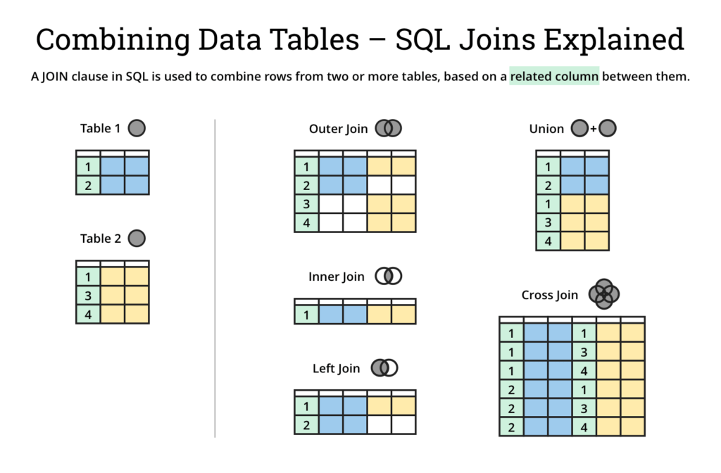

Slide 4
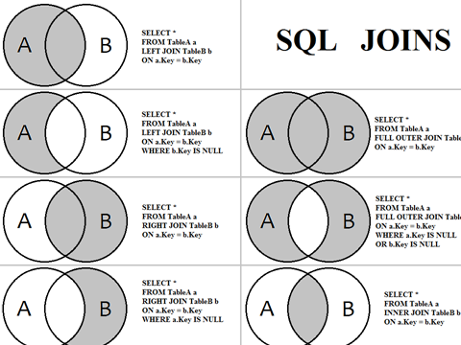

Slide 5
SQL primary key for one column
CREATE TABLE students
(
S_Id int NOT NULL PRIMARY KEY,
LastName varchar (255) NOT NULL,
FirstName varchar (255),
Address varchar (255),
City varchar (255),
)

Slide 6
SQL primary key for multiple columns
CREATE TABLE students
(
S_Id int NOT NULL,
LastName varchar (255) NOT NULL,
FirstName varchar (255),
Address varchar (255),
City varchar (255),
CONSTRAINT pk_StudentID PRIMARY KEY (S_Id, LastName)
)

Slide 7
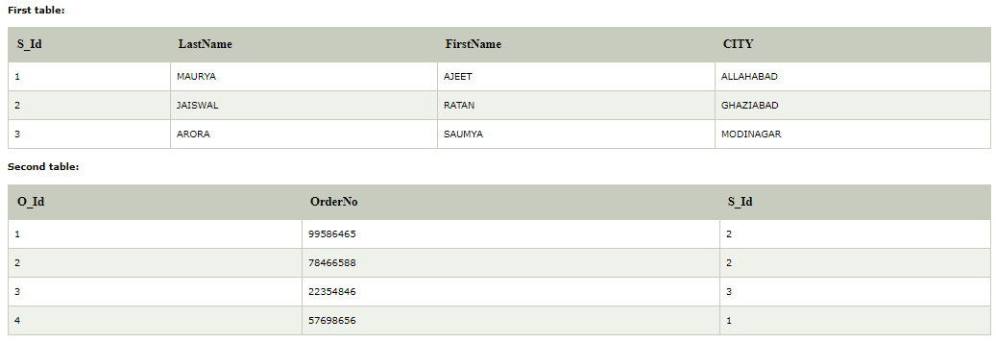
CREATE TABLE Orders ( O_Id int NOT NULL PRIMAY KEY, Order_No int NOT NULL, S_Id int FOREIGN KEY REFERENCES persons (S_Id) )

Slide 8
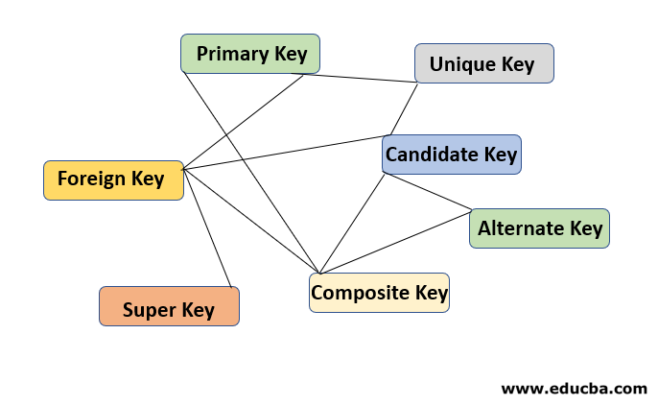

Slide 9
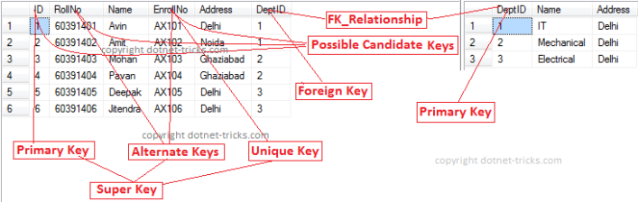

Slide 10


Slide 11
Example of initilizing variable
DECLARE
a integer := 30;
b integer := 40;
c integer;
f real;
BEGIN
c := a + b;
dbms_output.put_line('Value of c: ' || c);
f := 100.0/3.0;
dbms_output.put_line('Value of f: ' || f);
END;
Value of c: 70
Value of f: 33.333333333333333333
PL/SQL procedure successfully completed.

Slide 12
Example of Local and Global variables
DECLARE
-- Global variables
num1 number := 95;
num2 number := 85;
BEGIN
dbms_output.put_line('Outer Variable num1: ' || num1);
dbms_output.put_line('Outer Variable num2: ' || num2);
DECLARE
-- Local variables
num1 number := 195;
num2 number := 185;
BEGIN
dbms_output.put_line('Inner Variable num1: ' || num1);
dbms_output.put_line('Inner Variable num2: ' || num2);
END;
END;
/
Outer Variable num1: 95
Outer Variable num2: 85
Inner Variable num1: 195
Inner Variable num2: 185
PL/SQL procedure successfully completed.

Slide 13
PL/SQL constant
DECLARE
-- constant declaration
pi constant number := 3.141592654;
-- other declarations
radius number(5,2);
dia number(5,2);
circumference number(7, 2);
area number (10, 2);
BEGIN
-- processing
radius := 9.5;
dia := radius * 2;
circumference := 2.0 * pi * radius;
area := pi * radius * radius;
-- output
dbms_output.put_line('Radius: ' || radius);
dbms_output.put_line('Diameter: ' || dia);
dbms_output.put_line('Circumference: ' || circumference);
dbms_output.put_line('Area: ' || area);
END;
/
Radius: 9.5
Diameter: 19
Circumference: 59.69
Area: 283.53
Pl/SQL procedure successfully completed.

Slide 14
Regular Expression
import java.util.regex.*;
class RegexExample2{
public static void main(String args[]){
System.out.println(Pattern.matches(".s", "as"));//true (2nd char is s)
System.out.println(Pattern.matches(".s", "mk"));//false (2nd char is not s)
System.out.println(Pattern.matches(".s", "mst"));//false (has more than 2 char)
System.out.println(Pattern.matches(".s", "amms"));//false (has more than 2 char)
System.out.println(Pattern.matches("..s", "mas"));//true (3rd char is s)
}}

Slide 15
Pattern Matching
import java.util.regex.Pattern;
import java.util.Scanner;
import java.util.regex.Matcher;
public class RegexExample8{
public static void main(String[] args){
Scanner sc=new Scanner(System.in);
while (true) {
System.out.println("Enter regex pattern:");
Pattern pattern = Pattern.compile(sc.nextLine());
System.out.println("Enter text:");
Matcher matcher = pattern.matcher(sc.nextLine());
boolean found = false;
while (matcher.find()) {
System.out.println("I found the text "+matcher.group()+" starting at index "+
matcher.start()+" and ending at index "+matcher.end());
found = true;
}
if(!found){
System.out.println("No match found.");
}
}
}
}
Enter regex pattern: java
Enter text: this is java, do you know java
I found the text java starting at index 8 and ending at index 12
I found the text java starting at index 26 and ending at index 30

