Slide 1

WIPRO – Java Training
M.Ashok
Rajalakshmi Institutions

Slide 2
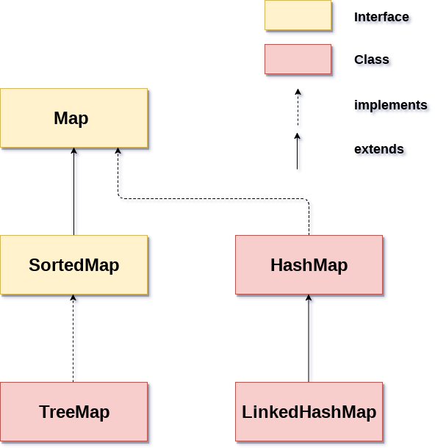

Slide 4
HashMap
import java.util.*;
public class HashMapExample1{
public static void main(String args[]){
HashMap<Integer,String> map=new HashMap<Integer,String>();//Creating HashMap
map.put(1,"Mango"); //Put elements in Map
map.put(2,"Apple");
map.put(3,"Banana");
map.put(4,"Grapes");
System.out.println("Iterating Hashmap...");
for(Map.Entry m : map.entrySet()){
System.out.println(m.getKey()+" "+m.getValue());
}
}
}

Slide 5
No Duplicate Key on HashMap
import java.util.*;
public class HashMapExample2{
public static void main(String args[]){
HashMap<Integer,String> map=new HashMap<Integer,String>();//Creating HashMap
map.put(1,"Mango"); //Put elements in Map
map.put(2,"Apple");
map.put(3,"Banana");
map.put(1,"Grapes"); //trying duplicate key
System.out.println("Iterating Hashmap...");
for(Map.Entry m : map.entrySet()){
System.out.println(m.getKey()+" "+m.getValue());
}
}
}
Iterating Hashmap... 1 Grapes 2 Apple 3 Banana

Slide 6
Linked Hash Map
import java.util.*;
class LinkedHashMapTest {
public static void main(String args[])
{
LinkedHashMap<Integer, String> lhm;
lhm = new LinkedHashMap<Integer, String>();
// insert element in LinkedHashMap
lhm.put(100, "Amit");
// inser first null key
lhm.put(null, "Ajay");
lhm.put(101, "Vijay");
lhm.put(102, "Rahul");
// insert second null key
// which replace first null key value
lhm.put(null, "Anuj");
// insert duplicate
// which replace first 102 key value
lhm.put(102, "Saurav");
lhm.entrySet().stream().forEach((m) -> {
System.out.println(m.getKey() + " " + m.getValue());
});
}
}

Slide 7
Tree Map
import java.util.*;
import java.lang.*;
import java.io.*;
class Main
{
// This function prints ordering of all elements
static void insertAndPrint(AbstractMap<Integer, String> map)
{
int[] array= {1, -1, 0, 2,-2};
for (int x: array)
{
map.put(x, Integer.toString(x));
}
for (int k: map.keySet())
{
System.out.print(k + ", ");
}
}
// Driver method to test above method
public static void main (String[] args)
{
TreeMap<Integer, String> map = new TreeMap<Integer, String>();
insertAndPrint(map);
}
}

Slide 8
Map Copy
import java.util.*;
public class Example3 {
public static void main(String args[]) {
// create two hash maps
HashMap <Integer,String> hash_map1 = new HashMap <Integer,String> ();
HashMap <Integer,String> hash_map2 = new HashMap <Integer,String> ();
// populate hash maps
hash_map1.put(1, "Red");
hash_map1.put(2, "Green");
hash_map1.put(3, "Black");
System.out.println("\nValues in first map: " + hash_map1);
hash_map2.put(4, "White");
hash_map2.put(5, "Blue");
hash_map2.put(6, "Orange");
System.out.println("\nValues in second map: " + hash_map2);
// put all values in secondmap
hash_map2.putAll(hash_map1);
System.out.println("\nNow values in second map: " + hash_map2);
}
}

