Slide 1

WIPRO – Java Training
M.Ashok
Rajalakshmi Institutions

Slide 2
Comparator
class Student {
int rollno;
String name;
int age;
Student(int rollno,String name,int age){
this.rollno=rollno;
this.name=name;
this.age=age;
}
public int getRollno() {
return rollno;
}
public void setRollno(int rollno) {
this.rollno = rollno;
}
public String getName() {
return name;
}
public void setName(String name) {
this.name = name;
}
public int getAge() {
return age;
}
public void setAge(int age) {
this.age = age;
}
}

Slide 3
Comparator
import java.util.*;
public class TestSort1{
public static void main(String args[]){
ArrayList<Student> al=new ArrayList<Student>();
al.add(new Student(101,"Vijay",23));
al.add(new Student(106,"Ajay",27));
al.add(new Student(105,"Jai",21));
/Sorting elements on the basis of name
Comparator<Student> cm1=Comparator.comparing(Student::getName);
Collections.sort(al,cm1);
System.out.println("Sorting by Name");
for(Student st: al){
System.out.println(st.rollno+" "+st.name+" "+st.age);
}
//Sorting elements on the basis of age
Comparator<Student> cm2=Comparator.comparing(Student::getAge);
Collections.sort(al,cm2);
System.out.println("Sorting by Age");
for(Student st: al){
System.out.println(st.rollno+" "+st.name+" "+st.age);
}
}
}
Sorting by Name 106 Ajay 27 105 Jai 21 101 Vijay 23
Sorting by Age 105 Jai 21 101 Vijay 23 106 Ajay 27

Slide 4
What is Apache Ant
Apache Ant (Another Neat Tool) is an open source project started by Apache Software Foundation. Ant is a Java library and a software tool used for automate software build processes such as compile, run, test and assemble Java application. It is designed and developed by Apache Software Foundation and initially released on 19 July 2000.

Slide 5
Apache Ant Features
Open Source
Flexible
Easy To Use
Cross Platform
Extensible
Scalable
XML

Slide 6
System Requirement
We need Java 8 or higher version for Ant 1.10.* version.
To install Ant, first we need to download binary from the official site https://ant.apache.org and store anywhere from the download folder.

Slide 7
Apache Ant Hello World
To create a simple hello world project, we are using Eclipse IDE and the project require the below steps.
Create a Java Project
Create a Java File
Create an XML File
Create a Folder
Run as Ant Build

Slide 8
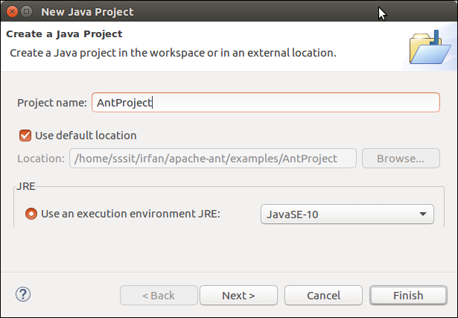

Slide 9
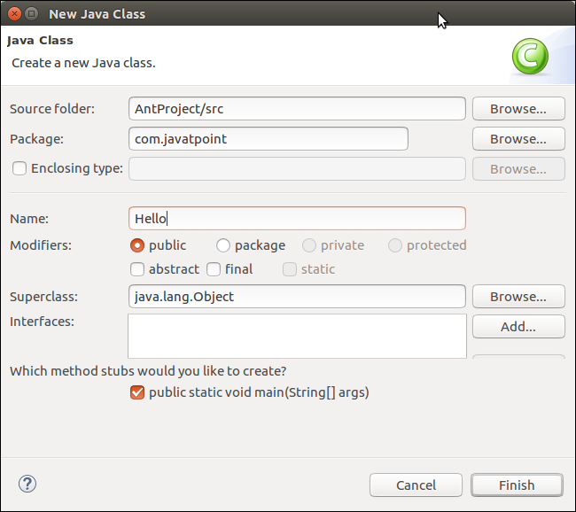

Slide 10
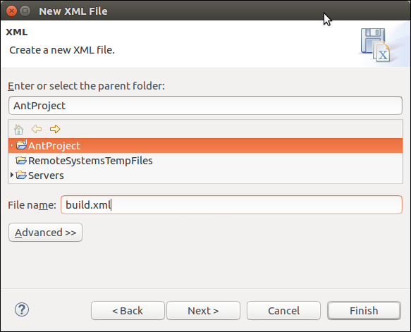

Slide 11
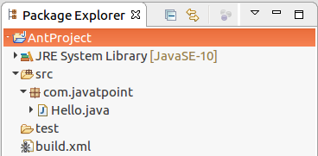

Slide 12
Hello.Java
package com.javatpoint;
public class Hello {
public static void main(String[] args) {
System.out.println("Hello World");
}
}

Slide 13
build.xml
<?xml version="1.0" encoding="UTF-8"?>
<project name="java-ant project" default="run">
<target name="run" depends="compile">
<java classname = "com.javatpoint.Hello">
<classpath path="test"></classpath>
</java>
</target>
<target name="compile">
<javac includeantruntime="false" srcdir="./src" destdir = "test"></javac>
</target>
</project>

Slide 14
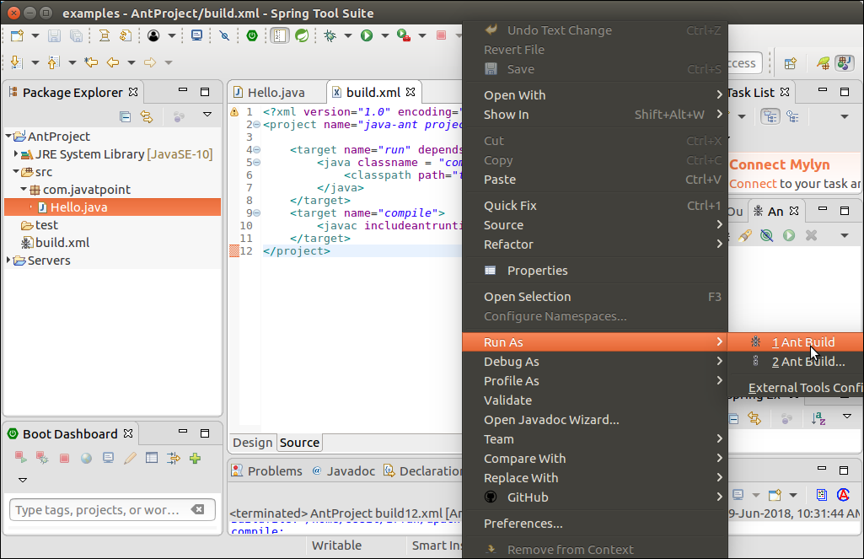

Slide 15
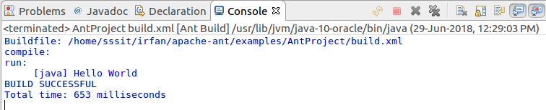

Slide 16
SEQUENCES
A sequence is a user defined schema bound object that generates a sequence of numeric values.
Sequences are frequently used in many databases because many applications require each row in a table to contain a unique value and sequences provides an easy way to generate them.
The sequence of numeric values is generated in an ascending or descending order at defined intervals and can be configured to restart when exceeds max_value.

Slide 17
SEQUENCES
CREATE SEQUENCE sequence_name
START WITH initial_value
INCREMENT BY increment_value
MINVALUE minimum value
MAXVALUE maximum value
CYCLE|NOCYCLE ;

Slide 18
E1
CREATE SEQUENCE sequence_1
start with 1
increment by 1
minvalue 0
maxvalue 100
cycle;

Slide 19
E2
CREATE SEQUENCE sequence_2
start with 100
increment by -1
minvalue 1
maxvalue 100
cycle;

Slide 20
create a table named students with columns as id and name.
CREATE TABLE students
(
ID number(10),
NAME char(20)
);
Now insert values into table
INSERT into students VALUES(sequence_1.nextval,'Ramesh');
INSERT into students VALUES(sequence_1.nextval,'Suresh');
where sequence_1.nextval will insert id’s in id column in a sequence as defined in sequence_1.
Output:
______________________
| ID | NAME |
------------------------
| 1 | Ramesh |
| 2 | Suresh |
----------------------

