Slide 1

WIPRO – Java Training
M.Ashok
Rajalakshmi Institutions

Slide 2
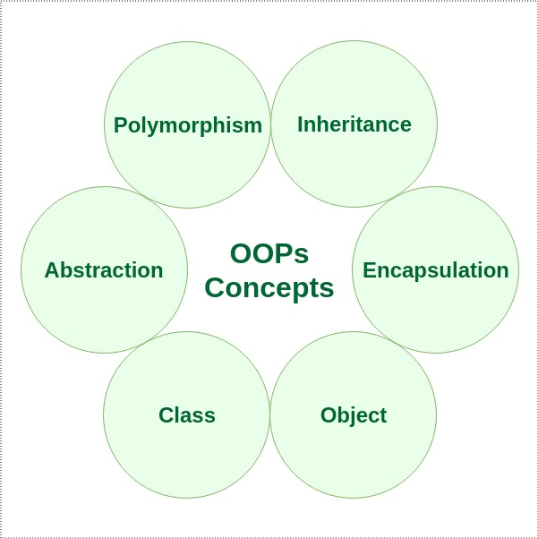
OOPS

Slide 3
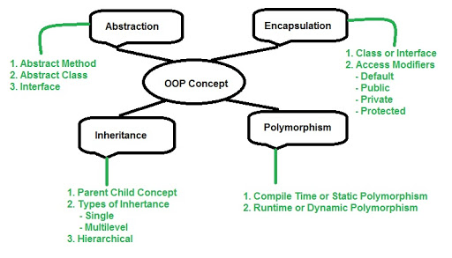
OOPS

Slide 4
Class & Object
class abc
{
int a,b;
}
public class MyClass {
public static void main(String args[]) {
abc o =new abc();
o.a=5;
o.b=7;
System.out.print(o.a+o.b);
}
}

Slide 5
Category-1
class abc
{
public void fun()
{
int a=5;
int b=6;
System.out.print(a+b);
}
}
public class MyClass {
public static void main(String args[]) {
abc o =new abc();
o.fun();
}
}

Slide 6
Category-2
class abc
{
public void fun(int a,int b)
{
System.out.print(a+b);
}
}
public class MyClass
{
public static void main(String args[])
{
abc o =new abc();
o.fun(5,6);
}
}

Slide 7
Category-3
class abc
{
public int fun()
{
int a=5,b=6;
int c=a+b;
return c;
}
}
public class MyClass
{
public static void main(String args[])
{
abc o =new abc();
int r=o.fun();
System.out.print(r);
}
}

Slide 8
Category-4
class abc
{
public int fun(int a,int b)
{
int c=a+b;
return c;
}
}
public class MyClass {
public static void main(String args[])
{
abc o =new abc();
int r=o.fun(5,6);
System.out.print(r);
}
}

Slide 9
Passing Array to a Method
class Testarray2{
//creating a method which receives an array as a parameter
static void min(int arr[]){
int min=arr[0];
for(int i=1;i<arr.length;i++)
if(min>arr[i])
min=arr[i];
System.out.println(min);
}
public static void main(String args[]){
int a[]={33,3,4,5};//declaring and initializing an array
min(a);//passing array to method
}}

Slide 10
Joinmyquiz.com

