Slide 1

WIPRO – Java Training
M.Ashok
Rajalakshmi Institutions

Slide 2
Inheritance
class one{
int a=40;
}
class two extends one{
int b=10;
public static void main(String args[]){
two p=new two();
System.out.println(p.a+p.b);
}
}

Slide 3
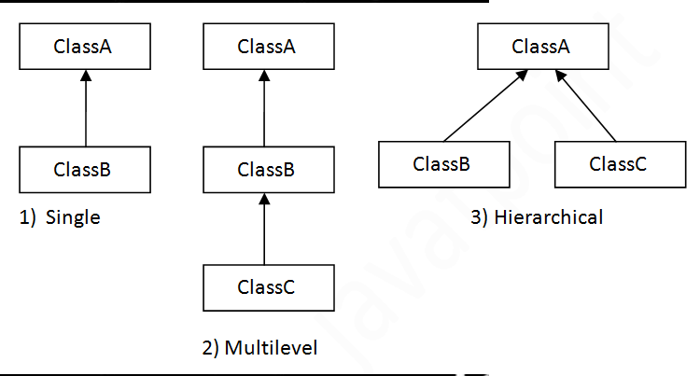
Types

Slide 4
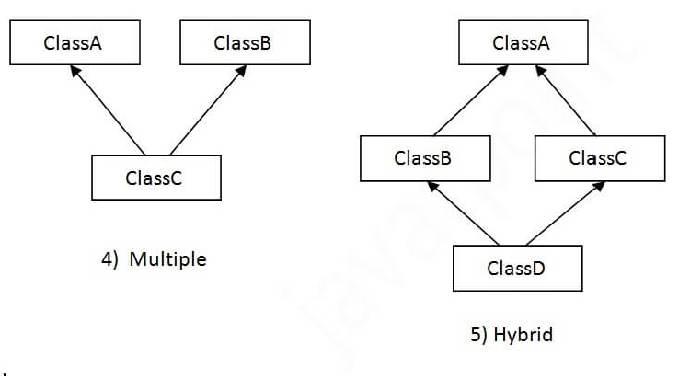
Types

Slide 5
Multilevel
class one{
int a=40;
}
class two extends one{
int b=40;
}
class three extends two{
int c=10;
public static void main(String args[]){
three p=new three();
System.out.println(p.a+p.b+p.c);
}
}

Slide 6
Hierarchial
class one{
int a=30;
}
class two extends one{
int b=40;
}
class three extends one{
int c=10;
}
class four
{
public static void main(String args[]){
three p=new three();
System.out.println(p.a+p.c);
}
}

Slide 7
Aggregation
class Operation{
int square(int n){
return n*n;
}
}
class Circle{
Operation op;//aggregation
double pi=3.14;
double area(int radius){
op=new Operation();
int rsquare=op.square(radius);//code reusability (i.e. delegates the method call).
return pi*rsquare;
}
public static void main(String args[]){
Circle c=new Circle();
double result=c.area(5);
System.out.println(result);
}
}

Slide 8
this
class Student{
int a,b;
Student(int a,int b){
this.a=a;
this.b=b;
}
void display(){System.out.println(a+b);}
}
class TestThis2{
public static void main(String args[]){
Student s1=new Student(3,5);
Student s2=new Student(6,7);
s1.display();
s2.display();
}}

Slide 9
this
class A{
void m(){System.out.println("hello m");}
void n(){
System.out.println("hello n");
//m();//same as this.m()
this.m();
}
}
class TestThis4{
public static void main(String args[]){
A a=new A();
a.n();
}}

Slide 10
1 D- Array
class Testarray{
public static void main(String args[]){
int a[]=new int[5];//declaration and instantiation
a[0]=10;//initialization
a[1]=20;
a[2]=70;
a[3]=40;
a[4]=50;
//traversing array
for(int i=0;i<a.length;i++)//length is the property of array
System.out.println(a[i]);
}}

