Slide 1

WIPRO – Java Training
M.Ashok
Rajalakshmi Institutions

Slide 2
Method Overloading: changing no. of arguments
class Adder{
static int add(int a,int b){return a+b;}
static int add(int a,int b,int c){return a+b+c;}
}
class TestOverloading1{
public static void main(String[] args){
System.out.println(Adder.add(11,11));
System.out.println(Adder.add(11,11,11));
}}

Slide 3
Method Overloading: changing data type of arguments
class Adder{
static int add(int a, int b){return a+b;}
static double add(double a, double b){return a+b;}
}
class TestOverloading2{
public static void main(String[] args){
System.out.println(Adder.add(11,11));
System.out.println(Adder.add(12.3,12.6));
}}

Slide 4
Puzzle
class TestOverloading4
{
public static void main(String[] args)
{System.out.println("main with String[]");}
public static void main(String args)
{System.out.println("main with String");}
public static void main()
{System.out.println("main without args");}
}

Slide 5
Method Overriding
//Creating a parent class.
class Vehicle{
//defining a method
void run(){System.out.println("Vehicle is running");}
}
//Creating a child class
class Bike2 extends Vehicle{
//defining the same method as in the parent class
void run(){System.out.println("Bike is running safely");}
public static void main(String args[]){
Bike2 obj = new Bike2();//creating object
obj.run();//calling method
}
}

Slide 6
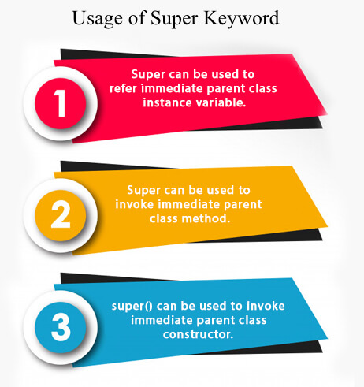
super

Slide 7
super with Variable
class Animal{
String color="white";
}
class Dog extends Animal{
String color="black";
void printColor(){
System.out.println(color);//prints color of Dog class
System.out.println(super.color);//prints color of Animal class
}
}
class TestSuper1{
public static void main(String args[]){
Dog d=new Dog();
d.printColor();
}}

Slide 8
super with Method
class Animal{
void eat(){System.out.println("eating...");}
}
class Dog extends Animal{
void eat(){System.out.println("eating bread...");}
void bark(){System.out.println("barking...");}
void work(){
super.eat();
bark();
}
}
class TestSuper2{
public static void main(String args[]){
Dog d=new Dog();
d.work();
}}

Slide 9
super with Constructor
class Animal{
Animal(){System.out.println("animal is created");}
}
class Dog extends Animal{
Dog(){
super();
System.out.println("dog is created");
}
}
class TestSuper3{
public static void main(String args[]){
Dog d=new Dog();
}}

Slide 10
this with Constructor
class A{
A(){System.out.println("hello a");}
A(int x){
this();
System.out.println(x);
}
}
class TestThis5{
public static void main(String args[]){
A a=new A(10);
}}

