Slide 1

WIPRO – Java Training
M.Ashok
Rajalakshmi Institutions

Slide 2
Ways to achieve Abstraction
Abstract class (0 to 100%)
Interface (100%)

Slide 3
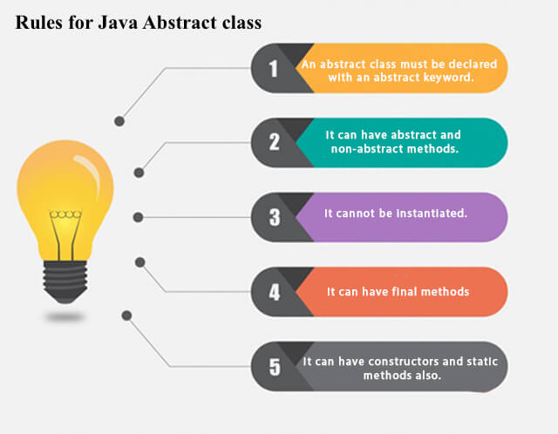
Rules

Slide 4
Abstract class that has an abstract method
abstract class Bike{
abstract void run();
}
class Honda4 extends Bike{
void run(){System.out.println("running safely");}
public static void main(String args[]){
Bike obj = new Honda4();
obj.run();
}
}

Slide 5
Real scenario of Abstract class
abstract class Shape{
abstract void draw();
}
//In real scenario, implementation is provided by others i.e. unknown by end user
class Rectangle extends Shape{
void draw(){System.out.println("drawing rectangle");}
}
class Circle1 extends Shape{
void draw(){System.out.println("drawing circle");}
}
//In real scenario, method is called by programmer or user
class TestAbstraction1{
public static void main(String args[]){
Shape s=new Circle1();//?
s.draw();
}
}

Slide 6
Interface - Facts
Since Java 8, we can have default and static methods in an interface.
Since Java 9, we can have private methods in an interface.

Slide 7
Interface
interface printable{
void print();
}
class A6 implements printable{
public void print(){System.out.println("Hello");}
public static void main(String args[]){
A6 obj = new A6();
obj.print();
}
}

Slide 8
Multiple inheritance in Java by interface
interface Printable{
void print();
}
interface Showable{
void show();
}
class A7 implements Printable,Showable{
public void print(){System.out.println("Hello");}
public void show(){System.out.println("Welcome");}
public static void main(String args[]){
A7 obj = new A7();
obj.print();
obj.show();
}
}

Slide 9
Interface inheritance
interface Printable{
void print();
}
interface Showable extends Printable{
void show();
}
class TestInterface4 implements Showable{
public void print(){System.out.println("Hello");}
public void show(){System.out.println("Welcome");}
public static void main(String args[]){
TestInterface4 obj = new TestInterface4();
obj.print();
obj.show();
}
}

Slide 10
String
String s="Sachin";
System.out.println(s.toUpperCase());
//SACHIN
System.out.println(s.toLowerCase());
//sachin
System.out.println(s);
//Sachin(no change in original)
String s=" Sachin ";
System.out.println(s);
// Sachin
System.out.println(s.trim());
//Sachin

