Slide 1
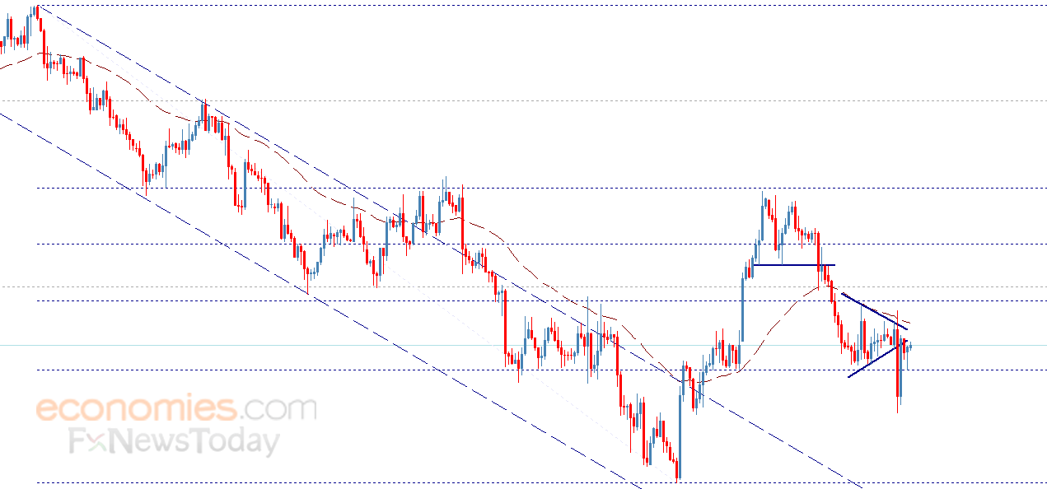
Forecast - Gold Price

Slide 2
Under the guidence: Raj shekar bapuram pallavi Team members: Shreya Verma Mohammad Sujayath Ali Priyanka Madhusagar Manchodi Anke Ashoke Omkar Kaustubh Dhananjay gambare Pranav Rajendra Bhosale

Slide 3
Business Objective:
Data provided is related to gold prices. The objective is to understand the underlying structure in your dataset and come up with a suitable forecasting model which can effectively forecast gold prices for next 30 days.
This forecast model will be used by gold exporting and gold importing companies to understand the metal price movements and accordingly set their revenue expectations.

Slide 4
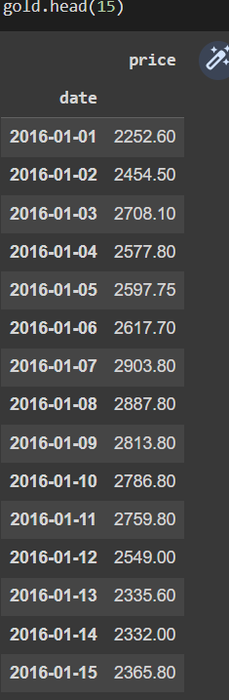
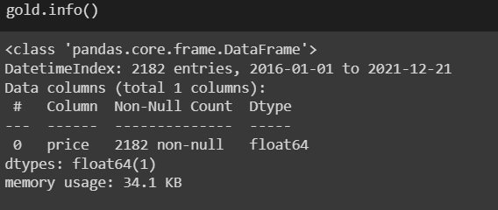
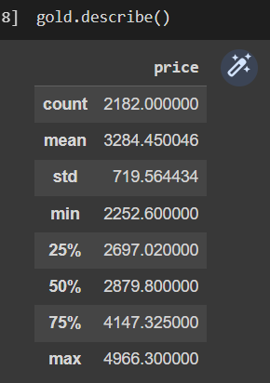

Slide 5
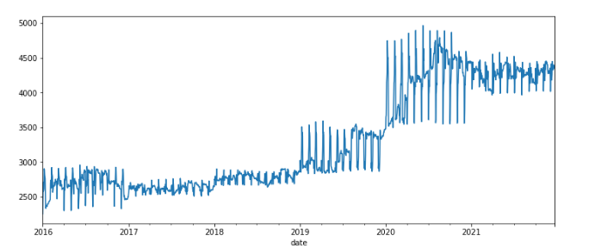
Time series plot:
Times Series plot is used to define the predictions with respect to time . The data set used for time series is called as Time-series Data set . Usually for other predictions we use Cross-sectional Data set. Here we see the flucations of gold price with respect to time for period of years

Slide 6
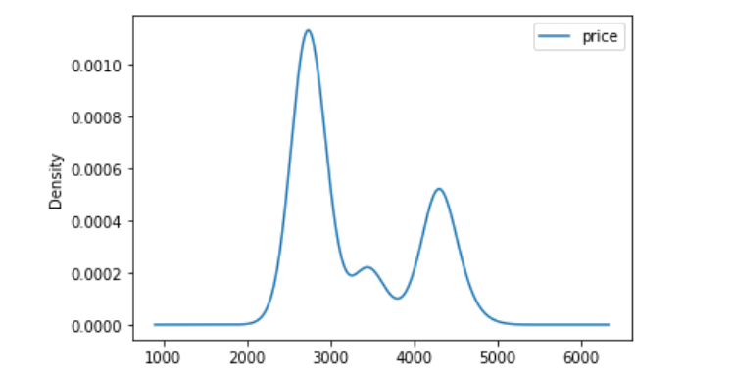
Density plot:
The density plot here gives the idea of frequency of gold price it lies for period of time

Slide 7
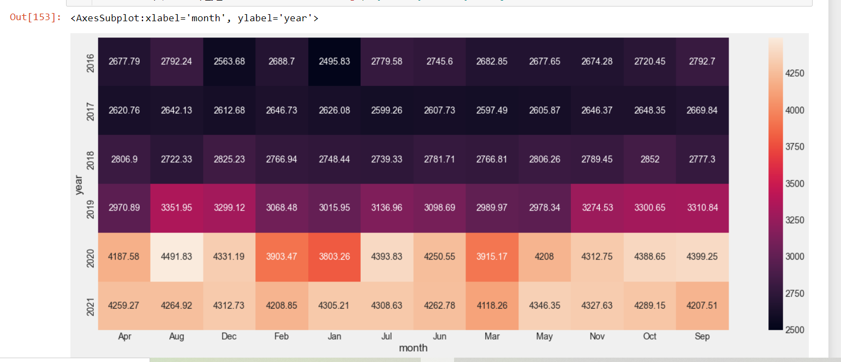
Heat Map :
The Heat map helps us to notice the value of gold prices raising/decreasing for monthwise over the years of given Data

Slide 8
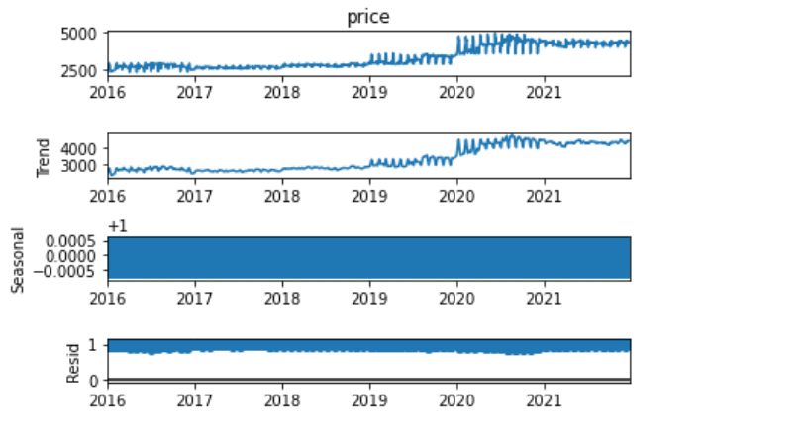
Seasonality plot:
Seasonality Plot helps understanding the laying trends , seasonality and there residuals plots , so to read whether data is Stationary or Non-Stationary

Slide 9
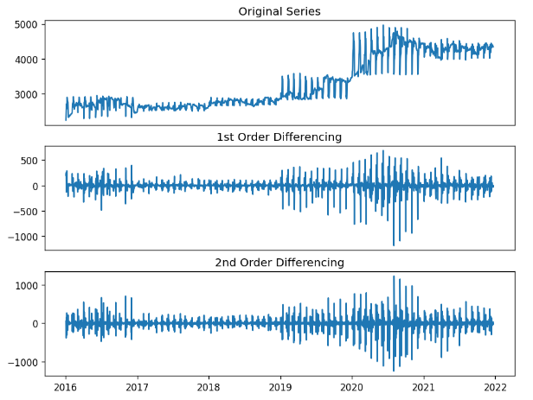
Order of Differencing:
Order of Differencing helps us to reduce the variance in data to make dataset from Non-Stationary to Stationary . Here we use Adfuller method to Know order of difference

Slide 10
Feature Engineering : By analysing the dataset , We had drawn some Insights Required for Model Building 1. Data set contains huge variance , where applying order of differencing method doesn't provides desired output { probability Value Is High even After 2nd OD } 2. So to make data stationary we had followed another method for reducing variance i.e, Transformation . In this particular method we are going with Log Transformation 3.After achieving desired Stationarity , we will be trying to built a model on SARIMA as data contains Seasonality As part of Equation Based Model
Further Process of Model Understanding and Building is Yet to Achieve

Slide 11
Forecasting models
SARIMA
Prophet
Naïve seasonal
NBEATS model
Xgboost
Darts librery

Slide 12
SARIMA model:
Seasonal Auto-Regressive Integrated Moving Average with eXogenous factors, or SARIMAX, is an extension of the ARIMA class of models.
Intuitively, ARIMA models compose 2 parts: the autoregressive term (AR) and the moving-average term (MA).
The former views the value at one time just as a weighted sum of past values. The latter model that same value also as a weighted sum but of past residuals (confer. time series decomposition).
There is also an integrated term (I) to difference the time series
Overall, ARIMA is a very decent type of models. However, the problem with this vanilla version is that it cannot handle seasonality — a big weakness.

Slide 13

Comes SARIMA — the predecessor of SARIMAX. One shorthand notation for SARIMA models is:

Slide 14
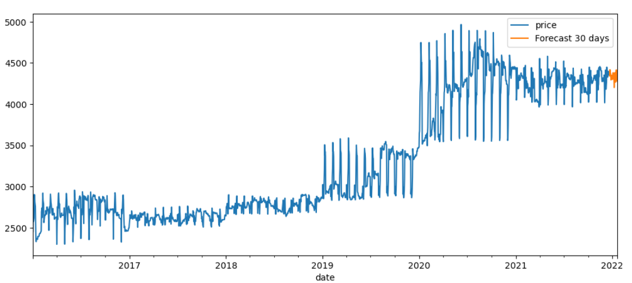
Fig:SARIMA model RMSE(Root mean square error) Of the SARIMA Model is:175.55

Slide 15
Prophet model:
Prophet is open source software released by Facebook’s Core Data Science team
Prophet is a procedure for forecasting time series data based on an additive model where non-linear trends are fit with yearly, weekly, and daily seasonality, plus holiday effects.
It works best with time series that have strong seasonal effects and several seasons of historical data.
Prophet is robust to missing data and shifts in the trend, and typically handles outliers well.
Prophet returns a large DataFrame with many interesting columns, but we subset our output to the columns most relevant to forecasting. These are:
ds: the datestamp of the forecasted value
yhat: the forecasted value of our metric (in Statistics, yhat is a notation traditionally used to represent the predicted values of a value y)
yhat_lower: the lower bound of our forecasts
yhat_upper: the upper bound of our forecasts

Slide 16
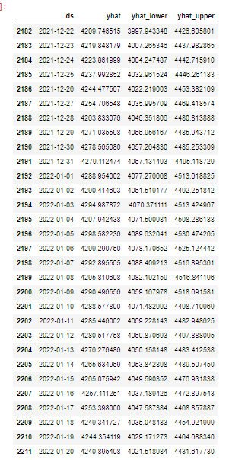
Table:Prophet forecasted prices

Slide 17
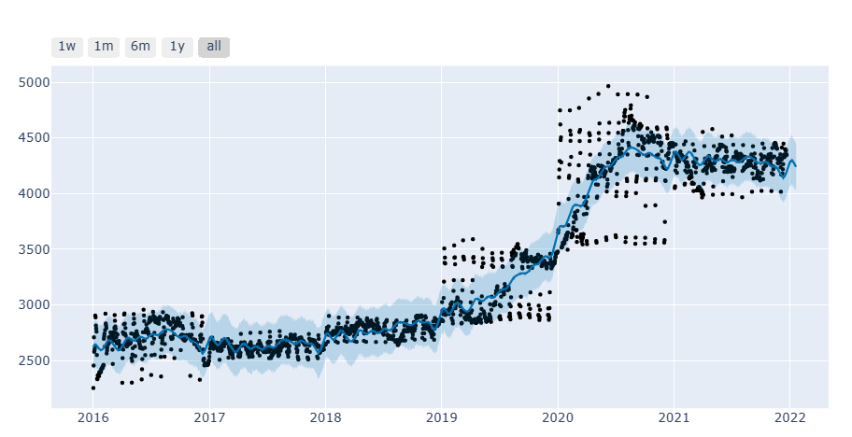
Prophet plots the observed values of our time series (the black dots), the forecasted values (blue line) and the uncertainty intervals of our forecasts (the blue shaded regions). RMSE Of the prophet model:168.7

Slide 18
Darts librery
The models can all be used in the same way, using fit() and predict() functions, similar to scikit-learn.
darts is a Python library for easy manipulation and forecasting of time series. It contains a variety of models, from classics such as ARIMA to deep neural networks.
The moeel can call be used in the sam way,using fit(),and predict() functions,similar to scikit-learn.
The library also makes it easy to backtest models, combine the predictions of several models, and take external data into account.
Darts supports both univariate and multivariate time series and models.
The ML-based models can be trained on potentially large datasets containing multiple time series, and some of the models offer a rich support for probabilistic forecasting.

Slide 19
Naïve seasonal:
There is a collection of "naive" baseline models in Darts, which can be very useful to get an idea of the bare minimum accuracy that one could expect.
For example, the NaiveSeasonal(K) model always "repeats" the value that occured K time steps ago.
In its most naive form, when K=1, this model simply always repeats the last value of the training series
It's very easy to fit models and produce predictions on TimeSeries. All the models have a fit() and a predict() function.
This is similar to Scikit-learn, except that it is specific to time series. The fit() function takes in argument the training time series on which to fit the model, and the predict() function takes in argument the number of time steps (after the end of the training series) over which to forecast.

Slide 20
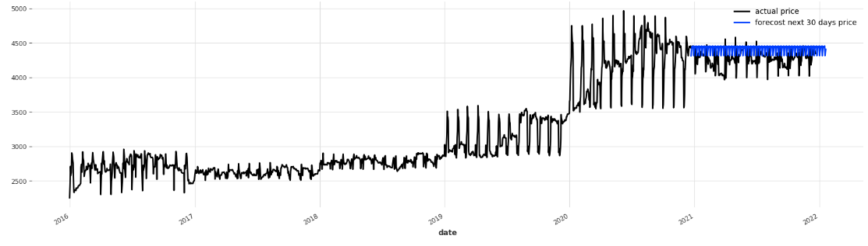
RMSE of the Naïve seasonal:189.29

Slide 21
NBEATS Model:
N-BEATS: Neural basis expansion analysis for interpretable time series forecasting
We focus on solving the univariate times series point forecasting problem using deep learning
We propose a deep neural architecture based on backward and forward residual links and a very deep stack of fully-connected layers.
N-BEATS is a state-of-the-art model that shows the potential of pure DL architectures in the context of the time-series forecasting.
It outperforms well-established statistical approaches on the M3, and M4 competitions.
N-BEATS is a univariate model architecture that offers two configurations: a generic one and a interpretable one.
The generic architecture uses as little prior knowledge as possible, with no feature engineering, no scaling and no internal architectural components that may be considered time-series-specific.
To start off, we use a model with the generic architecture of N-BEATS:

Slide 22
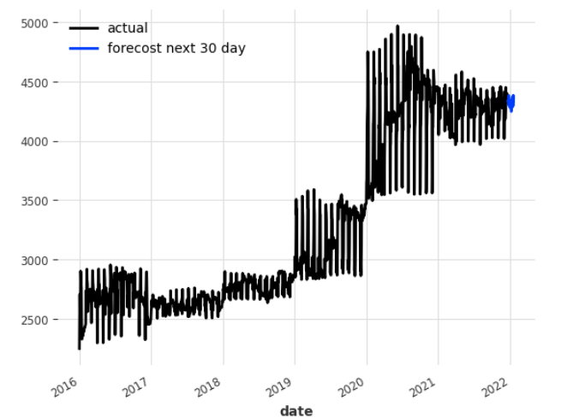
RMSE of NBEATS Model:366.9

Slide 23
Xgboost model:
XGBoost is an efficient implementation of gradient boosting for classification and regression problems.
XGBoost is designed for classification and regression on tabular datasets, although it can be used for time series forecasting.

Slide 24
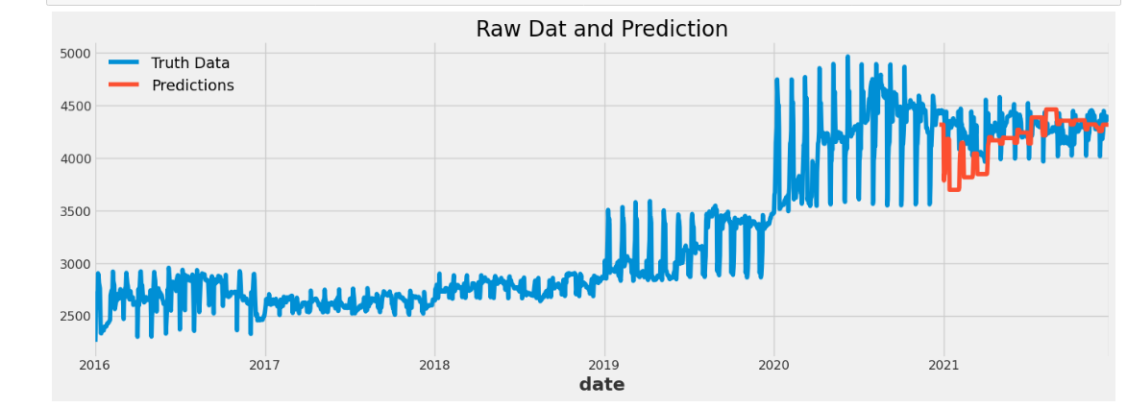
RMSE of the Xgboost model :231.89

Slide 25
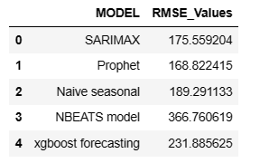
Conclusion:
Finally move on the deployement which model gives the lowest rmse value,to move on deployement.
To observe the all rmse values, lowest rme value give the prphet model

Slide 26
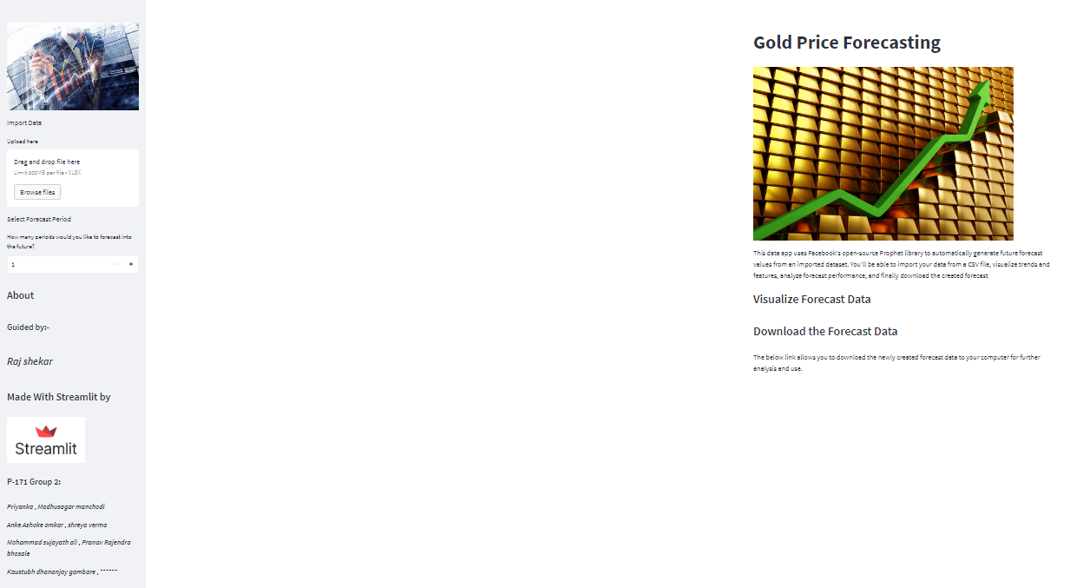
Deployment:

Slide 27


Slide 28
challenges faced:
Fist of all we faced the challenges to understand the data and we have learn only class room teaching forecasting model.
To research different forecasting model and to undersatnd the model concepts very to difficult but to need to concentrated the concept is very easy

Slide 29
THANK YOU
We team welcomes your doubts ; reach us @
shverma511@gmail.com
sujayath105@gmail.com
vollepriyanka@gmail.com
sagarmadhu029@gmail.com
ashokomkar6@gmail.com
kaustubhgambare4040@gmail.com
pranavbhosale100@gmail.com

