Slide 1

Cucumber Framework: Set-Up

Slide 2
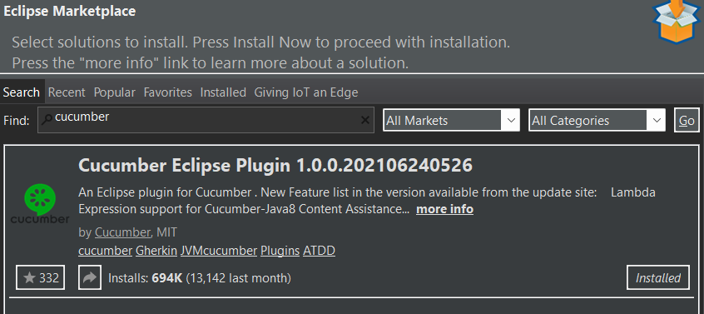
Cucumber Framework: Setup
Install cucumber plugin

Slide 3
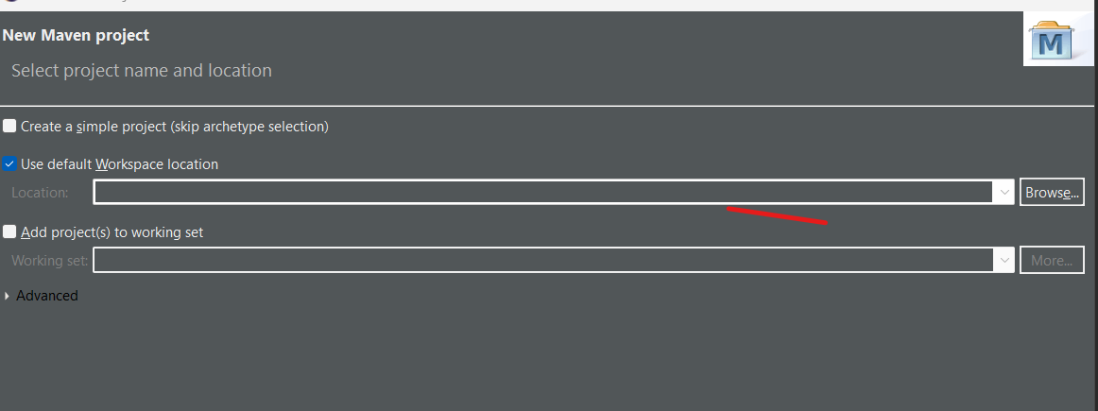
Cucumber Framework: Setup
Create Maven Project

Slide 4
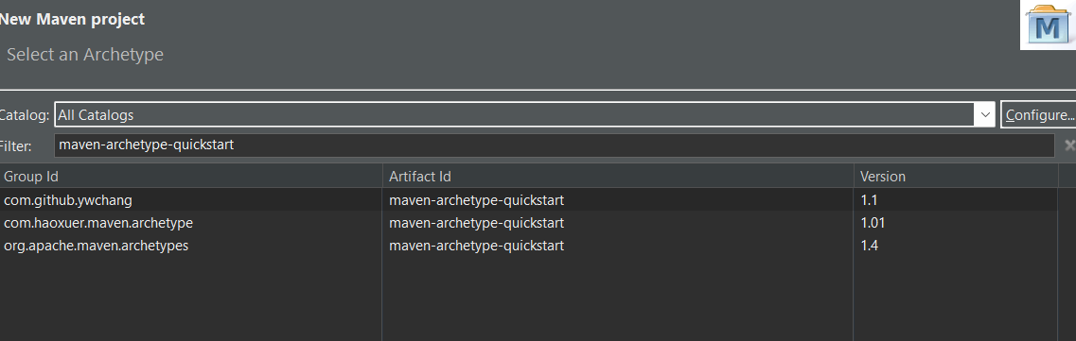
Cucumber supports maven-archetype-quickstart(1.1) template
Groupid : project name artifact id : package name
Src/test/java is the folder we need to have test cases
Convert project to cucumber project ( rightclick on project→ configure→ Convert to cucumber project)

Slide 5
Add Dependencies
Latest Junit
Add Cucumber Dependencies
Download Eclipse Natural plug-in

Slide 6


