Slide 1
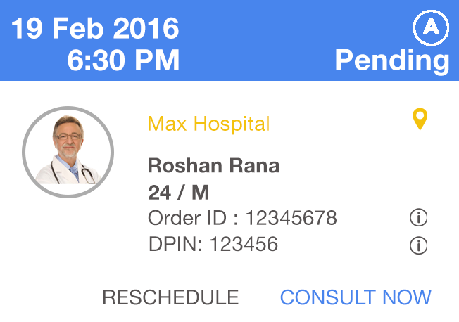
Dear <Salutation> <First Name>
Your Online Video Consultation appointment with <Patient Name> is confirmed.
Day of Week also
From & to time
Rs. 500
No Photo
No i Icons
Practice location in blue
Grey outline
Left Indent of text, tile in center
REQUEST RESCHEDULE Button
Please make sure that you connect at the scheduled time, the consultation can be completed only during the scheduled timeslot.
Be ready for the consultation with good internet connection, peaceful surroundings and good ambient light. In case of technical issues / connectivity issues you can complete your consultation on phone by calling on our Backup number - 9643334131 . You will have to enter the order ID & TPIN DPIN to successfully complete this consultation on phone.
In case of no show by you either by phone or video call the appointment will be automatically cancelled and the full amount will be refunded back to the patient. No Show on video consultation has an impact on your ratings on the platform.
You can raise a reschedule request for this appointment anytime upto 5 minutes prior to the scheduled time. Patient will get an option to reschedule the appointment for the same location or cancel the appointment and raise a refund request. For more details on rescheduling & cancellation ploicy, visit NimbusClinic T&C.
Team NimbusClinic

