Slide 1
Power & Thermal (Bring up checklist & overview)
Vinit – IN005850
BSP TEAM

Slide 2
Agenda
Power checklist
Wake lock Profiler
Thermal Hal service
Horae & Unified intelligent temperature control
ORMS – Introduction
Debug tools & logs
Case studies

Slide 3
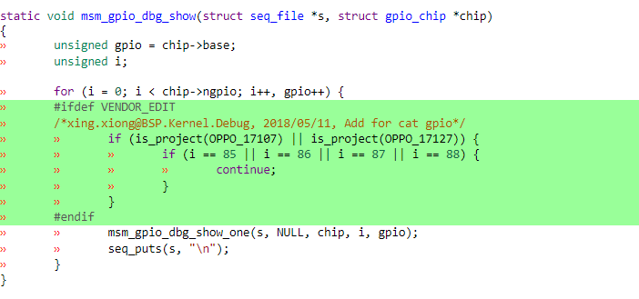
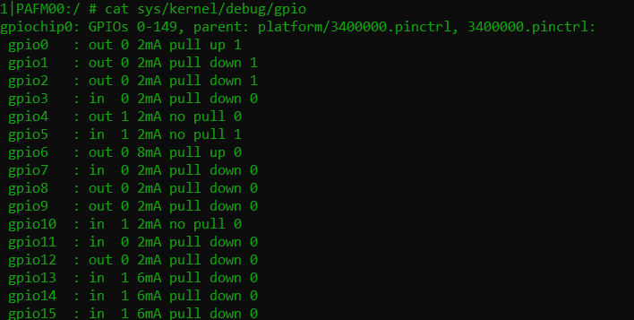
Power
Base Current :
Standby Current [ Screen OFF <10mA & Screen ON – compare with previous OS]
GPIO Verification
All GPIO verification [ including camera, MM, wifi etc. ]
pinctrl-msm.c -> msm_gpio_dbg_show() & /sys/kernel/debug/gpio (http://gerrit.scm.adc.com:8080/#/c/10055522/ )

Slide 4
wakelock_profiler
Wakelock Profiler
Need to configure wakelock profiler, so that DCS and power monitor reasons can be identified.
Flags to enable this feature [defconfig]
CONFIG_OPLUS_WAKELOCK_PROFILER=y
CONFIG_OPLUS_POWER_QCOM=y
Interrupt statics
\kernel\msm-4.14\drivers\irqchip\irq-gic-v3.c
alarm statistics
\kernel\msm-4.14\kernel\time\alarmtimer.c
Wakeup statistics
\kernel\msm-4.14\drivers\base\power\wakeup.c
wakelock_profiler code
\vendor\oplus\kernel\oppo_wakelock_profiler\

Slide 5
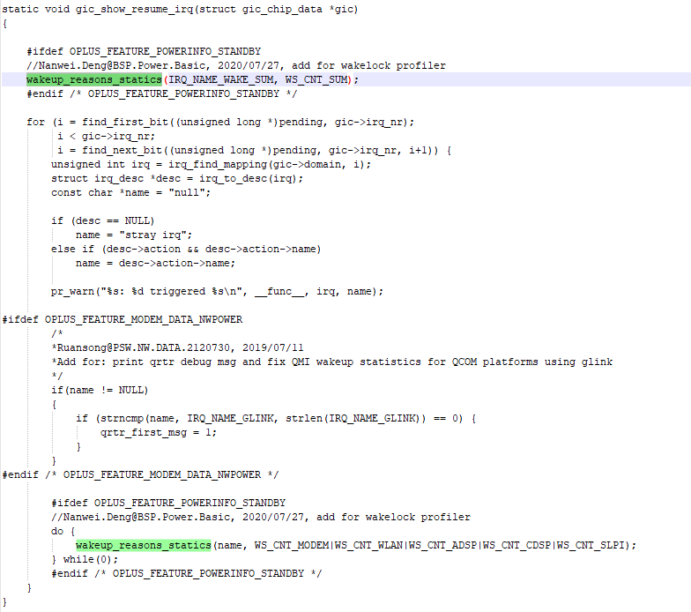
Statistics of the number of interruptions
Wakeup_reasons_statics is the entry of wakelock_profiler interrupt statistics
WS_CNT_SUM: counts all interrupt times
WS_CNT_MODEM|WS_CNT_WLAN|WS_CNT_ADSP|WS_CNT_CDSP|WS_CNT_SLPI: counts the number of interrupts separately

Slide 6
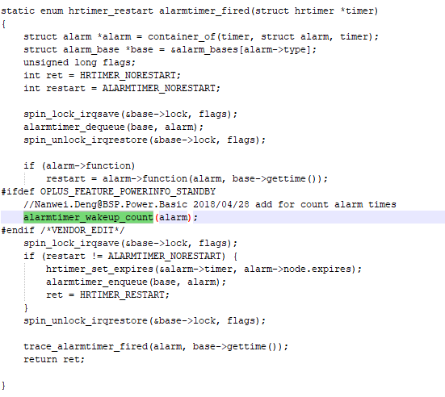
Alarm Statistics
alarmtimer_wakeup_count is the entry of wakelock_profiler alarm statistics times

Slide 7
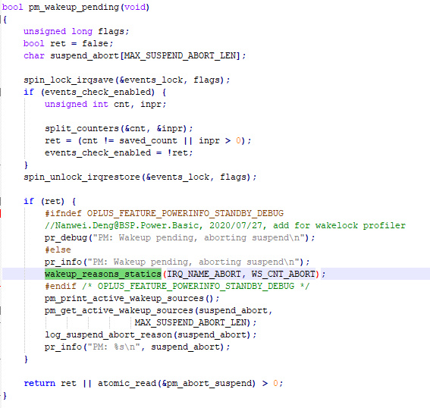
Wakeup Statistics
Wakeup_reasons_statics is the entrance to wakelock_profiler wakeup statistics

Slide 8
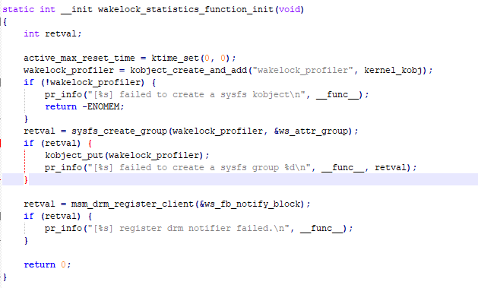
Wakelock profiler
Initialize wakelock_profiler
/sys/kernel/wakelock_profiler/ap_resume_reason_stastics
/sys/kernel/wakelock_profiler/modem_resume_reason_stastics

Slide 9
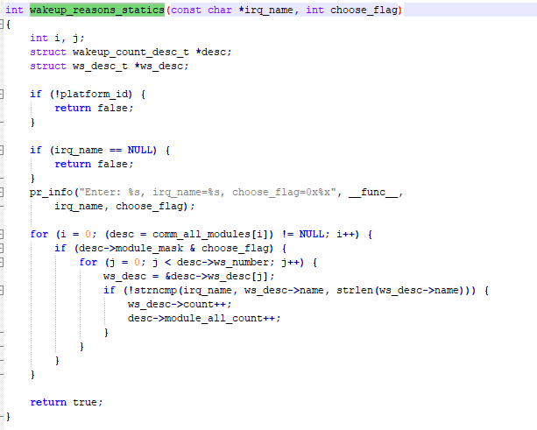
Wakelock profiler
interruptions and wakeups:

Slide 10
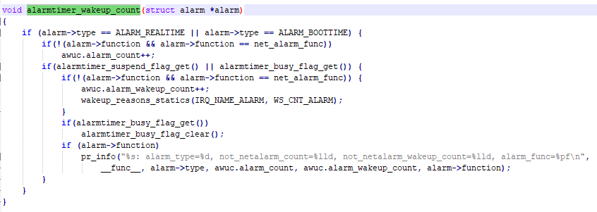
Wakelock profiler
Alarm Statistics

Slide 11
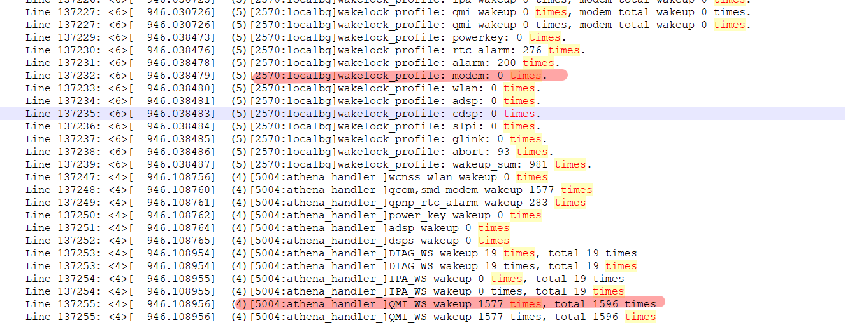
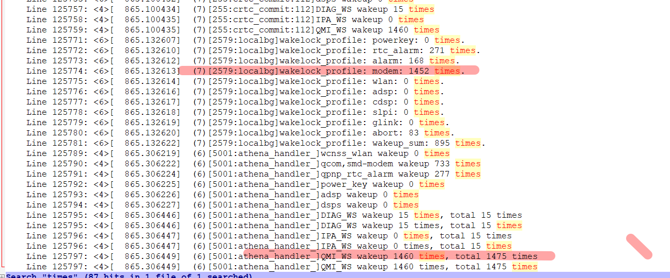
Logs
Kernel

Slide 12
Other
OPLUS_FEATURE_POWERINFO_RPMH & OPLUS_FEATURE_POWERINFO_STANDBY
Feature and solutions
Freeze solutions, GPA optimization , multilevel brightness, night network mode etc.

Slide 13
Thermal
Thermal@2.0 Integration
thermal-hal_product.mk
SE Policy related changes
Thermalconfig.cpp [ changes specific to soc id ]
DTSI changes

Slide 14
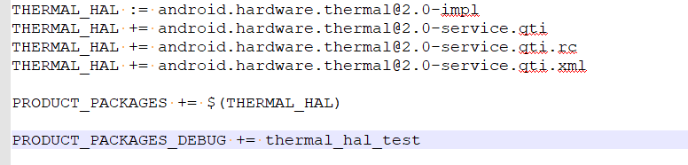
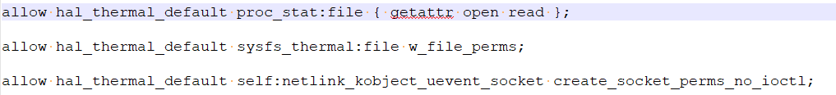
Thermal : qcom-proprietary changes
platform/vendor/qcom-proprietary/coretech-config-vendor / thermal-hal/thermal-hal_product.mk
device/qcom/sepolicy_vndr / legacy/vendor/common/hal_thermal_default.te
device/qcom/sepolicy_vndr / legacy/vendor/common/file_contexts
/(vendor|system/vendor)/bin/hw/android.hardware.thermal@2.0-service.qti u:object_r:hal_thermal_default_exec:s0

Slide 15

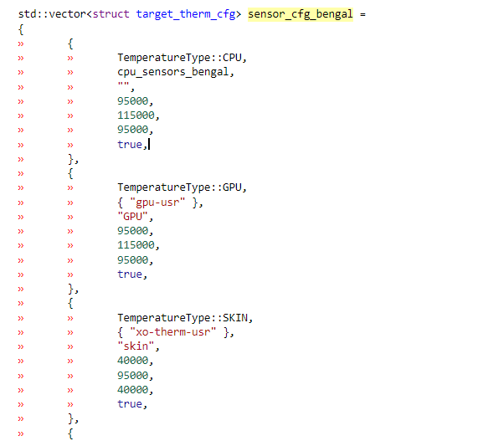
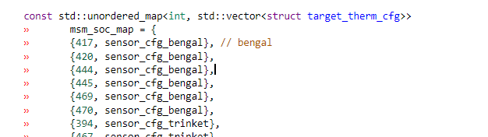
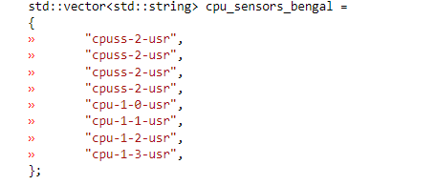
Thermal
thermalConfig.cpp
Add entry in target_therm_cfg map for project soc id along with sensor vector.
Configure based on soc ID(/sys/devices/soc0/soc_id)

Slide 16
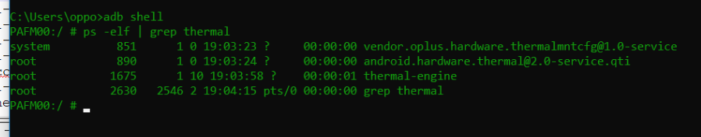
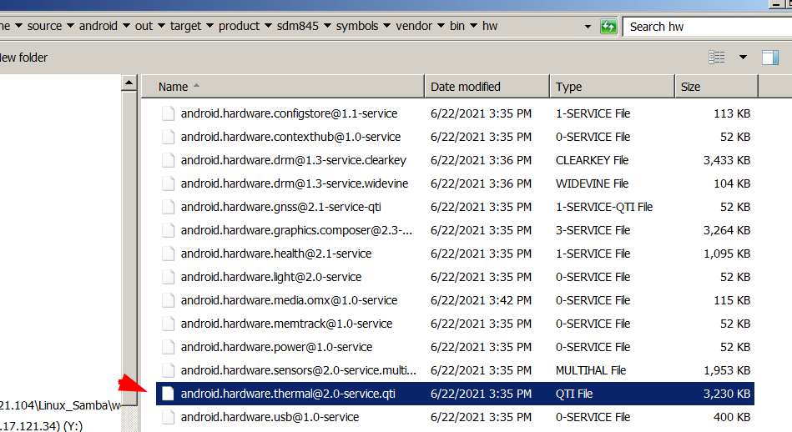
Thermal Service verification

Slide 17
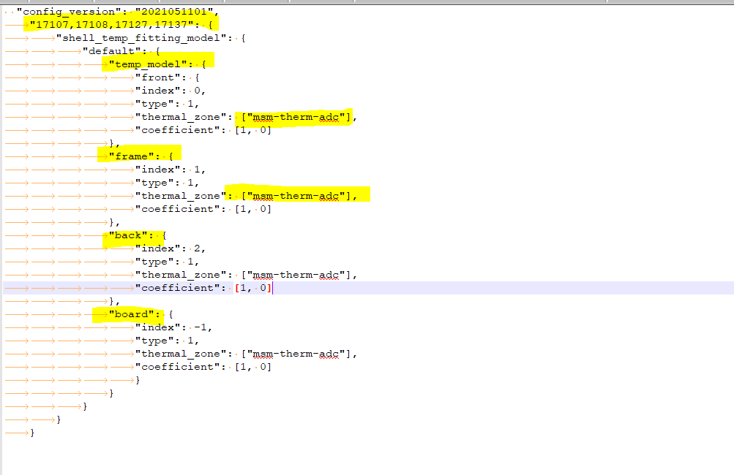
Oplus Thermal
oplus/thermal / dist/prjConfig/horae_source_SDM845.conf

Slide 18
Unified intelligent Temperature control
my_product/etc/temperature_profile/sys_thermal_control_config.xml
adb shell dumpsys activity service com.coloros.oppoguardelf getThermalConfig
Total of 21 levels are defined ( -1 to 19)

Slide 19
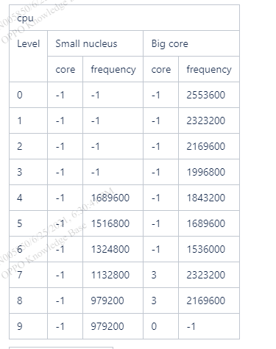
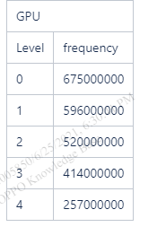
Unified intelligent Temperature control
CPU is divided into 10 levels & GPU is divided into 5 levels.
Ref: https://doc.myoas.com/pages/viewpage.action?pageId=229896640

Slide 20
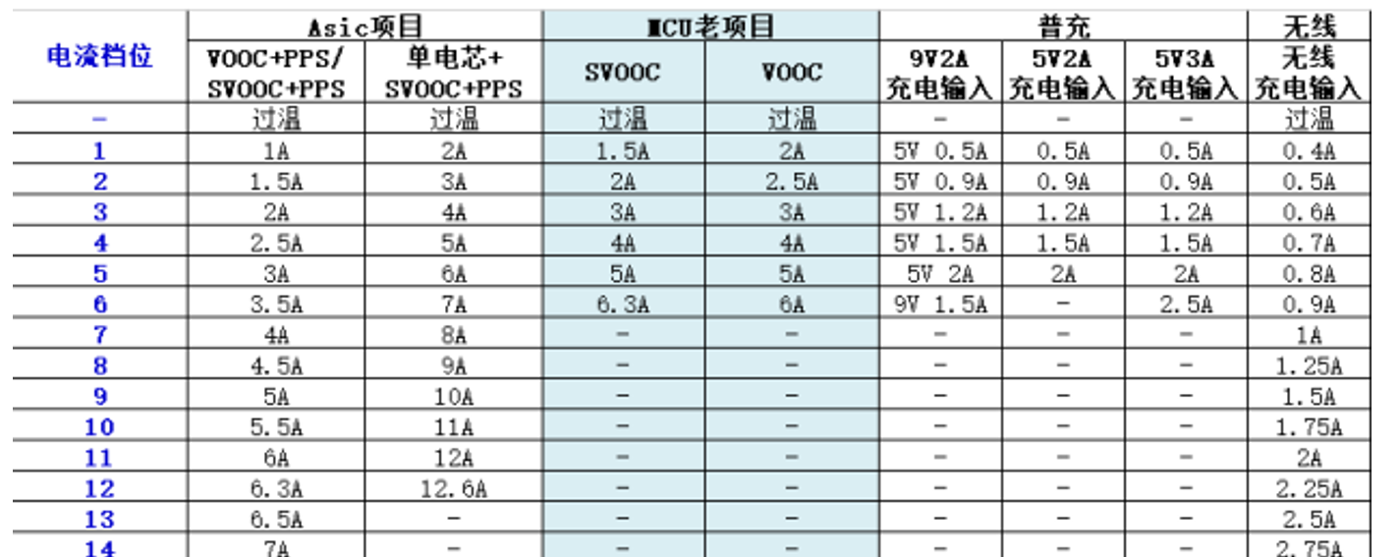
Unified intelligent Temperature control
Application control level capability
Application control is currently divided into 5 levels. Athena implements different types of cleaning strategies according to the level value transmitted by the intelligent temperature control.
Charge speed limit
The charging speed limit is divided into 25 levels, and the impact on the charging time and temperature is tested by the thermal design colleagues during the strategic configuration and debugging. Level 0 represents unlimited charging.

Slide 21
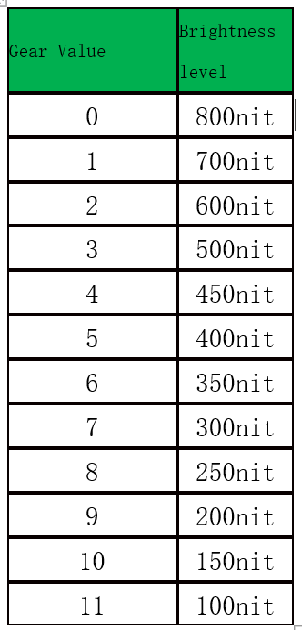
Unified intelligent Temperature control
Camera Control
camera provides control functions such as turning off the fill light, stopping video recording, adjusting the brightness of the camera scene screen, and turning off the camera.
Brightness Control
Set multi-level brightness gears, a total of 11 gears, and fix the adjustable range of each gear, such as 100nit/ gear; level 0 means cancelling the temperature control brightness limit.
Likewise there are other parameters which can be controlled..

Slide 22
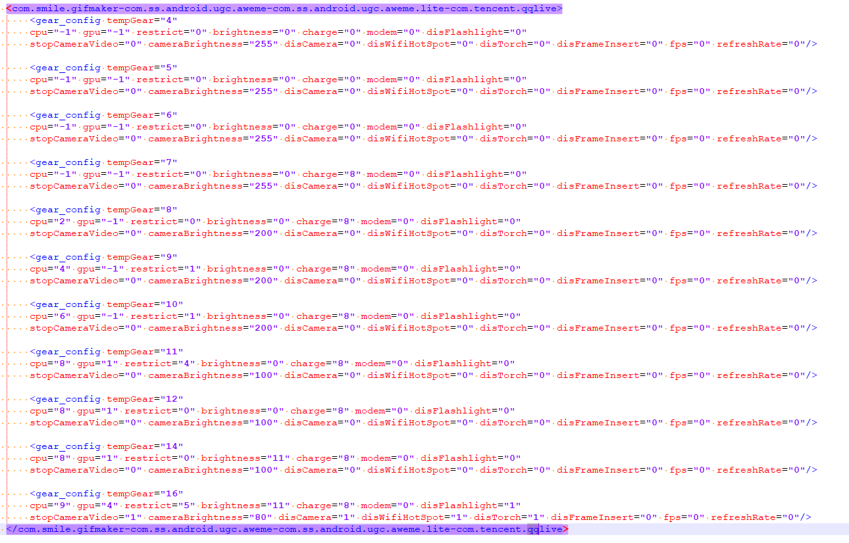
Unified intelligent Temperature control

Slide 23
Unified intelligent Temperature control
tempGear="1" --- represents trigger level 1
cpu="0" --- represents cpu level 0
gpu="0" --- represents gpu level 0
restrict="0" ---Represents application control level 0
brightness="1" --- stands for screen brightness level 1. This function currently has no practical effect.
charge="0" ---represents the charging speed level 0
modem="0" --- represents modem control level 0
disFlashlight="1" --- means turn off the fill light, 1 means turn off
stopCameraVideo="0" ---1 means stop recording, 0 means not stop
cameraBrightness="200" --- represents adjusting the brightness of the camera scene screen, 200 represents the brightness value
disCamera="0" ---1 means to turn off the camera, 0 means not to turn off
disWifiHotSpot="0" ---1 means to turn off the hotspot, 0 means not to turn off
disTorch="0" ---1 means turn off the flashlight, 0 means not turn off
disFrameInsert="0" ---0 means temperature control exits frame insertion and disables control, 1 means frame insertion is disabled
fps="55" --- stands for adjusting the application frame rate, 55 stands for the frame rate value, the default is restored to 120Hz
refreshRate="1" ---1 means to set the refresh rate to 60hz, 0 means to exit the temperature control and take over the screen refresh rate
disVideoSR="1" ---1 means turn off the over-resolution capability, 0 means temperature control exits the over-resolution disable
disHBMHB="1" ---1 closes the HBM highlighting ability, 0 means that the temperature control exits and takes over the HBM highlighting ability
disOSIE="1" ---1 Turn off the ultra-clear visual effect ability, 0 means that the temperature control exits and takes over the ultra-clear visual effect

Slide 24
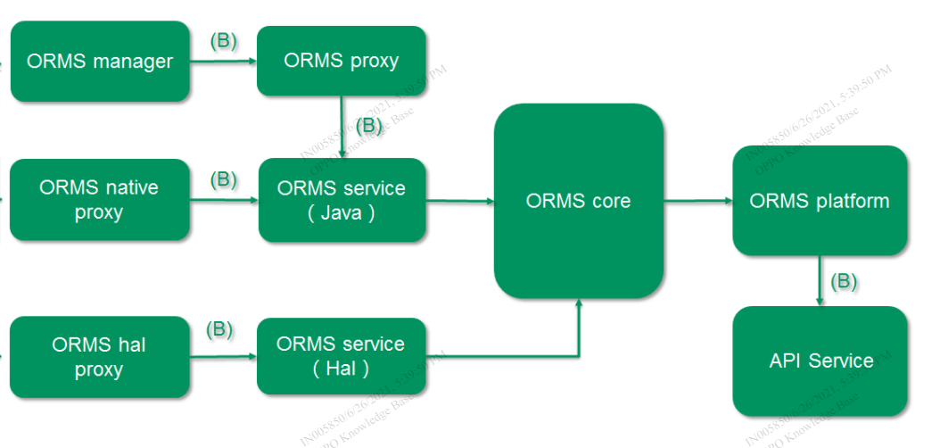
ORMS
The system power consumption is reduced as much as possible while ensuring system performance
Mainly it inherit the hypnus philosophy ( scene-based optimization )
Hypnus module consists of a Linux Kernel (DLKM) and some modifications over Kernel/Android Framework layer.
App launch, scene switch , Sliding
Touch acceleration
Fingerprint , facelock etc.

Slide 25
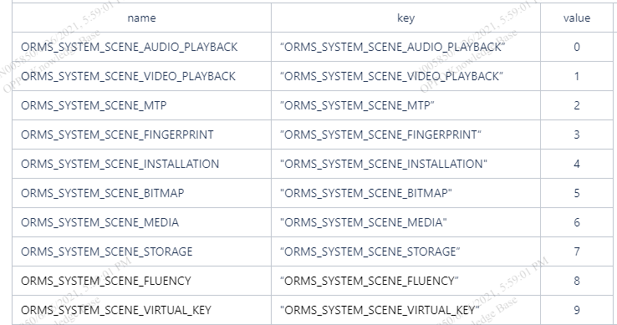
ORMS
Scene based customization

Slide 26
ORMS
What we can control?
CPU/GPU frequency & other parameters
Scene based performance enhancement for application or system services
DDR frequency, Sched, LPM etc

Slide 27
Debug tools & logs
Kernel Logs
Android Logs
Batterystat and event logs
Bug report & battery historian
Systrace
Power Monitor
On device debugging
HW

Slide 28
Case Studies – Higher Standby 7150R
power decomposition result
UFS power consumption was more in R
DTSI comparison
SPM level for UFS was 5, while in Q , spm-level was not set.
FS team feedback
FS team confirm, that we should remove spm-level from R version also.

Slide 29
Case Studies - 2706755
16%。 power consumption , Standby 12H
Initial Analysis:
DIAG_WS wake lock is acquired which has stopped the device to go in deep sleep.
Further Analysis:
Logkit was running with Modem logs enabled.
Retest after disabling the modem logs , power consumption was normal.

Slide 30
Case Studies - 2755214
2 hours of screen hold, the test version current is 76.7mA, 59.7mA greater than the standard 17mA
Initial Analysis:
In first set of logs, dexopt optimization was on-going. When QA re-test it , current was still high.
In later set of logs , we found longwake due to com.oppo.ota, after disabling the OTA service current was normal. Later issue transferred to ROM Team for further debugging.

Slide 31
Case Studies - 2794791
Camera Avg Current was high
Initial Analysis: In systrace, we found the CPU frequency in case of Q is more as compare to P.
Camera Team Analysis: The Recording resolution is upgraded in Q OS , that’s why camera is running on higher frequency.
Test Team : When same issue is tested with same resolution on both P and Q OS, current was same.

Slide 32
Case Studies - 2790839
The average current of the face recognition test machine is 565.6mA, which is 45.8mA larger than the average current of the contrast machine, 519.8mA
Analysis:
With the help of systrace we found that in case of Android Q, the frequency is more during face unlock as compare to Android P. When we investigate further with face lock team, we found that algorithm for face unlock is changed, which increase CPU frequency. Due to this the current was higher.

Slide 33
Thank you!

