Slide 1
Non-Seasonal Box-Jenkins Models

Slide 2
Box-Jenkins (ARIMA) Models
The Box-Jenkins methodology refers to a set of procedures for identifying and estimating time series models within the class of autoregressive integrated moving average (ARIMA) models.
ARIMA models are regression models that use lagged values of the dependent variable and/or random disturbance term as explanatory variables.
ARIMA models rely heavily on the autocorrelation pattern in the data
This method applies to both non-seasonal and seasonal data. In this course, we will only deal with non-seasonal data.

Slide 3
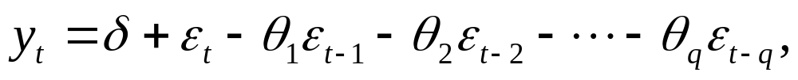
Box-Jenkins (ARIMA) Models
Three basic ARIMA models for a stationary time series y_{t} :
  (1) Autoregressive model of order p (AR(p))
  i.e., y_{t} depends on its p previous values
  (2) Moving Average model of order q (MA(q))
  i.e., y_{t} depends on q previous random error terms

Slide 4
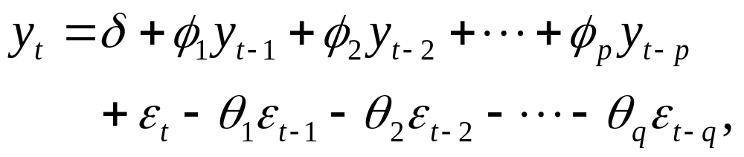
Box-Jenkins (ARIMA) Models
  (3) Autoregressive-moving average model of order p and q (ARMA(p,q))
  i.e., y_{t} depends on its p previous values and q previous random error terms

Slide 5

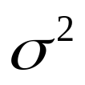
Box-Jenkins (ARIMA) Models
In an ARIMA model, the random disturbance term
is typically assumed to be “white noise”; i.e., it is identically and independently distributed with a mean of 0 and a common variance across all observations.
We write ~ i.i.d.(0, )

Slide 6
A five-step iterative procedure
Stationarity Checking and Differencing
Model Identification
Parameter Estimation
Diagnostic Checking
Forecasting

Slide 7
Step One: Stationarity checking

Slide 8
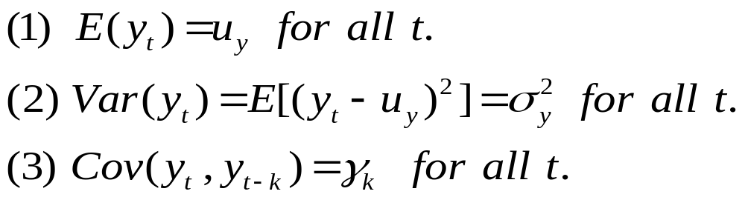
Stationarity
“Stationarity” is a fundamental property underlying almost all time series statistical models.
A time series y_{t} is said to be stationary if it satisfies the following conditions:

Slide 9


Stationarity
The white noise series satisfies the stationarity condition because
(1) E( ) = 0
(2) Var( ) =
(3) Cov( ) = for all s 0

Slide 10
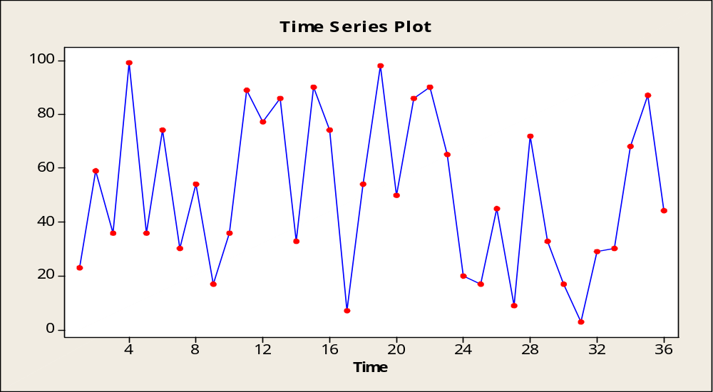
Example of a white noise series

Slide 11
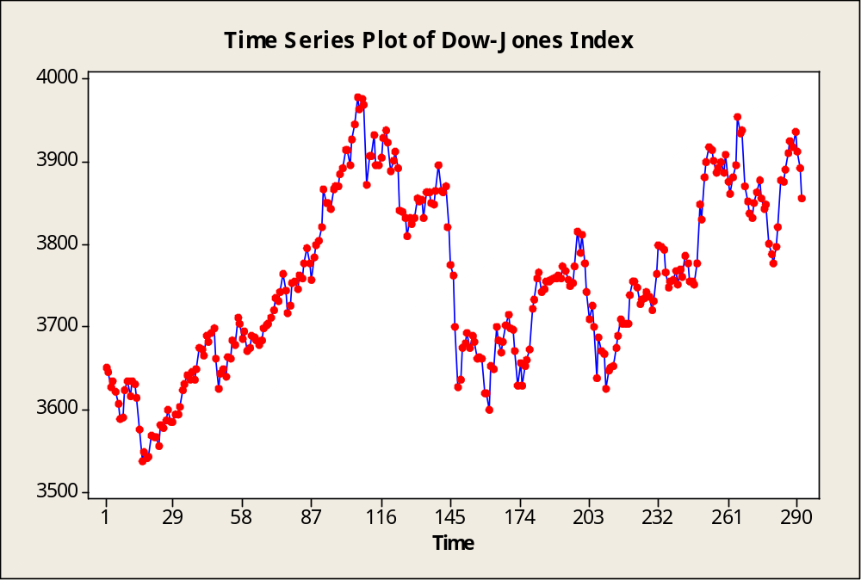
Example of a non-stationary series

Slide 12
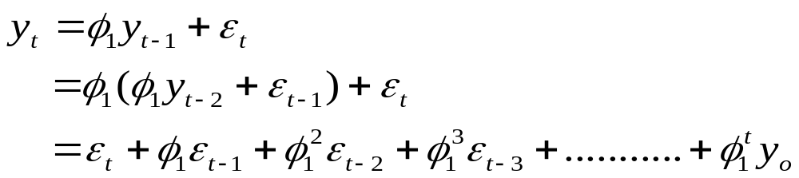
Stationarity
Suppose y_{t} follows an AR(1) process without drift.
Is y_{t} stationarity?
Note that

Slide 13
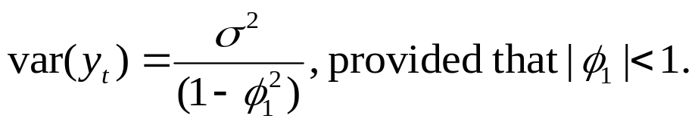
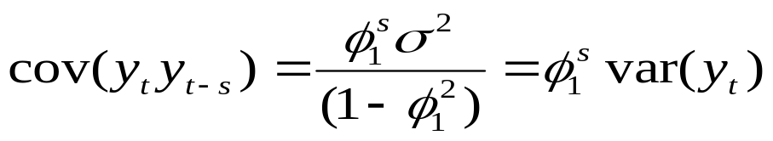
Stationarity
Without loss of generality, assume that y_{o} = 0. Then E(y_{t})=0.
Assuming that t is large, i.e., the process started a long time ago, then
It can also be shown that provided that the same condition is satisfied,

Slide 14
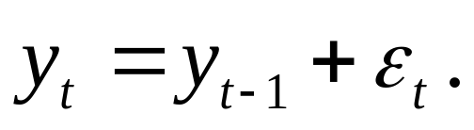
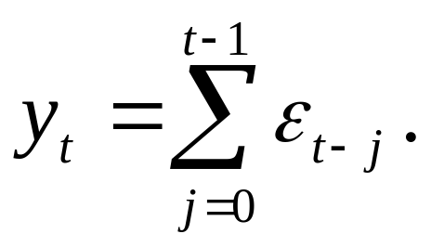
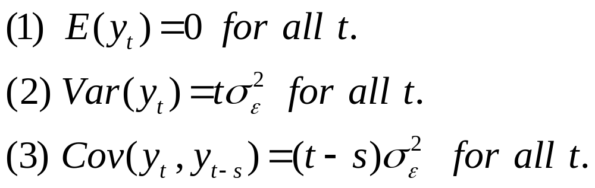
Stationarity
Special Case: φ₁ = 1
It is a “random walk” process. Now,
Thus,

Slide 15
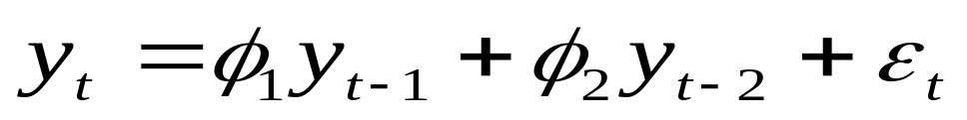
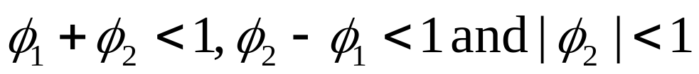
Stationarity
Suppose the model is an AR(2) without drift, i.e.,
It can be shown that for y_{t} to be stationary,
The key point is that AR processes are not stationary unless appropriate prior conditions are imposed on the parameters.

Slide 16


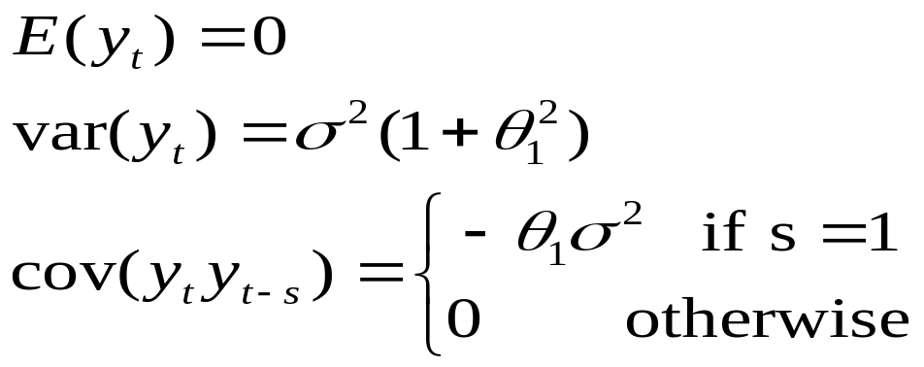
Stationarity
Consider an MA(1) process without drift:
It can be shown, regardless of the value of , that

Slide 17

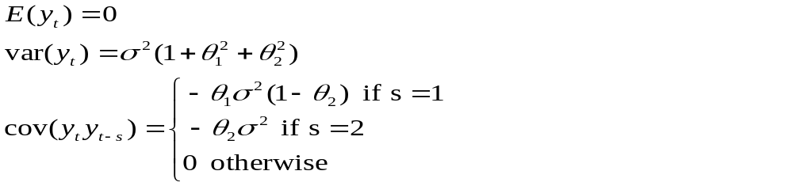
Stationarity
For an MA(2) process

Slide 18
Stationarity
In general, MA processes are stationarity regardless of the values of the parameters, but not necessarily “invertible”.
An MA process is said to be invertible if it can be converted into a stationary AR process of infinite order.
The conditions of invertibility for an MA(k) process is analogous to those of stationarity for an AR(k) process. More on invertibility in tutorial.

Slide 19
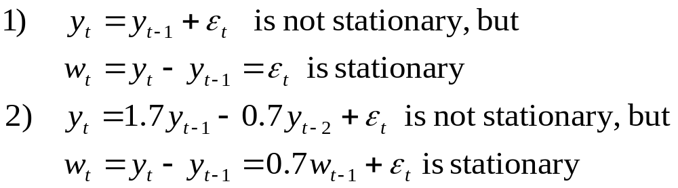
Differencing
Often non-stationary series can be made stationary through differencing.
Examples:

Slide 20

Differencing
Differencing continues until stationarity is achieved.
The differenced series has n-1 values after taking the first-difference, n-2 values after taking the second difference, and so on.
The number of times that the original series must be differenced in order to achieve stationarity is called the order of integration, denoted by d.
In practice, it is almost never necessary to go beyond second difference, because real data generally involve only first or second level non-stationarity.

Slide 21

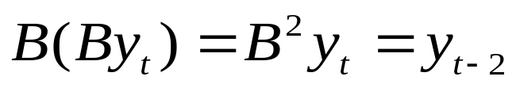
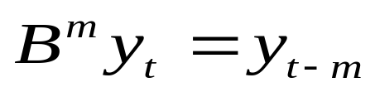
Differencing
Backward shift operator, B
B, operating on y_{t}, has the effect of shifting the data back one period.
Two applications of B on y_{t} shifts the data back two periods.
m applications of B on y_{t} shifts the data back m periods.

Slide 22

Differencing
The backward shift operator is convenient for describing the process of differencing.
In general, a dth-order difference can be written as
The backward shift notation is convenient because the terms can be multiplied together to see the combined effect.

Slide 23
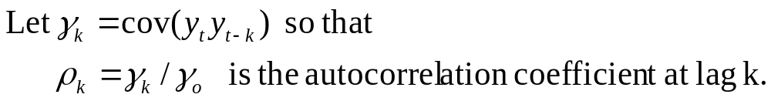
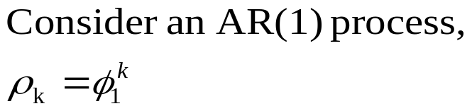


Population autocorrelation function
The question is, in practice, how can one tell if the data are stationary?
If the data are non-stationary (i.e., random walk), then = 1 for all values of k
If the data are stationary (i.e., ), then the magnitude of the autocorrelation coefficient “dies down” as k increases.

Slide 24
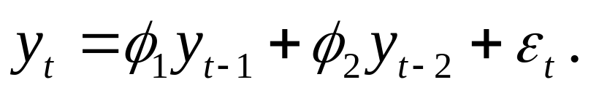
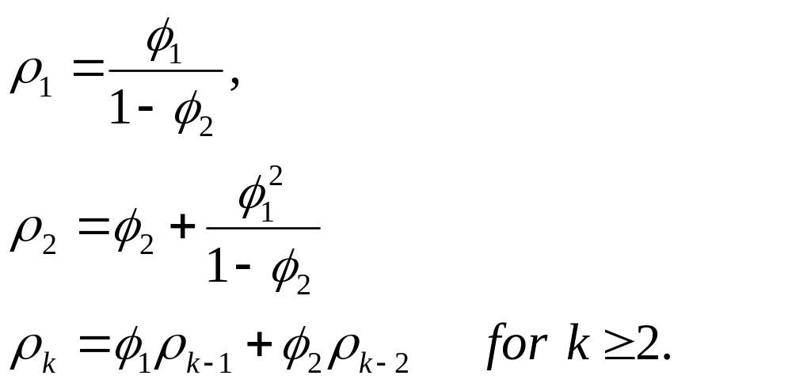
Population autocorrelation function
Consider an AR(2) process without drift :
The autocorrelation coefficients are

Slide 25
Population autocorrelation function
Then the autocorrelation function dies down according to a mixture of damped exponentials and/or damped sine waves.
In general, the autocorrelation of a stationary AR process dies down gradually as k increases.

Slide 26
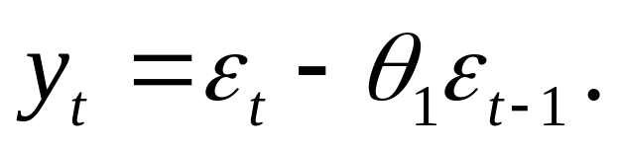
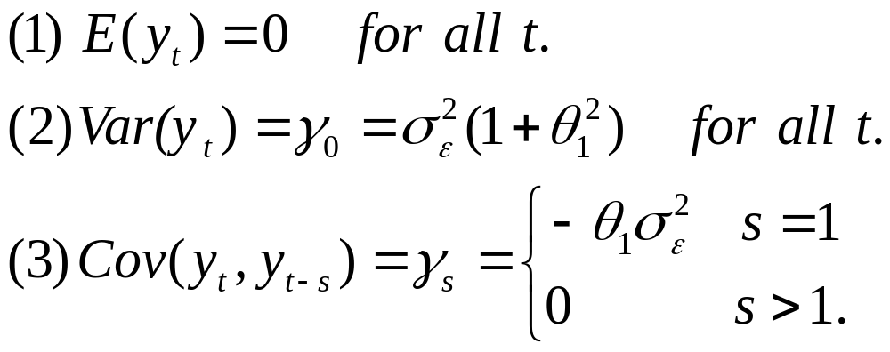
Population autocorrelation function
Moving Average (MA) Processes
Consider a MA(1) process without drift :
Recall that

Slide 27
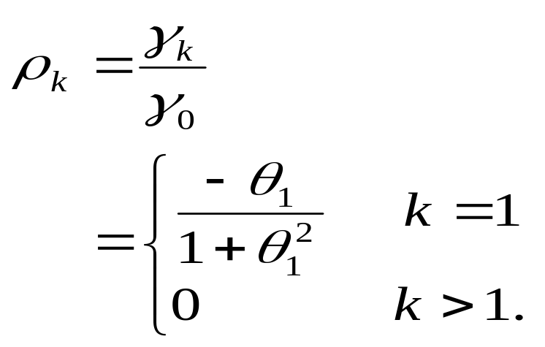
Population autocorrelation function
Therefore the autocorrelation coefficient of the MA(1) process at lag k is
The autocorrelation function of the MA(1) process “cuts off” after lag k=1.

Slide 28
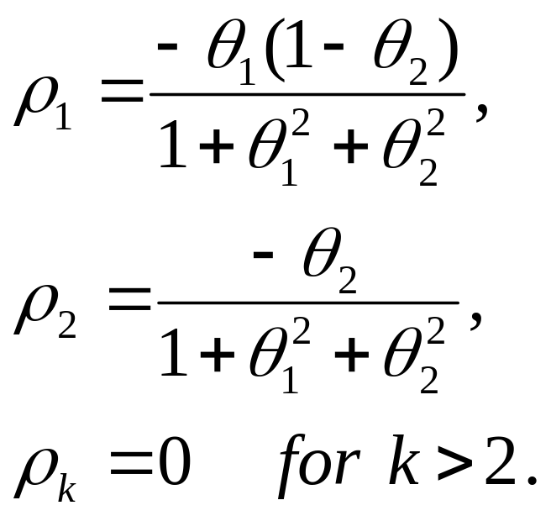
Population autocorrelation function
Similarly, for an MA(2) process :
The autocorrelation function of a MA(2) process cuts off after 2 lags.

Slide 29
Population autocorrelation function
In general, all stationary AR processes exhibit autocorrelation patterns that “die down” to zero as k increases, while the autocorrelation coefficient of a non-stationary AR process is always 1 for all values of k. MA processes are always stationary with autocorrelation functions that cut off after certain lags.
Question: how are the autocorrelation coefficients “estimated” in practice?

Slide 30
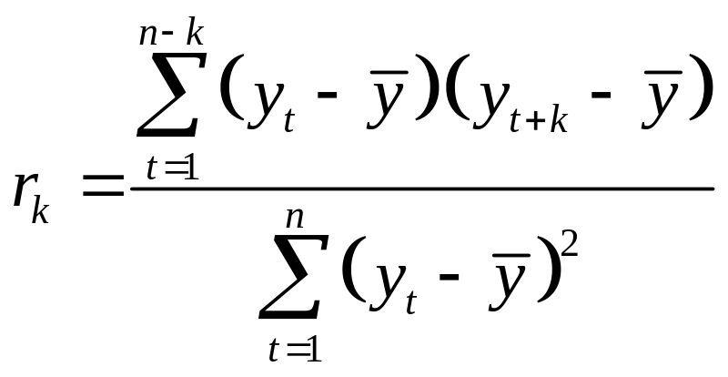
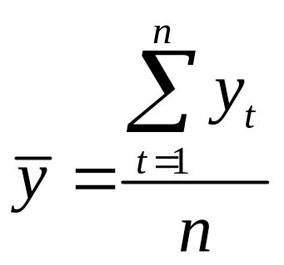
Sample Autocorrelation Function (SAC)
For the series y₁, y₂, …, y_{n}, the sample autocorrelation at lag k is
where

Slide 31
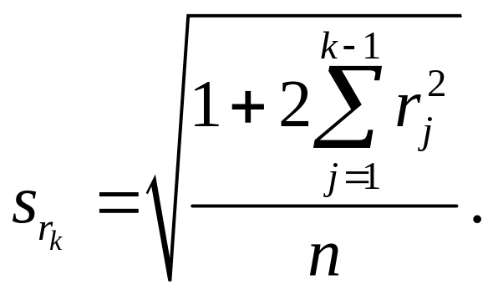
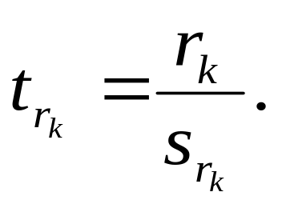
Sample Autocorrelation Function (SAC)
r_{k} measures the linear relationship between time series observations separated by a lag of k time units
The standard error of r_{k} is
The t_{rk} statistic is

Slide 32
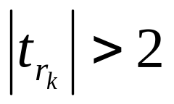
Sample Autocorrelation Function (SAC)
Behaviour of SAC
(1) The SAC can cut off. A spike at lag k exists in the SAC if r_{k} is statistically large. If
Then r_{k} is considered to be statistically large. The SAC cuts off after lag k if there are no spikes at lags greater than k in the SAC.

Slide 33
Sample Autocorrelation Function (SAC)
(2) The SAC is said to die down if this function does not cut off but rather decreases in a ‘steady fashion’. The SAC can die down in
(i) a damped exponential fashion
(ii) a damped sine-wave fashion
(iii) a fashion dominated by either one of or a combination of both (i) and (ii).
The SAC can die down fairly quickly or extremely slowly.

Slide 34
Sample Autocorrelation Function (SAC)
The time series values y₁, y₂, …, y_{n} should be considered stationary if the SAC of the time series values either cuts off fairly quickly or dies down fairly quickly.
However if the SAC of the time series values y₁, y₂, …, y_{n} dies down extremely slowly, and r₁ at lag 1 is close to 1, then the time series values should be considered non-stationary.

Slide 35
Stationarity Summary
Stationarity of data is a fundamental requirement for all time series analysis.
MA processes are always stationary
AR and ARMA processes are generally not stationary unless appropriate restrictions are imposed on the model parameters.

Slide 36
Stationarity Summary
Population autocorrelation function behaviour:
1) stationary AR and ARMA: dies down gradually as k increases
2) MA: cuts off after a certain lag
3) Random walk: autocorrelation remains at one for all values of k

Slide 37
Stationarity Summary
Sample autocorrelation function behaviour:
1) stationary AR and ARMA: dies down gradually as k increases
2) MA: cuts off after a certain lag
3) Random walk: autocorrelation functions dies down very slowly and the estimated autocorrelation coefficient at lag 1 is close to 1.
What if the data are non-stationary?
Perform differencing until stationarity is accomplished.

Slide 38
SAC of a stationary
AR(1) process
The ARIMA Procedure
Name of Variable = y
Mean of Working Series -0.08047
Standard Deviation 1.123515
Number of Observations 99
Autocorrelations
Lag Covariance Correlation -1 9 8 7 6 5 4 3 2 1 0 1 2 3 4 5 6 7 8 9 1 Std Error
0 1.262285 1.00000 | |********************| 0
1 0.643124 0.50949 | . |********** | 0.100504
2 0.435316 0.34486 | . |******* | 0.123875
3 0.266020 0.21075 | . |****. | 0.133221
4 0.111942 0.08868 | . |** . | 0.136547
5 0.109251 0.08655 | . |** . | 0.137127
6 0.012504 0.00991 | . | . | 0.137678
7 -0.040513 -.03209 | . *| . | 0.137685
8 -0.199299 -.15789 | . ***| . | 0.137761
9 -0.253309 -.20067 | . ****| . | 0.139576
"." marks two standard errors

Slide 39
SAC of an MA(2) process
The ARIMA Procedure
Name of Variable = y
Mean of Working Series 0.020855
Standard Deviation 1.168993
Number of Observations 98
Autocorrelations
Lag Covariance Correlation -1 9 8 7 6 5 4 3 2 1 0 1 2 3 4 5 6 7 8 9 1 Std Error
0 1.366545 1.00000 | |********************| 0
1 -0.345078 -.25252 | *****| . | 0.101015
2 -0.288095 -.21082 | ****| . | 0.107263
3 -0.064644 -.04730 | . *| . | 0.111411
4 0.160680 0.11758 | . |** . | 0.111616
5 0.0060944 0.00446 | . | . | 0.112873
6 -0.117599 -.08606 | . **| . | 0.112875
7 -0.104943 -.07679 | . **| . | 0.113542
8 0.151050 0.11053 | . |** . | 0.114071
9 0.122021 0.08929 | . |** . | 0.115159
"." marks two standard errors

Slide 40
SAC of a random walk process
The ARIMA Procedure
Name of Variable = y
Mean of Working Series 16.79147
Standard Deviation 9.39551
Number of Observations 98
Autocorrelations
Lag Covariance Correlation -1 9 8 7 6 5 4 3 2 1 0 1 2 3 4 5 6 7 8 9 1 Std Error
0 88.275614 1.00000 | |********************| 0
1 85.581769 0.96948 | . |******************* | 0.101015
2 81.637135 0.92480 | . |****************** | 0.171423
3 77.030769 0.87262 | . |***************** | 0.216425
4 72.573174 0.82212 | . |**************** | 0.249759
5 68.419227 0.77506 | . |**************** | 0.275995
6 64.688289 0.73280 | . |*************** | 0.297377
7 61.119745 0.69237 | . |************** | 0.315265
8 57.932253 0.65627 | . |************* | 0.330417
9 55.302847 0.62648 | . |*************. | 0.343460
"." marks two standard errors

Slide 41
SAC of a random walk process after first difference
The ARIMA Procedure
Name of Variable = y
Period(s) of Differencing 1
Mean of Working Series 0.261527
Standard Deviation 1.160915
Number of Observations 97
Observation(s) eliminated by differencing 1
Autocorrelations
Lag Covariance Correlation -1 9 8 7 6 5 4 3 2 1 0 1 2 3 4 5 6 7 8 9 1 Std Error
0 1.347723 1.00000 | |********************| 0
1 0.712219 0.52846 | . |*********** | 0.101535
2 0.263094 0.19521 | . |****. | 0.126757
3 -0.043040 -.03194 | . *| . | 0.129820
4 -0.151081 -.11210 | . **| . | 0.129901
5 -0.247540 -.18367 | .****| . | 0.130894
6 -0.285363 -.21174 | .****| . | 0.133525
7 -0.274084 -.20337 | .****| . | 0.136943
8 -0.215508 -.15991 | . ***| . | 0.140022
9 -0.077629 -.05760 | . *| . | 0.141892
"." marks two standard errors

Slide 42
Step Two: Model Identification

Slide 43
Model Identification
When the data are confirmed stationary, one may proceed to tentative identification of models through visual inspection of both the SAC and partial sample autocorrelation (PSAC) functions.

Slide 44
Partial autocorrelation function
Partial autocorrelations are used to measure the degree of association between Y_{t} and Y_{t-k}, when the effects of other time lags (1, 2, 3, …, k – 1) are removed.
The partial autocorrelations at lags 1, 2, 3, …, make up the partial autocorrelation function or PACF.

Slide 45
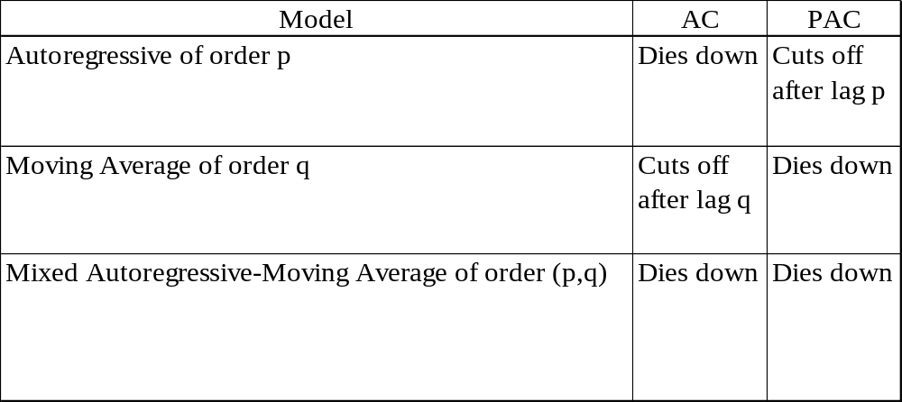
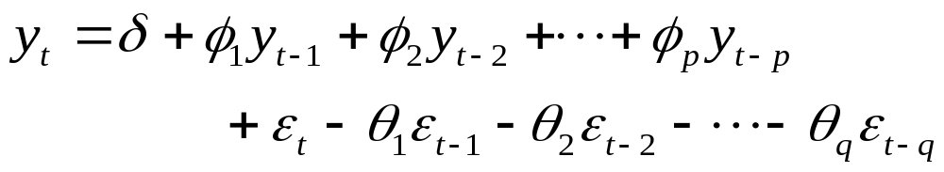
Summary of the Behaviour of autocorrelation and partial autocorrelation functions
Behaviour of autocorrelation and partial autocorrelation functions

Slide 46
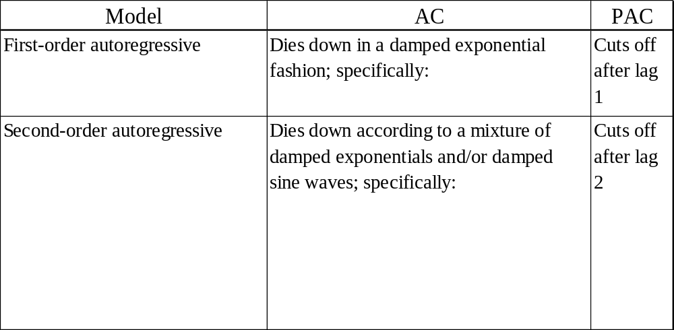



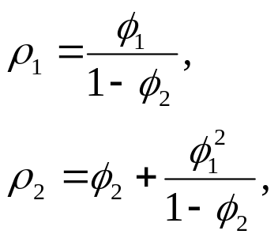

Summary of the Behaviour of autocorrelation and partial autocorrelation functions
Behaviour of AC and PAC for specific non-seasonal models

Slide 47
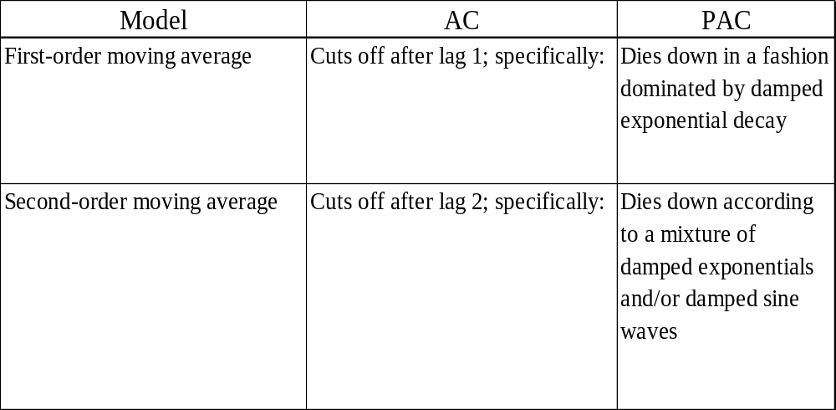

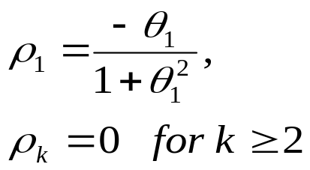

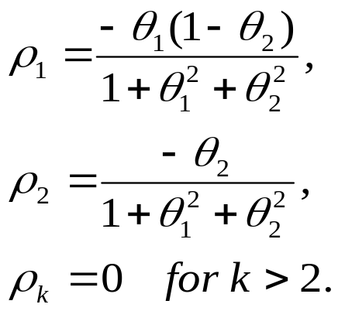
Summary of the Behaviour of autocorrelation and partial autocorrelation functions
Behaviour of AC and PAC for specific non-seasonal models

Slide 48
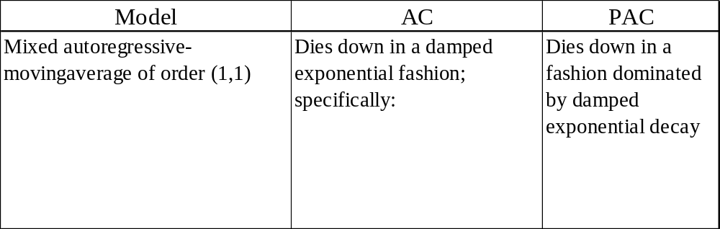

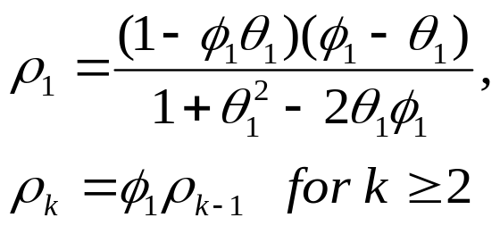
Summary of the Behaviour of autocorrelation and partial autocorrelation functions
Behaviour of AC and PAC for specific non-seasonal models

Slide 49
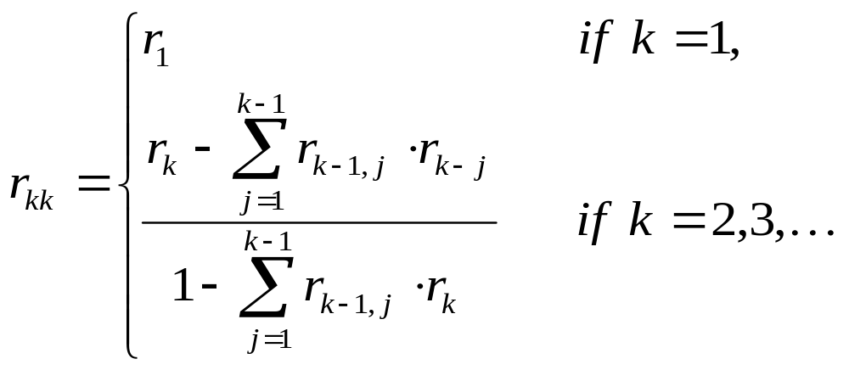
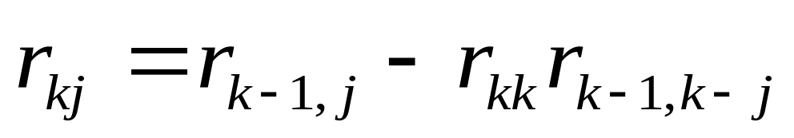
Sample Partial Autocorrelation Function (SPAC)
The sample partial autocorrelation at lag k is
where
for j = 1, 2, …, k-1.

Slide 50
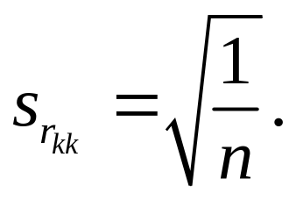
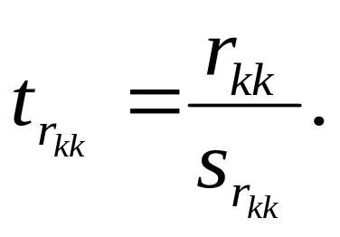
Sample Partial Autocorrelation Function (SPAC)
r_{kk} may intuitively be thought of as the sample autocorrelation of time series observations separated by a lag k time units with the effects of the intervening observations eliminated.
The standard error of r_{kk} is
The t_{rkk} statistic is

Slide 51
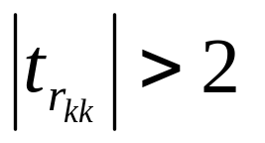
Sample Partial Autocorrelation Function (SPAC)
Behaviour of SPAC similar to its of the SAC. The only difference is that r_{kk} is considered to be statistically large if
for any k.

Slide 52
Model Identification
Refers to class Examples 1, 2 and 3 for SAC and SPAC of simulated AR(2), MA(1) and ARMA(2,1) processes respectively.

Slide 53
Step Three: Parameter Estimation

Slide 54
Parameter Estimation
The method of least squares can be used. However, for models involving an MA component, there is no simple formula that can be applied to obtain the estimates.
Another method that is frequently used is maximum likelihood.

Slide 55
Parameter Estimation
Given n observations y₁, y₂, …, y_{n}, the likelihood function L is defined to be the probability of obtaining the data actually observed.
The maximum likelihood estimators (m.l.e.) are those value of the parameters for which the data actually observed are most likely, that is, the values that maximize the likelihood function L.

Slide 56
Parameter Estimation
Given n observations y₁, y₂, …, y_{n}, the likelihood L is the probability of obtaining the data actually observed.
For non-seasonal Box-Jenkins models, L is a function of δ, φ’s, θ’s and σ_{ε}² given y₁, y₂, …, y_{n}.
The maximum likelihood estimators (m.l.e.) are those values of the parameters which make the observation of the data a most likely event, that is, the values that maximize the likelihood function L.

Slide 57
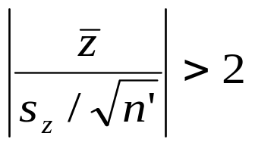

Parameter Estimation
To test whether the drift term should be included in the model, i.e., H₀: δ = 0 vs H_{a}: δ ≠ 0
  If , reject H₀, where is the mean of
  the working series, s_{z} is the standard deviation, and n’ is the sample size of the working series.

Slide 58
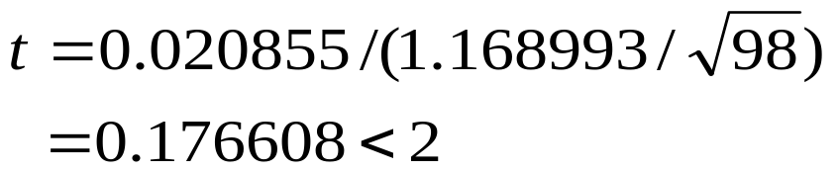
Parameter estimation
Refers to the MA(1) example seen before
The ARIMA Procedure
Name of Variable = y
Mean of Working Series 0.020855
Standard Deviation 1.168993
Number of Observations 98
Here,
The drift term should not be included.

Slide 59
Step Four: Diagnostic Checking

Slide 60
Diagnostic Checking
Often it is not straightforward to determine a single model that most adequately represents the data generating process, and it is not uncommon to estimate several models at the initial stage. The model that is finally chosen is the one considered best based on a set of diagnostic checking criteria. These criteria include
(1) t-tests for coefficient significance
(2) residual analysis
(3) model selection criteria

Slide 61
Diagnostic checking (t-tests)
Consider the data series of Example 4. First, the data appear to be stationary. Second, the drift term is significant. The SAC and SPAC functions indicate that the an AR(2) model probably best fits the data.
For illustration purpose, suppose an MA(1) and ARMA(2,1) are fiitted in addition to the AR(2).

Slide 62
Diagnostic checking (t-tests)
data MA2;
input y;
cards;
4.0493268
7.0899911
4.7896497
.
.
2.2253477
2.439893;
proc arima data=ma2;
identify var=y;
estimate p=2 method=ml printall;
estimate q=1 method=ml printall;
estimate p=2 q=1 method=ml printall;
run;

Slide 63


Diagnostic checking (t-tests)
The AR(2) model estimation results produce
The t test statistic for is 8.93, indicating significance.
Similarly, the t test also indicates that is significantly different from zero.

Slide 64
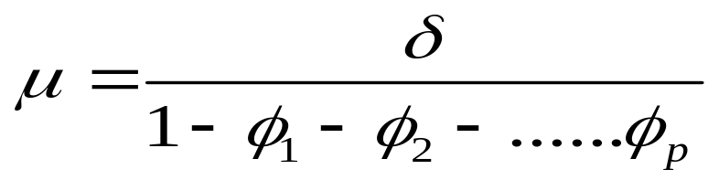
Diagnostic checking (t-tests)
Note that for any AR model, the estimated mean value and the drift term are related through the formula
Hence for the present AR(2) model, we have
4.10353 = 4.68115/(1-0.35039+0.49115)

Slide 65
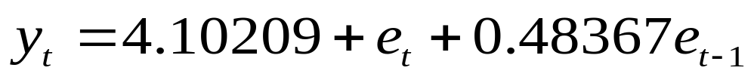


Diagnostic checking (t-tests)
The MA(1) model produces
The t test indicates significance of the coefficient of .
Note that for any MA models,

Slide 66

Diagnostic checking (t-tests)
For the ARMA(2,1) model,
t tests results indicate that the two AR coefficients are significant, while the MA coefficient is not significant.
For any ARMA model,

Slide 67

Residual Analysis
If an ARMA(p,q) model is an adequate representation of the data generating process, then the residuals should be uncorrelated.
Portmanteau test statistic:

Slide 68

Residual Analysis
Let’s take the AR(2) model as an example, let u_{t} be the model’s residual. It is assumed that
Suppose we want to test, up to lag 6,
The portmanteau test statistic gives 3.85 with a p-value of 0.4268. Hence the null cannot be rejected and the residuals are uncorrelated at least up to lag 6.

Slide 69
Residual Analysis
The results indicate that AR(2) and ARMA(2, 1) residuals are uncorrelated at least up to lag 30, while MA(1) residuals are correlated.

Slide 70
Model Selection Criteria
Akaike Information Criterion (AIC)
AIC = -2 ln(L) + 2k
Schwartz Bayesian Criterion (SBC)
SBC = -2 ln(L) + k ln(n)
where L = likelihood function
k = number of parameters to be estimated,
n = number of observations.
Ideally, the AIC and SBC should be as small as possible

Slide 71
Model Selection Criteria
For the AR(2) model,
AIC = 1424.66, SBC = 1437.292
For the MA(1) model,
AIC = 1507.162, SBC = 1515.583
For the ARMA(2,1) model,
AIC = 1425.727, SBC = 1442.57

Slide 72

Model Selection Criteria

Slide 73
Step Four: Forecasting

Slide 74
Forecasting
The h-period ahead forecast based on an ARMA(p,q) model is given by
where elements on the r.h.s. of the equation may be replaced by their estimates when the actual values are not available.

Slide 75


Forecasting
For the AR(2) model,
For the MA(1) model,

