Slide 1
Decision tree

Slide 2
Decision tree builds classification or regression models in the form of a tree structure.
It breaks down a dataset into smaller and smaller subsets while at the same time an associated decision tree is incrementally developed.
The final result is a tree with decision nodes and leaf nodes. A decision node (e.g., Outlook) has two or more branches (e.g., Sunny, Overcast and Rainy).
Leaf node (e.g., Play) represents a classification or decision. The topmost decision node in a tree which corresponds to the best predictor called root node.

Slide 3
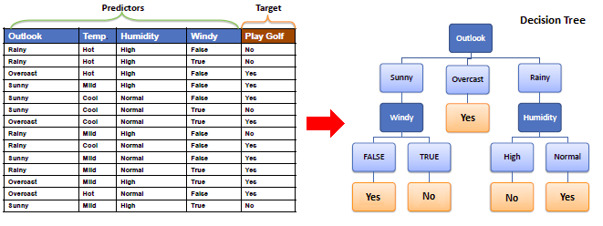

Slide 4
Entropy
A decision tree is built top-down from a root node and involves partitioning the data into subsets that contain instances with similar values (homogenous). ID3 algorithm uses entropy to calculate the homogeneity of a sample. If the sample is completely homogeneous the entropy is zero and if the sample is an equally divided it has entropy of one.

Slide 5
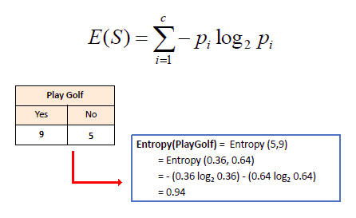

Slide 6
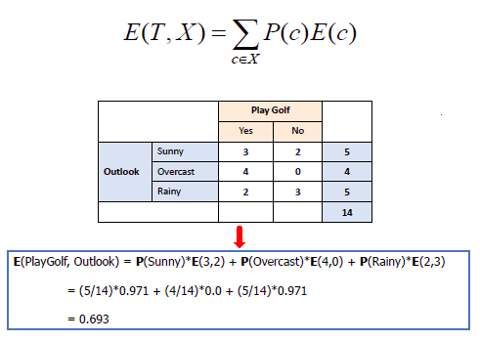

Slide 7
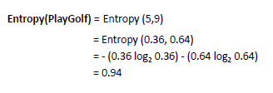
Information Gain
The information gain is based on the decrease in entropy after a dataset is split on an attribute. Constructing a decision tree is all about finding attribute that returns the highest information gain (i.e., the most homogeneous branches).

Slide 8
Step 2: The dataset is then split on the different attributes. The entropy for each branch is calculated. Then it is added proportionally, to get total entropy for the split. The resulting entropy is subtracted from the entropy before the split. The result is the Information Gain, or decrease in entropy.

Slide 9
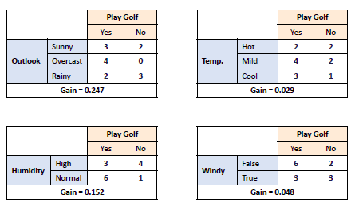
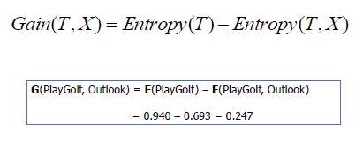

Slide 10
Step 3: Choose attribute with the largest information gain as the decision node, divide the dataset by its branches and repeat the same process on every branch.

Slide 11
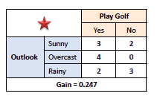
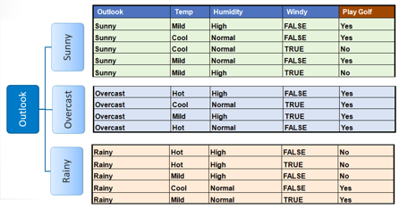

Slide 12
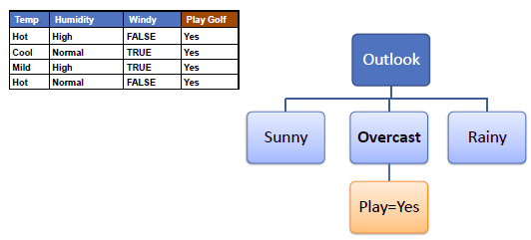
Step 4a: A branch with entropy of 0 is a leaf node.

Slide 13
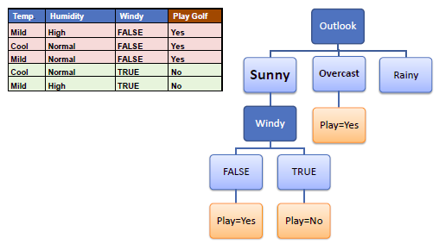
Step 4b: A branch with entropy more than 0 needs further splitting.

Slide 14
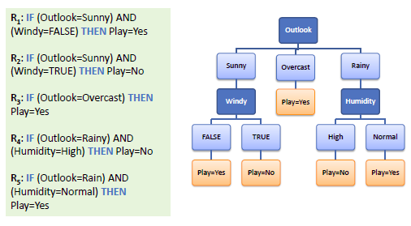
Decision Tree to Decision Rules
A decision tree can easily be transformed to a set of rules by mapping from the root node to the leaf nodes one by one.

