Slide 1
Introduction to simple linear regression

Slide 2
Regression model
Relation between variables where changes in some variables may “explain” or possibly “cause” changes in other variables.
Explanatory variables are termed the independent variables and the variables to be explained are termed the dependent variables.
Regression model estimates the nature of the relationship between the independent and dependent variables.
  Change in dependent variables that results from changes in independent variables, ie. size of the relationship.
  Strength of the relationship.
  Statistical significance of the relationship.

Slide 3
Examples
Dependent variable is retail price of gasoline in Regina – independent variable is the price of crude oil.
Dependent variable is employment income – independent variables might be hours of work, education, occupation, sex, age, region, years of experience, unionization status, etc.
Price of a product and quantity produced or sold:
  Quantity sold affected by price. Dependent variable is quantity of product sold – independent variable is price.
  Price affected by quantity offered for sale. Dependent variable is price – independent variable is quantity sold.

Slide 4
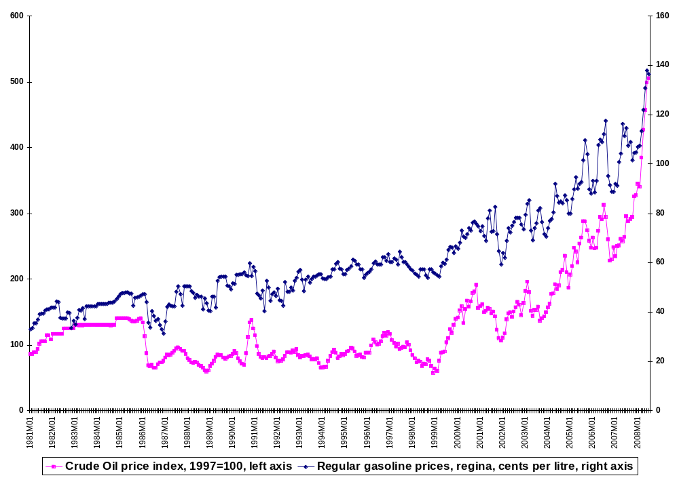
Source: CANSIM II Database (Vector v1576530 and v735048 respectively)

Slide 5
Bivariate and multivariate models
(Education) x y (Income)
(Education) x₁
(Sex) x₂
(Experience) x₃
(Age) x₄
Bivariate or simple regression model
Multivariate or multiple regression model
y (Income)
Model with simultaneous relationship
Price of wheat
Quantity of wheat produced

Slide 6
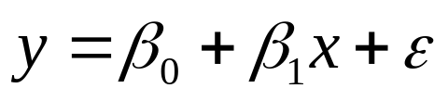
Bivariate or simple linear regression (ASW, 466)
x is the independent variable
y is the dependent variable
The regression model is
The model has two variables, the independent or explanatory variable, x, and the dependent variable y, the variable whose variation is to be explained.
The relationship between x and y is a linear or straight line relationship.
Two parameters to estimate – the slope of the line β₁ and the y-intercept β₀ (where the line crosses the vertical axis).
ε is the unexplained, random, or error component. Much more on this later.

Slide 7
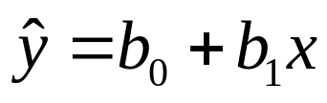

Regression line
The regression model is
Data about x and y are obtained from a sample.
From the sample of values of x and y, estimates b₀ of β₀ and b₁ of β₁ are obtained using the least squares or another method.
The resulting estimate of the model is
The symbol is termed “y hat” and refers to the predicted values of the dependent variable y that are associated with values of x, given the linear model.

Slide 8
Relationships
Economic theory specifies the type and structure of relationships that are to be expected.
Historical studies.
Studies conducted by other researchers – different samples and related issues.
Speculation about possible relationships.
Correlation and causation.
Theoretical reasons for estimation of regression relationships; empirical relationships need to have theoretical explanation.

Slide 9
Uses of regression
Amount of change in a dependent variable that results from changes in the independent variable(s) – can be used to estimate elasticities, returns on investment in human capital, etc.
Attempt to determine causes of phenomena.
Prediction and forecasting of sales, economic growth, etc.
Support or negate theoretical model.
Modify and improve theoretical models and explanations of phenomena.

Slide 10
Income | hrs/week |  | Income | hrs/week
8000 | 38 |  | 8000 | 35
6400 | 50 |  | 18000 | 37.5
2500 | 15 |  | 5400 | 37
3000 | 30 |  | 15000 | 35
6000 | 50 |  | 3500 | 30
5000 | 38 |  | 24000 | 45
8000 | 50 |  | 1000 | 4
4000 | 20 |  | 8000 | 37.5
11000 | 45 |  | 2100 | 25
25000 | 50 |  | 8000 | 46
4000 | 20 |  | 4000 | 30
8800 | 35 |  | 1000 | 200
5000 | 30 |  | 2000 | 200
7000 | 43 |  | 4800 | 30
Notes:
Discuss cleaning the data.
– 0 incomes out
– income and 0 hours out
– The 200 hours?

Slide 11
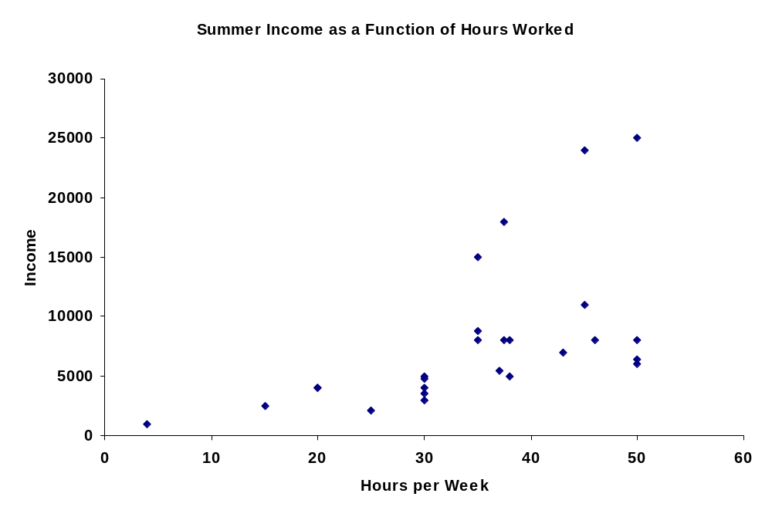

Slide 12
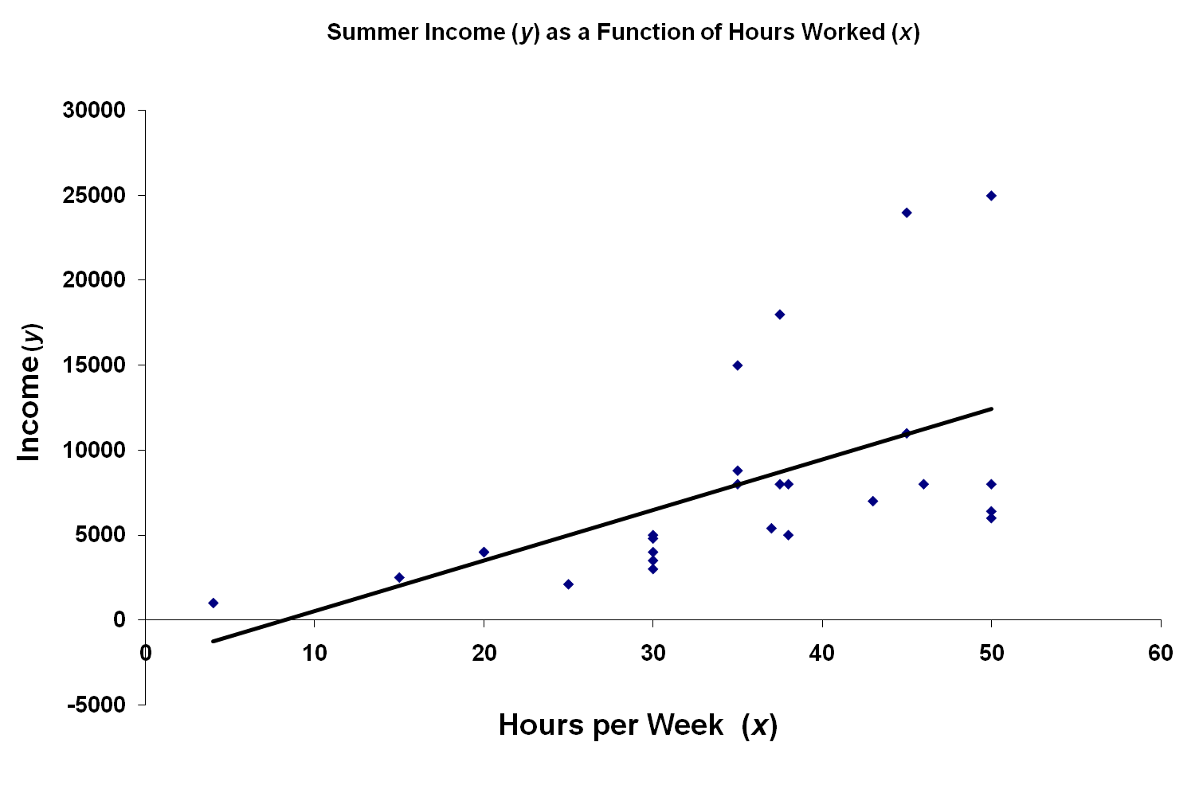
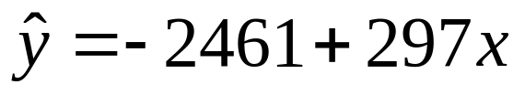
R² = 0.311
Significance = 0.0031
Notes:
Trendline shows the positive relationship.
Evidence of other variables?

Slide 13
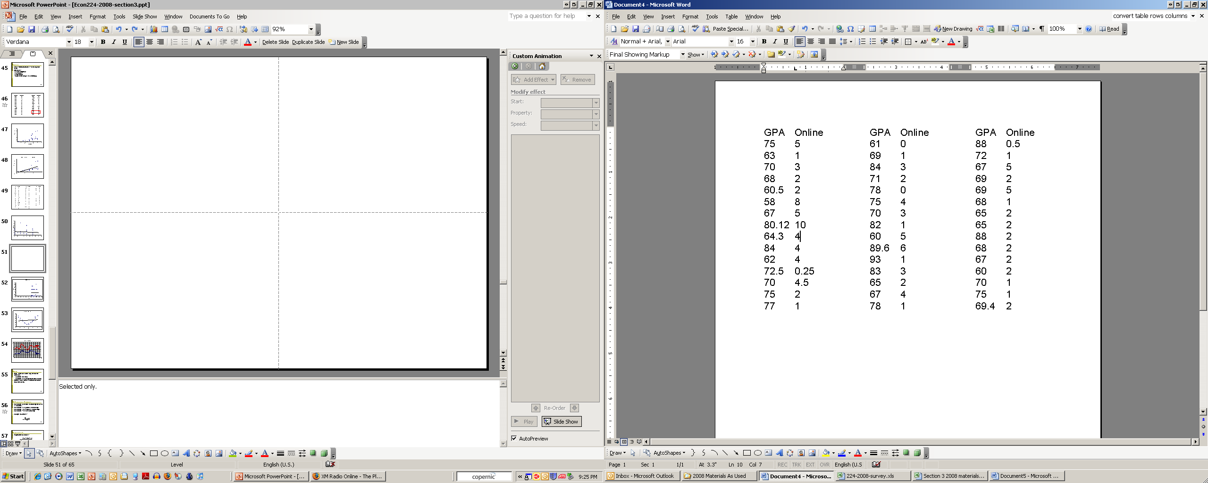
Notes:
Selected only.

Slide 14
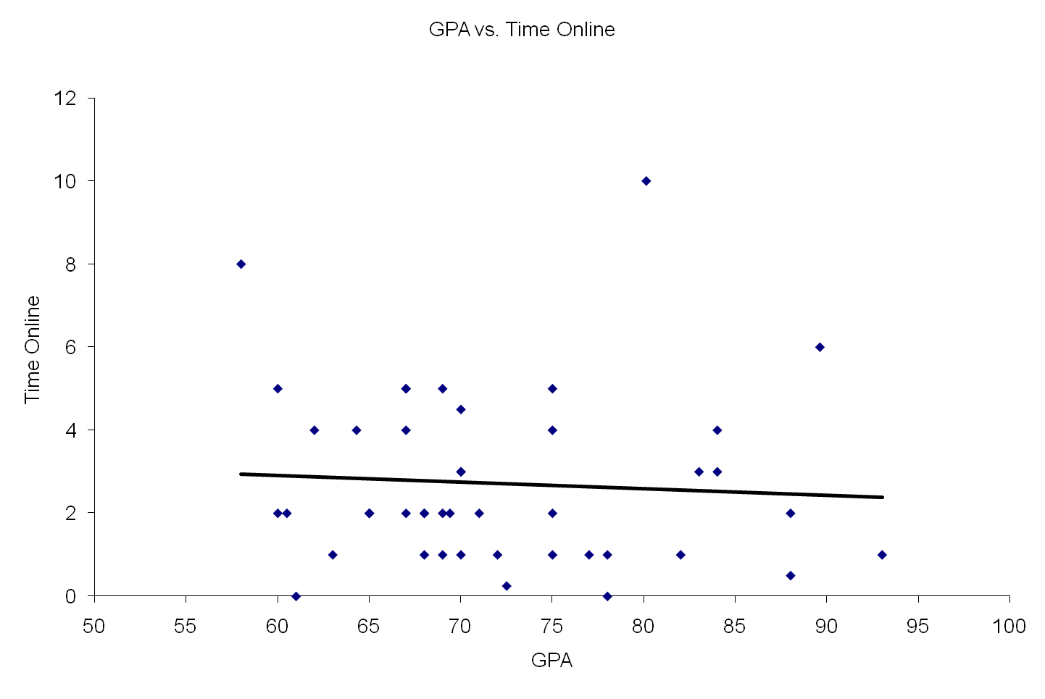
Notes:
The role of the two significant observations

Slide 15
Outliers
Rare, extreme values may distort the outcome.
  Could be an error.
  Could be a very important observation.
Outlier: more than 3 standard deviations from the mean.
Notes:
If you see one, check if it is a mistake.

Slide 16
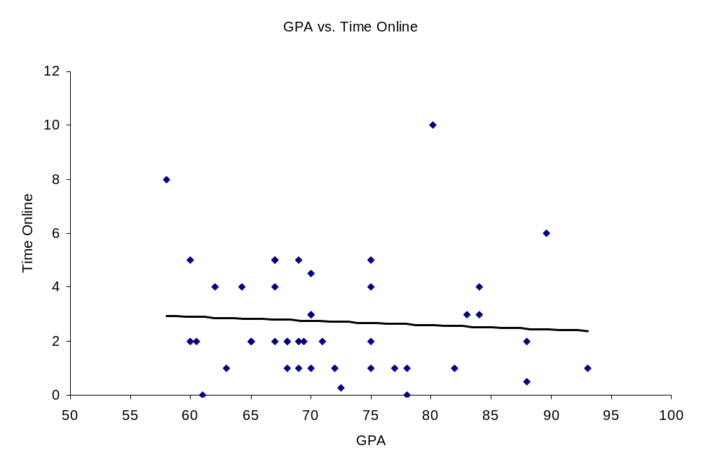
Notes:
The role of the two significant observations

Slide 17
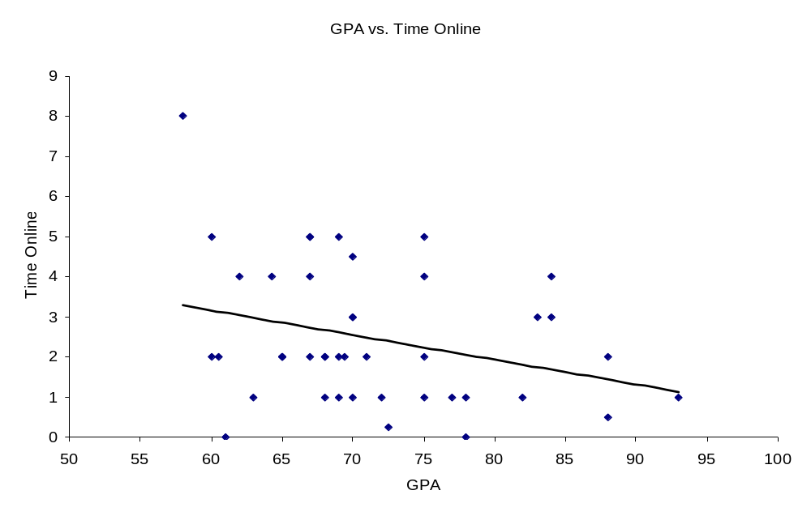
Notes:
The role of the two significant observations

Slide 18
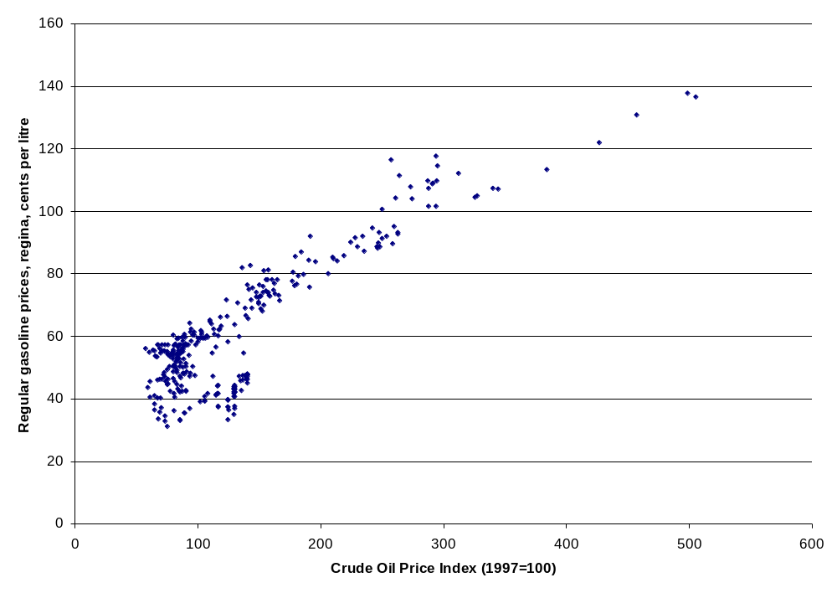
Correlation = 0.8703
Source: CANSIM II Database (Vector v1576530 and v735048 respectively)

Slide 19
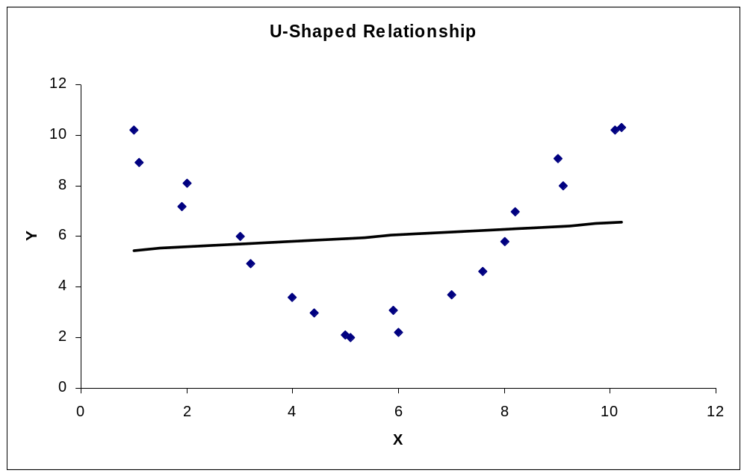
Correlation = +0.12.
Notes:
Be wary of the scatter graph, it is not always perfect.
Close to zero relationship, but there really is a more complex one.

