Slide 1
Statistics
Parameswari Ettiappan

Slide 2
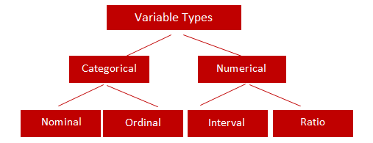
Types of Variables

Slide 3
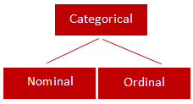
Categorical
Qualitative data are often termed categorical data.
Data that can be added into categories according to their characteristics.
Examples are gender, social class and blood types

Slide 4
Nominal Variable (Unordered list)
A variable that has two or more categories, without any implied ordering.
Examples : Gender - Male, Female
Marital Status - Unmarried, Married, Divorcee
State - New Delhi, Haryana, Illinois, Michigan

Slide 5
Ordinal Variable (Ordered list)
A variable that has two or more categories, with clear ordering. Examples :
Scale - Strongly Disagree, Disagree, Neutral, Agree, Strongly Agree
Rating - Very low, Low, Medium, Great, Very great

Slide 6
Interval
An interval variable is similar to an ordinal variable, except that the intervals between the values of the interval variable are equally spaced.
In other words, it has order and equal intervals.
Examples :
Temperature in Celsius - Temperature of 30°C is higher than 20°C, and temperature of 20°C is higher than 10°C. The size of these intervals is the same.
Annual Income in Dollars - Three people who make $5,000, $10,000 and $15,000. The second person makes $5,000 more than the first person and $5,000 less than the third person, and the size of these intervals is the same.

Slide 7
Ratio
It is interval data with a natural zero point.
When the variable equals 0.0, there is none of that variable. Examples :
Height
Weight
Temperature in Kelvin - It is a ratio variable, as 0.0 Kelvin really does mean 'no temperature.

Slide 8
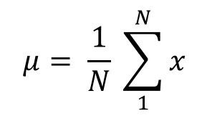

Central Location
(a) Arithmetic Mean
Of these “averages,” the most common and familiar is the arithmetic mean, defined by
(b) Geometric Mean
The geometric mean is defined as the nth root of the product of n observations:

Slide 9


Central Location
© Logarithmic Mean
The logarithmic mean of two numbers is given by the difference of the natural logarithms of the two numbers, divided by the difference between the numbers.
It is used particularly in heat transfer and mass transfer.
(d) Harmonic Mean
The harmonic mean involves inverses—i.e., one divided by each of the quantities.
The harmonic mean is the inverse of the arithmetic mean of all the inverses.

Slide 10
Median
If all the items with which we are concerned are sorted in order of increasing magnitude (size), from the smallest to the largest, then the median is the middle item.
Consider the five items: 12, 13, 21, 27, 31. Then 21 is the median.
If the number of items is even, the median is given by the arithmetic mean of the two middle items. Consider the six items: 12, 13, 21, 27, 31, 33.
The median is (21 + 27) / 2 = 24.

Slide 11
Mode
If the frequency varies from one item to another, the mode is the value which appears most frequently.
In the case of continuous variables the frequency depends upon how many digits are quoted, so the mode is more usefully considered as the midpoint of the class with the largest frequency.

Slide 12


Variability or Spread of the Data
Mean Deviation from the Mean
The mean deviation from the mean, defined as –
Mean Absolute Deviation from the Mean

Slide 13

Variability or Spread of the Data
Variance
Since squares of both positive and negative real numbers are always positive, the variance is always positive.

Slide 14

Variability or Spread of the Data
Standard Deviation

Slide 15
Quartiles, Deciles, Percentiles, and Quantiles
Quartiles, deciles, and percentiles divide a frequency distribution into a number of parts containing equal frequencies.
Quartiles divide the range of values into four parts, each containing one quarter of the values.
Percentiles divide into a hundred parts, each containing one hundredth of the total frequency.
Quantile divides a frequency distribution into parts containing stated proportions of a distribution.

Slide 16

Normal Distribution
They are approximately symmetrical, and the mode is close to the centre of the distribution.
The mean, median, and mode are close together.
The shape of the distribution can be approximated by a bell: nearly flat on top, then decreasing more quickly, then decreasing more slowly toward the tails of the distribution.
This implies that values close to the mean are relatively frequent, and values farther from the mean tend to occur less frequently.
Probability Density Function

Slide 17
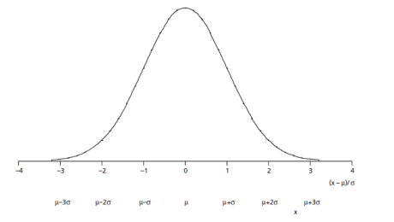
Normal Distribution

Slide 18
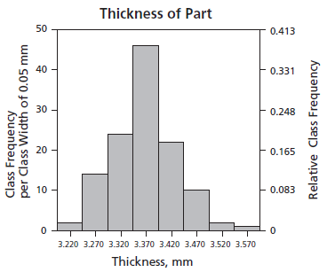
Normal Distribution

Slide 19
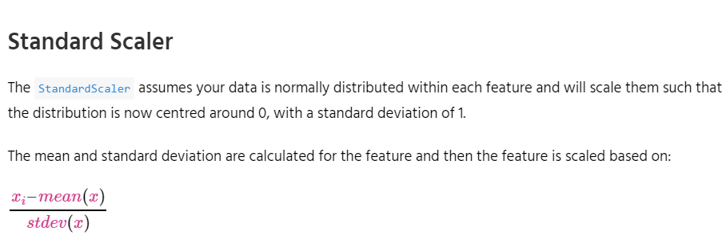
Feature Scaling
StandardScaler
MinMaxScaler
RobustScaler
Normalizer

Slide 20
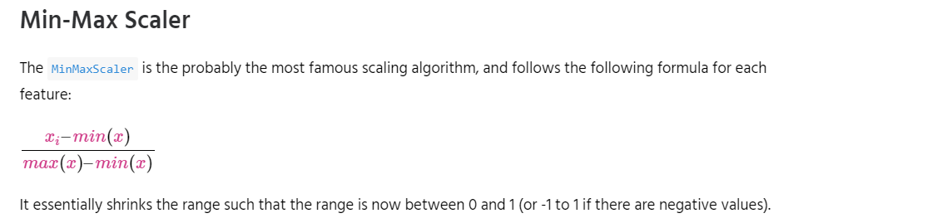
Feature Scaling
StandardScaler
MinMaxScaler
RobustScaler
Normalizer

Slide 21
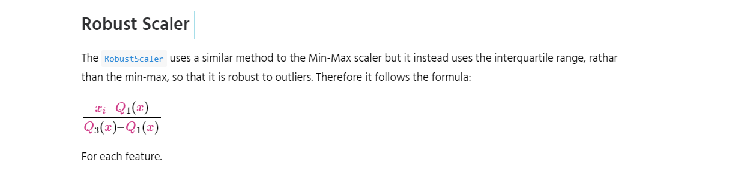
Feature Scaling

Slide 22
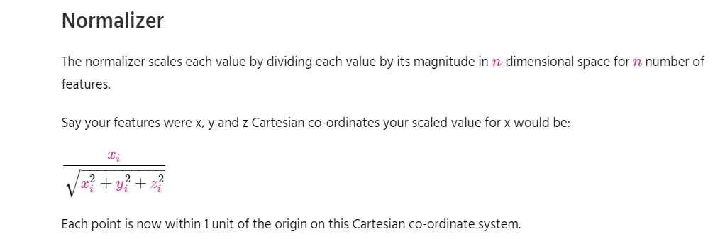
Feature Scaling

Slide 23
Simple Linear Regression
Simple linear regression is a statistical method that allows us to summarize and study relationships between two continuous (quantitative) variables:
One variable, denoted x, is regarded as the predictor, explanatory, or independent variable.
The other variable, denoted y, is regarded as the response, outcome, or dependent variable.

Slide 24
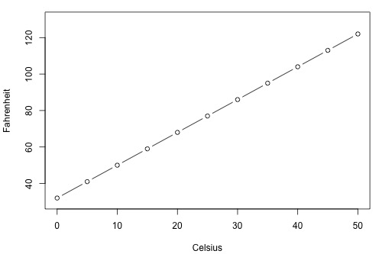
Simple Linear Regression

Slide 25
Types of Relationships
Deterministic
Temperature conversion
Circumference = π × diameter
Hooke's Law: Y = α + βX, where Y = amount of stretch in a spring, and X = applied weight.
Ohm's Law: I = V/r, where V = voltage applied, r = resistance, and I = current.
Boyle's Law: For a constant temperature, P = α/V, where P = pressure, α = constant for each gas, and V = volume of gas.

Slide 26
Types of Relationships
Statistical
Height and weight — as height increases, you'd expect weight to increase, but not perfectly.
Alcohol consumed and blood alcohol content — as alcohol consumption increases, you'd expect one's blood alcohol content to increase, but not perfectly.
Vital lung capacity and pack-years of smoking — as amount of smoking increases (as quantified by the number of pack-years of smoking), you'd expect lung function (as quantified by vital lung capacity) to decrease, but not perfectly.
Driving speed and gas mileage — as driving speed increases, you'd expect gas mileage to decrease, but not perfectly.

Slide 27
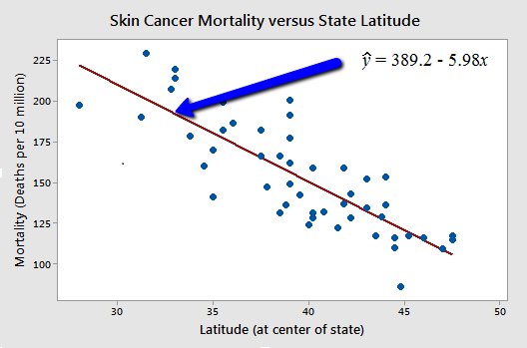
Types of Relationships

Slide 28
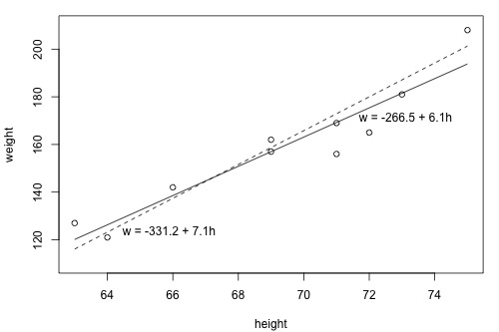
What is the "Best Fitting Line"?

Slide 29
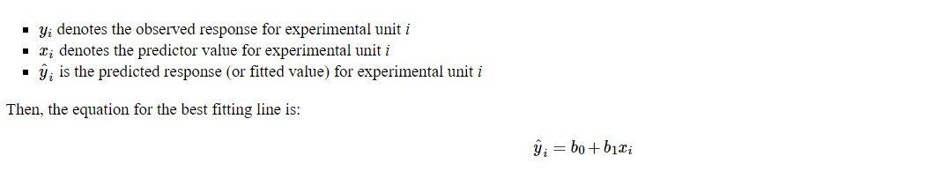
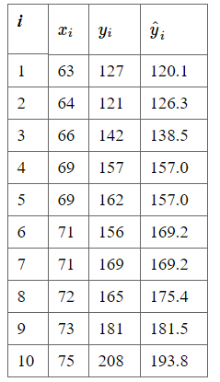
What is the "Best Fitting Line"?
it has some "prediction error" (or "residual error").
In fact, the size of its prediction error is 127-120.1 or 6.9 pounds.
As you can see, the size of the prediction error depends on the data point.
If we didn't know the weight of student 5, the equation of the line would predict his or
her weight to be -266.53 + 6.1376(69) or 157 pounds.
The size of the prediction error here is 162-157, or 5 pounds.

Slide 30
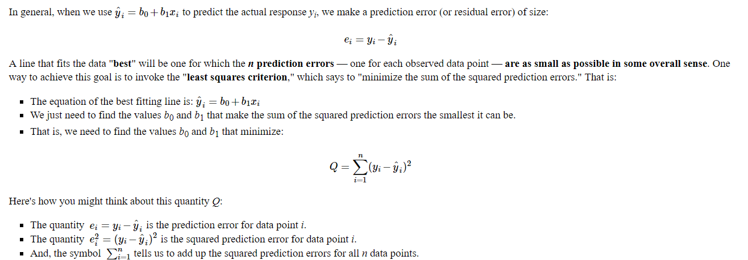
What is the "Best Fitting Line"?

Slide 31
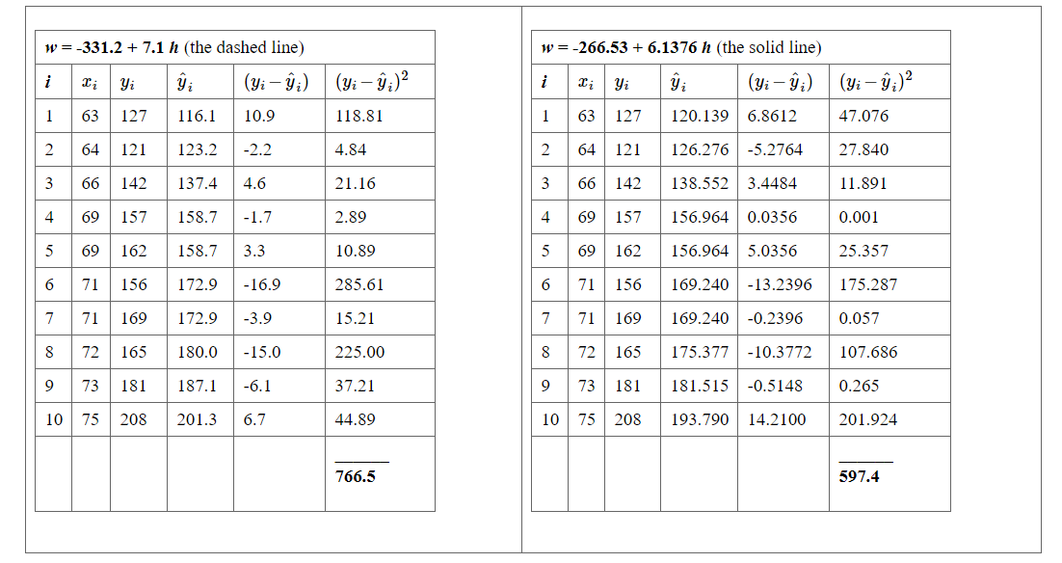
What is the "Best Fitting Line"?

Slide 32
What is the "Best Fitting Line"?
Based on the least squares criterion, which equation best summarizes the data?
The sum of the squared prediction errors is 766.5 for the dashed line, while it is only 597.4 for the solid line.
Therefore, of the two lines, the solid line, w = -266.53 + 6.1376h, best summarizes the data.

Slide 33
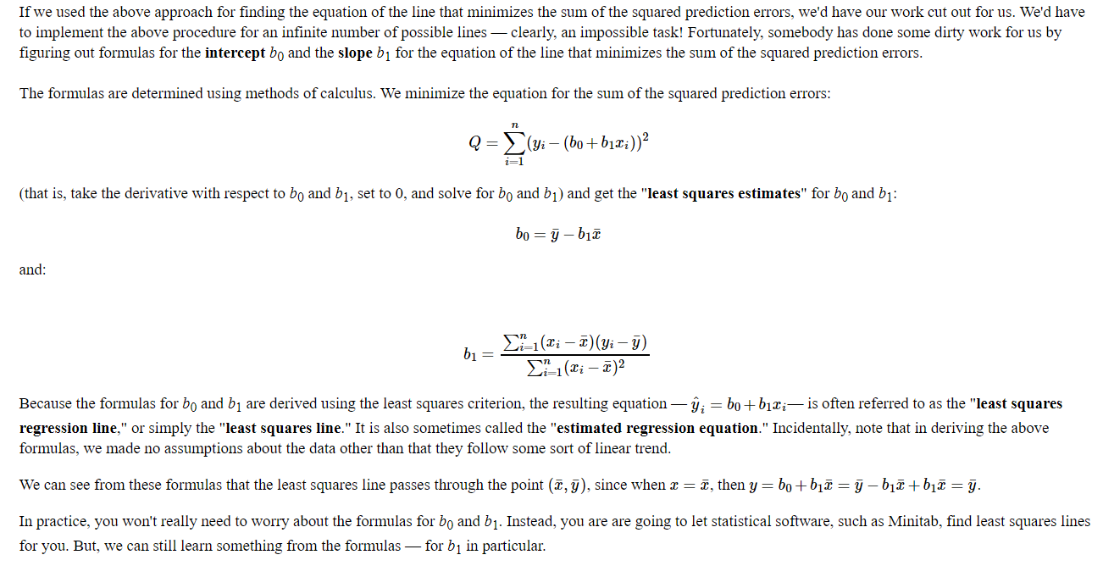
What is the "Best Fitting Line"?

