Slide 1
Recruitment Portal
To process all the steps in Recruitment easily……
Ashok Ram. G
Harish Shanmugam

Slide 2

Introduction
Manage end to end recruitment process.
Centralized Repository for Recruiter, Interviewer and for the Accountant.
No more running for CC index.

Slide 3
Modules
Crawling Resumes from the given data source (As of now Machine)
Indexing the content of those resumes for search and analysis purpose
UI module for Searching the resume based on skillset, education, Designation, Companies that the candidate served and based on our screening process status.
Interviewer process management.
Centralized Access for the data.

Slide 4
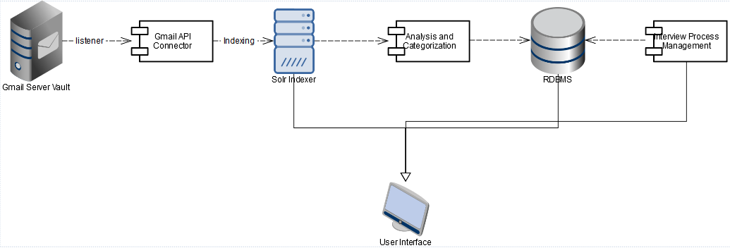
Architecture Diagram

Slide 5
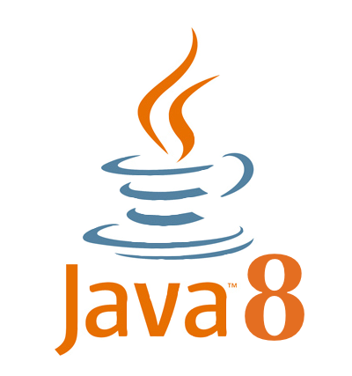








Technology Stack

Slide 6
Future Scope
Any Data source for resumes.
The idea is all about to do end to end employee analytics starting from the screening to the employee left the company.
This portal can used to do all the document management while joining the company. Which saves more time in on-boarding.
This portal can also used as a exit portal where employee can download his/her reference letters, Bona fide letters and experience certificates digitally signed. Without disturbing the PE partners.
Referral Management, Payslip Management, Employee Hike Management.

Slide 7
THANK YOU

