Slide 1


Slide 2

Product Overview

Slide 3

Drivers
Overview
Components
Compatibility
Getting into more details
Mobile?
Language?
Live Demo
Questions
Agenda

Slide 4

His Highness the Amir of Kuwait vision for Kuwait as a financial and economic hub in the region and the world.
Law number 20/2014 for electronic transactions.
Executive regulations for law number 20/2014.
Council of ministries decision 455/2016.
G2G solution availability.
Drivers

Slide 5

All in one place
Designed with Government in mind
Cutting edge user experience
Signature ready
What you see is what you get
ECM enabler
Overview

Slide 6








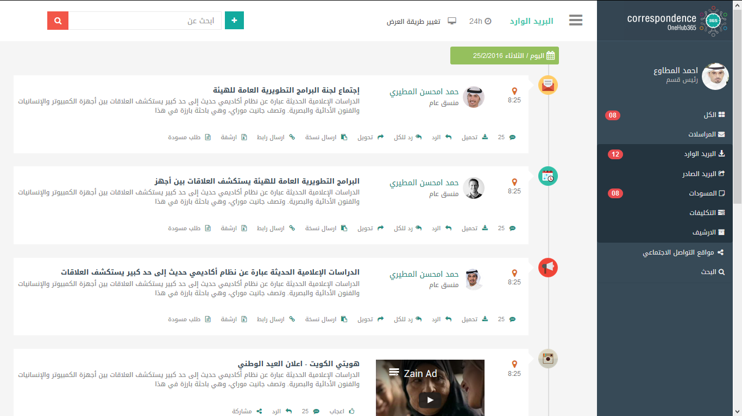




Tasks
Alerts
Signatures
Dashboards
Correspondences
المراسلات
Components

Slide 7









Compatibility

Slide 8




Compatibility

Slide 9

Getting into more details

Slide 10


Slide 11
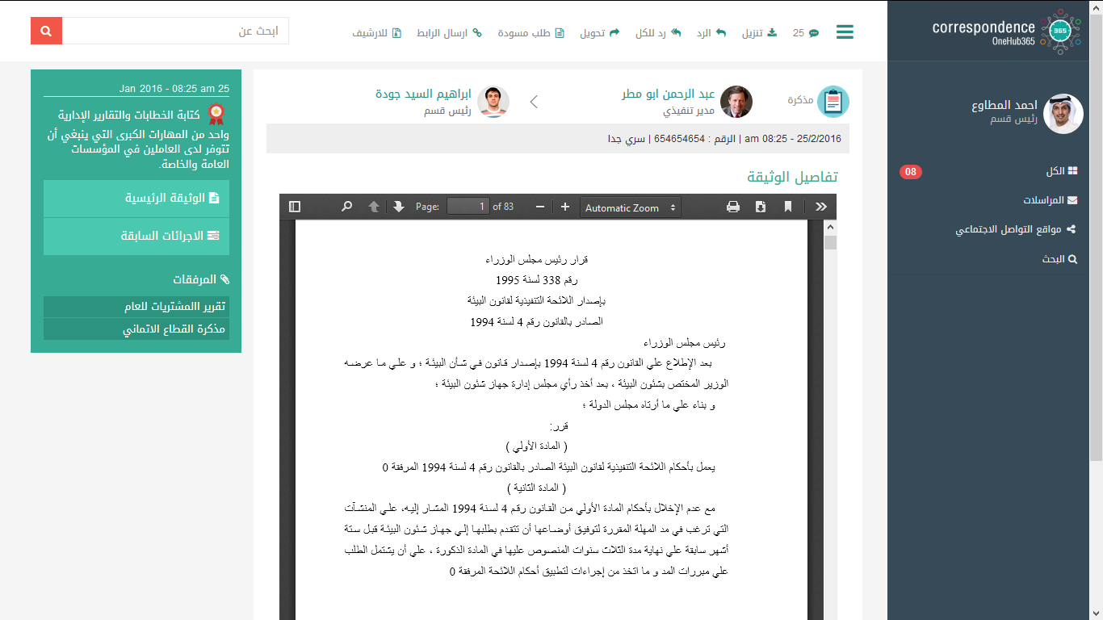

Slide 12
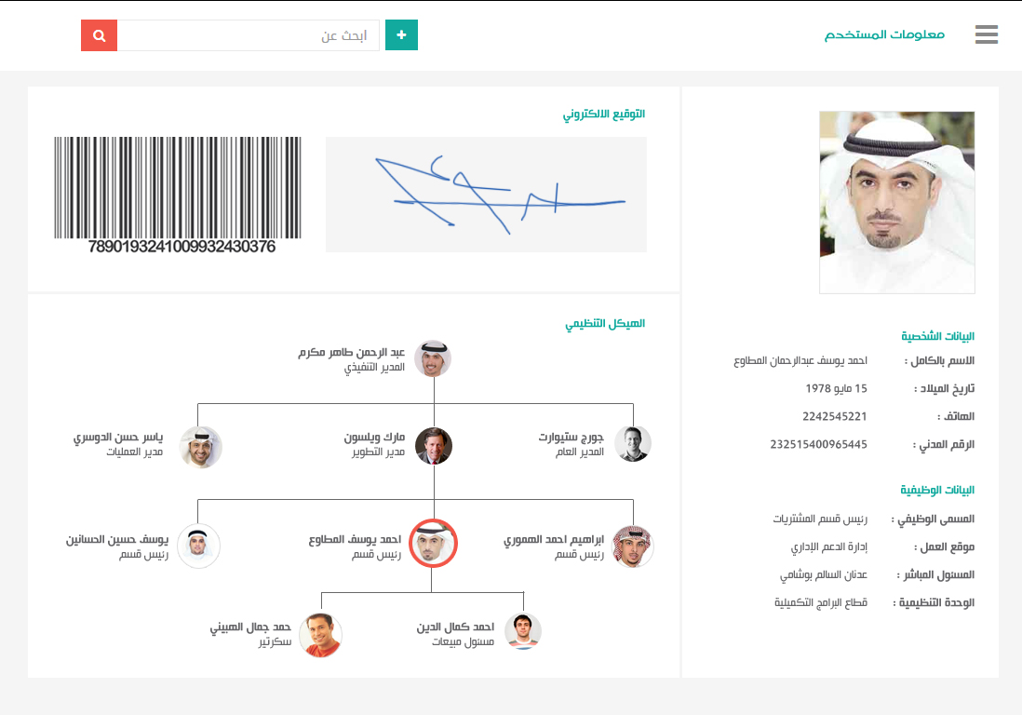

Slide 13
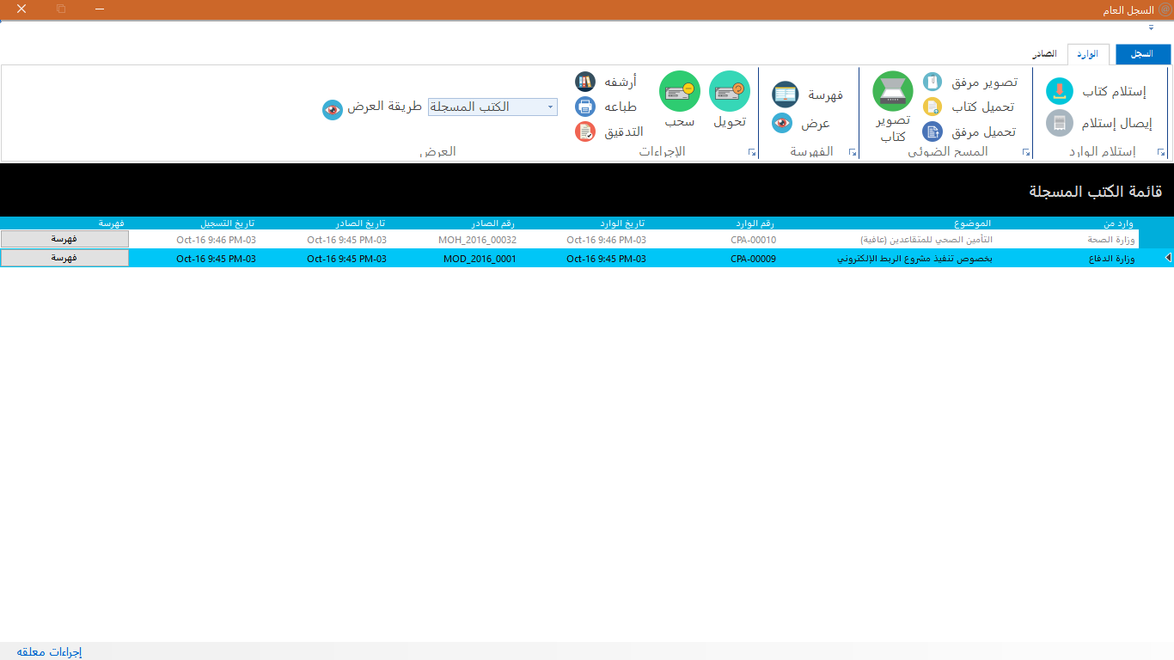

Slide 14
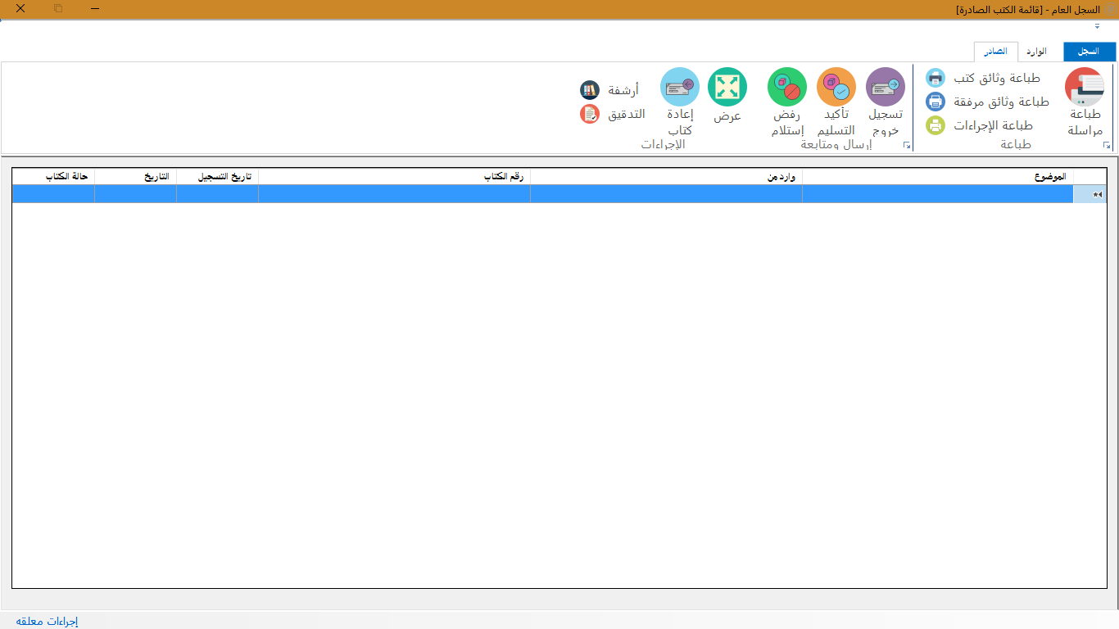

Slide 15
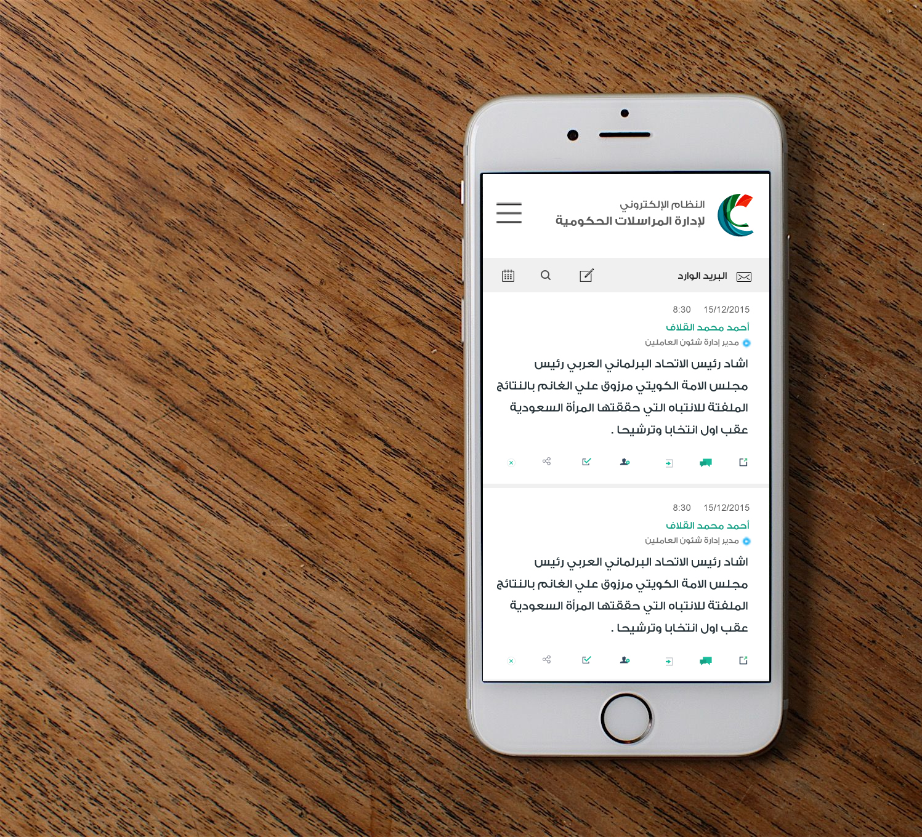
Mobile

Slide 16

Language

Slide 17
Live Demo

Slide 18
Thank You

