Slide 1
Training to Primary Level Teachers of Gujarati
Saturday 12th November 2016
Rekhaben Shah

Slide 2
Session 1
Training 4 to 6 year olds
Developing listening and speaking skills through music and songs
Recognising and naming letters of the alphabet and numbers orally
Developing simple words and sentences orally

Slide 3
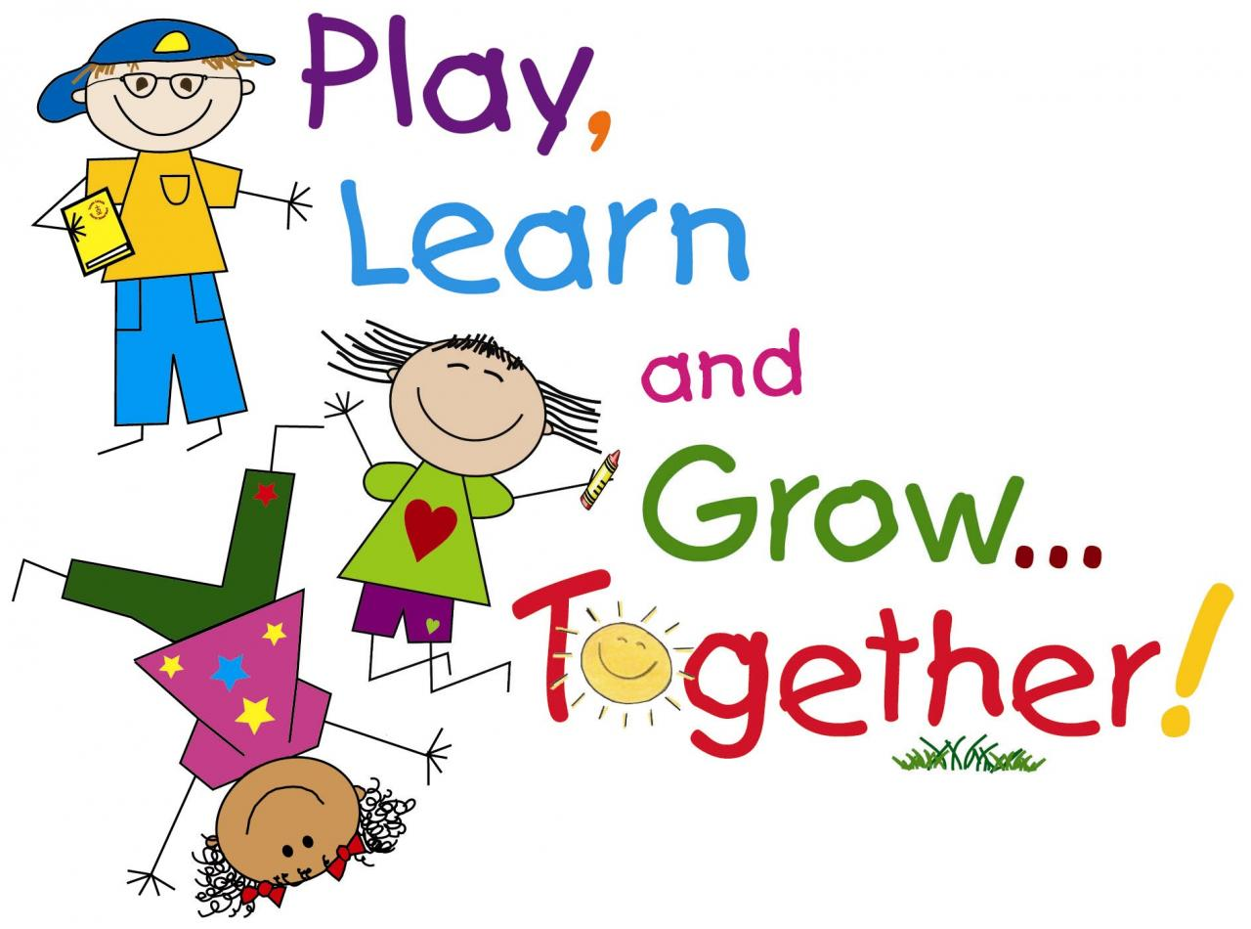

Slide 4
Developing listening and speaking skills through music and songs

Slide 5
Action Songs
Bus na paida gol gol jai, gol gol jai, gol, gol jai
Taara dhima dhima aavo………….
Ek jambu, Be jambu, tran jambu khadha……
Pata uper gaadi, dode doto kadhi….
Jambubhai na khetarma………..
Me ek biladi padi chhe………….
Chakki ben chakki ben, mari saathe ramva…..
http://www.youtube.com/watch?v=pPtF4nTsqH8

Slide 6
Teaching Parts of the Body
Mathu, Khabha, Gothun ane pug
Gothun ane pug
Naak ane kaan ane aankh ane modhu,
Mathu……………
Or
Nani maari ankh………..
http://www.youtube.com/watch?v=Bnr3gmOwzOY

Slide 7
Gujarati Teaching Skills
Nursery
Reception
Infants

Slide 8
What Should be Taught?
For 4-5 year olds
Simple rhymes, later use CDs
Numbers 1-10
Recognise instructions
Family relations
Common animals,
pictures, colouring
Common fruits
Alphabet speaking and recognition, simple words formed using the letters
Simple stories
Team games
For 5-6 year olds
Songs using CDs
Written numbers 1-10
Simple sums, worksheets
on counting
Parts of the body
Alphabet writing and
words, attention to the phonetic sounds
Extended family
Simple questions and answers
Fruits, Vegetables, Animals, Days of the week (Oral)

Slide 9
Recognising and naming letters of the alphabet and numbers orally

Slide 10
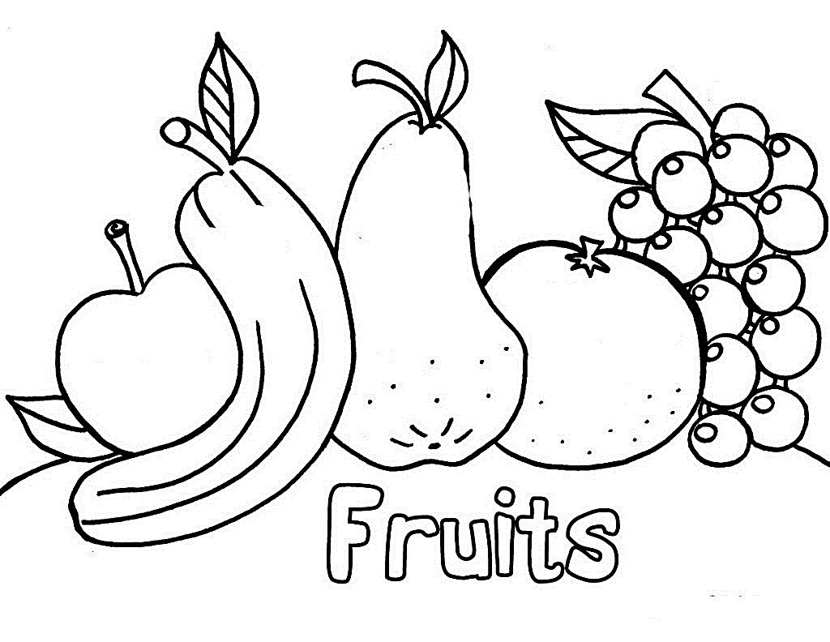
ફ
ફળ
http://www.youtube.com/watch?v=EsE0_mvxV2U

Slide 11
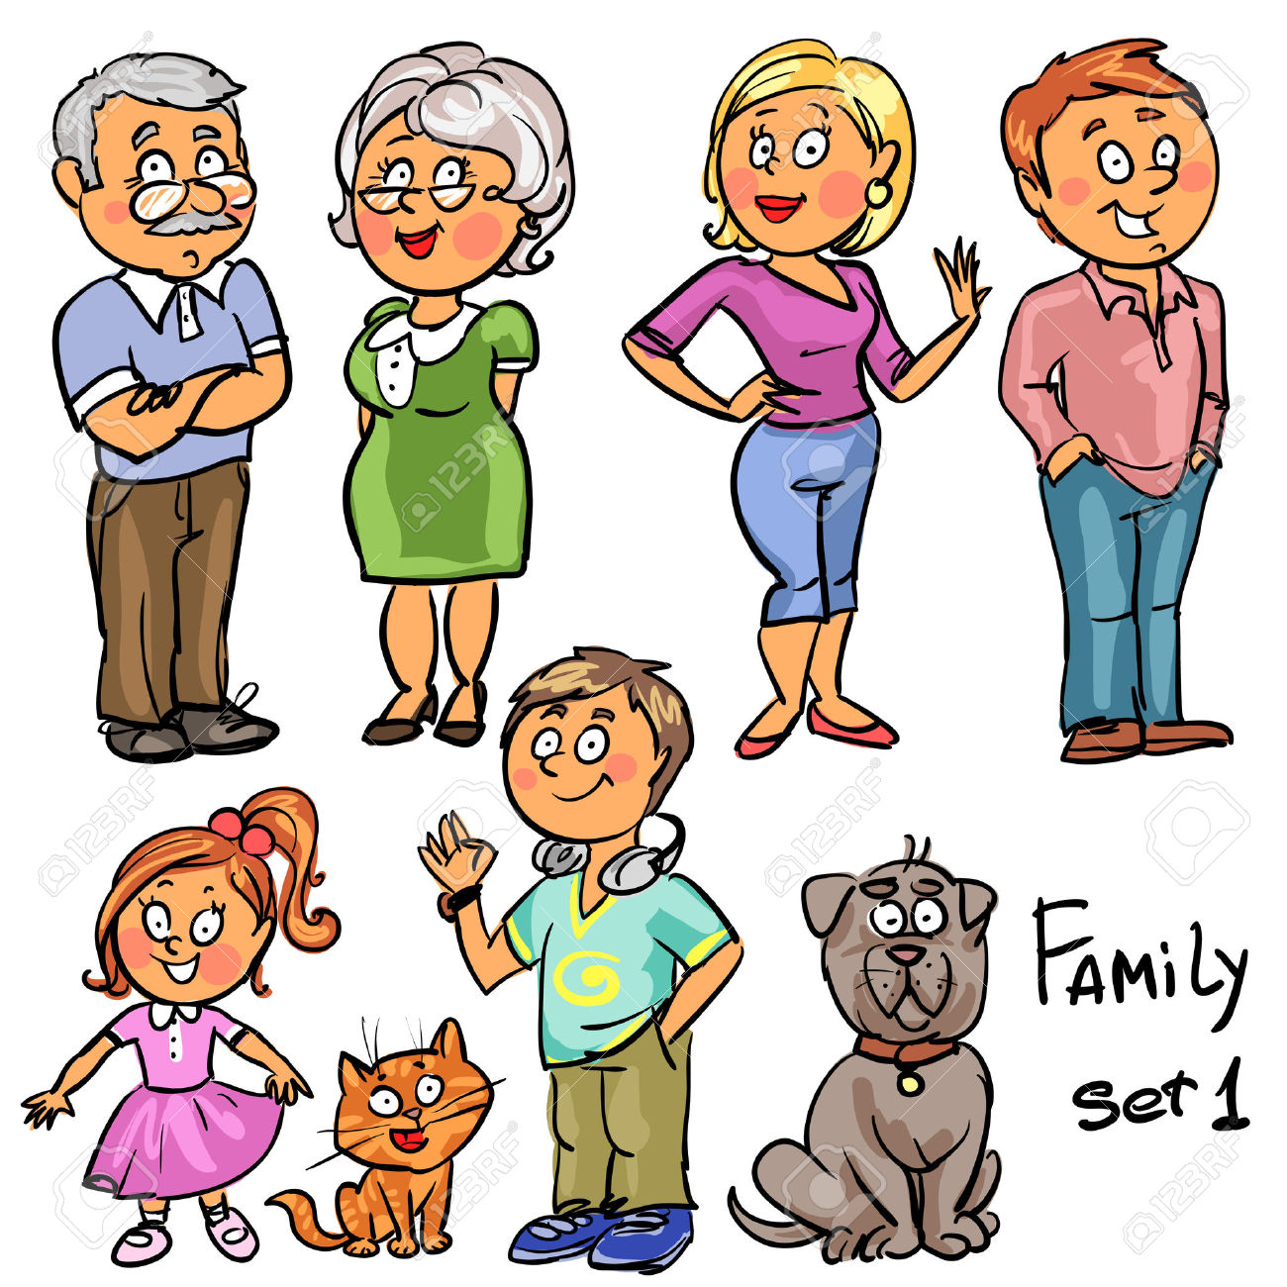

Slide 12
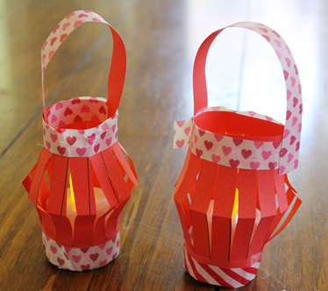
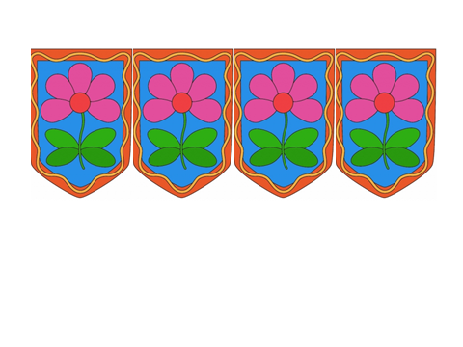
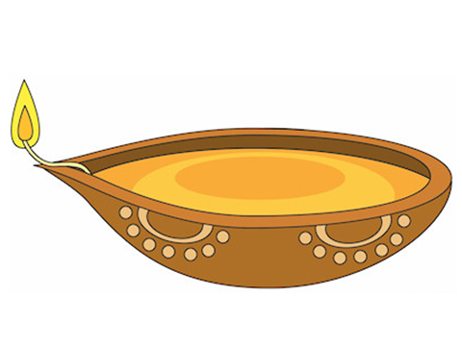
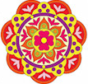



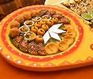
DIWALI

Slide 13
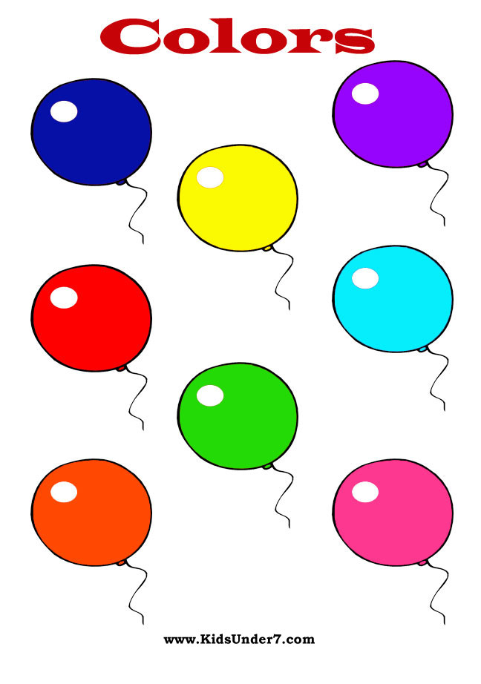
Colours

Slide 15
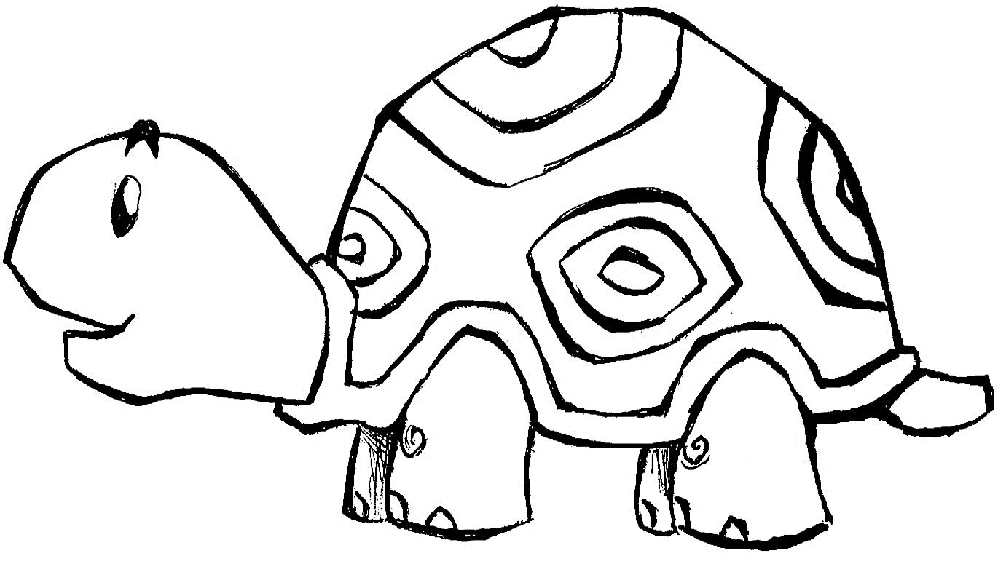
કાચબો

Slide 16
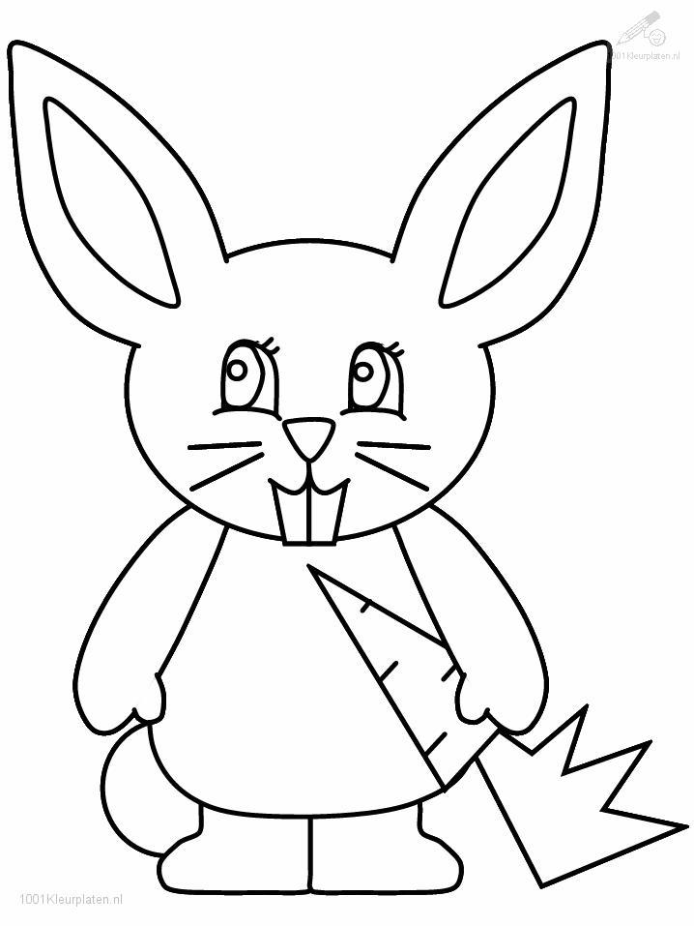
સસલું

Slide 17
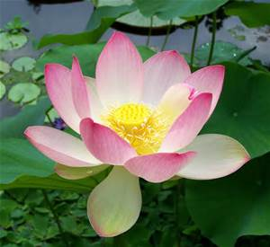

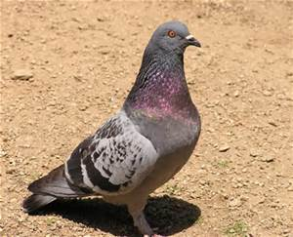


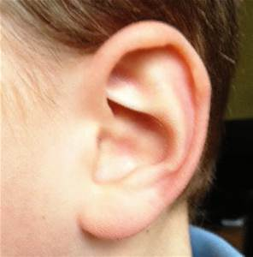

ક

Slide 18

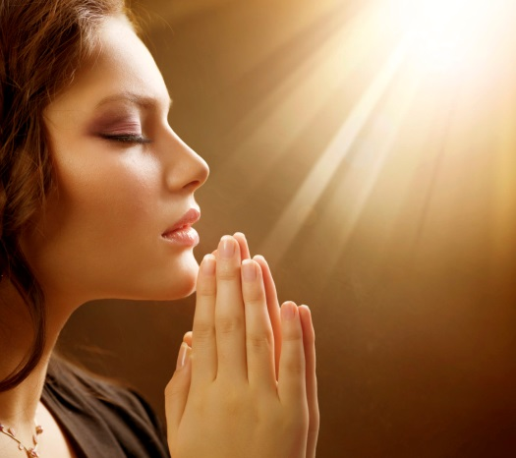
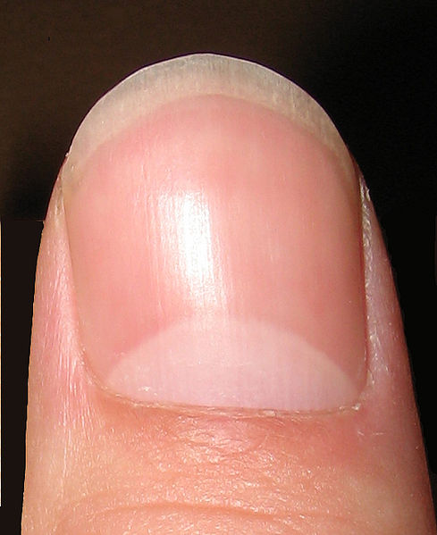
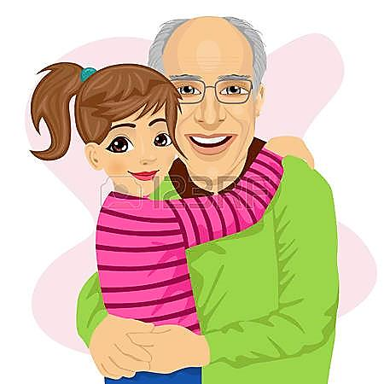
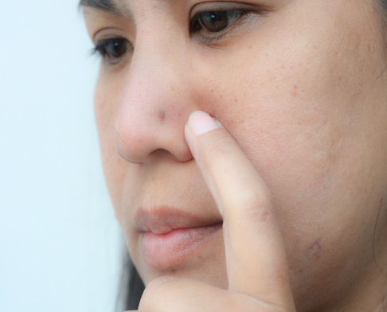
ન

Slide 19
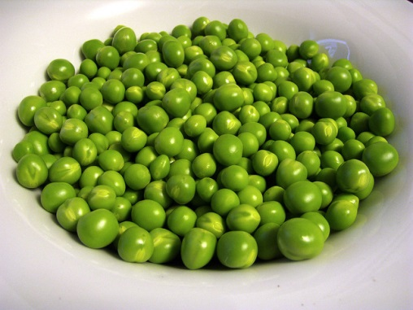
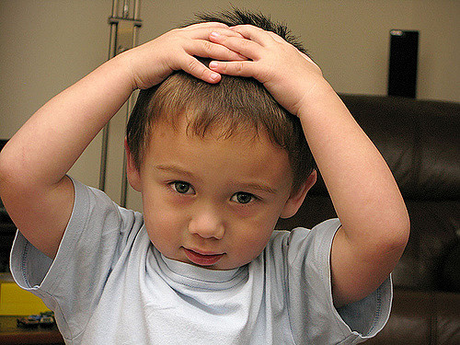
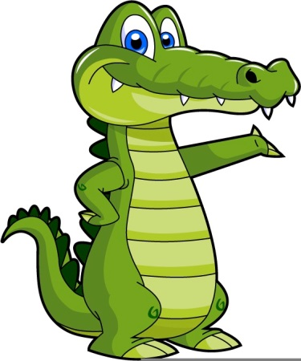
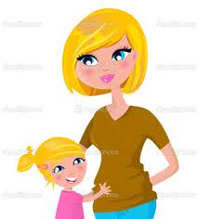


મ

Slide 20
ળ
ન​ળ

Slide 21

ન
નમ

Slide 22
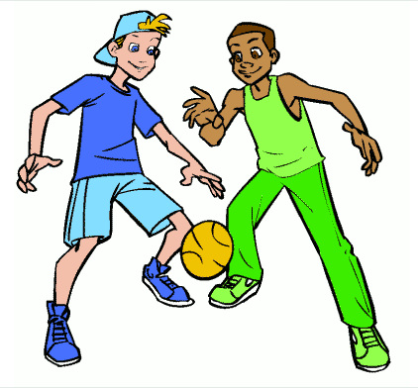
ર
રમ

Slide 23
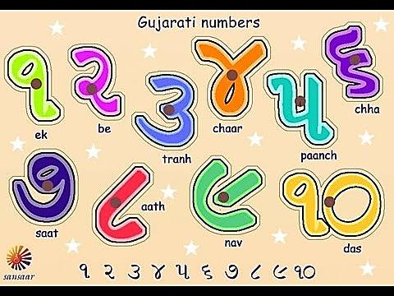

Slide 24
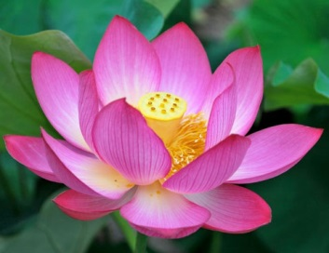

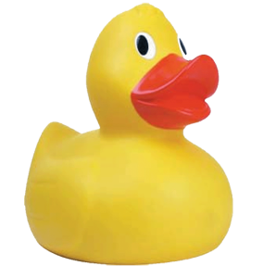
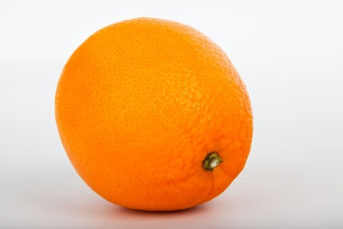
૧ | ૧
૧
૧

Slide 25
૨ | ૨ | ૨
૨
૨

Slide 26
૩ | ૩
૩
૩

Slide 27
૪ | ૪
૪
૪

Slide 28
૫ | ૫
૫
૫

Slide 29
Flashcards
CDs/Videos
Create
RESOURCES
White Boards
Stories
Worksheets
Games
Clipart/Images
Internet
Books

Slide 30
Lesson Planning
Number of students
Helper
Age group
New words
Re-inforce
Variation
Different resources

Slide 31

Are the Resources Accurate and Precise?

Slide 32
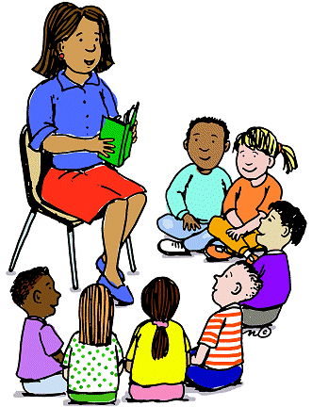
Successful early learning occurs when both teachers and children are actively engaged!

