Slide 1


Introduction
The project focuses on the challenge of predicting book pricing in the dynamic book market. Predicting book pricing is the issue we attempt to solve. In a competitive market, this is an essential task for writers, publishers, and retailers. For businesses to maximize profits and satisfying consumer demand, accurate pricing is crucial, and machine learning offers data-driven insights into how they do so. We use a large dataset with important book properties, like User Rating, Reviews, Year, Author, and Name, to achieve these objectives.

Slide 2

Objectives
Build prediction models to calculate book pricing based on significant features.
Evaluate the efficacy of various regression techniques.
Uncover out which characteristics or elements of the book have the biggest bearing on price prediction by conducting a thorough examination.
Identify the main variables influencing book pricing decisions and share this information with key industry players.

Slide 3

Methodology
Data preprocessing: Handling missing values, cleansing the data, and feature engineering are all examples of data preparation. EDA, or exploratory data analysis, is used to find out more about the dataset.
Regression models, Implementations include linear regression and K-Nearest Neighbors (KNN).
We use measures like MSE and Root Mean Squared Error to assess the model's performance.

Slide 4

Dataset Description
Name: The book's title or name.
Author: The name of the author.
User Rating: A numerical rating that reflects the reader's overall opinion of the book on a scale of, say, 0 to 5.
Reviews: The quantity of reader evaluations of the book.
Price: The cost of the book in a given currency, such as the US dollar.
Year: The year the book was published.

Slide 5

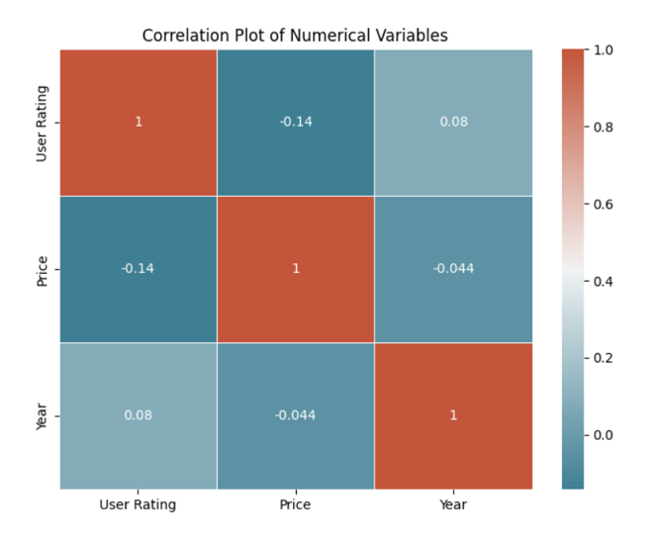



Correlation Plot
Correlation Plot of Numerical variables in the dataset

Slide 6
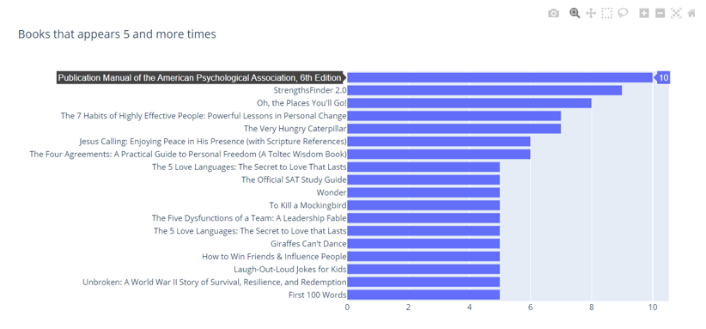
Bar Chart
The frequency of different books appearing in a dataset is shown in this graph.

Slide 7
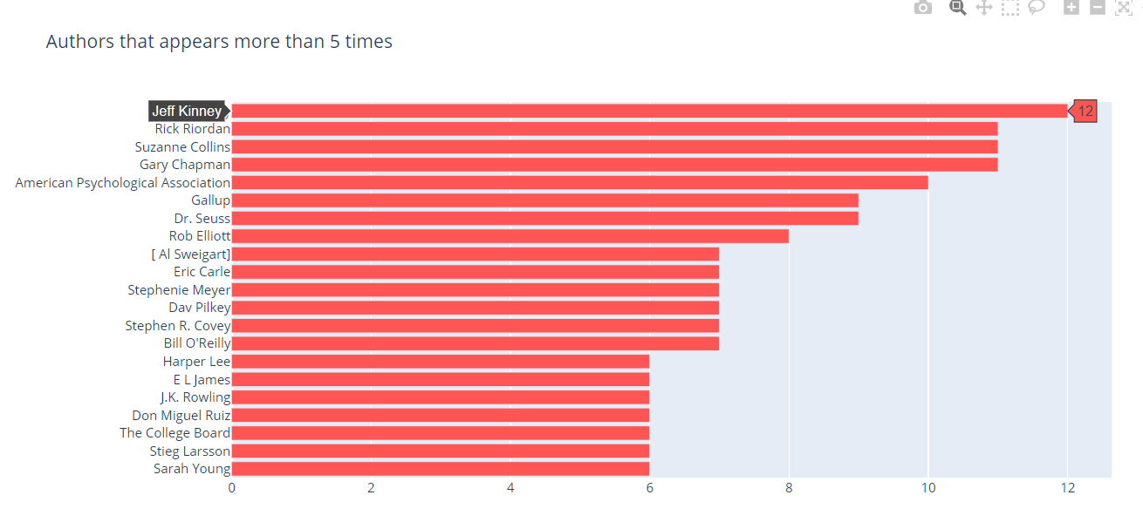
The graph shows how frequently different authors occur in a dataset.

Slide 8
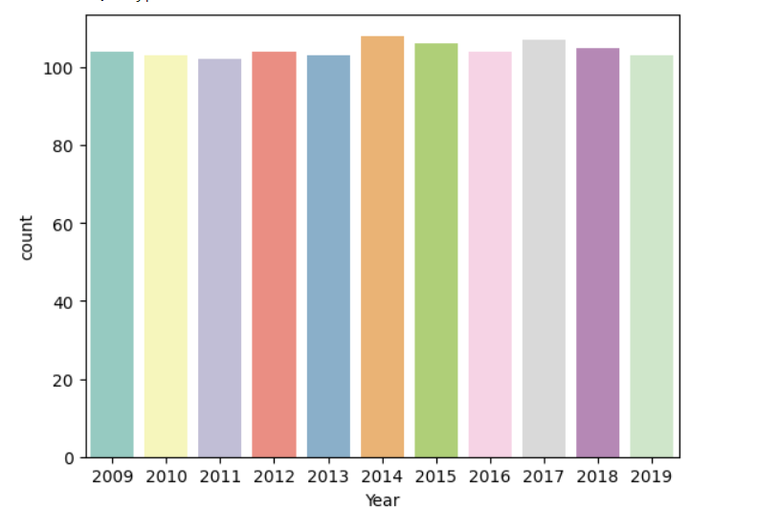
The graph offers a graphic depiction of data counts over time.

Slide 9
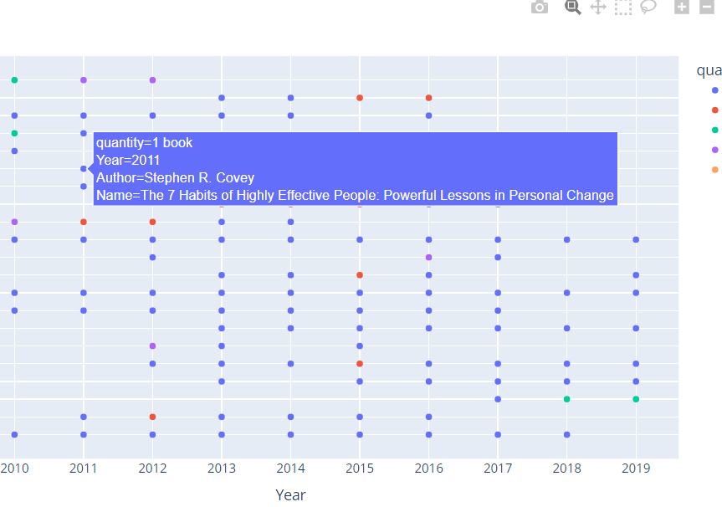
The graph shows the top authors from 2009 to 2019 alongside the number of books each published each year.

Slide 10
Models
We used Linear regression KNN models for our dataset.
The goal variable and the data have a linear relationship when predicated in the traditional and understandable regression model known as linear regression.
The majority decision or average of the KNN's k-nearest neighbors in the feature space acts as the basis for its predictions. KNN is a non-parametric regression model.
Limitations include exposure to the selection of the neighborhood size (k) as well as difficulty for large datasets.

Slide 11
Model Evaluation
The RMSE is obtained by taking the square root of the previously calculated MSE.
The r2_score function is used to compute the R-squared value, which represents percentage of the variance of dependent variable that can be calculated for by the independent variables.
Result of the evaluation indicate that the mean squared error is 1043.132 and the R-squared value is 0.87635.

Slide 12
Conclusion
In conclusion, our project's goals of creating precise prediction models for calculating book prices and assessing the effectiveness of various regression techniques were both successfully attained. We learned important things about the dynamics of book price through careful data preparation, exploratory data analysis, and model application. The importance of elements like User Rating, Reviews, and Year in affecting book prices was highlighted by our project.

Slide 13
References
BRAD 1.0: Book Reviews in Arabic dataset, Agadir, Morocco: 13th IEEE/ACS International Conference on Computer Systems and Applications, pp. 1–8, doi: 10.1109/AICCSA.2016.7945800.
Linear Regression Models Combined, Journal of the American Statistical Association, 100:472, 1202-1214; Zheng Yuan and Yuhong Yang; DOI: 10.1198/016214505000000088; 2005.
Amazon book reviews and advice https://paperswithcode.com/dataset/amazon-review

