Slide 1
Hotel Database Management System
Group –
1.
2.
3.
4.
5.

Slide 2
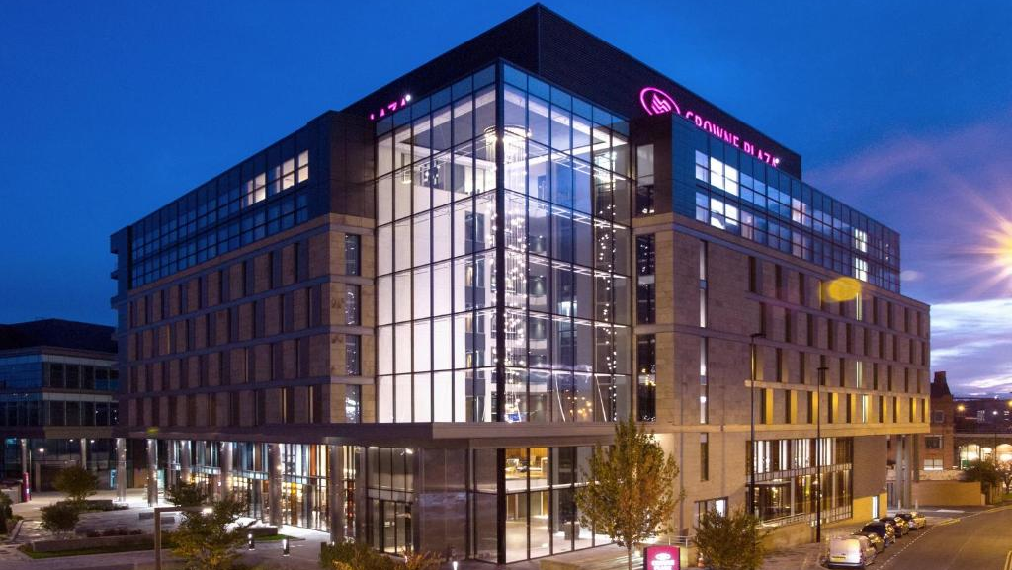
Introduction
Introducing Hotel DB, an innovative platform for managing hotel databases that is intended to improve customer service, improve management effectiveness, and streamline hotel operations.
For hotel staff and management, HotelDB provides a powerful administrative backend together with an easy-to-use front for guests.
All hotel administration functions are integrated into one easy to use platform with Hotel DB, including staff management, event planning, room reservations, and customized amenities.

Slide 3

Objectives
Centralization: Combine all hotel operations and guest information into a single accurate source.
User Experience: By providing simple access to hotel services and facilities via a user-friendly interface, you can improve the overall experience of your guests.
Scalability: Create a system that extends with the company to meet the needs of different users, properties, and changing market conditions.
Sustainability: By using less paper and supporting eco-friendly projects, you can help maintain the sustainability of the environment.

Slide 4

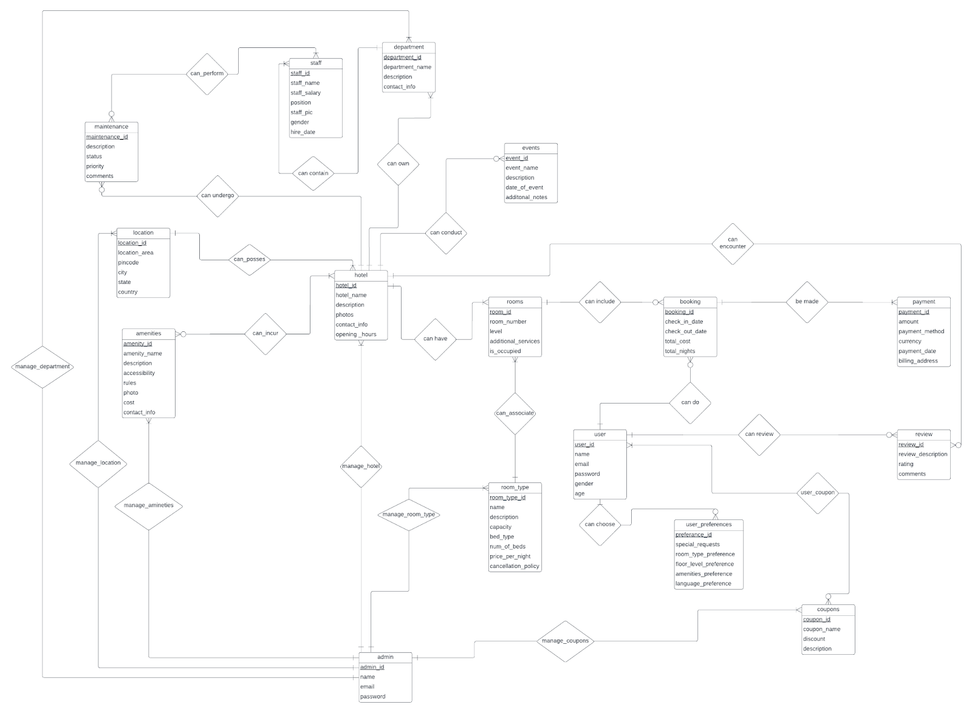



Entity Relationship Diagram

Slide 5

Entities and Attributes
Hotel - hotel_id, hotel_name, description, photos, contact_info, opening_hours,location_id
User - user_id, name, email, password, gender, age
Admin - admin_id, name, email, password
room_type - room_type_id(PK), name, description, capacity, bed_type, num_of_neds, price_per_night, cancellation_policy, admin_id(FK)
Maintenance - maintenance_id, description, status, priority, comments,hotel_id(FK)
maintenance_staff - maintenance_id(FK),staff_id(FK)
Location - location_id, location_area, pincode, place, city, country
Amenities - amenity_id, amenity_name, description, accessibility, rules, photo, cost, contact_info
Department - department_id, department_name, description, contact_info,department_id(FK)
Staff - staff_id, staff_name, position, staff_salary, staff_pic, gender, hire_date,admin_id(FK)
Events- event_id, event_name, description, date_of_event, additional_notes,hotel_id (FK)

Slide 6
Technical Part
Frontend Backend
ReactJS Node.Js
CSS ExpressJs
MySQL
Tools: Visual Studio, MySQL Work Bench

Slide 7
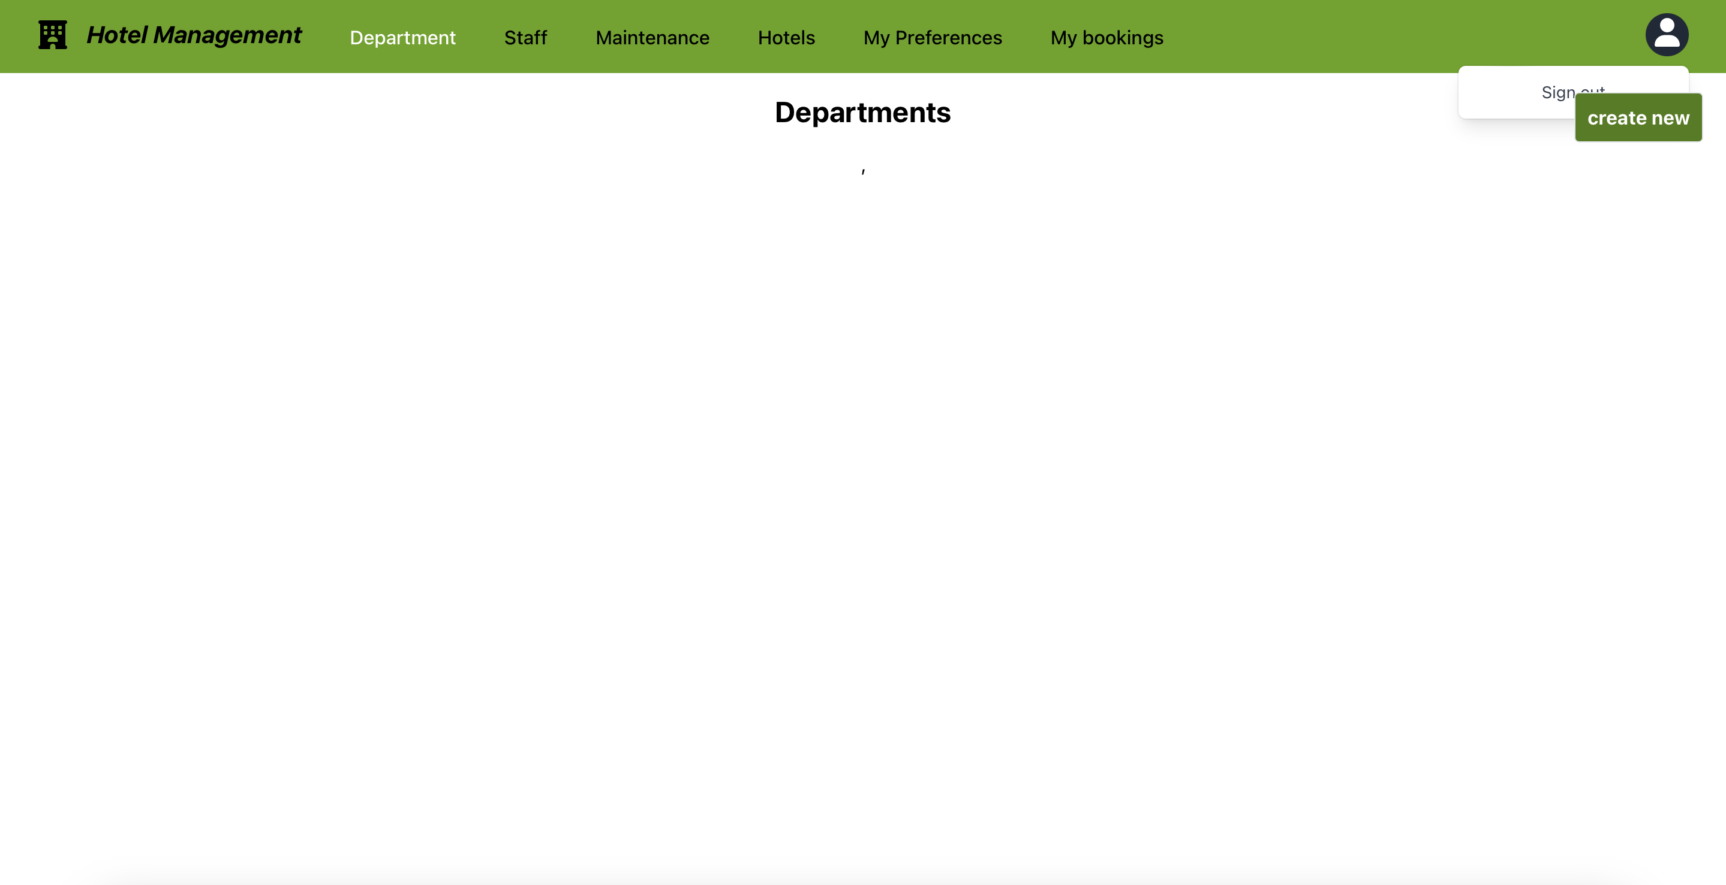
Admin flow Actions
Admin Login and Logout
Manage Department
Manage staff profiles.
Update Maintenance Details
Delete and Update Hotel Details
Update Guest Preferences
Monitor guest booking

Slide 8
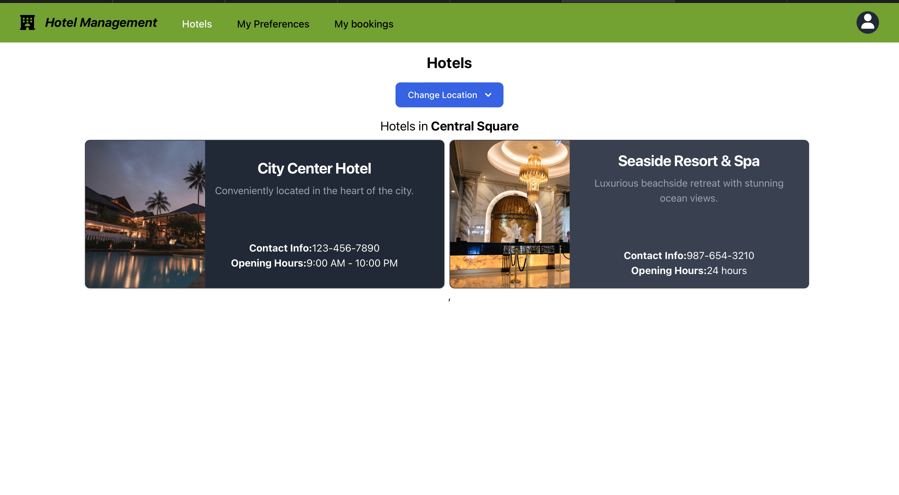
Login Flow
Book Hotels by selecting Location
Choose Amenities
Select number of rooms
Select number of Nights
Add and update user preferences
Check the list of bookings

Slide 9
Conclusion
In conclusion, The Hotel Management System makes handling jobs simpler while delivering an excellent guest experience with its strong capabilities and ease of use. It aims to adjust to the demands of the hotel and enhance the way that hotels provide for their guests.

