Slide 1
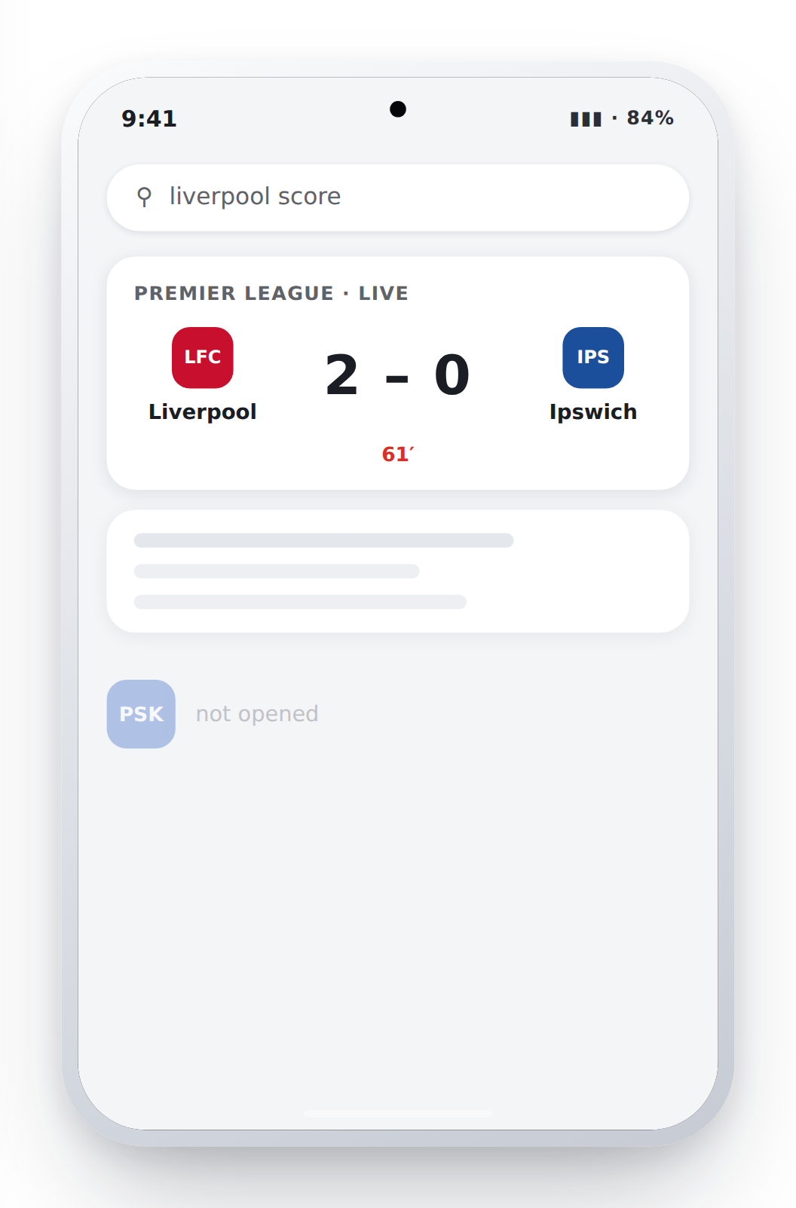
FEG INNOVATION HACKATHON 2026 · CHALLENGE 2 · PSK
THE USER
DOESN'T HAVE TO
OPEN US ANYMORE.
The information they want is already everywhere.
Search
Score apps
Social
Notifications
PSK app
not opened
Notes:
Open cold, no logo slide.
The behaviour has already changed. A customer who wants a score types it into a search box, sees it in half a second, and never opens a betting app. Every operator is fighting for a tap that increasingly does not need to happen.
Our starting position: we are not competing with other sportsbooks for that moment. We are competing with the phone's own surfaces — search, score apps, notifications. So that is where we should be.

Slide 2
THE PROBLEM
WE DELIVER INFORMATION.
THEY GET IT SOMEWHERE ELSE.
TODAY
WITH AMBIENT
They want the score
They want the score
They search for it
It is already on their screen
They get the answer
Widget · lock screen
The app never opens
They come back
Notes:
Walk the left column first, one step at a time — this is today's journey and it ends in a dead end.
Then the right column. Same intent, but the answer is already on a surface they own, so the journey is two steps instead of four and it ends back with us.
Supporting numbers if asked: Android push click-through sits around 4.6%. At three to six pushes a day roughly 40% of users switch notifications off; at one a week it is closer to 10%. Targeted messages retain about 1.9 times better than broadcast — 39% vs 21% past eleven sessions.

Slide 3
THE BUSINESS QUESTION
HOW DO WE GIVE THEM
A REASON TO COME BACK?
RELEVANCE
INTERACTION
OPPORTUNITY
Notes:
This is the hinge of the pitch. Say it and pause.
Note what we are NOT asking: how do we get more bets out of each customer. The brief scopes existing customers and retention, and every EU regulator is moving the same way — so the only honest lever left is relevance.
The chain is simple: more relevance leads to more interaction, more interaction creates more commercial opportunity. We quantify the last step at the end.

Slide 4
THE COMPETITIVE LANDSCAPE
THE PLAYBOOK IS THE SAME.
Betano
Superbet
SuperSport
STS
Missions
XP
Tiers
Rewards
THEM
US
MONEY
ATTENTION
Reward engagement, not wagering.
Notes:
Every operator in our markets runs missions, XP and tiers. The mechanic works — that is not in dispute.
The difference is what sits at the end of it. They pay out in free bets, bonus funds, free spins and mystery boxes. Players then keep wagering to hold a tier, which is precisely the harm pattern regulators are naming: restricted in Romania, banned outright in the Netherlands and Belgium, and never lawful to an at-risk or self-excluded customer anywhere.
We keep the mechanic and change the currency to attention: status, identity and access. "Wager 50 euros this week" becomes "follow three teams". "Ten bets for Gold" becomes "check in on five live matches". A ten-euro free bet becomes a badge, your club's colours, or a match ticket.
Commercial upside beyond compliance: nothing here needs rebuilding when the next bonus ban lands.

Slide 5
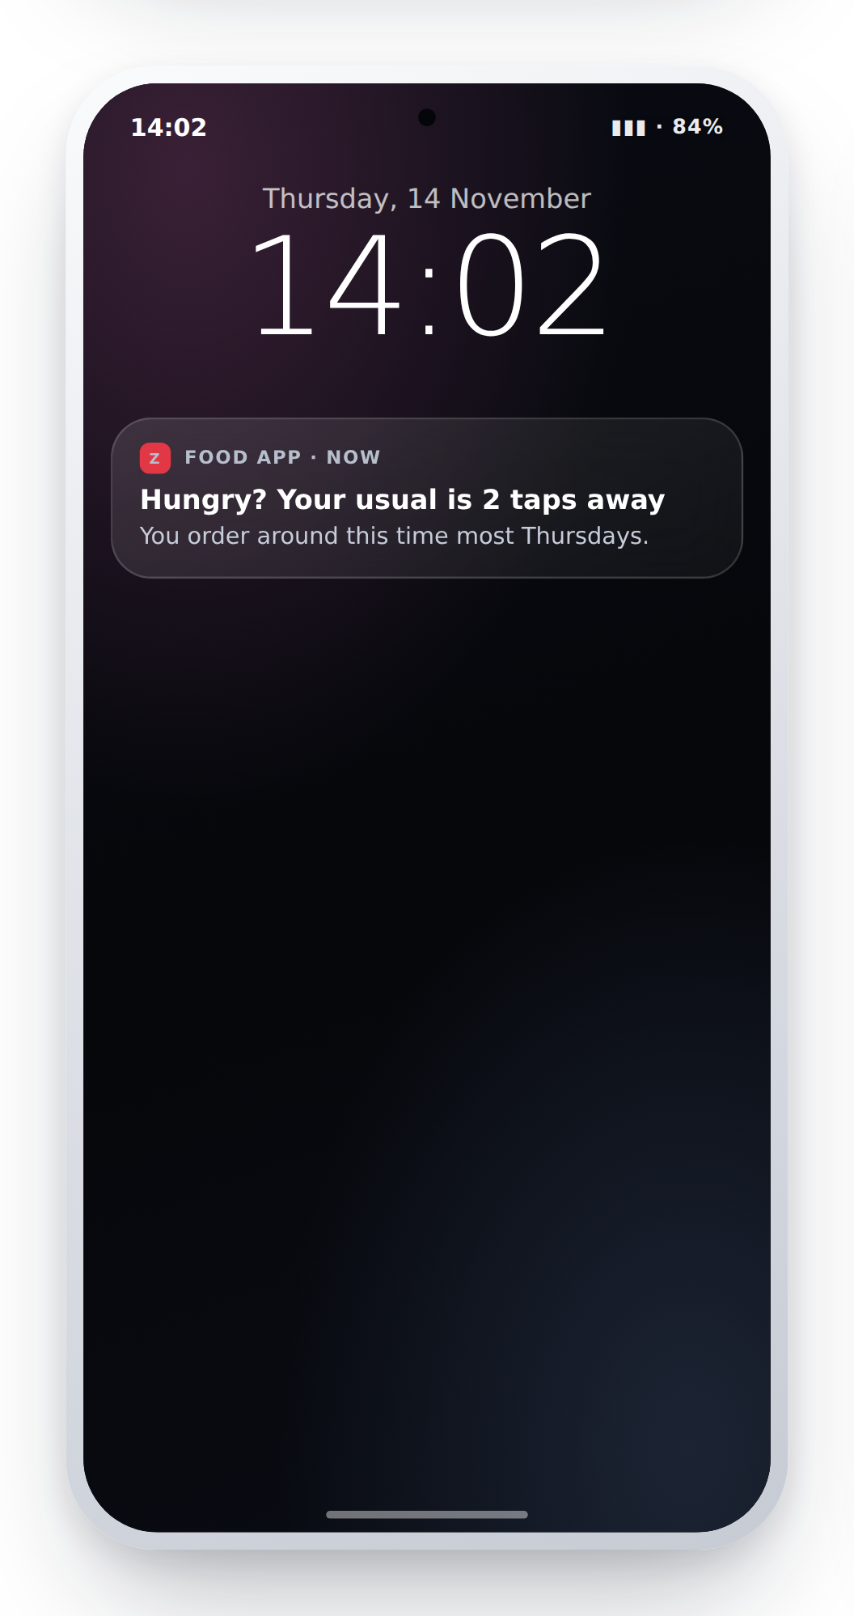
WHERE THE IDEA CAME FROM
ZOMATO DOESN'T ASK.
IT KNOWS WHEN TO SPEAK.
2:00 PM
their usual ordering time
RIGHT PERSON.
RIGHT TIME.
RIGHT MESSAGE.
What if PSK did the same?
Notes:
A food app never says "don't miss out". It notices that you order at two on a Thursday and says one short, human line at 1:58. No discount, no countdown, no pressure.
That is the whole insight, and it is portable: right person, right time, right message.
A betting app cannot copy the offer — but it can copy the manners. And unlike a food app, we have something even better than a habit to work from: a live match the customer already cares about.

Slide 6
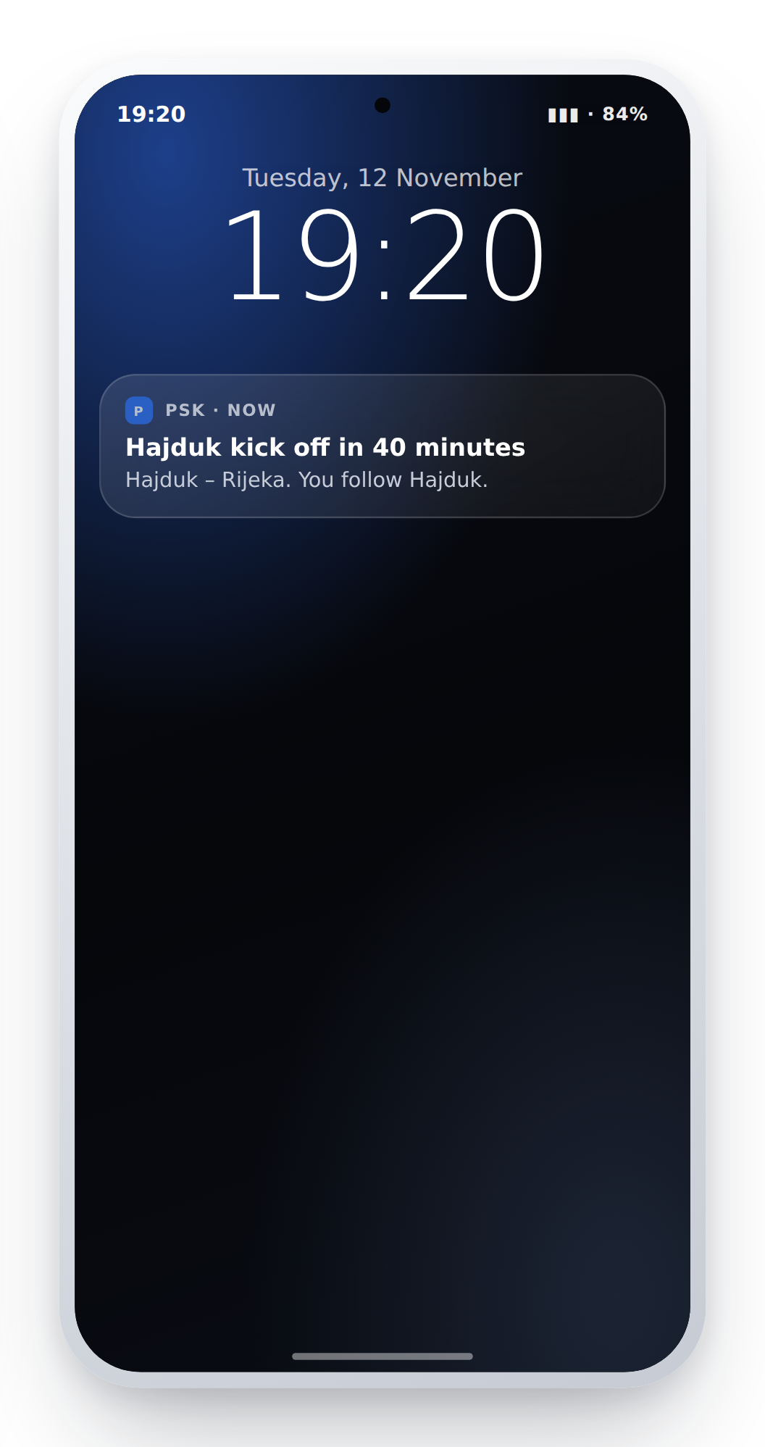
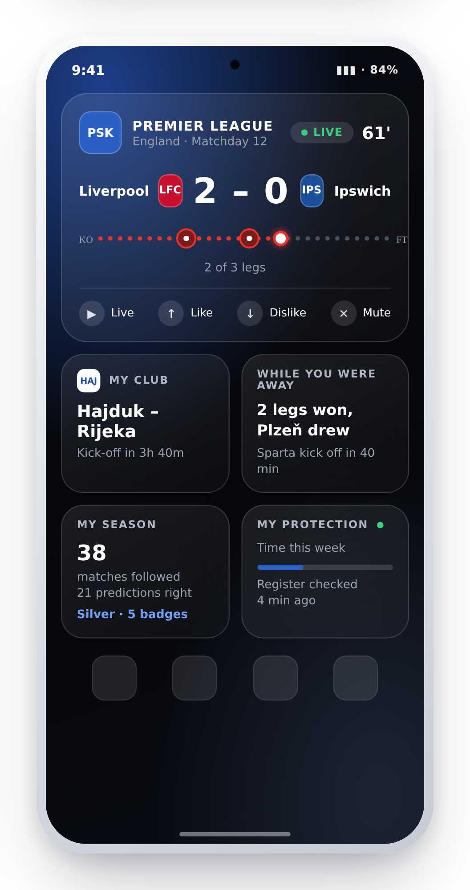
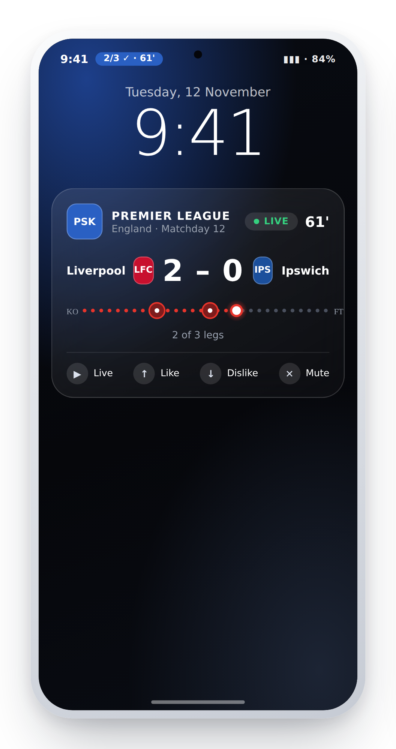
THE IDEA · AMBIENT
MAKE PSK FEEL PERSONAL.
Personalised across the surfaces they already look at — no app open required.
NOTIFICATION
HOME WIDGET
LOCK SCREEN
Notes:
Three surfaces, one engine.
One: a notification that is about their club, not our promotion. "Hajduk kick off in 40 minutes." No odds, no offer, no urgency language.
Two: a family of home-screen widgets — my club, while you were away, my season, my protection — themed in the colours of the team they follow.
Three: the lock screen. On Android 16 a live slip renders as a progress bar that updates as legs land. The customer follows the match without unlocking the phone.
Hard rule across all three: no stake, no odds, no returns, no balance ever appears on an OS surface. Money stays inside the app, behind the login.

Slide 7
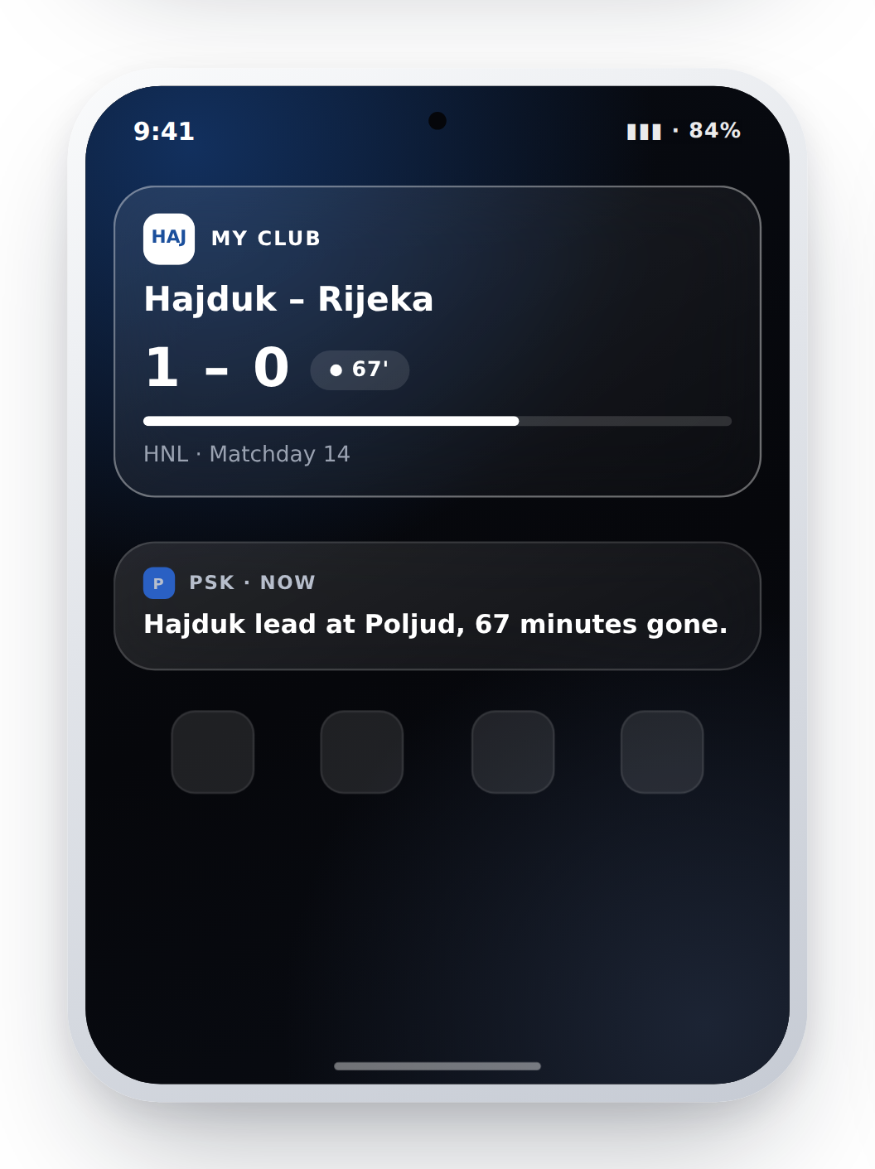
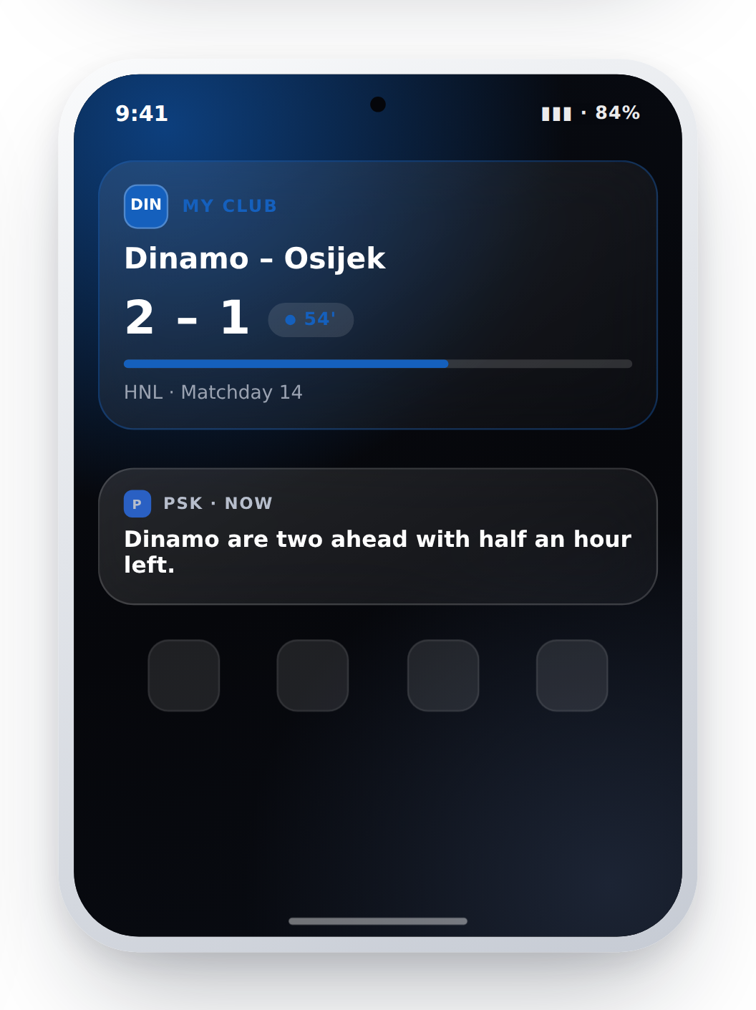
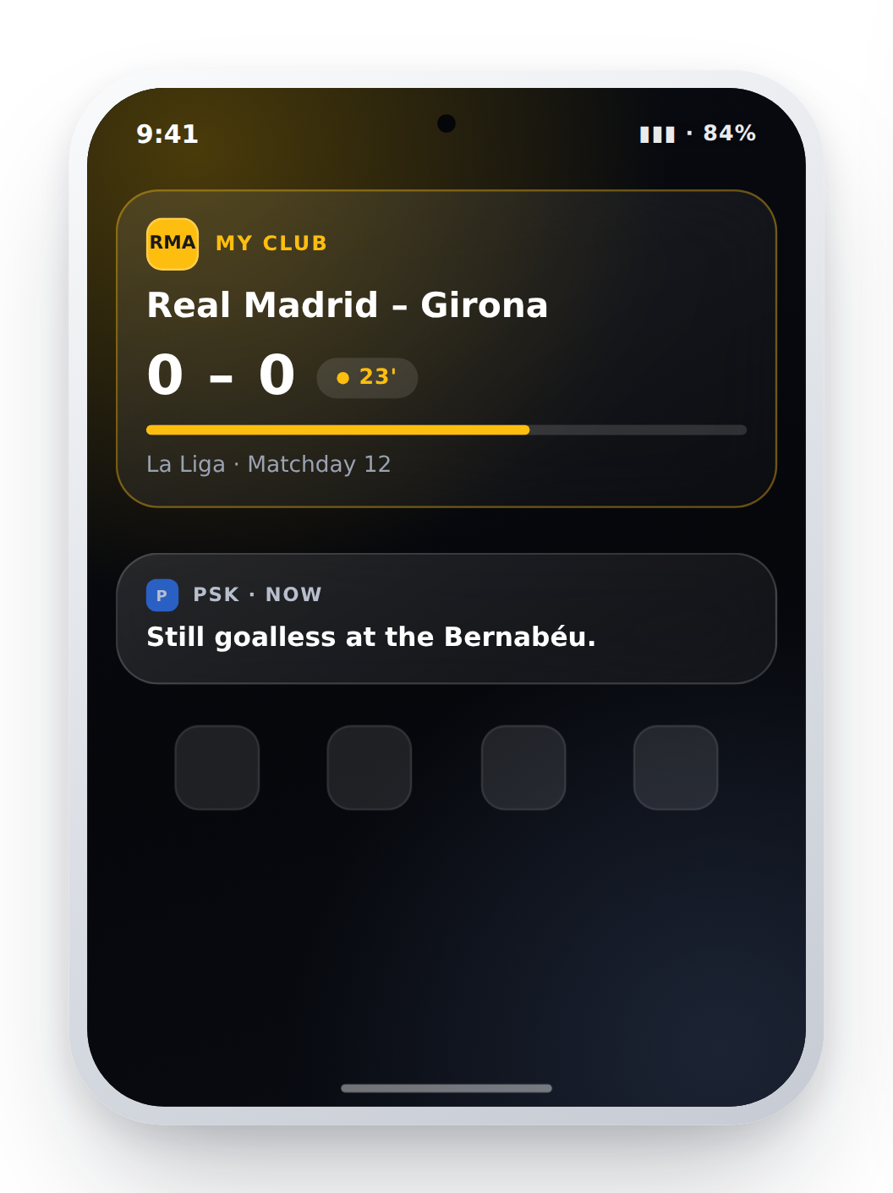
PERSONALISATION
ONE APP.
A DIFFERENT EXPERIENCE FOR EVERY USER.
Preferences + behaviour → a personalised experience
Marko
Ivan
Ana
follows Hajduk
follows Dinamo
follows Real Madrid
Notes:
Same build, same binary, three different products.
Following a club themes the widget and the live update — the crest, the club's colour as the accent, the club's fixtures in the idle state. It is cosmetic, it costs nothing at runtime, and it is the cheapest lever we have on widget adoption, which the brief names as a metric.
Identity beats incentive: a customer who has themed their home screen around their club has made the app part of who they are. No bonus buys that.
Note we bundle no club logos — initials and colours only, so there is no licensing exposure.

Slide 8
THE TECHNOLOGY
PERSONALISATION WITHOUT SENDING
PERSONAL DATA AWAY.
ON THE DEVICE
Behaviour
Notification
Local profile
Widget
On-device ML
Lock screen
Personalised moment
Response
feeds back in
The intelligence lives on the device.
Notes:
Keep this conceptual on the slide; the depth belongs here.
Everything that decides what to say, and when, runs inside the app on the phone. Behaviour signals — which clubs you follow, which matches you check, what time you look — build a local profile that never leaves the device. A small on-device language model turns the chosen moment into one human sentence. The customer's response feeds straight back into the same local model.
Implementation, if asked: Android ML tooling — ML Kit's on-device GenAI API where the device supports it, with a LiteRT-packaged small model as the fallback and deterministic templates below that, so the app always has a voice. No API key, no inference server, no per-message cost, and it works offline.
Why it matters commercially as well as legally: personalisation with no personal data transfer is defensible under GDPR Article 25 by design, and it means our per-message cost is zero at any scale.

Slide 9
THE DIFFERENTIATOR
IT DOESN'T JUST PERSONALISE.
IT LEARNS.
TRY
LEARN
ADAPT
“Your team is playing.”
“Hajduk kick off in 20 min.”
Ignored
Opened
Every reaction — opened, ignored, muted — retrains the next message. On the phone.
And staying silent counts as a win.
Notes:
This is the part competitors are not building, and it is where the originality score lives.
Under the hood it is a contextual bandit running on the device. Roughly fifty combinations of surface, tone and timing; Thompson sampling picks one; two numbers per option get updated from what the customer actually did. After about twenty interactions it has stopped guessing for that individual.
The unusual design decision is the reward table. Opening the app scores +1. Being ignored scores -0.3. Being muted scores -1. And correctly choosing to stay silent scores +0.5.
That single line changes the incentive of the whole system. Most engagement models are only ever paid for speaking, which is why they get louder over time. Ours is paid for restraint, so message volume falls while relevance rises — and notification permission, which everything else depends on, survives.
Measurable in A/B: we expect a 20-30% relative lift in tap-through after twenty interactions versus fixed routing. The ledger that records arm and reward is the analytics.

Slide 10
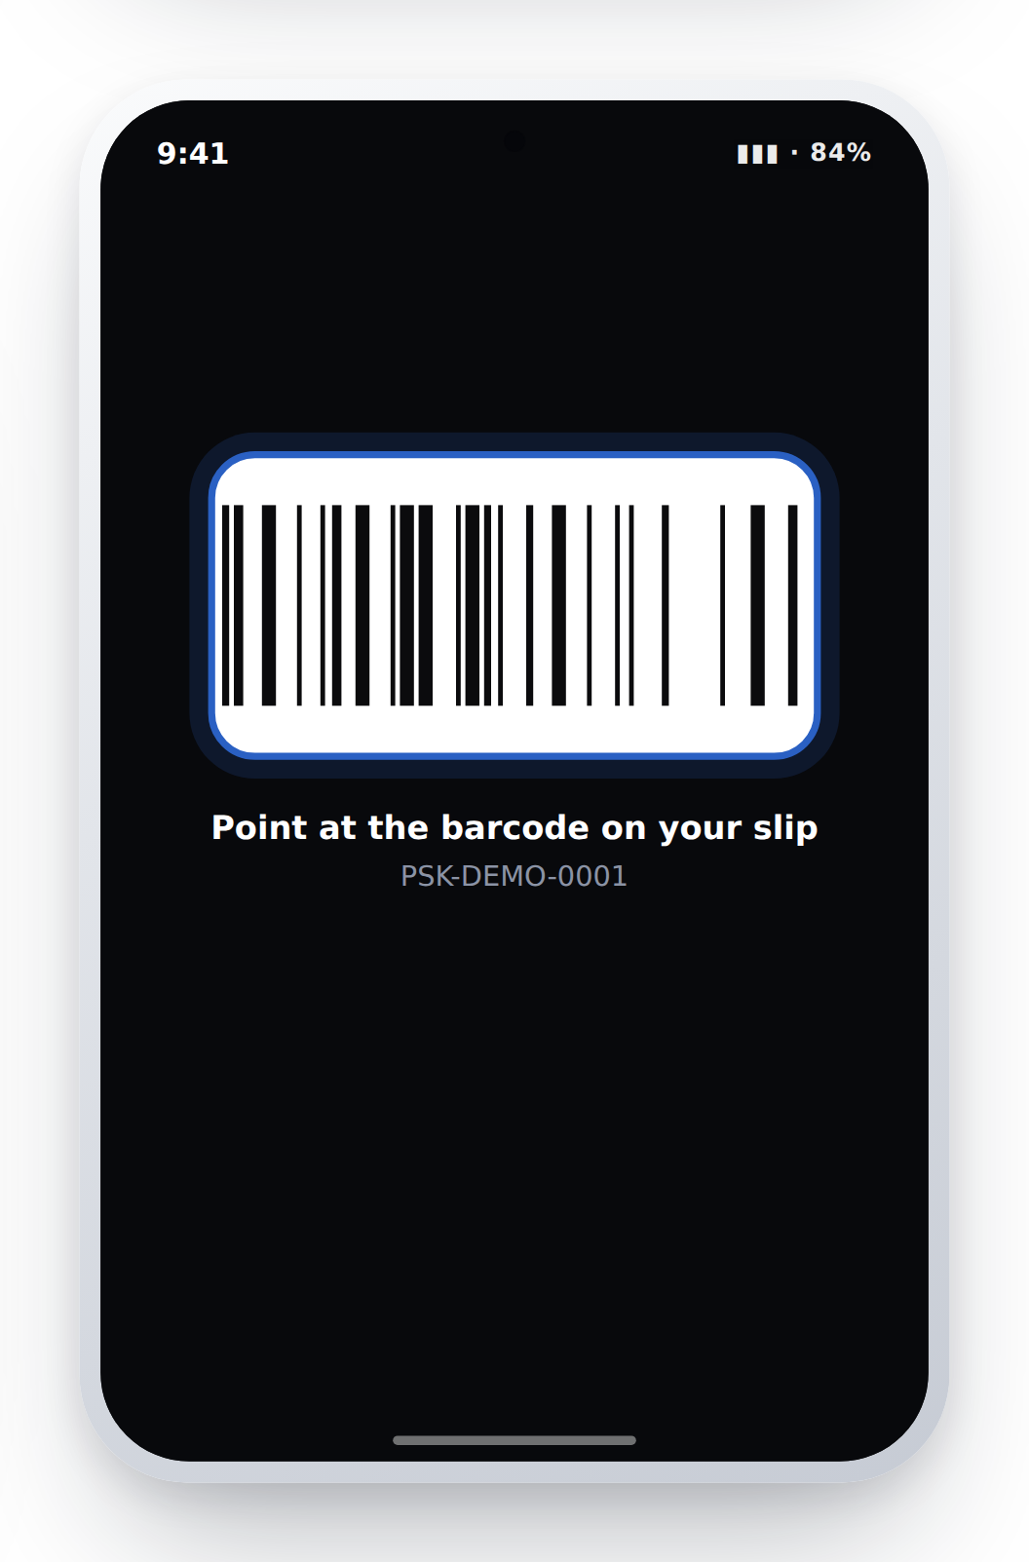
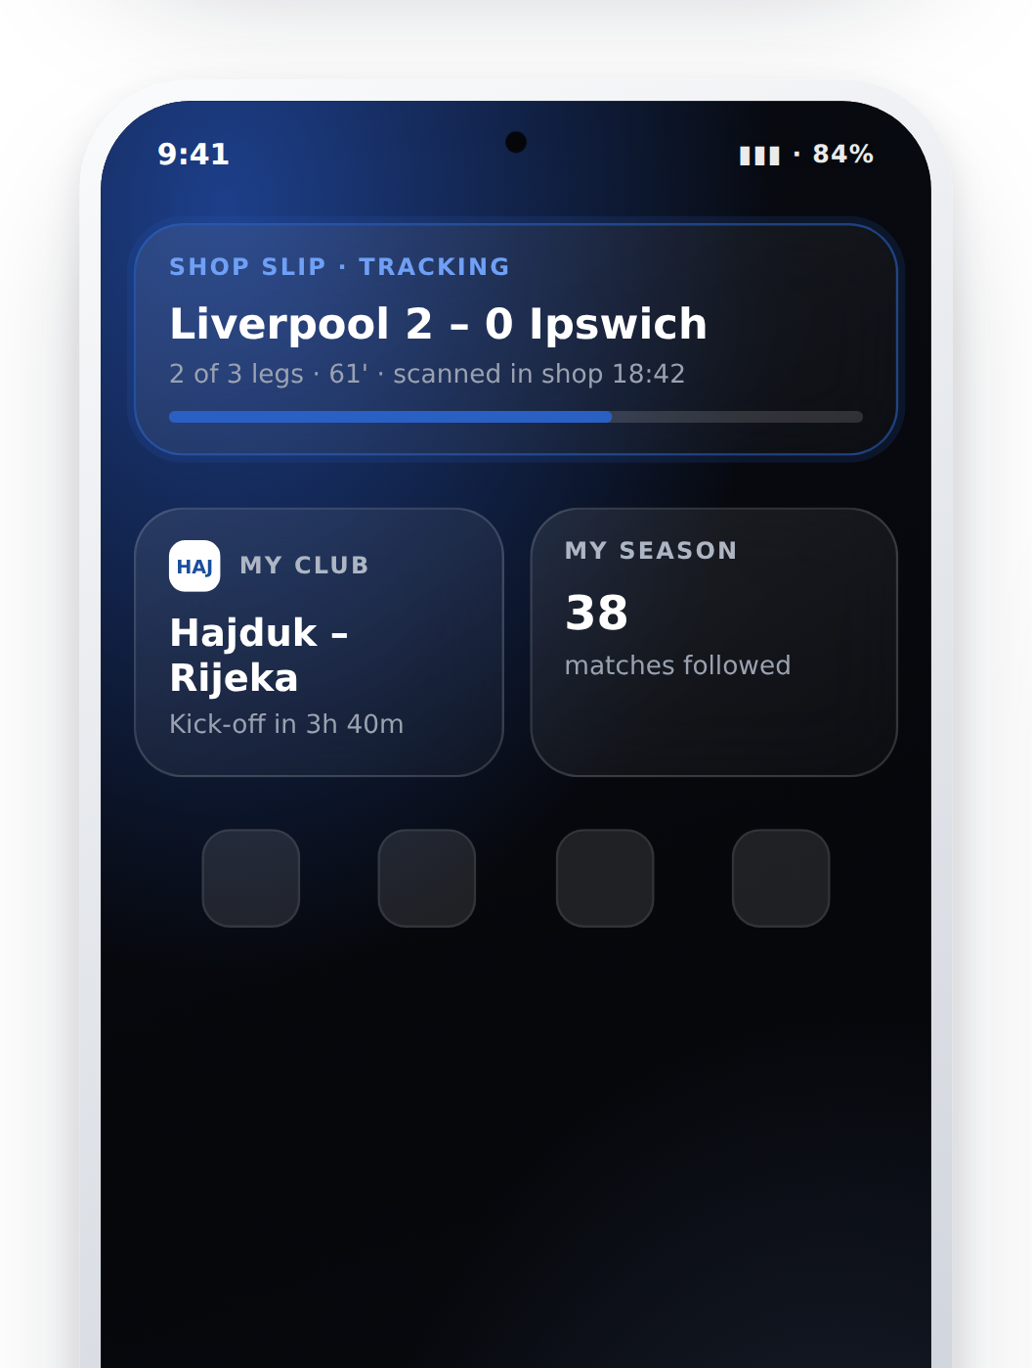
TWO MORE REASONS TO COME BACK
TURN ATTENTION
INTO PROGRESS.
ONE SCAN.
ONE MORE TOUCHPOINT.
Follow three teams
Badge
Level
Perks
No mission asks for a stake.
From the shop counter to a surface that stays.
Notes:
Left — loyalty. Missions, badges, levels and perks: the same mechanic every competitor runs, with the currency changed. Progress is counted in attention, never in money, so it cannot become an inducement. Perks are merchandise, early access and match tickets — never free bets or bonus credit. One of the missions is "set a deposit limit", which earns a badge like any other.
Right — retail. PSK already ships a barcode scanner in the app; we did not rebuild it, we gave its output somewhere to go. Scan the slip from the shop and it starts tracking on the lock screen — no deposit, no account top-up, and the app never needs opening again.
This is the only mechanic here that pulls a retail-only customer into the digital estate, and it costs nothing to acquire them. Even 5% of retail slips scanned is a bridge that does not exist today.

Slide 11
Demo Video Link : https://youtu.be/aLRzElPIAgY
IMPACT
SMALLER DISTANCE.
MORE RETURNS.
+17%
4.6% → 20%
12%
Daily active users
Notification to app open
Widget adoption at 90 days
DAU/MAU 25% → 29.3%, base case
vs the Android push benchmark
of Android monthly actives
ILLUSTRATIVE ESTIMATE
Relevance → engagement → retention → business value
DON'T WAIT FOR THEM TO OPEN THE APP.
GIVE THEM A REASON TO COME BACK.
Notes:
Three numbers only. All three are illustrative and built on stated assumptions — say that out loud.
Base: FEG reports roughly 1.3 million active players; assume half are app users, so about 650k app MAU.
One. Daily actives. If 30% of monthly actives are reached by a surface in a given week and each gains one extra active day, DAU/MAU moves from 25% to 29.3% — about +28k incremental daily actives, a 17% relative lift. The conservative case is 15% reach and half a day, which still gives +7k.
Two. Notification to app open. The public Android benchmark is 4.6%. A live update about the customer's own slip is status about something they own — flight-tracker behaviour — so we model 20-30%. There is no public sportsbook benchmark for this; it is the first thing we would A/B test.
Three. Widget adoption. 6% at 90 days conservative, 12% base case, on Android monthly actives. Club theming is the cheapest lever on this number.
The value formula is incremental retained users times ARPU, minus cost. We deliberately do not claim more betting per customer — the value is retention and reactivation of existing customers, which is exactly what the brief scopes. And because the AI runs on the device, the marginal cost per message is zero.
Close on the line and stop talking.

